Slide 1
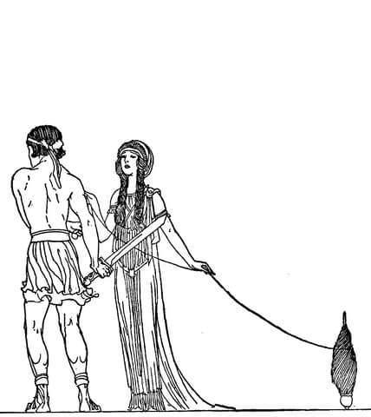


The European Pillar of Social Rights: quo vadis?
The overwhelming ambition for a social Europe
Jozef Pacolet, Frederic De Wispelaere, Liesbeth Op de Beeck
HIVA - Research Institute for Work and Society, Katholieke Universiteit Leuven

Slide 2
Content
European social initiatives from the past to the future: just a time line or a thread of Ariadne to guide you through the overwhelming ambition of the European social project. A genuine social market economy.
The European Pillar of Social Rights
Towards a more social Europe?
EZA involvement: the overwhelming expectations or responsibilities
Conclusions

Slide 3
The Social Acquis and the track record of Social Europe
Recent social initiatives of the European Commission
The European Pillar of Social Rights
The future: towards a more social Europe?

Slide 4
Economic and social progress: a European and international project

Slide 5
The social evolution of Europe
The social mandate of the European Union is the result of a long and gradual process. It began as a means to secure market integration and developed from there on. Some milestones:
  The Treaty of Paris (1951) ECSC
  the Treaty of Rome (1957) included fundamental rights (e.g. equal pay for women and men, free movement of workers);
  the Single European Act (1987) and the possibility to include minimum standards for health and safety of workers;
  the expansions of areas for social action in the Social Protocol of the Maastricht Treaty (1992);
  the subsequent integration of the social provisions in the Amsterdam Treaty (1998);
  achieving a competitive social market economy in the Lisbon Treaty (2007)

Slide 6
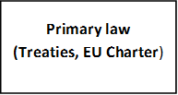
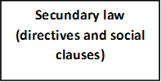
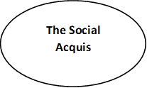

The social evolution of Europe
The Social Acquis consists of:

Slide 7
Past European social initiatives – in detail
The Social Chapter of the Maastricht Treaty refers to the Social Policy Protocol and the Agreement on Social Policy as annex to the Maastricht Treaty.
The Social Policy Protocol embodies a compromise in the form of an ‘opt-out’ for the UK to overcome the impasse concerning the social policy provisions. A two-speed Europe was the result.
In 1997, the UK ‘opted-in’ and the Agreement on Social Policy was integrated in the Amsterdam Treaty.

Slide 8
Past European social initiatives – in detail
1997 European Employment strategy
2001 Open method of coordination, first for pensions and social inclusion
2003 Open method of coordination for health and long-term care

Slide 9
Past European social initiatives – in detail
The Europe 2020 strategy was set up in 2010 as a strategy for smart, sustainable and inclusive growth and jobs over the ten years to come.
Key targets in five domains:
  employment;
  research and development;
  climate change and energy;
  education;
  poverty and social exclusion
2010:
launch Europe 2020
2014:
mid-term evaluation
2020:
end

Slide 10
Past European social initiatives – in detail
Greater involvement in the economic integration
1992 Treaty of Maasticht
1996 Stability Pact
1999 start of EMU with in 2002 the introduction of the Euro
The European Semester, established in 2010, monitors the steps and progress Member States take towards reaching the Europe 2020 goals.
The European Semester is a framework for the coordination of economic policies across the European Union.
The European Semester offers EU-wide and country specific guidance to Member States on priority reforms and a follow-up on their evolution.
Increasing attention and involvement of social dimension
But confronted with the persistent rational of austerity and fiscal consolidation

Slide 11
Recent European social initiatives – in detail
The Labour Mobility Package was announced in the Commission’s 2015-2016 Work Programme. It aims to support labour mobility within the EU and coordinate social security systems to fight abuse.
The Labour Mobility Package includes a review/creation of:
  the Posting of Workers Directive;
  action to better coordinate social security systems;
  an enhanced European Network of Employment Services

Slide 12
Recent European social initiatives – in detail
Together with the proposal of the recommendation on the European Pillar of Social Rights a number legislative and non-legislative initiatives were put forward:
  the work-life balance
  access to social protection
  the Written Statement Directive
  the Working Time Directive

Slide 13
Recent European social initiatives – balance work-life
The ‘new start’ initiative is part of the broader approach to address the underrepresentation of women in the labour force by encouraging a better sharing of caring responsibilities between women and men.
It is a package of complementary legal and policy measures setting new/higher minimum standards relating to:
  paternity leave;
  parental leave;
  Carer’s leave;
  flexible working arrangements

Slide 14
Recent European social initiatives – access to social protection
In the changing world of work standard contracts are more and more being replaced with non-standard contracts. This has implications for an adequate social security coverage.
A consultation process with the social partners is started to define possibilities and new rules.

Slide 15
Recent European social initiatives – the Written Statement Directive
The Written Statement Directive gives employees starting a new job the right to be notified in written on their employment conditions.
In reality, some employees do not benefit from this right. Mostly atypical/intermittent workers (e.g. zero-hour contracts) certain categories of workers (e.g. paid trainees, domestic workers) and in specific sectors (e.g. construction).
A consultation process with the social partners of the revision of the Written Statement Directive is started.

Slide 16
Recent European social initiatives – the Working Time Directive
A clarification of the Working Time Directive is adopted by the European Commission to provide guidance on how Member States should correctly interpret the various aspects of the Directive.
The objective is to bring clarity on the content and help Member States implement the Directive in a correct manner and avoid infringements (e.g. a minority of people systematically work over the 48-hour average weekly limit).

Slide 17
The European Pillar of Social Rights - background
Aggiornamento of relevance of ‘social acquis’
Four main drivers of change:
  consequences of the crisis
  divergence within the euro area
  an ageing society
  a changing world of work

Slide 18
The European Pillar of Social Rights - timeline
09-'15: start
03-'16: outline
'16: consultation process
19-01-'17: own initiative report EP
23-01-'17: conference
26-04-'17: recommen-dation
04/10-'17: debates
17-11-'17: Social Summit and proclamation

Slide 19
The European Pillar of Social Rights – scope and ambition
Jean-Claude Juncker, State of the Union, September 9th, 2015:
‘We have to step up the work for a fair pan-European labour market. As part of these efforts, I want to develop a European Pillar of Social Rights which can serve as a compass for the renewed convergence in the euro area. It should complement what we have already jointly achieved.’
Jean-Claude Juncker, Statement in the European Parliament plenary session, October 22nd 2014:
‘What I want is for Europe to have a social triple-A rating: that is just as important as an economic and financial triple-A rating.’

Slide 20
The European Pillar of Social Rights – scope and ambition
Express a number of essential principles recalling already defined rights to support well functioning and fair labour markets and welfare systems
Build on and complement existing EU-level ‘Social Acquis’, within the existing rules of subsidiarity
The European Pillar of Social Rights is about delivering new and more effective rights for citizens.
The European Pillar of Social Rights is conceived of as:
  a reference framework providing guidance for upward convergence;
  further building on the EU social acquis, complementing and modernizing it;
  initially intended for use within the euro area, with the option for other Member States to join in.

Slide 21
The European Pillar of Social Rights – content
Building on existing primary law and rights
  Treaty of European Union
  Treaty of the Functioning of the European Union
  European Social Charter
  Community Charter of Fundamental Rights of Workers
  Charter of Fundamental Rights of the European Union
The European Pillar of Social Rights consists of:
  20 principles and rights;
  structured around three chapters:
    Chapter I: Equal opportunities and access to the labour market,
    Chapter II: Fair working conditions,
    Chapter III: Social protection and inclusion

Slide 22
The European Pillar of Social Rights – content
Chapter I: Equal opportunities and access to the labour market
  Education, training and life-long learning
  Gender equality
  Equal opportunities
  Active support to employment
Chapter II: Fair working conditions
  Secure and adaptable employment
  Wages
  Information about employment conditions and protection in case of dismissals
  Social dialogue and involvement of workers
  Work-life balance
  Healthy, safe and well-adapted work environment and data protection
Chapter III: Social protection and inclusion
  Childcare and support to children
  Social protection
  Unemployment benefits
  Minimum income
  Old age income and pensions
  Health care
  Inclusion of people with disabilities
  Long-term care
  Housing and assistance for the homeless
  Access to essential services

Slide 23
The European Pillar of Social Rights – legal form and enforcement
Delivering on the European Pillar of Social Rights is a shared commitment of the EU, the Member States and the social partners;
Each within their competencies and taking into account the principle of subsidiarity;
Given the legal nature of the European Pillar of Social Rights, its principles and rights will not be directly enforceable. A translation into action or separate pieces of legislation will be necessary

Slide 24
The European Pillar of Social Rights – legal form and enforcement
The tools of the European Union
LEGISLATION | GUIDANCE
Minimum requirements Free movement and mobility Harmonization of basic standards | Policy recommendations Exchange of best practices Support for reform
FUNDING | COOPERATION
Skills Youth SME financing Poverty reduction Regional and rural development Research and development | Dialogue with social partners Engaging with civil society Working with national actors and international institutions

Slide 25
The European Pillar of Social Rights – monitoring
The monitoring process will take place within the context of the European Semester;
A social scoreboard will be developed, consisting of:
  12 areas along the three dimensions of the European Pillar of Social Rights;
  14 headline and 21 secondary indicators based on existing data (EU-LFS, EU-SILC, OECD PISA survey)
https://composite-indicators.jrc.ec.europa.eu/social-scoreboard/#

Slide 26
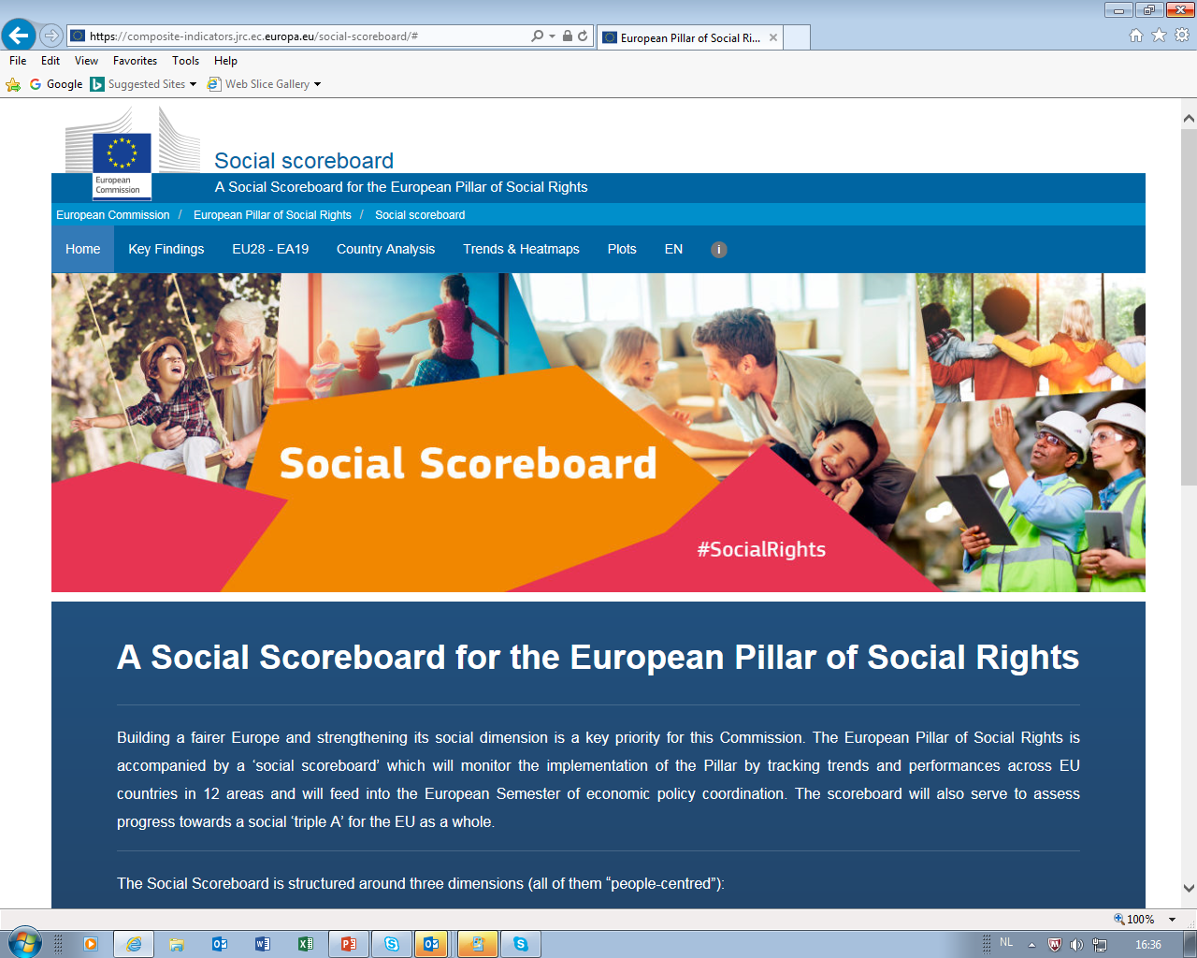
Social scoreboard

Slide 27
The European Pillar of Social Rights – further evolution
The development of the European Pillar of Social Rights is still an ongoing work in progress:
  fine-tuning and further clarifying
  consensus seeking
Call for more input from stakeholders, social partners, lobbyists, academics, etc. to feed into the European Parliament and European Council debates.

Slide 28
The European Pillar of Social Rights – usefulness and viability
A good narrative, but a strong enough instrument?
  lack of a clear overall vision is perhaps because of lack of transparency: it completes and steps up the European Social model ;
  vague and ambiguous formulations…but also ambitious in its list or even its targets;
  emphasis on economic and labour realities reflect the ambition to combine economic and social progress;
  not enough legally enforceable … leaves much of the responsibilities at national level
  what role can the EU play given its limitations
Loopholes remain:
  monitoring; within the European Semester, what indicators will be used, how the balance between fiscal consolidation, competition and social progress will be guaranteed?
  funding; resort to existing funds and/or create new funds?

Slide 29
The European Pillar of Social Rights – usefulness and viability
In the end, will the European Pillar of Social Rights be able to deliver on its ambitions?
  Rights enshrined in primary law, constitutions, charters, solemn declarations, have an intrinsic power
  It entails a transformative power to shape a more social Europe bringing Member States together
  It needs national/political support, legal enforceability, proper monitoring and enough funding
  Europe should make its track record of social progress more visible, including also when it is deviating from this desired path
  We should avoid that the fear that it might backfire and more European citizens turn their backs on the European project becomes a self fulfilling prophecy

Slide 30
Towards a more social Europe? – White paper on the future of Europe
The European Pillar of Social Rights is part of a broader debate on the future of Europe.
The white paper on the future of Europe as a starting point of a broader process of discussing what Europe can look like.
March 2017:
White Paper
April-June 2017: debates + reflection papers
December 2017: first conclusions
January 2018 -June 2019: course of action
June 2019: EU elections
...

Slide 31
Towards a more social Europe? – White paper on the future of Europe
The white paper on the future of Europe presents five possible ways Europe can evolve by 2025:
  scenario 1: carrying on
  scenario 2: nothing but the single market
  scenario 3: those who want more, do more
  scenario 4: doing less more efficiently
  scenario 5: doing much more together

Slide 32
Towards a more social Europe? – reflection paper on the social dimension of Europe
The reflection paper on the social dimension of Europe presents three possible ways Europe can evolve socially:
  scenario 1: limiting the social dimension to free movement
  scenario 2: those who want to do more in the social field, can do more
  scenario 3: the EU27 deepen the social dimension together

Slide 33
Towards a more social Europe? – the intertwining of timelines
The European Pillar of Social Rights: EC & EP
Parallel initiatives
The future of Europe
09-'15: start
03-'16: outline
'16: consultation
01-'17: conference
04-'17: presentation
11-'17: social summit and proclamation
12-'17:
proclamation
01-'17:
own initiative report
04/12-'17:
debates
2015-2016: the Labour Mobility Package
2017: work-life balance
2017: access to social protection
2017: Written Statement Directive
2017: Working Time Directive
March 2017:
White Paper
April-June 2017: debates + reflection papers
December 2017: first conclusions
January 2018 -June 2019: course of action
June 2019: EU elections
...

Slide 34

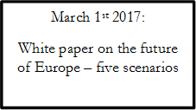
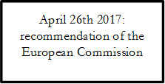
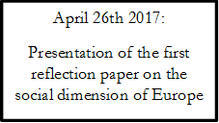
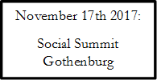
Towards a more social Europe? – the intertwining of timelines

Slide 35
EZA involvement – contribution to the consultation process
Feedback relating to equal opportunities and access to the labour market:
  equality should be at the core of the European Pillar of Social Rights;
  a better alignment of labour market needs and education/lifelong learning;
  a focus on social and technical skills;
  the creation of structural partnerships between schools, training organizations, companies and social partners;
  the Youth Guarantee is a good initiative, but should be strengthened and better applied in all Member States.

Slide 36
EZA involvement – contribution to the consultation process
Feedback relating to fair working conditions:
  employees confronted with a change in their employment status, including forms of atypical work, must enjoy the same benefits obtained before or negotiate on them by means of the social dialogue;
  this specifically refers to the new trend of outsourcing of public service functions and its impact on public service employees.

Slide 37
EZA involvement – contribution to the consultation process
Feedback relating to social protection and inclusion:
  the European Pillar of Social Rights should promote a universal social floor sufficient enough to ensure an adequate standard of living for all;
  it should provide for the establishment of a highly visible and integrated EU anti-poverty strategy;
  putting in place tools to combat discrimination and inequality

Slide 38
EZA involvement – contribution to the consultation process
Feedback relating to the overall initiative:
  the European Pillar of Social Rights should apply to the entire European Union, not only the euro area;
  it should show a clear commitment to the highest economic and social rights standards of international human rights law (e.g. the European Social Charter);
  these human rights should be fully implemented in EU secondary and national law in order for individuals to seek enforcement;
  it needs to be enforceable.

Slide 39
EZA involvement – further EZA involvement
Participation in discussion seminars:
Discussion seminar | Date
Beweging.academie, Belgium
Cartel Alfa, Romania
CET Europe, Belgium
Eurofedop, EU
IFES, Romania
UHM, Malta
UNAIE, Italy

Slide 40
Conclusions
Overwhelming ambitions of Europe
Overwhelming expectations on the Social dimension of Europe are warranted
Overwhelming responsibilities remain within the scope of subsidiarity in our own hands
We are really heading further towards a genuine social market economy

Slide 41
Conclusions: a common European growth path of economic and social progress
Further qualitative and
quantitative
Quantitative
Rationalisation
expansion
innovation
expansion
but also
because new risks are accepted
diversification
because economic and
demographic pressure
differentiation
Expenditures for social protection
…and improved working conditions
1970
1985
1990
1995
2010

