Slide 1
Human Rights as stepping stones for a social and democratic Europe
Madrid, 8th of May 2015

Slide 2
Introduction
Michel Debruyne, Beweging.net

Slide 3
The idea of justice
“Proclamations of human rights, even though stated in the form of recognizing the existence of things that are called human rights, are really strong ethical pronouncements as to what should be done. They indicate that something needs to be done for the realization of these recognized freedoms that are identified through these rights. One thing they are not are claims that these human rights are already established legal rights.”
Amartya Sen, page 357-358

Slide 4
Human rights as stepping stones for a social and democratic Europe
Marie-Cécile Renoux (ATD Fourth World)
Dora Dimitra Telloni (TEI dep social work)
Siobhan Lloyd (Just Fair)

Slide 5
An alternative social program for Spain
By prof Nacho Alvarez (University of Valladolidad, Spain) and member of Podemos

Slide 6

Ending economic austerity.
An alternative economic policy
Nacho Álvarez
Department of Applied Economics
University of Valladolid

Slide 7
Contents:
1. Reasons to change the Spanish economic policy
2. Four priorities for an alternative economic policy
3. Key lines of action

Slide 8
1. Reasons to change the Spanish economic policy
Strong macroeconomic imbalances in 2007-2009
Fiscal deficit
External deficit
Excessive private debt
Imbalances are solved?
No, imbalances are displaced ➔ new economic imbalances:
Unemployment
Inequalities
Excessive public debt
+ 4. Structural problems remain

Slide 9
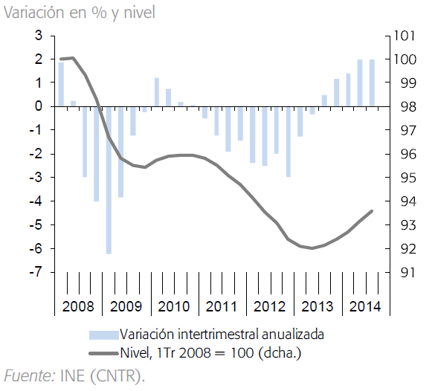
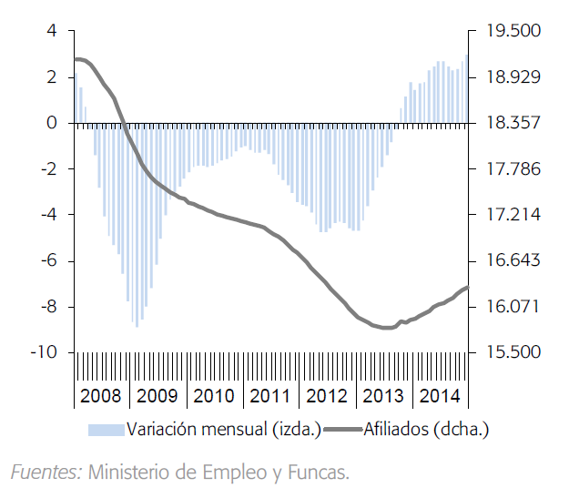
Gross Domestic Product (2008=100)
Employees (thousands)

Slide 10
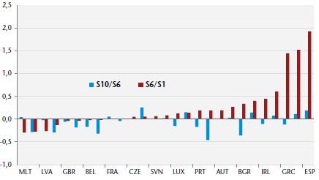
Change in interdecile ratios, 2008-2012 (Percentage points)

Slide 11
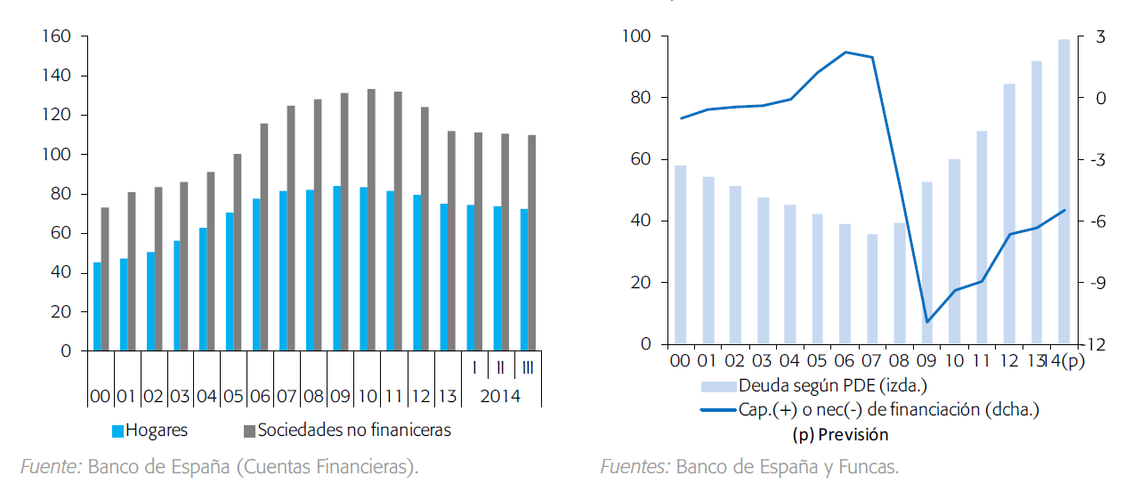
Private debt (% GDP)
Public debt (% GDP)

Slide 12
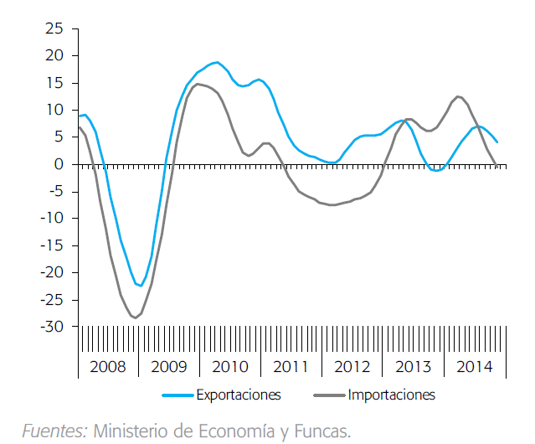
Exports and imports (annualized quarterly change %)

Slide 13
New factors determine a slight recovery:
* Falling oil prices
* QE policy of the ECB
* Reduction in the rate of household savings
* Reduction in the pace of fiscal adjustment
➔ sustainable?
➔ do not solve the aforementioned problems
And in 2014-2015 ....?

Slide 14
* Reduce unemployment and create decent jobs
* Reduce inequalities
* Transform the industrial structure to build a sustainable growth model
* Reduce the debt burden
2. Four priorities for an alternative economic policy

Slide 15
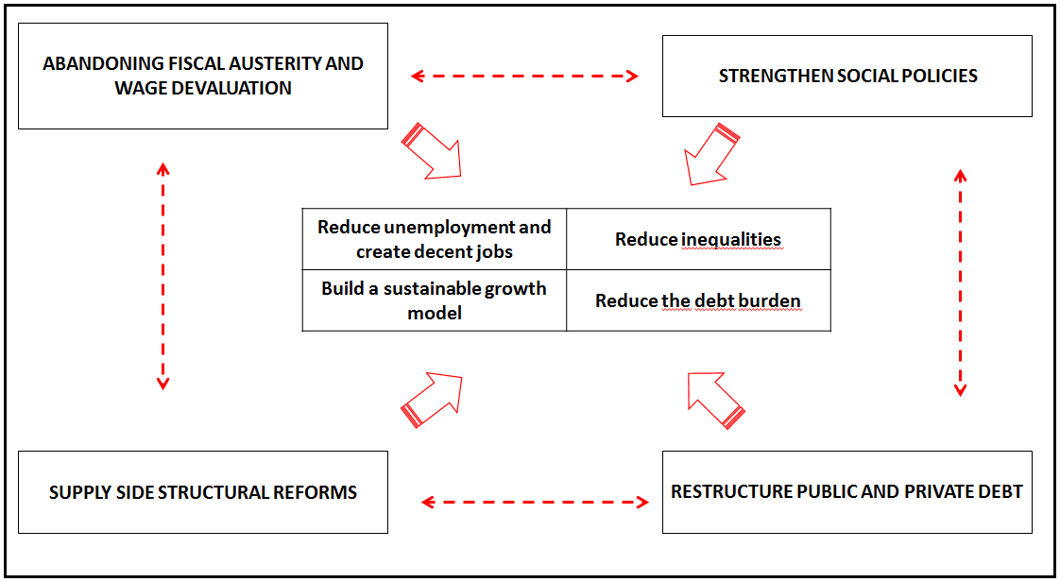
3. Key lines of action

Slide 16
* Postpone the objective of reducing the public deficit, giving priority to reducing unemployment.
* Reverse cuts in social spending and public investments
* Tax reform based on progressivity and fight against fiscal fraud
3. Key lines of action
a) Abandoning fiscal austerity and wage devaluation

Slide 17
Trade-off ➔ in this context we must choose between:
* Orthodox path: rapid deficit reduction with slower reductions in the unemployment rate
* An alternative path: slow deficit reduction and more rapid reduction in the unemployment rate.
3. Key lines of action
a) Abandoning fiscal austerity and wage devaluation

Slide 18
SIMULATION OF A MORE EXPANSIONARY FISCAL POLICY
Fiscal multiplier (expenses): 1.5
Fiscal multiplier (taxes):1
Fiscal impulse 2015: 30.000 billions €
Tax reform 2015: 15.000 billions €
In 2019 the unemployment rate would be 6 points lower
The annual growth rate would have been 1.5 points higher each year
The deficit and public debt would not increase; its reduction would be delayed

Slide 19
Wage-led recovery ➔ wages should grow in line with productivity
* Strengthen the role of collective bargaining
* Updating the minimum wage
* Removal of wage freeze in the public sector
* Discouragement of temporary jobs
3. Key lines of action
a) Abandoning fiscal austerity and wage devaluation

Slide 20
Tackling the problems of poverty and social exclusion
* Guaranteed minimum income for poor families
* Improved benefits for the unemployed
* Restore retirement age to 65, with previous benefits.
3. Key lines of action
b) Strengthen social policies

Slide 21
1. Increase structural competitiveness: investments in education, technology, innovation and infrastructure.
2. Move towards a low carbon economy: priority use of renewable energies
3. Labor market reform: reconciliation of work and family life, reducing duality, restoring collective bargaining.
4. Tax Reform (increase revenue to European standards): fight tax evasion, bring effective and nominal rates closer, expand tax bases.
5. Public banking and financial reform
3. Key lines of action
c) Structural reforms

Slide 22
➔ Reducing debt by primary surpluses entails high social costs
1. Restructuring of public debt above 60% of GDP by the ECB (mutualization, PADRE plan)
2. Restructuring of public debt linked to the EU bailout: banks should contribute
3. Restructuring of private mortgage debt
* Reduction in the nominal value of mortgages on primary residences for families who meet certain conditions
* Repossessions to clear owner’s mortgage debt
3. Key lines of action
d) Reduce the debt burden to exit the crisis and create jobs

Slide 23
Human Rights as stepping stones for a social and democratic Europe
Introduction by Marie-Cécile Renoux (ATD Fourth World)

Slide 24
Human rights as an answer to the social damage of the crisis in Greece
Introduction by Dora Dimitra Telloni (TEI dep social work)

Slide 25
“Human rights as an answer to the social damage of the crisis in Greece ”
Dimitra – Dora Teloni, MA, PhD
doratel71@gmail.com
Scientific Associate, Department of Social Work, Technological Educational Institute (TEI) of Athens – Member of Greek Social Work Action Network

Slide 26
Presentation outline
A. Blaming a country: Austerity as the answer to economical crisis Vs Crisis as endemic to capitalism
B. The austerity measures Or how the ‘guinea pig’ of Europe proved how austerity and neoliberalism resulted in a humanitarian crisis
C. Struggles, Social movements and ‘grassroots’ welfare: The response of the society
D. Social mobilization and the change of the political landscape

Slide 27
A. The blame of a country for the global economical crisis: How to turn a country into a scapegoat
Step 1: Propaganda against Greeks in public dialogue
Step 2: Strict austerity measures for the Greek people
Step 3: Repression and raise of fascism

Slide 28
A. Step 1:The blame of the Greeks in public dialogue
 | The Myth | The Truth
1 | The “lazy” Greek | Weekly hours of work 42 – among the highest in all the EU27 countries (Eurostat, 2011)
2 | The insufficient and over-populated public sector | 11.4% of the population in public sector below Sweden 30%, Denmark 29%, France 21.2%, UK 17,8% (Handler et al, 2005)
3 | High standard of living | 24.0% of the Greeks below poverty line in 2010 and social expenditure among the lowest in Europe (Papatheodorou, 2014)
4 | Austerity measures as the solution | The alibi of crisis for the promotion of neoliberalism (Ioakimidis & Teloni, 2013, Papatheodorou , Sakellaropoulos and Yeros, 2012)
5 | Troika as the rescue of the people | The profit of the banks and IMF – Greek debt in 2009 113% of the GDP in 2014 reached up 175% of the GDP

Slide 29
A. Step 2: Austerity measures for the punishment of Greece
Income reduction, pensions of 380€(Matsaganis, 2012)
Deregulation of labour markets
Cuts in benefits
Drastic curtailments in public health care (Kentikelmenis et al, 2014)
Shortage of hundreds of medicines in 2012 (Karamanoli, 2012)
High cost of common commodities (electricity, food)
Tax increase
Privatization of public sector
The attack in social services and social work
Already declined social services

Slide 30
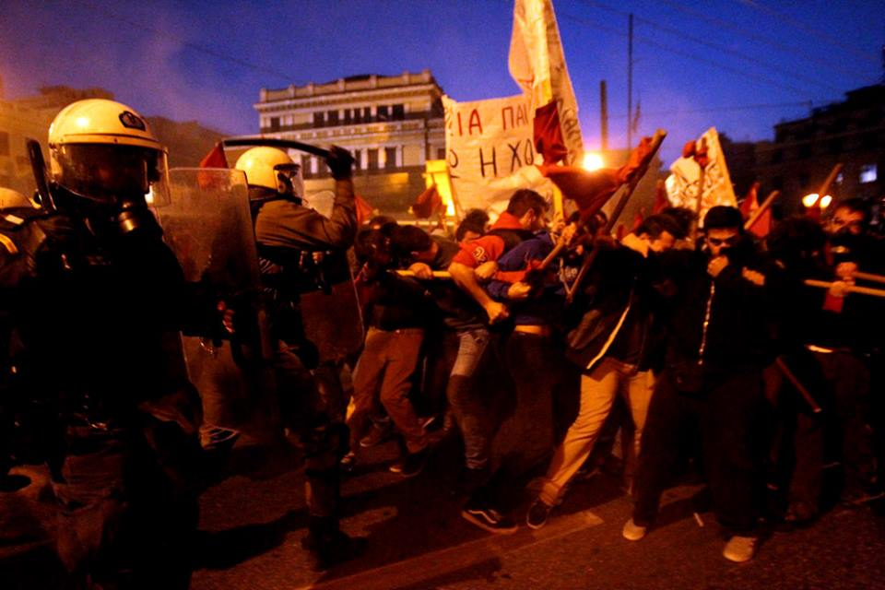
A. Step 3: Repression and raise of fascism photo: Marios Lolos

Slide 31
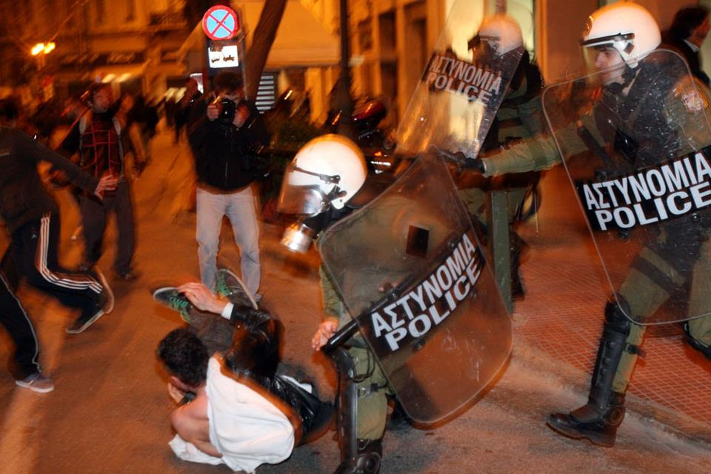
Systematic violence of human rights by Greek Police (Amnesty International, 2012) photo: Marios Lolos

Slide 32
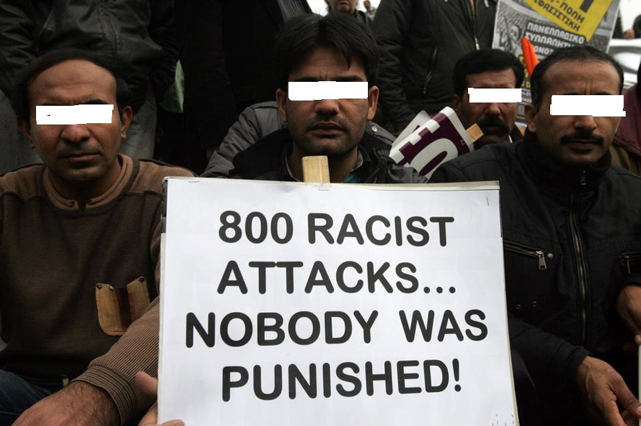
Murders and racist attacks photo: Marios Lolos

Slide 33

Raise of fascism

Slide 34
B. Austerity measures resulted in dramatic implications on society
Poverty reached 30% (ELSTAT, 2010)
Youth unemployment up to 55% (Eurostat, 2012)
Raise of suicides up to 40% in 2011 (Kentikelmenis et al, 2013)
2.500.000 people lack of health care
Increase of mental disorders and HIV rates
Children in poverty
Increased rates of homeless
Greece holds a large wealth gap between the poorest and the richest in Europe (OECD, 2011)
(Ifanti et al, 2013, Adam & Papatheodorou, 2014)

Slide 35
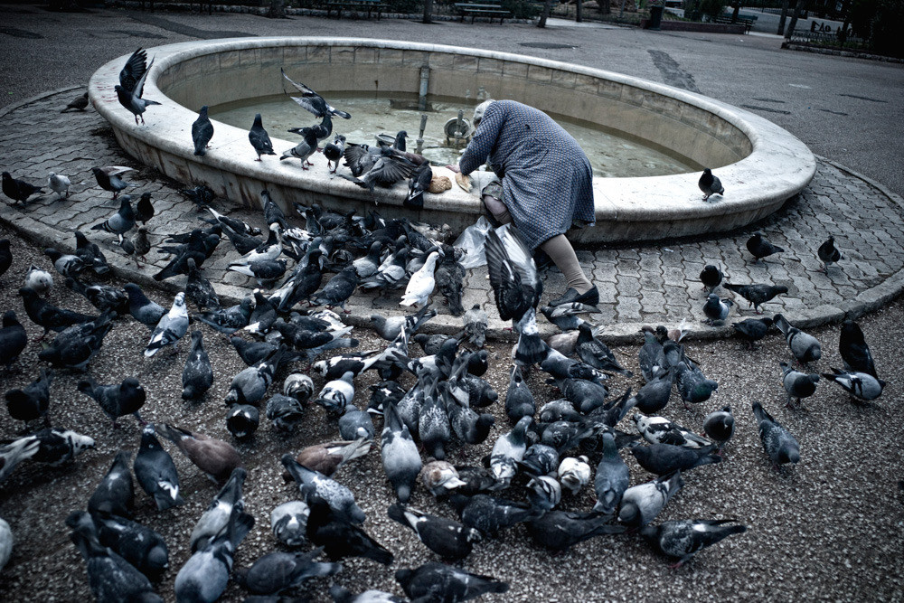
“Statistics are people with the tears wiped away”
Humanitarian crisis in real life
photo: Michalakis Dimitris

Slide 36
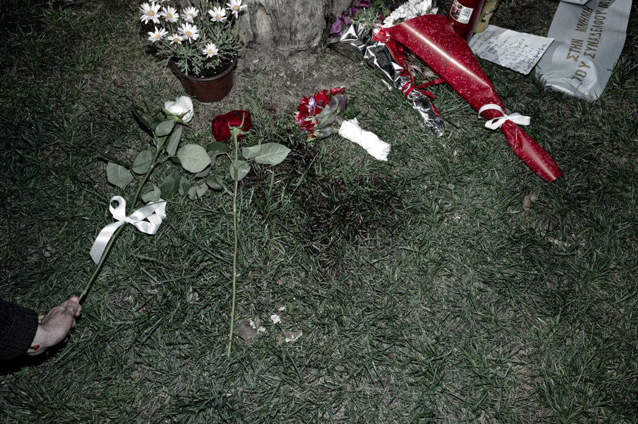
Suicide note in Syntagma square in 2012 by an elderly:
“It’s not a suicide, they killed me”
photo: Michalakis Dimitris

Slide 37
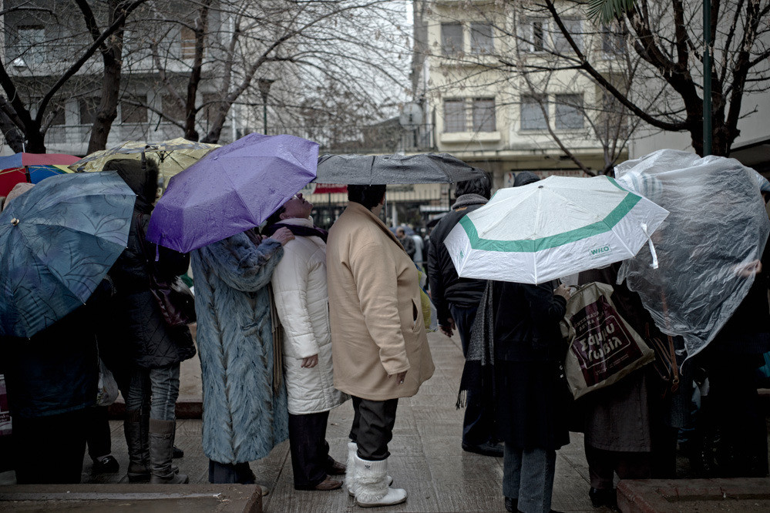
Queues for common meals across Greece
photo: Michalakis Dimitris

Slide 38
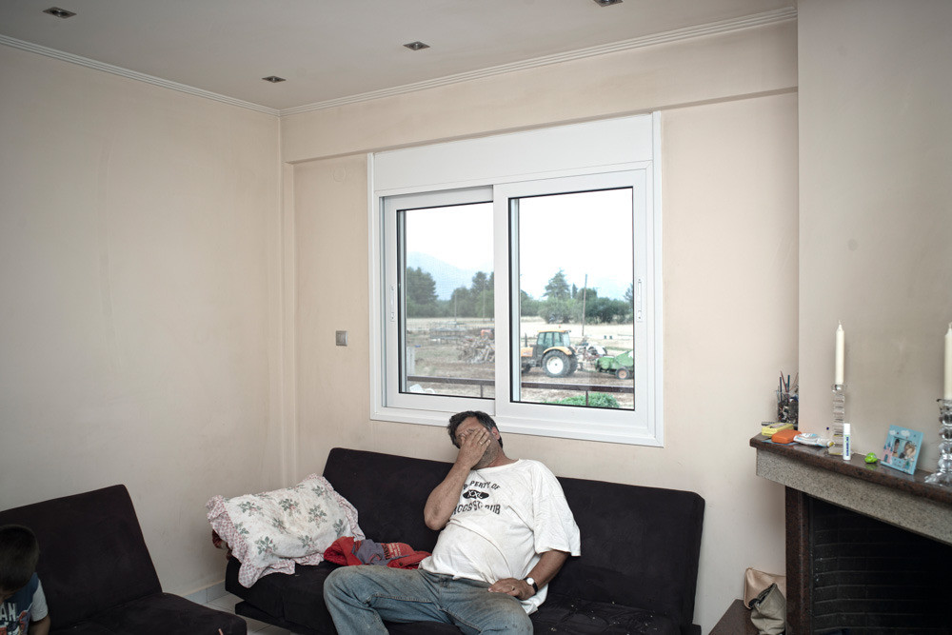
Despair
photo: Michalakis Dimitris

Slide 39
C. The response of the society: Radicalization and Struggles of the people in the era of crisis
Strikes
Square movement 2011 turned to Public assemblies in the neighbourhoods and grassroots welfare initiatives
Massive Demonstrations in 2011
Anti-racist and anti-fascist movement
Solidarity and resistance: The basic aim of solidarity movements

Slide 40
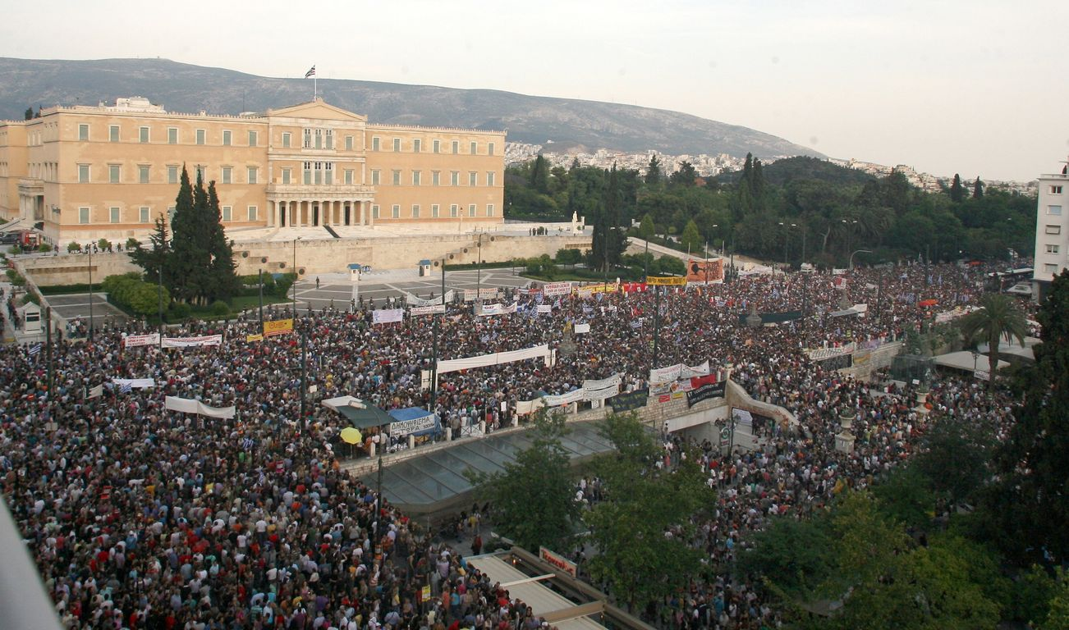
20.120 demonstrations from 2010 until 2014
439 strikes in 2012 (Katsoridas & Labousaki, 2013)

Slide 41
C. 5 years day to day struggle for survival and resistance
Day to day involvement in the struggles and the movements
Hundreds of demonstrations, participation in the strikes and struggles of the people.
Threats and insecurity in work
Low income as a common issue shared with the majority
Create and participate in collective action
Be in the front line of poverty and deprivation through solidarity initiatives
Apply in practice radical and critical approaches in a humanitarian crisis’ situation (Greek SWAN)

Slide 42
C. Solidarity movements in Greece: Solidarity and struggle for social change and justice
More than 300 welfare initiatives run across Greece
Solidarity Networks for provision of food and services
Free education to children, social music schools.
Reclaim of public space
S.O.S Chalkidiki (protection of the environment against private investment for gold mining)
Antiracist movement (legal advice, lessons of the Greek language, antiracist festivals, demonstrations, provision of food and medical care to refugees)

Slide 43
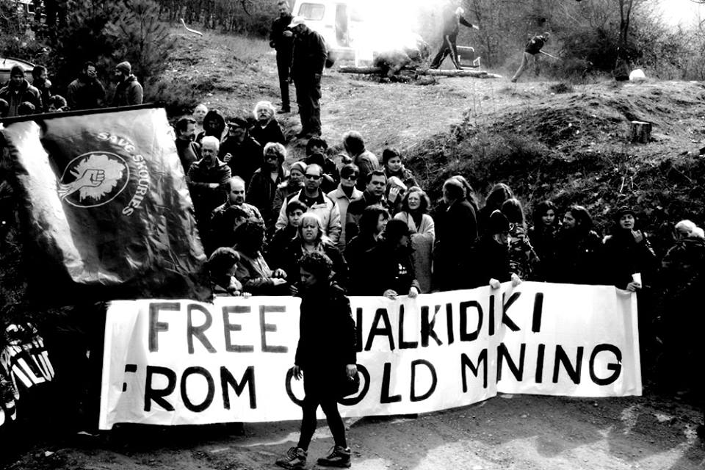
S.O.S. Chalkidiki
photo: Marios Lolos

Slide 44

595 dismissed cleaners symbol of resistance
photo: Marios Lolos

Slide 45

Solidarity initiatives music and free clothes for all
Social Medical Clinic of Peristeri

Slide 46

Collective kitchen in Patras

Slide 47
The case of the Social Medical Clinics
75 Social Medical Clinics from 2012 until 2015 (Adam & Teloni, forthcoming)
About 2.500.000 people lack of national security (Adam & Papatheodorou, 2014)
Free access to primary health care
The majority of the SMD derive by the movements (ibid)

Slide 48
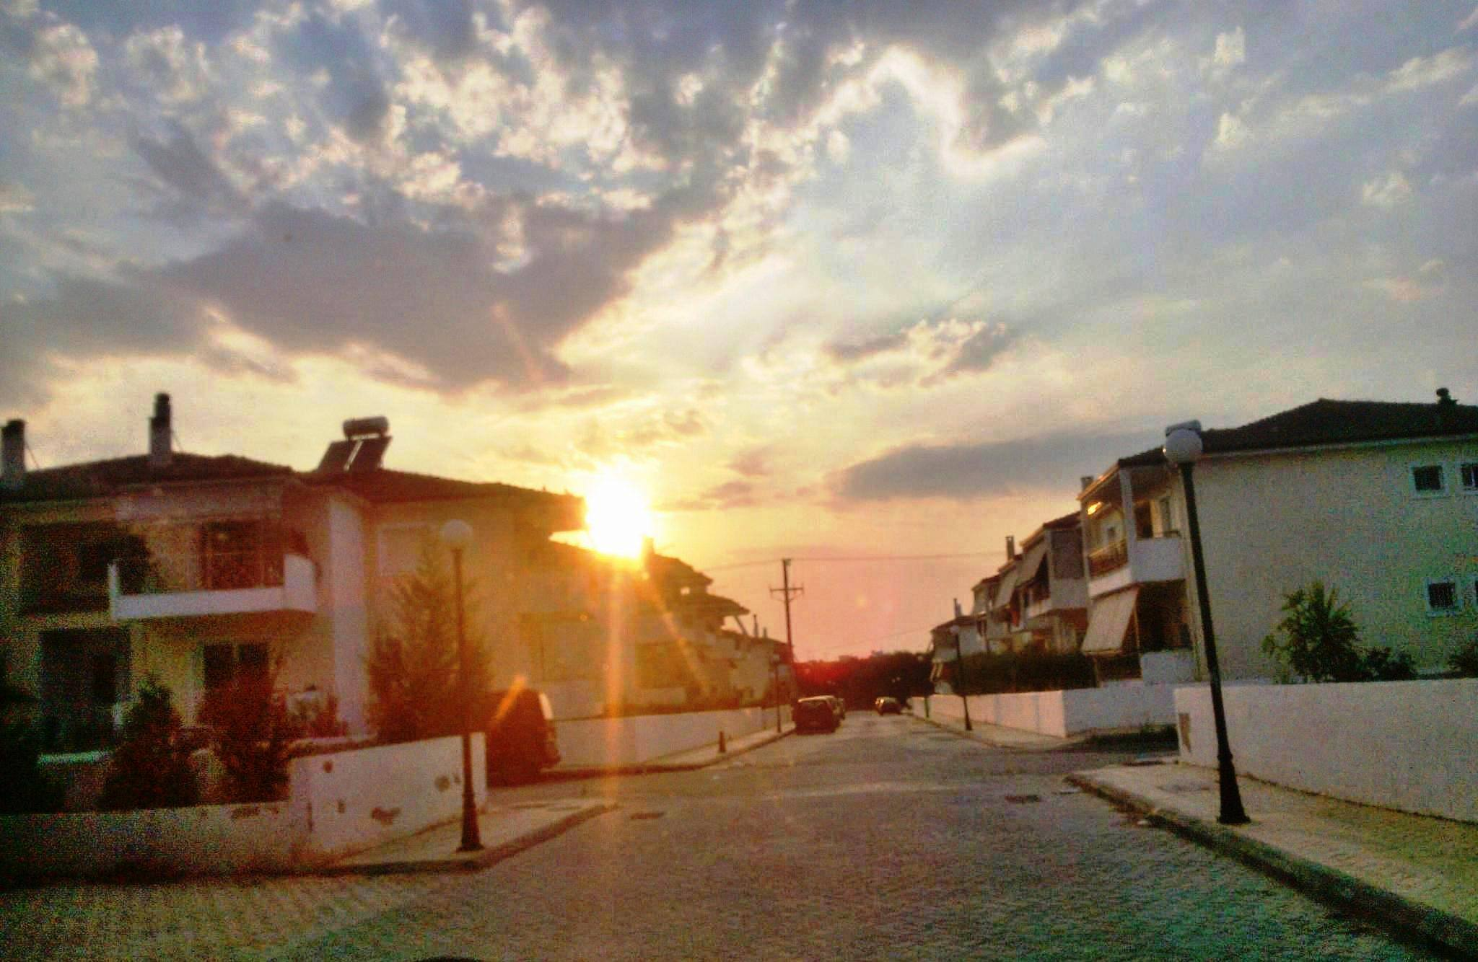
Community Action and Poverty: The case of the Greek Social Work Action Network in Patras

Slide 49
The context of the community: Workers’ Houses of Lefka - Patras
5O families with children
95% of the habitants unemployed
poverty and deprivation
poor housing conditions
People’s sense of guilt for their own poverty
Feelings of despair and isolation

Slide 50
Aim of the community action
Empowerment
Activation
Critical consciousness

Slide 51
Aim: Activation of the inhabitants and critical consciousness
Step 1: Bringing people together
How?
Alliances in the community: Union of the inhabitants of workers’ houses.
Co-operation with the Union
Call people in joy: Open meetings for coffee, food, open assemblies, action for a common goal
Groups with children: Games, creations, discussions, movies, role-playing

Slide 52
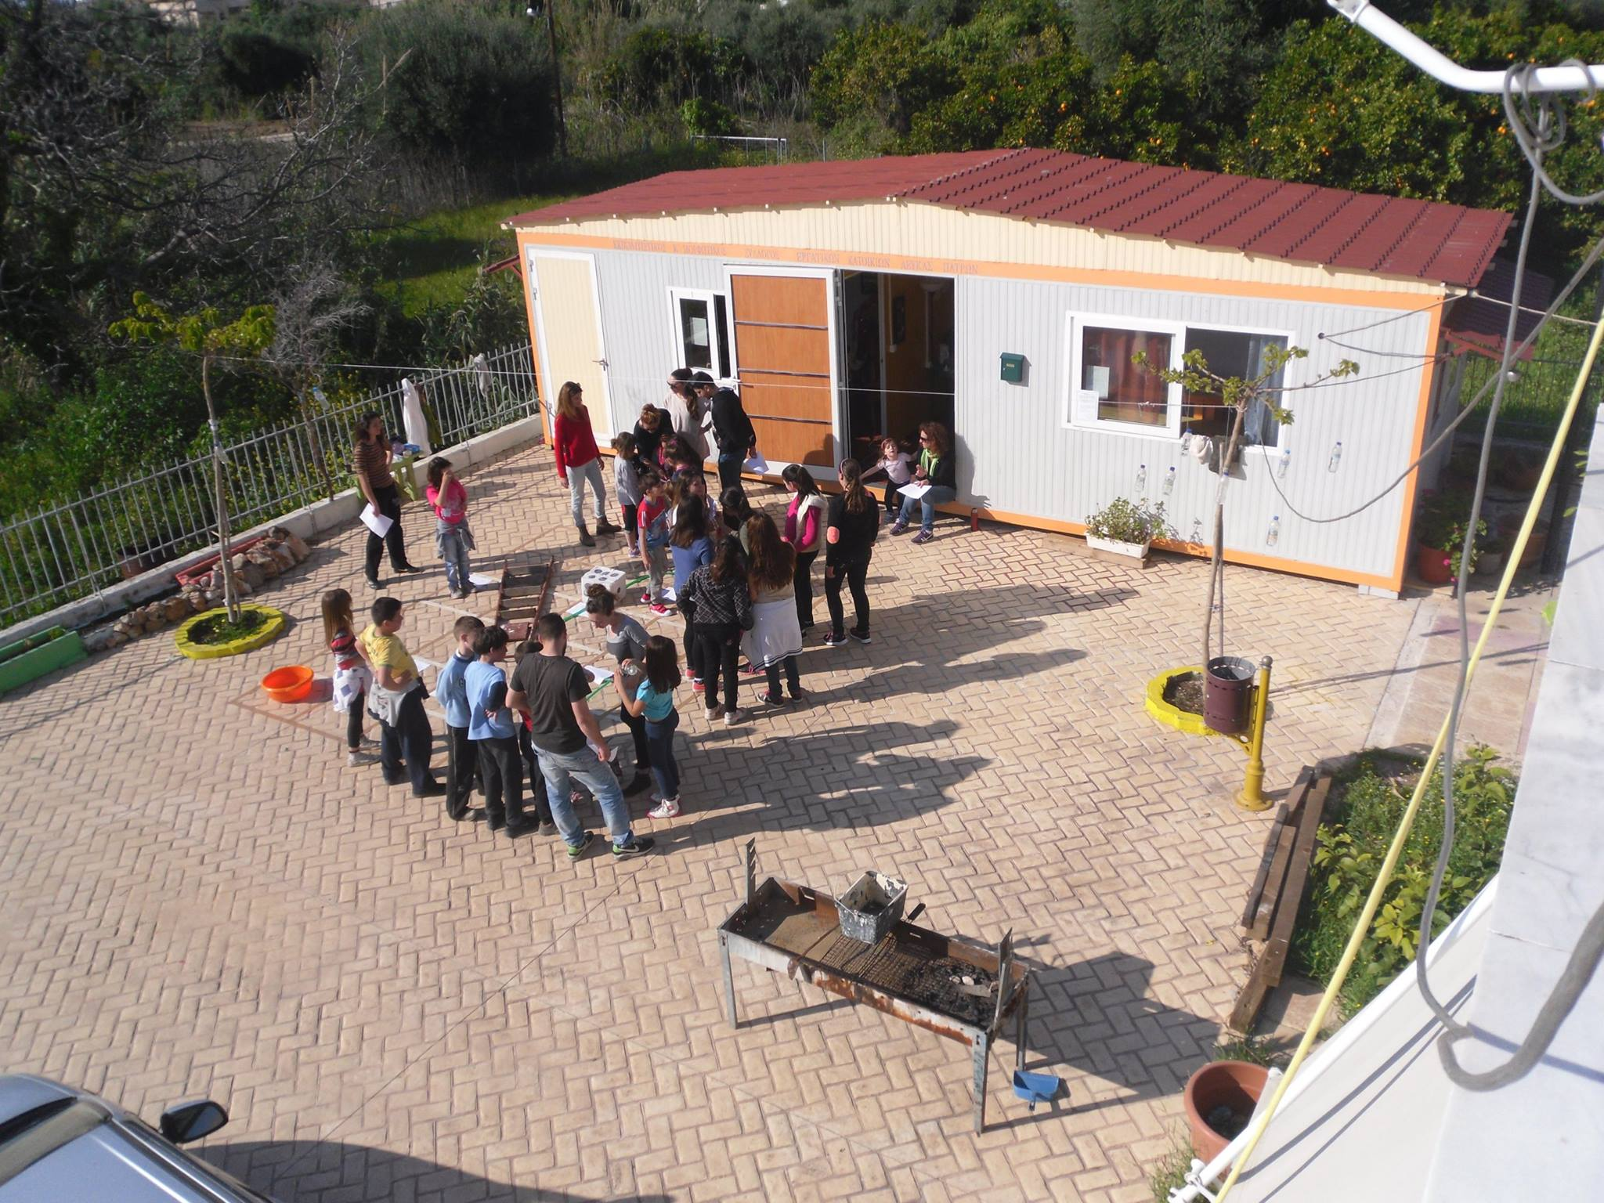
The container of the union of inhabitants turns to the point of Swan’s interventions

Slide 53
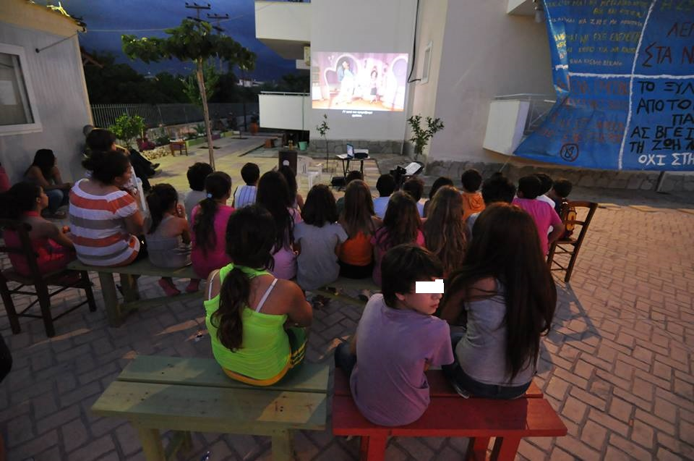
Groups with children

Slide 54
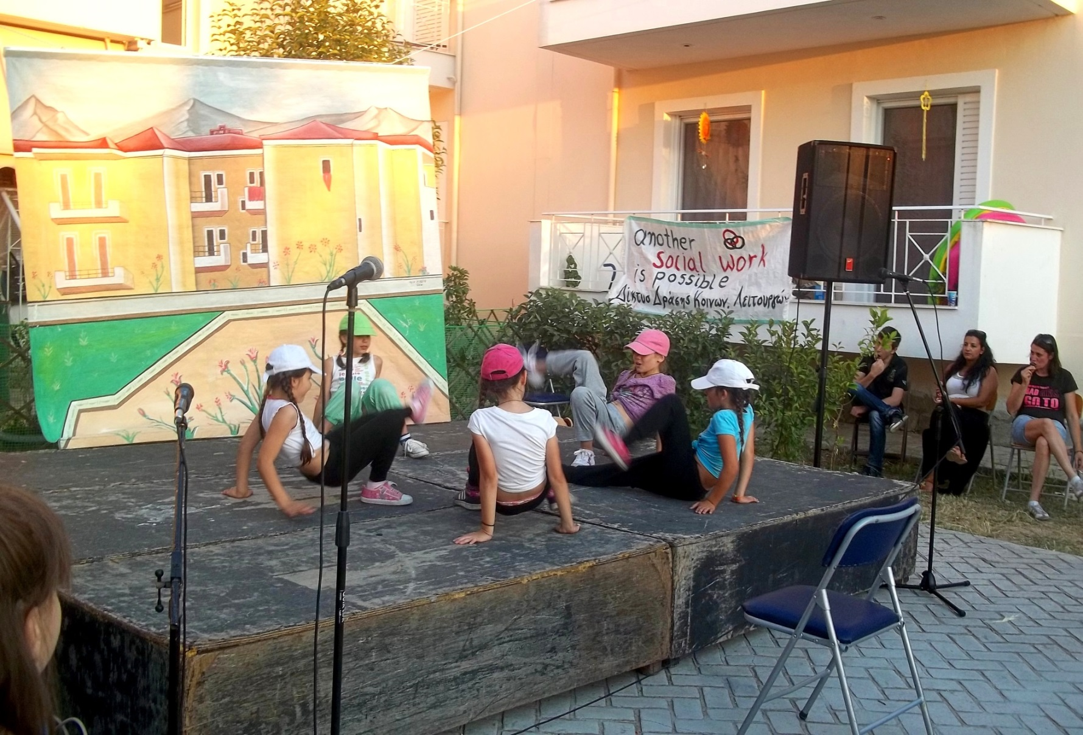
Children and young people getting creative

Slide 55
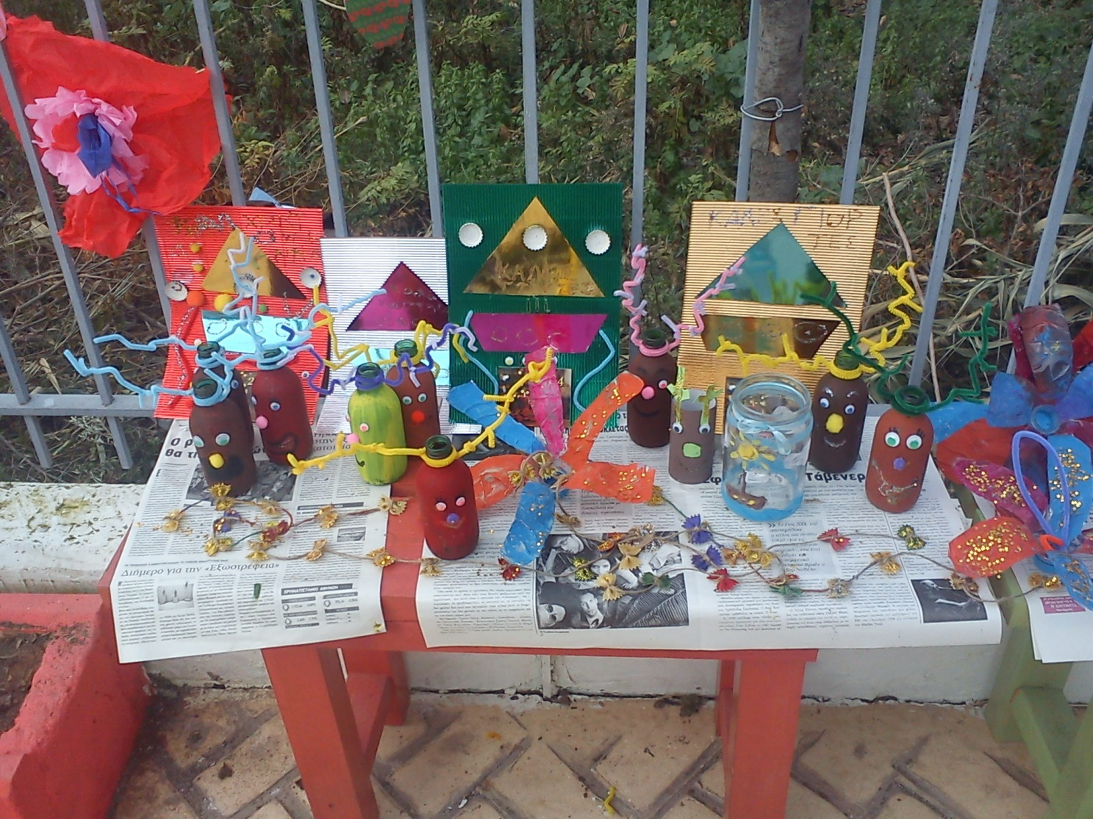
Children and young people getting creative

Slide 56
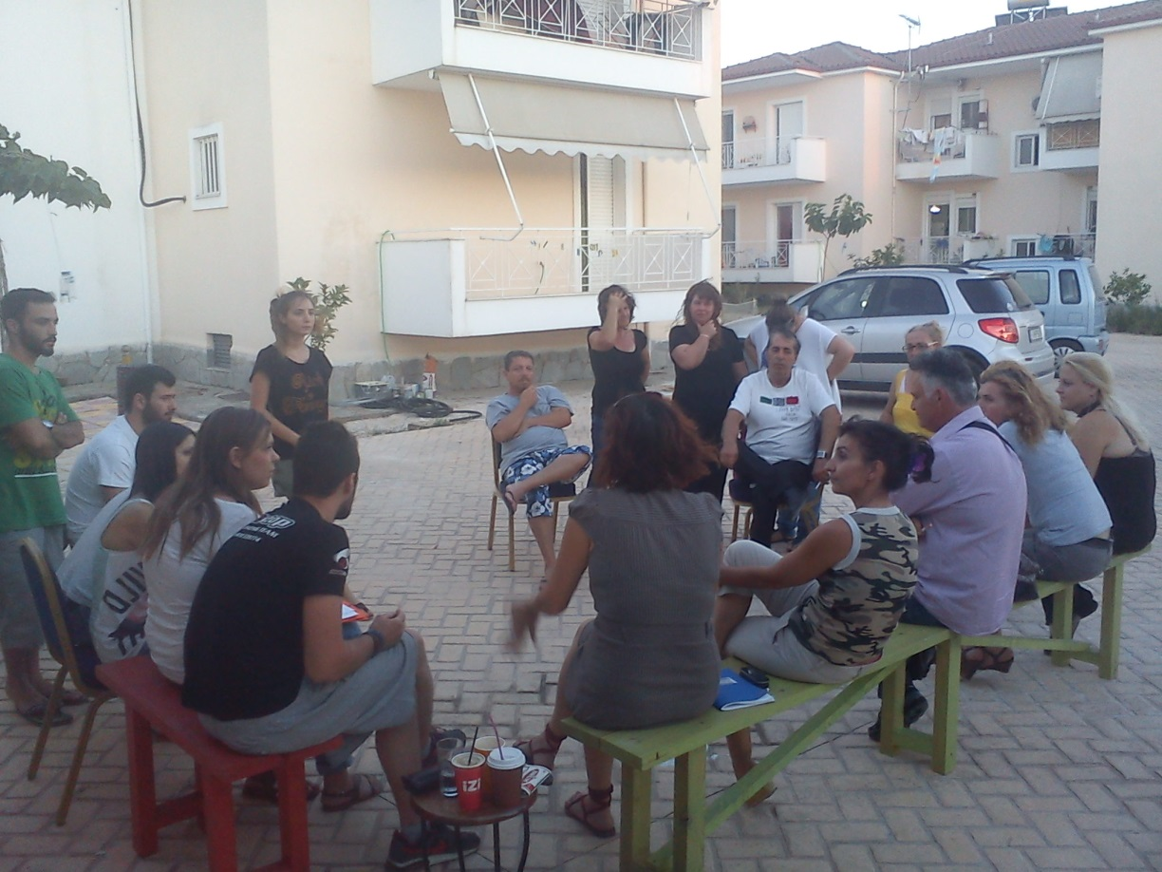
Assemblies with the inhabitants

Slide 57
Acting in and with the community
Children’s groups once per week
Solidarity school – Free preparation for school lessons
Women’s groups - Getting creative
Social support for deprived families – connection with public social services
Intervention in high risk situations
Festivals co-organised with the inhabitants of the neighbourhood → stop the stigma of a poor neighbourhood

Slide 58
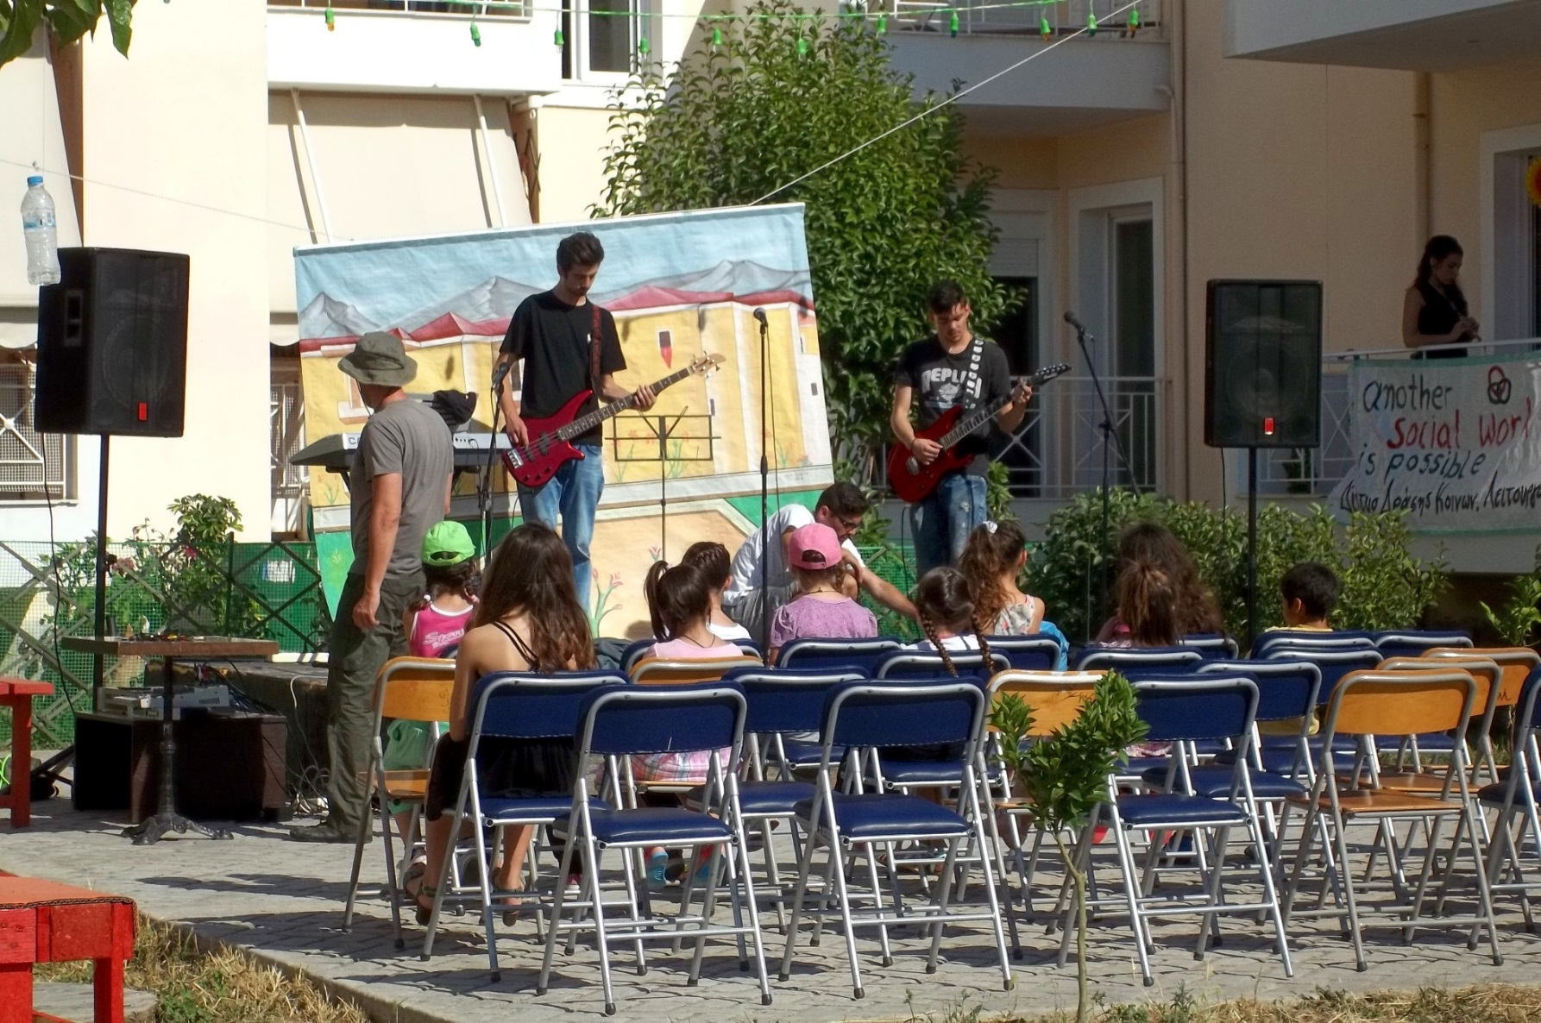
Sound check for a group of young people of the community – Festival of Lefka 2014

Slide 59
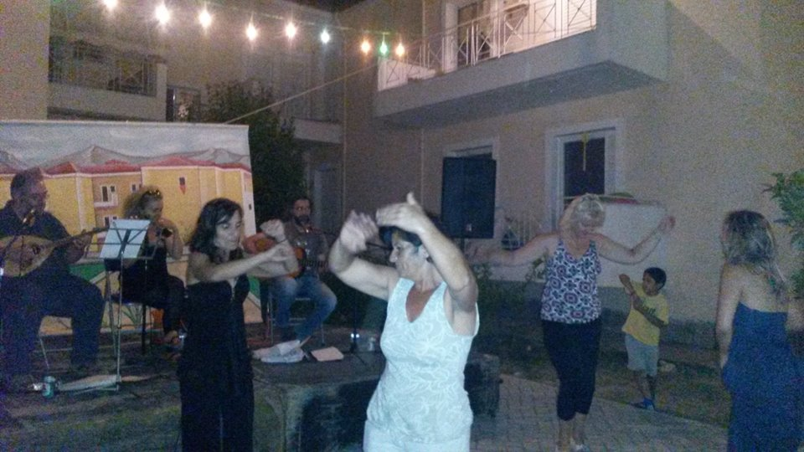
Women of the community dancing

Slide 60
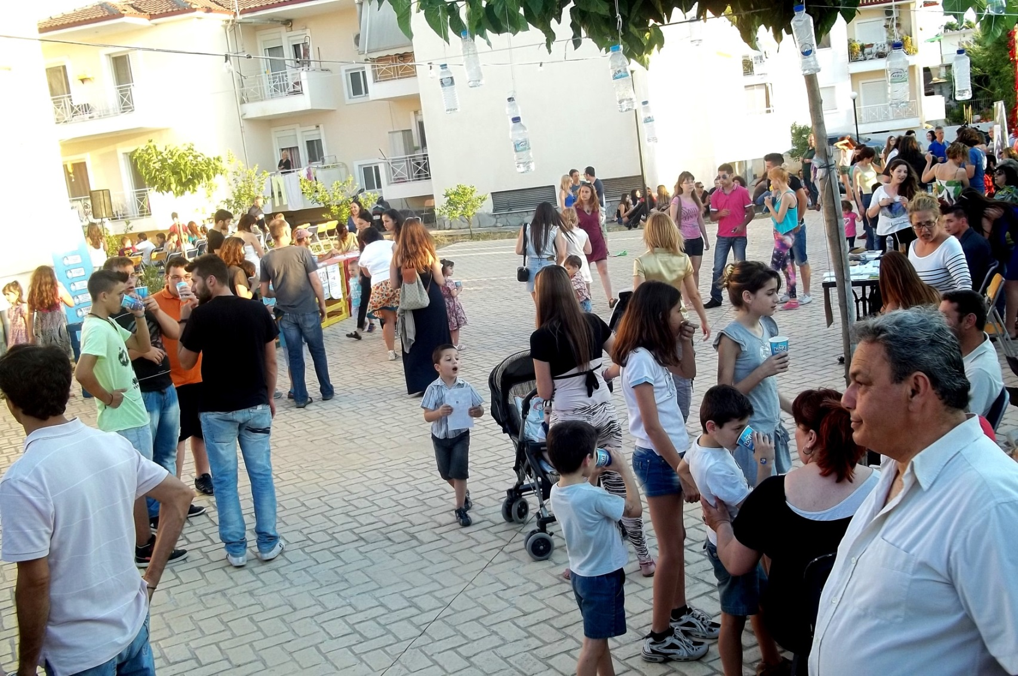
If you want people to act together, start with creativity and common goals

Slide 61
Step 2: Collective action for housing conditions and water supply
Key-factor: Co-operation and empowerment of the Inhabitants’ Union
Interventions in local authorities
Set the local problem into the political agenda – members of the parliament visiting the community
Define the needs of the inhabitants: social research as a tool for political pressure
Establish connections between the Union and other political and social organisations

Slide 62
The problems…
Turn mainstream social work education to community action and community development in practice
Manage the difficulties and disappointments
See the bigger picture
Lack of public social services and
Lack of time and resources ….

Slide 63
The gain
More people involved in the union and in public assemblies
Involvement of more habitants in community’s activities
Empowerment of the habitants through positive actions in their community
Break down the stigma and isolation of the neighbourhood (Festival)
Raise the awareness of the political character of their demand
Restoration of the water supply by Local Authorities May 2015
Collective action is a unique experience ….

Slide 64
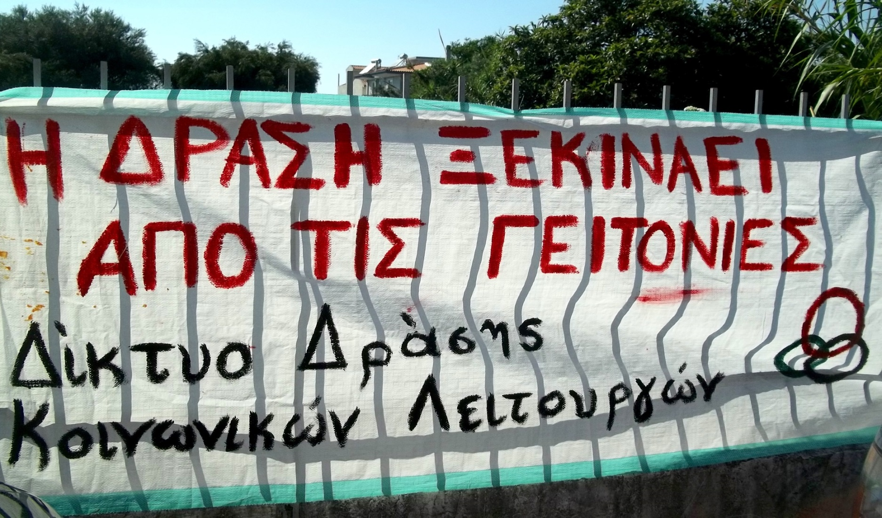
“Action starts in the Community” – Greek Swan

Slide 65
Lessons from the movements
Self-organized political – social initiatives
Collective action and demand (macro level)
Community work (alternative approaches)
Broader understanding of the structural causes
Connection with local networks
Welfare grassroots structures Vs Bureaucratisation of welfare and health sector

Slide 66
Social mobilization and the change of
political landscape
Elections 2015 and various expectations from the Greek government
What we have been taught:
  Collective action and solidarity is integral part of survival (physically and mentally)
  Coalition based on a common agenda between social and political organisations→ Strengths the movement
  Social mobilization and political process in micro level through collective action affect political landscape in macro level→ Gradual close down of the detention centres by the Greek government as a demand of the antiracist movement
  Grassroots initiatives as alternative paths for the function of welfare and health sector

Slide 67
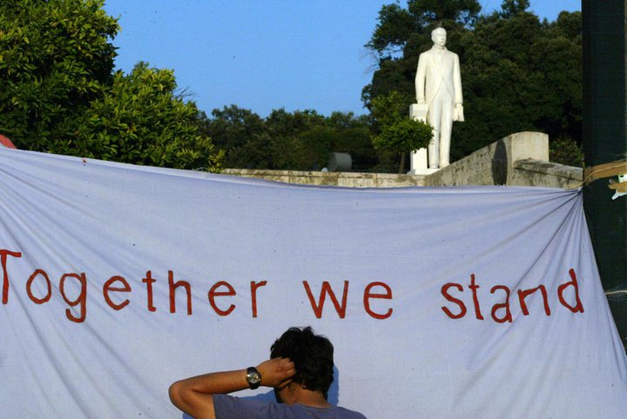
… and the Greek message

Slide 68
Human Rights as a policy tool
Introduction by Siobhan Lloyd (Just Fair)

Slide 69

USING HUMAN RIGHTS AS A POLICY TOOL
  Sources of human rights law
  Social and economic rights
    Articles from different international instruments
    Examples of violations from UK
  How social and economic rights can be used as a policy tool
    Complaints Procedures
    Shadow reporting
    Litigation
    Media
  Conclusion
Notes:
Thanks for invitation to speak
Just Fair - campaigning for economic and social rights in the United Kingdom – many organisations which campaign for the advancement of human rights in UK but we are the only one that focuses purely on economic nad social rights

Slide 70
SOURCES OF HUMAN RIGHTS LAW
Universal Declaration of Human Rights
Civil and Political Rights
  International Covenant on Civil and Political Rights (ICCPR) (UN)
  European Convention on Human Rights (Council of Europe)
Economic and Social Rights
  International Covenant on Economic, Social and Cultural Rights (ICESCR) (UN)
  European Social Charter (Council of Europe)
Notes:
What are human rights? Clients often say that their rights have been breached but what do we mean
Sources of human rights law
Universal Declaration of Human Rights – proclaimed and adopted by the UN General Assembly in 1948 – a declaration - not a legally binding Treaty
Contains articles on both civil and political and economic and social rights
What is the difference?
Civil and political rights – individual rights – limiting state interference – right to life, freedom from torture, right to a private, family and home life, freedom of thought, conscience and religion and freedom of association among rights protected by three documents – could be described as negative obligations
Economic and social rights - positive obligations – what the state should provide
Civil and political rights
Council of Europe’s Convention for the Protection of Human Rights and Fundamental Freedoms (1950)
UN’s International Covenant on Civil and Political Rights (1966) – Article 1 of both ICCPR and ICESCR – right to self-determination - Scotland & Catalonia
EU’s Charter of Fundamental Rights
Economic and Social Rights
European Social Charted adopted 1961 and revised in 1966
ICESCR 1966
European Union – worth pointing out that the preamble to the Treaty on European Union
Treaty on European Union preamble – “CONFIRMING their attachment to fundamental social rights as defined in the European Social Charter signed at Turin on 18 October 1961 and in the 1989 Community Charter of the Fundamental Social Rights of Workers,”
Charter of Fundamental Rights –

Slide 71
EUROPEAN UNION
Preamble to the Treaty on European Union
  CONFIRMING their attachment to fundamental social rights as defined in the European Social Charter signed at Turin on 18 October 1961 and in the 1989 Community Charter of the Fundamental Social Rights of Workers,
  Charter of Fundamental Rights
    Has the same legal value as the Treaty on European Union and Treaty on the Functioning of the European Union (Art 6(1) TFEU)
    Contains both economic & social rights as well as political & civil rights

Slide 72
THE IMPORTANCE OF SOCIAL
& ECONOMIC RIGHTS
Recognising that, in accordance with the Universal Declaration of Human Rights, the ideal of free human beings enjoying freedom from fear and want can only be achieved if conditions are created whereby everyone may enjoy his economic social and cultural rights, as well as his civil and political rights
Preamble - ICESCR 1966
Notes:
Civil and political rights have often been seen as more important than economic and social rights -preamble sets out why it’s not

Slide 73
RIGHT TO SELF-DETERMINATION
Article 1 of ICCPR and ICESCR
  Ending colonialisation
  Catalonia/Scotland?
  Greece?
Notes:
Troika and policies in Greece – Evangelia’s presentation and what she asked for at the end - this is about the right to self-determination

Slide 74
THE RIGHT TO WORK
  ICESCR
  Article 6
  The State Parties to the present Covenant recognise the right to work…
  The steps to be taken by a State Party to the present Covenant to achieve the full realisation of this right shall include technical and vocational guidance and training programmes, policies and techniques to achieve steady, economic, social and cultural development and full and productive employment under conditions safeguarding fundamental political and economic freedoms to the individual.
  Article 7
  The States Parties to the present Covenant recognise the right of everyone to the enjoyment of just and favourable conditions of work which ensure, in particular:
    Remuneration which provides all workers, as a minimum with:
  …
  ii. A decent living for themselves and their families in accordance with the provisions of the present Covenant.
  …
  d. Rest, leisure and reasonable limitation of working hours and periodic holidays with pay, as well as remuneration for public holidays.
Notes:
This part of the presentation looks at some of the economic and social rights protected by the three instruments.

Slide 75
RIGHT TO WORK
European Social Charter (1961 and revised ESC 1996)
  Article 1 – the right to work
  Article 2 – the right to just conditions of work
  Article 4 – the right to a fair remuneration
With a view to ensuring the effective exercise of the right to a fair remuneration, the Contracting Parties undertake:
  to recognise the right of workers to a remuneration such as will give them and their families a decent standard of living;
  to recognise the right of workers to an increased rate of remuneration for overtime work, subject to exceptions in particular cases;
  Article 9 – the right to vocational guidance
  Article 10 – the right to vocational training
Notes:
Violations of right to work and ancillary rights
Working poor (Sandra)
Patricia Berzuntea – 11.7% of workers are poor in Spain
Nachho Alvarez – minimum wage less than the living wage
Same in the United Kingdom
Investments in vocational training – recommendations that workers should be trained

Slide 76
RIGHT TO FOOD
ICESCR
  Article 11
  The State Parties to the present Covenant recognise the right of everyone to an adequate standard of living for himself and his family, including adequate food…The State Parties will take appropriate steps to ensure the realisation of this right…
  The State Parties to the present Covenant, recognising the fundamental the fundamental right to be free from hunger…
Revised European Social Charter
Article 30 – the right to protection against poverty and social exclusion
    Right to food not specifically mentioned

Slide 77
RIGHT TO FOOD
Violations?
  Just Fair’s Report “Going Hungry? The Human Right to Food in the UK” 2014 found that:
  “Welfare reforms, benefit delays and cost of living crisis have pushed an unprecedented number of people into a state of hunger, malnutrition and food insecurity in the UK. In recent years one of the world’s richest countries has witnessed a massive increase in the number of people seeking an emergency food aid from the Trussel Trust has confirmed today that 913,138 people received a minimum of three days emergency from its food banks in 2013-14, compared to 346,992 in 2012-13 and up from 26,000 in 2008-09.”
  Evangelia’s presentation on Greece 07.07.2015
    People eating food from garbage
    Children fainting at school
  P.22-23 of OHCHR Factsheet No. 34(2010) on the Right to Adequate Food sets out what the obligations under Article 11 ICESCR means – states cannot allow the existing level of fulfilment of the right to food to deteriorate unless there are strong justifications for it.
  Violation of other rights?
Notes:
Just Fair Report – use of food banks related to:
-2010 – ‘Emergency Budget’ - £11 billion of welfare reductions
Benefits in adequate – fall well below 40% of the European median - £280 per onth
Bedroom tax
Sanctions procedures for benefits
All part of welfare reform package
Portugal – Sandra EAPN - 67 food banks in Portugal in 2011 and now figure is over 900
Government spending money on foodbanks instead of on welfare reform
What about the right to human dignity?

Slide 78
RIGHT TO HOUSING
Article 11(1) ICESCR
The States Parties to the present Covenant recognise the right of everyone to an adequate standard of living for himself and his family, including adequate…housing.
Revised European Social Charter
  Article 31– the right to housing
With a view to ensuring the effective exercise of the right to housing, the Parties undertake to take measures designed:
    to promote access to housing of an adequate standard;
    to prevent and reduce homelessness with a view to its gradual elimination;
    to make the price of housing accessible to those without resources.
Article 34 (3) Charter of Fundamental Rights
In order to combat social exclusion and poverty, the Union recognises and respects the right to social and housing assistance so as to ensure a decent existence for all those who lack sufficient resources, in accordance with the rules laid down by Union law and national laws and practices.

Slide 79
RIGHT TO HOUSING
“Protecting the Right to Housing in England: A context of Crisis” Dr Jessie Hohmann
  No. of individuals forced to sleep rough in England has increased year on year - by a total of 37% since 2010 – true level of homelessness masked by overcrowding and use of temporary accommodation
  33% of homes in the private rented sector do not meet basic standards of health, safety and habitability
  Security of tenure inadequate – tenants afraid of complaining. No safeguards against retaliatory evictions – approximately 200,000 in 2013
Notes:
Patrica Berzunatea – increase in foreclosure – 11.9% compared to 2013 – loss of social housing

Slide 80
RIGHT TO HEALTHCARE
Article 12 ICESCR
1. The State Parties to this Convention recognise the right of everyone to the enjoyment of the highest attainable standard of physical and mental health.
2. The steps to be taken by the State Parties to the present Covenant to achieve the full realisation of this right shall include those necessary for:
…
d. The creation of conditions which would assure to all medical service and medical attention in the event of sickness.
Article 11 Revised European Social Charter – the right to protection of health
Article 35 Charter of Fundamental Rights
Everyone has the right of access to preventive health care and the right to benefit from medical treatment under the conditions established by national laws and practices.
Threats?
  Privatisation
Notes:
Patricia spoke of there being a 16.3% reduction in health spending in Spain – no longer universal access to healthcare

Slide 81
RIGHT TO SOCIAL SECURITY
Article 9 ICESCR – right to social security
Article 10(2) ICESCR maternity rights
Article 13 revised European Social Charter
  Right to social and medical assistance
Article 34 Charter of Fundamental Rights – right to social security in accordance with practices in Member States
Notes:
Emergency Budget 2010 – need to save £32 billion by 2014-2015 - £11 billion of welfare reforns
Malik S & Butler P (2014) “Revealed: hitlist of welfare cuts facing Britain’s next chancellor” the Guardian – cuts to statutory maternity pay
Proposals to cut benefits further - Cutting of statutory maternity pay
Patricia Rais Fundación 740,000 people are without any coverage of benefits

Slide 82
USING HUMAN RIGHTS AS A POLICY TOOL
Why?
  Shrinking/Dismantling of welfare
  Challenging the austerity discourse
  Purpose of the Nation State?
  Powerful discourse on positive obligations
Council of Europe Commissioner for Human Rights (2013)
Economic policy is not exempt from the duty of member states to implement human rights norms and procedural principles. As embodied in international human rights law, civil, political, economic, social and cultural rights are not expendable in times of economic hardship, but are essential to a sustained and inclusive recovery.
Notes:
“Safeguarding human rights in times of economic crisis” November 2013

Slide 83
COMPLAINTS PROCEDURES
Complaints to Committee on Economic, Social and Cultural Rights
  Optional Protocol to ICESCR
    Committee - can receive complaints from individuals or groups of individuals – BE, FI, FR, IT, LUX, PT, ES
    Complaint against Spain
      2/2014 – denial of the access to court to protect author’s housing rights
Notes:
Very new system – opened for signature in 2009
Only three complaints that have been communicated to the government so far: 2 against Spain; 1 against Ecuador

Slide 84
COMPLAINTS PROCEDURES
Collective Complaints Procedure to European Committee of Social Rights – BE, CZ, FI, FR, GR, IRE, IT, NL, NO, SL, SWE
  No.111/2014 Greek Confederation of Labour v Greece
  The complaint concerns Article 1 (the right to work), Article 2 (the right to just conditions of work), Article 4 (the right to a fair remuneration) and Article 7 (the right of children and young persons to protection) of the 1961 Charter, as well as Article 3 of the 1988 Additional Protocol (the right to take part in the determination and improvement of the working conditions and working environment). The complainant trade union, GSEE, alleges that some of the new legislation enacted as part of the austerity measures adopted in Greece during the economic and financial crisis affects workers’ rights in a manner that is contrary to the Charter.
Notes:
European Committee on Social Rights
international organisations of employers and trade unions referred to in paragraph 2 of Article 27 of the Charter; (2 bodies from each MS)
other international non-governmental organisations which have consultative status with the Council of Europe and have been put on a list established for this purpose by the Governmental Committee;
representative national organisations of employers and trade unions within the jurisdiction of the Contracting Party against which they have lodged a complaint.

Slide 85
SHADOW/PARALLEL REPORTING
UN Committee on Economic, Social and Cultural Rights
  Monitors MS’s compliance every five years through States parties reports
  Committee accepts parallel reports/ written information from national/international NGOs and coalitions of NGOs
  Media coverage – Just Fair’s Housing Report – UK Housing Crisis ‘in breach of human rights

Slide 86
POLICY TOOL
Litigation
Campaigns
Reports
Embedding social & economic rights into discourses
Challenges - opposition
  “Outrage as 'loopy' UN inspector lectures Britain: She's from violent, slum-ridden Brazil, yet still attacks us on housing and human rights”
  11.09.2013 www.dailymail.co.uk
Notes:
UN Special Rapporteur on right to housing criticised UK

Slide 87

a: 356 Holloway Road, London, N7 6PA, UK
e: info@just-fair.co.uk
t:@JustFairUK

Slide 88
USING HUMAN RIGHTS AS A POLICY TOOL
  Sources of human rights law
  Social and economic rights
    Articles from different international instruments
    Examples of violations from UK
  How social and economic rights can be used as a policy tool
    Complaints Procedures
    Shadow reporting
    Litigation
    Media
  Conclusion

Slide 89
SOURCES OF HUMAN RIGHTS LAW
Universal Declaration of Human Rights
Civil and Political Rights
  International Covenant on Civil and Political Rights (ICCPR) (UN)
  European Convention on Human Rights (Council of Europe)
Economic and Social Rights
  International Covenant on Economic, Social and Cultural Rights (ICESCR) (UN)
  European Social Charter (Council of Europe)

Slide 90
EUROPEAN UNION
Preamble to the Treaty on European Union
  CONFIRMING their attachment to fundamental social rights as defined in the European Social Charter signed at Turin on 18 October 1961 and in the 1989 Community Charter of the Fundamental Social Rights of Workers,
  Charter of Fundamental Rights
    Has the same legal value as the Treaty on European Union and Treaty on the Functioning of the European Union (Art 6(1) TFEU)
    Contains both economic & social rights as well as political & civil rights

Slide 91
THE IMPORTANCE OF SOCIAL
& ECONOMIC RIGHTS
Recognising that, in accordance with the Universal Declaration of Human Rights, the ideal of free human beings enjoying freedom from fear and want can only be achieved if conditions are created whereby everyone may enjoy his economic social and cultural rights, as well as his civil and political rights
Preamble - ICESCR 1966

Slide 92
RIGHT TO SELF-DETERMINATION
Article 1 of ICCPR and ICESCR
  Ending colonialisation
  Catalonia/Scotland?
  Greece?

Slide 93
THE RIGHT TO WORK
  ICESCR
  Article 6
  The State Parties to the present Covenant recognise the right to work…
  The steps to be taken by a State Party to the present Covenant to achieve the full realisation of this right shall include technical and vocational guidance and training programmes, policies and techniques to achieve steady, economic, social and cultural development and full and productive employment under conditions safeguarding fundamental political and economic freedoms to the individual.
  Article 7
  The States Parties to the present Covenant recognise the right of everyone to the enjoyment of just and favourable conditions of work which ensure, in particular:
    Remuneration which provides all workers, as a minimum with:
  …
  ii. A decent living for themselves and their families in accordance with the provisions of the present Covenant.
  …
  d. Rest, leisure and reasonable limitation of working hours and periodic holidays with pay, as well as remuneration for public holidays.

Slide 94
RIGHT TO WORK
European Social Charter (1961 and revised ESC 1996)
  Article 1 – the right to work
  Article 2 – the right to just conditions of work
  Article 4 – the right to a fair remuneration
With a view to ensuring the effective exercise of the right to a fair remuneration, the Contracting Parties undertake:
  to recognise the right of workers to a remuneration such as will give them and their families a decent standard of living;
  to recognise the right of workers to an increased rate of remuneration for overtime work, subject to exceptions in particular cases;
  Article 9 – the right to vocational guidance
  Article 10 – the right to vocational training

Slide 95
RIGHT TO FOOD
ICESCR
  Article 11
  The State Parties to the present Covenant recognise the right of everyone to an adequate standard of living for himself and his family, including adequate food…The State Parties will take appropriate steps to ensure the realisation of this right…
  The State Parties to the present Covenant, recognising the fundamental the fundamental right to be free from hunger…
Revised European Social Charter
Article 30 – the right to protection against poverty and social exclusion
    Right to food not specifically mentioned

Slide 96
RIGHT TO FOOD
Violations?
  Just Fair’s Report “Going Hungry? The Human Right to Food in the UK” 2014 found that:
  “Welfare reforms, benefit delays and cost of living crisis have pushed an unprecedented number of people into a state of hunger, malnutrition and food insecurity in the UK. In recent years one of the world’s richest countries has witnessed a massive increase in the number of people seeking an emergency food aid from the Trussel Trust has confirmed today that 913,138 people received a minimum of three days emergency from its food banks in 2013-14, compared to 346,992 in 2012-13 and up from 26,000 in 2008-09.”
  Evangelia’s presentation on Greece 07.07.2015
    People eating food from garbage
    Children fainting at school
  P.22-23 of OHCHR Factsheet No. 34(2010) on the Right to Adequate Food sets out what the obligations under Article 11 ICESCR means – states cannot allow the existing level of fulfilment of the right to food to deteriorate unless there are strong justifications for it.
  Violation of other rights?

Slide 97
RIGHT TO HOUSING
Article 11(1) ICESCR
The States Parties to the present Covenant recognise the right of everyone to an adequate standard of living for himself and his family, including adequate…housing.
Revised European Social Charter
  Article 31– the right to housing
With a view to ensuring the effective exercise of the right to housing, the Parties undertake to take measures designed:
    to promote access to housing of an adequate standard;
    to prevent and reduce homelessness with a view to its gradual elimination;
    to make the price of housing accessible to those without resources.
Article 34 (3) Charter of Fundamental Rights
In order to combat social exclusion and poverty, the Union recognises and respects the right to social and housing assistance so as to ensure a decent existence for all those who lack sufficient resources, in accordance with the rules laid down by Union law and national laws and practices.

Slide 98
RIGHT TO HOUSING
“Protecting the Right to Housing in England: A context of Crisis” Dr Jessie Hohmann
  No. of individuals forced to sleep rough in England has increased year on year - by a total of 37% since 2010 – true level of homelessness masked by overcrowding and use of temporary accommodation
  33% of homes in the private rented sector do not meet basic standards of health, safety and habitability
  Security of tenure inadequate – tenants afraid of complaining. No safeguards against retaliatory evictions – approximately 200,000 in 2013

Slide 99
RIGHT TO HEALTHCARE
Article 12 ICESCR
1. The State Parties to this Convention recognise the right of everyone to the enjoyment of the highest attainable standard of physical and mental health.
2. The steps to be taken by the State Parties to the present Covenant to achieve the full realisation of this right shall include those necessary for:
…
d. The creation of conditions which would assure to all medical service and medical attention in the event of sickness.
Article 11 Revised European Social Charter – the right to protection of health
Article 35 Charter of Fundamental Rights
Everyone has the right of access to preventive health care and the right to benefit from medical treatment under the conditions established by national laws and practices.
Threats?
  Privatisation

Slide 100
RIGHT TO SOCIAL SECURITY
Article 9 ICESCR – right to social security
Article 10(2) ICESCR maternity rights
Article 13 revised European Social Charter
  Right to social and medical assistance
Article 34 Charter of Fundamental Rights – right to social security in accordance with practices in Member States

Slide 101
USING HUMAN RIGHTS AS A POLICY TOOL
Why?
  Shrinking/Dismantling of welfare
  Challenging the austerity discourse
  Purpose of the Nation State?
  Powerful discourse on positive obligations
Council of Europe Commissioner for Human Rights (2013)
Economic policy is not exempt from the duty of member states to implement human rights norms and procedural principles. As embodied in international human rights law, civil, political, economic, social and cultural rights are not expendable in times of economic hardship, but are essential to a sustained and inclusive recovery.

Slide 102
COMPLAINTS PROCEDURES
Complaints to Committee on Economic, Social and Cultural Rights
  Optional Protocol to ICESCR
    Committee - can receive complaints from individuals or groups of individuals – BE, FI, FR, IT, LUX, PT, ES
    Complaint against Spain
      2/2014 – denial of the access to court to protect author’s housing rights

Slide 103
COMPLAINTS PROCEDURES
Collective Complaints Procedure to European Committee of Social Rights – BE, CZ, FI, FR, GR, IRE, IT, NL, NO, SL, SWE
  No.111/2014 Greek Confederation of Labour v Greece
  The complaint concerns Article 1 (the right to work), Article 2 (the right to just conditions of work), Article 4 (the right to a fair remuneration) and Article 7 (the right of children and young persons to protection) of the 1961 Charter, as well as Article 3 of the 1988 Additional Protocol (the right to take part in the determination and improvement of the working conditions and working environment). The complainant trade union, GSEE, alleges that some of the new legislation enacted as part of the austerity measures adopted in Greece during the economic and financial crisis affects workers’ rights in a manner that is contrary to the Charter.

Slide 104
SHADOW/PARALLEL REPORTING
UN Committee on Economic, Social and Cultural Rights
  Monitors MS’s compliance every five years through States parties reports
  Committee accepts parallel reports/ written information from national/international NGOs and coalitions of NGOs
  Media coverage – Just Fair’s Housing Report – UK Housing Crisis ‘in breach of human rights

Slide 105
POLICY TOOL
Litigation
Campaigns
Reports
Embedding social & economic rights into discourses
Challenges - opposition
  “Outrage as 'loopy' UN inspector lectures Britain: She's from violent, slum-ridden Brazil, yet still attacks us on housing and human rights” Daily Mail 11.09.2013 www.dailymail.co.uk

Slide 106
a: 356 Holloway Road, London, N7 6PA, UK
e: info@just-fair.co.uk
t:@JustFairUK

Slide 107
Discussion

