Slide 1
Answers to the social damage of the austerity policy
Afternoon session

Slide 2
Is redistribution a key condition for EU?
The Juncker Investment Plan

Slide 3
The Juncker Investment plan
An “investment offensive”, “the greatest effort in EU history to mobilise the EU budget to trigger new investments”
“We are offering hope to millions of Europeans disillusioned after years of stagnation”
Budget:
  a €16bn guarantee from the EU budget and
  a €5bn contribution from the European Investment Bank (EIB)
Focus on funding investment in infrastructure: target broadband and energy networks, transport infrastructure in industrial centers, renewable energy projects, education and training, and funding for SMEs and middle capitalization companies

Slide 4
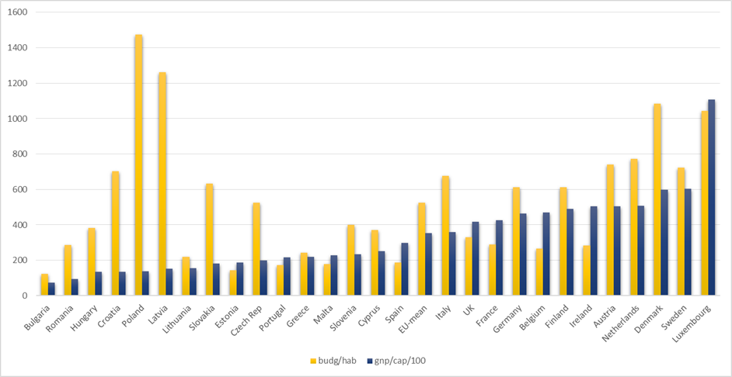
The indicative program: a first attempt to analyse

Slide 5
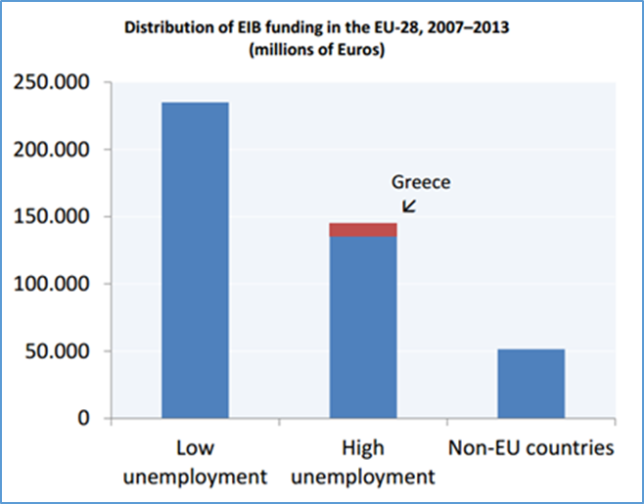
Convergence as a goal of Europe?

Slide 6
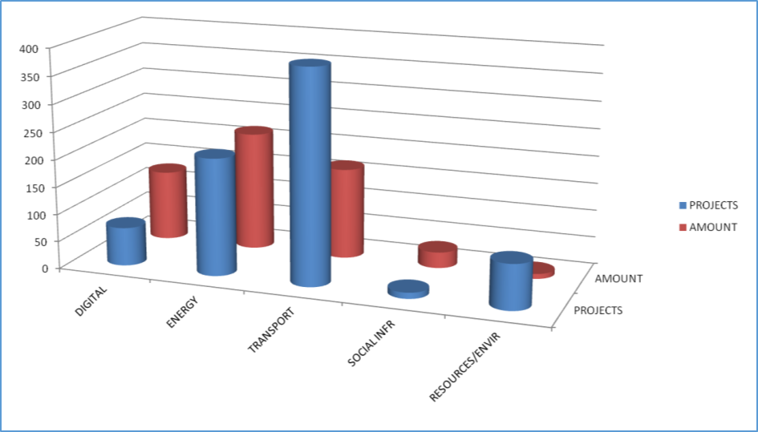
The indicative list: a second attempt to analyse

Slide 7
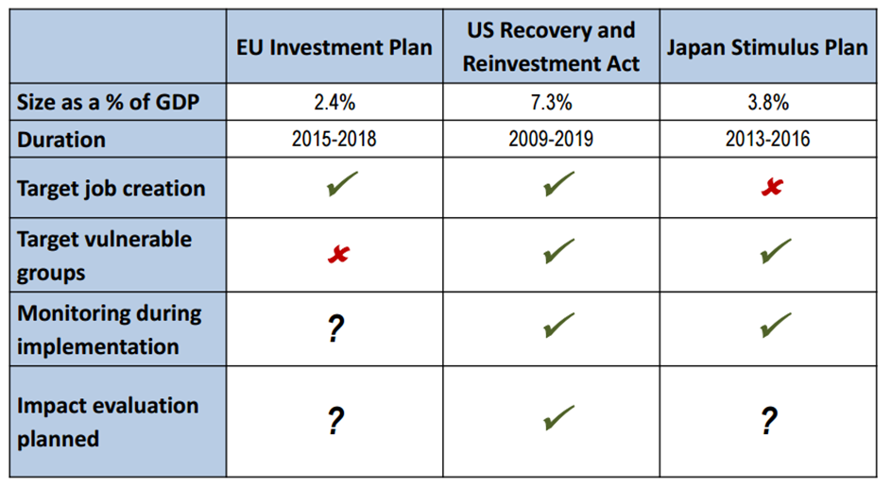
Comparison of investment plans

Slide 8
We need an other investment plan
Conclusion
  It will widen the gap between the northern and southern countries
  Doesn’t answer the social damage of the crisis
  It is not a social investment plan
Elements of an other investment plan
  Redistribution must be a key characteristic
  Investment in answers to the social damage of the crisis
  Social investment (health, education, unemployment, …)
  Investment must be linked to the reinforcement of the resilience of people

Slide 9
EU Long term unemployment initiative
State of Affairs
Sofie Put

Slide 10
Context of the initiative
=policy deliverable 2015 for employability (package of measures before the summer)
Legal form: Council recommendation on integration of the long-term unemployed
Inspirated by the Youth Guarantee
Europe recovers slowly from the crisis, but LT unemployment continues to increase
Notes:
Under the Youth Guarantee Member States have committed to ensure that all young people under 25 get a good-quality, concrete offer for a job, apprenticeship, traineeship, or continued education, within 4 months of them leaving formal education or becoming unemployed.

Slide 11
EU diagnosis of LT
EU diagnosis: after 6 years of crisis, LT and youth unemployment are emerging as the main employment legacy of the crisis
50% of unemployed are LT
EU LT unemployment: 11,9 million people or 4,9% of active population
Within LT numbers, 59% jobless for at least 2 consecutive years
Personal consequences: Social stigma, skills depreciation, higher incidence of health problemes, prejudices
MS consequences: jeopardises overall employment policy goals ad matching efficiency of the labour market , undermines mobility, polarisation of labour market
Notes:
Polarisation of the labour market: caused by the rapidly increasing share of the low qualified among the LT unemployed

Slide 12
Challenges to reduce LT unemployment (1)
High risk of dropping into inactivity and low transition rates to employment
Support to LT unemployed:
most of ALMPs are directed to ‘more employable’
most MS: min activation requirements, conditionality not always enforced
Public Employment Services: making eligible for unemployment benefits. Mostly limited in duration.
Most MS: range of ALMPs narrows de facto with the length of unemployment
Notes:
Of those LT unemployed in 2012, by 2013 more than 50% were still unemployed and another 19% were inactive (=no longer searching for a job). The connection to the labour market deteriorates as unemployment duration increases.
2. As the unemployed go from short-term to LT unemployment, both the coverage and the intensity of active and passive labour market interventions decrease. Unemployment benefits stop in many countries within 1 year. When eligibility ends, the LT unemployed may be eligible for non-contributory minimum income or other social assistance benefits.

Slide 13
Challenges to reduce LT unemployment (2)
Coordination between delivery agents
EU: Hugh variations in type of agents and cooperation mechanisms between them. No defined obligations to collaborate
Some MS integrated services (one-stop-shops) but many lack policy coordination
Often costly and inefficient administration, poor monitoring and follow up and gaps in coverage
Notes:
Lack of policy coordination lead to framentation and inconsistencies in service provision.

Slide 14
Purpose of the forthcoming EU initiative
A framework for individual activation offers
Delivered by local, regional or national delivery agents
Seek to deepen collaboration of municipalities, family services, other social services, NGO’s, social enterprises, social partners with Public Employment Services
Better coordination is most optimal via integrated service provision/one stop shops
LTU needs quality services
LTU needs access to activation measures (rights and responsibilities) and income support (min income, housing benefits)
Notes:
Quality services: childcare, elderly care, transport problems, de bt counseling, health issues
Activation measures:

Slide 15
EU Public consultation (deadline 15th of May)
Opinions on:
Integration of services
Tailored individual support
Mutual obligations
Incentives for employers to take up LTU

Slide 16
Beyond TINA, looking for a TIAA
Jeremy Leaman (Loughbourough University)
Mahmood Messkoub (University of Rotterdam)

Slide 17
The Juncker Investment Plan and Poverty Reduction: a ‘Trickle-Down’?
Mahmood Messkoub
Institute of Social Studies (EUR)

Slide 18
Investment→
Growth-employment-poverty nexus?
Trickle-down: benefits of growth filter down to all, including the poor…
Growth is Necessary BUT NOT Sufficient for poverty alleviation
Employment-poverty nexus: macro and micro
Macro: growth, state/tax revenue up and social expenditure to reduce poverty
Micro: economic growth, demand for goods and services, firm level demand for labour

Slide 19
…BUT…
productivity growth v employment growth debate
…Employment neutral growth…?
Pressure to create jobs … who benefits? Depends on integrability of people and elasticity or response of sectors
Integrability depends on required skills…mismatch of demand for and supply of skills….poor v non-poor, male v female, local v foreign workers...
Elasticity of Employment in which sector responds faster to growth…

Slide 20
Integrability and elasticity conditions
(growth and employment?)
Integrability: can the poor and unemployed meet demand conditions (skills, etc.)?
Elasticity: 1% growth → Emp. Gr.%? <1, =1, >1?
Can sectoral labour demands grow fast enough to absorb sectoral labour supply?
Data on EU on employment elasticity of growth: variation across countries and sectors…<1, highest service sector
Elasticity depends on sector institutional framework of labour market – unionisation, labour rights/laws
What about excess capacity?...and the silver lining of productivity!

Slide 21
Poverty out?
In-work poverty
Age related poverty
  Children
  Youth
  Old (Perhaps not NOW, but in the past and in the future!)
Welfare state developed for a reason!
Growth in the past combined with solidarity

Slide 22

Alliances against Poverty
Madrid May 7 2015
The Juncker Investment Plan: Breaking the Mould?
Jeremy Leaman
Loughborough University, EuroMemo Group of Economists for an Alternative Economic Policy in Europe

Slide 23
Centrality of Investment to Progress
Business investment is not just a key determinant of long-term growth, but also a highly cyclical component of aggregate demand. (Bank for International Settlements)
(i)n some countries – including France, Germany, Italy and Japan – real investment has not even recovered to its pre-recession level. The low level of investment has generated concerns that the average growth of advanced economies may be much weaker in the future (ibid.)

Slide 24
Cost of Neglect of Investment
Negative multiplier effect on demand & growth
Cyclical effect on employment & incomes
Cyclical and structural effect on use of social resources:
Hysteresis: waste of ‘human capital’, dilution of social capital, migration of mobile younger generation
Reduction of asset base for future generations (Weale)
Core perception of Juncker Plan is correct

Slide 25
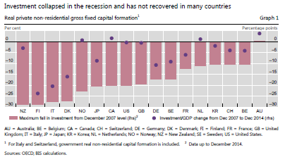
Collapse of Real Investment in Advanced Economies

Slide 26
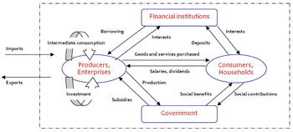
Traditional Shape of Capitalist Economy

Slide 27
New Circuitry of Financialised Capitalism
FOREX 2013: $1,951 trillion
GDP 2013: $75.6 trillion
Trade 2013: $37.7 trillion
Global Financial Markets:
Securities trading; currencies, commodities etc
= Decoupling/ Deformation

Slide 28
The Case for Boosting Investments

Slide 29
Elite explanations of investment slump: Bank for International Settlements
“Despite the easy financial conditions globally, business investment in recent years has been rather weak in advanced economies. Two leading hypotheses have been proposed to account for weak investment: one that the cost and availability of finance remain restrictive, and another that the expected return is not sufficient to justify the risk of irreversible physical investment”. (BIS)

Slide 30
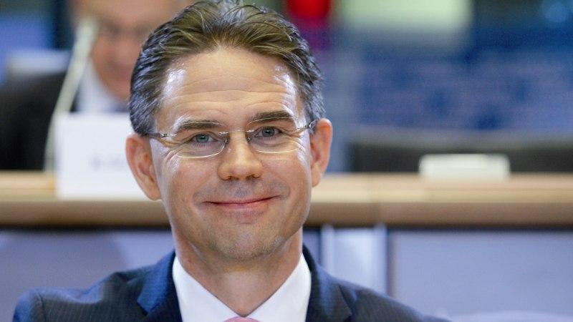
Policy-Makers Explanations: EU
“Research tells us that a major barrier is the lack of risk financing - a lack of certainty regarding investment projects and regulatory burdens”. (Jyrki Katainen, April 2015)
Ergo: reduce risk, remove uncertainty, deregulate

Slide 31
Heterodox views of investment slump
Collapse of aggregate demand – by households, enterprises and public sector
Income and wealth inequalities have grown, weakening mass consumption
Use of existing capacity remains low – chronically low in peripheral economies
Colossal corporate surpluses continue to be attracted to financial ‘securities’; housing, equity AND to market consolidation (M & A) >>
Say’s Law is wrong; demand theory more persuasive

Slide 32
Recovery of Financial (not Real) Investments
 | Nominal GDP 2009-14 Change in percent | Share Price Index Change in percent
United States | +18.2% | Dow Jones: +179%
Britain | +18.2% | FTSE: +128%
Germany | +14% | DAX: +96%
Pension Funds’ and Investment Funds’ “Flight to Safety”

Slide 33
Revival of Financial Investments: Mergers & Acquisitions 2007-2014
Strong evidence for dysfunctional effect of corporate consolidation/ acquisitions

Slide 34
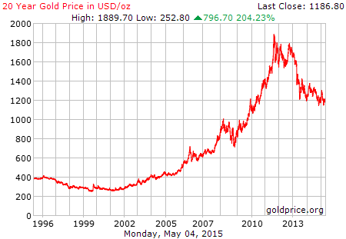
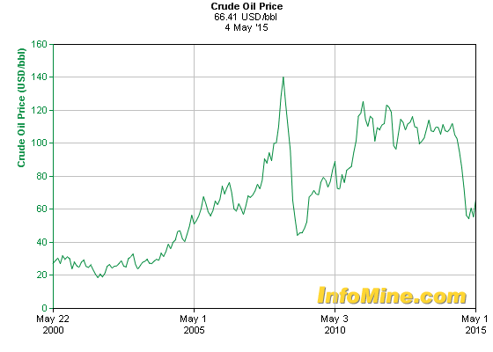
Investment Conundrum Explained
BUSINESS AS USUAL: PREFERENCE FOR FINANCIAL ‘SECURITIES’:
Limited choice of strong Rates of Return >>
Precious Metals (2008-13) & Oil (commodities)

Slide 35
Flight to the Safety of a Bubble
‘Irrational exuberance’ of the financial ‘herd’ chasing returns from fictitious values
IN THE ABSENCE OF BETTER RETURNS FROM REAL INVESTMENT
FACED WITH THE REALITY OF SURPLUS CAPACITY & WEAK DEMAND IN EUROPE
FACED WITH THE NEED TO MAINTAIN INVESTOR LOYALTY:
WHAT DOES A PENSION FUND MANAGER DO??

Slide 36

Behold!! The Juncker Plan
Commission’s recognition of investment gap is correct;
Its diagnosis of our crises does not acknowledge the over-dependence on financialised capitalism. The prescription (the Juncker Plan) therefore ignores key obstacles to a transformed and transforming investment culture.
Much of what financial services do is ‘socially useless’ (Adair Turner)
The diversion of resources by FS is socially destructive

Slide 37
Juncker Plan Transmission Mechanisms
EU/ MS ensure against entrepreneurial risk as incentive to invest (€16 billion)
European Investment Bank provides €6 billion for funding specific projects
Jointly these €21 billion generate €315 + billion in private sector investment activity
Losses from credit financed investments will be made good by EU credit guarantees

Slide 38
Project Selection
€240 billion for infrastructure (transport, healthcare, R&D etc)
€75 for SMEs
MS invited to submit proposals for relevant projects
Co-funding only possible for states with deficit of 3% of GDP or less
Selection of successful projects by ad hoc Investment Committee (strong influence of MS with higher level of co-funding)
Implementation envisaged by end of Latvian presidency

Slide 39
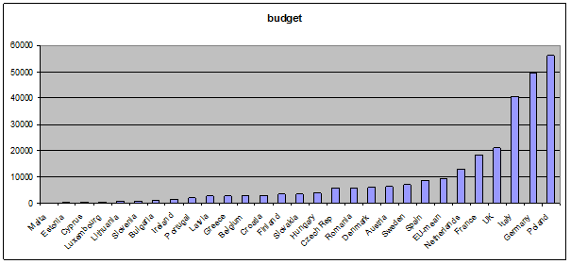
Distribution of Juncker Plan Funding

Slide 40
Provisional Allocations: Centripetal
Bulk of financing goes to Core Economies (Germany, Italy, UK, France, Netherlands): €132 bn
Poland, the Czech Republic, Hungary, Slovakia and Latvia: €75 bn
SEE economies (Rom, Bulg, Croatia): €10 bn
Southern Periphery (Spain, Greece, Portugal, Cyprus): €15.5 billion (c.f. Debruyne)

Slide 41
Continuing non-recovery 2013

Slide 42
Spare Capacity in Majority of EU

Slide 43
Overall and Relative Weaknesses
State | Rate of Youth Unemployment in % | Investment Ratio as % of GDP | Level of Growth/Contraction of GDP 2008-2013
Netherlands | 10.5 | 16 | -4.8
France | 23.2 | 19 | +0.5
UK | 16.9 | 14 | +0.3
Italy | 42.7 | 17 | -5.5
Germany | 7.7 | 17 | +3.1
Greece | 52.4 | 12 | -24.5
Spain | 53.2 | 18 | -6.0
Portugal | 34.8 | 15 | -7.6
Where is the greatest objective macroeconomic need?

Slide 44
Fall in Investment Ratio EU28
2000-2013 (GFCF as percentage of GDP)

Slide 45
Juncker/ Katainen Logic re: Investment Plan
1. Speed/ ease of implementation
2. Effectiveness of financing
3. Absence of risk/ reliability of economic culture
4. Aggregate growth/ multiplier effects
5. Private preparedness to borrow/ invest
= capacity pressures/ productivity pressure
ONLY MARGINALLY PERSUASIVE LOGIC. What is missing???

Slide 46
What is missing from the Plan?
Convergence imperative!! (Regional dimension)
Solidarity dimension
Long-term viability
Demand dimension (Faith in Say’s Law of Supply)
Human and social dimension
A proper public sector planning dimension
New RESOURCES (€16 billion redirected from H2020, Erasmus etc!!!)
Multiplier Delusion: 1:15 very optimistic (1: 1.7)

Slide 47
Conclusions
Baron von Münchhausen Programme (Krugman)
Business as usual, with supply-side delusions
Continued socialisation of risk
Infrastructure investment with monopoly income streams
Perpetuation of a distorted and unsustainable investment culture (hyper-dependence on financial services)
Need to prioritise human welfare as purpose of investment
Restore the active state

Slide 48
Commentary and discussion
Introduction by
- Spain: Patricia Berzunatea (RAIS Fundacion Spain)
- Greece: Evangelia Lyssari (Trade Union Greece)
- Portugal: Sandra Araujo (EAPN Portugal)

Slide 49


Human Rights as stepping stones for a social and democratic Europe
Answers to the social damage of the austerity policy
Alliances to Fight Poverty Seminar
May, 7th 2015
Madrid

Slide 50

Diagnosis
  Crisis affected first housing and financial sectors and then, entire economies. Weakness of the Spanish economy in both aspects.
  Clear impact of austerity in social benefits and in fundamental rights (economic and social rights more affected than others):
    Education: Budget decreased 6,8% in one year compared to 1,1% in EU (Loss of 20,000 jobs in public education).
    Healthcare: Budget decreased 16,3% (2009-2013); 19% reductions of jobs; 5,1% reduction in number of beds available in public hospitals; not universal health coverage anymore.
    Access to justice: 2012: End of free access to justice; 2015: Approval of Royal Decree to remove court fees for individuals.
    Freedom of expression: 2015 “Gag Law” (Citizen Security Act)
    Housing: Increase of foreclosures and evictions (+11,9% in 2014 compared to 2013). Loss of social housing and local allowances.

Slide 51
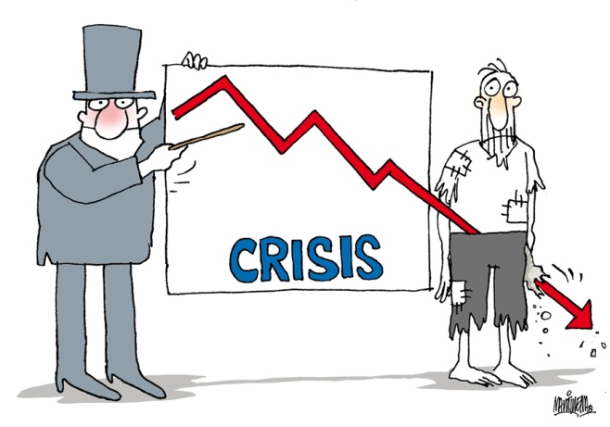
Main challenges:
  High poverty rate : AROPE affecting 28,1% of the Spanish population, especially children, single-parent families and other specific groups: immigrants, Roma, disabled people, homeless...).
  Inequalities: Spain is one of EU countries with highest increase of inequalities. Differences in distribution of rent (comparing 20% with higher income with 20% with lower income) has increased from 5.3 times in 2007 to 6.8 times in 2011.

Slide 52

Actual situation:
  Little progress in improving the situation of low-income households
  Social security system continues to struggle in terms of coverage and efficiency. Limited redistributive effects.
  Persistent unemployment. 740.500 households without any coverage or benefit (double than 2008)
  Education and childcare in early ages hampered by cost and availability of services
  Regional inequalities

Slide 53
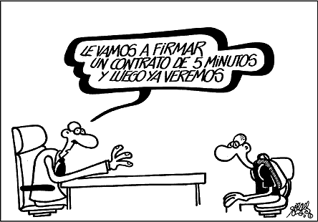
Labour market:
  High unemployment rate: General 23,78%; youth 51,4%
  +9% of long term unemployment (2009-2013): 50,5% women; 48,9 men.
  Benefits of incipient recovery affecting only marginally to disadvantaged groups.
  New contracts borne a major part of adjustment (decrease of wages)
  11,7% of workers are poor (specially
  women, low-skilled and temporary
  workers)
  Inefficiency of public employment
  services.

Slide 54
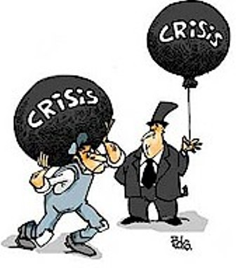
Labour market (2):
  Low mobility rate of workers (“double message” from EU representatives)
  Inefficiency of measures to tackle (youth) unemployment (specially for disadvantaged groups)
  Mismatch between education and employment policies. Increasing inequality gap.
  Drastic reduction in quality of employment
  No response for people away from labour
    market

Slide 55

We need:
  Coherent and balanced policies between structural reforms and investment.
  Political commitment
  To make finance reach the real economy and social protection reach people.
  To tackle inequalities. Duality in: society, access to services and benefits, labour market.
  A democratic change: fight corruption, lack of
  confidence in institutions, go deeper in
  accountability, transparency,
  surveillance... Increase participation.
  A de

Slide 56
We need (2):
  Fair employment and well designed social protection systems:
    Universality of policies and services
    Respond to disadvantage
    Respect the rights of people. Foster their participation
    Use evidence to inform policies
    Support people along the path to employment
  Investments:
    In real economy
    In people
    In social infrastructures
    In social protection
    In active labour market programs
  A de

Slide 57
We need (3):
  Structural reforms: A better context for employment...
    Regulation of financial and housing markets
    Tackle indebtedness and other structural imbalances. Tax justice.
    Avoid segmented labour markets
    Stimulating labour market demand (specially in private sector, given the immense constrictions to public spending): employment subsidies, tax incentives for hiring and training, anti-discrimination laws and promotion of equal opportunities.
    Better spending and additional spending in active labour market programs. Align the proposed €315 billion investment plan with aims to reduce long term unemployment...
    Flexibility for MS to invest. Treating job creation schemes as investments exempt from fiscal rules imposed to MS.
    Guaranteed social transfers, especially for those definitively out of labour market.
  A de

Slide 58

Contact:
Patricia Bezunartea
RAIS Fundación
www.raisfundacion.org
+3491 110 89 84
patriciab@raisfundacion.org
Follow us:
Síguenos en
www.facebook.com/RAISfundacion
https://twitter.com/RAISFundacion
www.youtube.com/user/RAISfundacion
www.linkedin.com/company/rais-fundaci-n

Slide 59
Long term unemployment in Greece.
Investing in the economy, in humans, in society.
Evangelia Lyssari
Social Worker
Job Advisor
Member of Manpower Organization stuff union in Southwest Greece and Peloponnese
Member of Greek Social Workers Action Network

Slide 60
GREECE
Population: 11.030.000
Manpower: 4.862.900
Unemployed: 1.327.900
www.statistics.gr

Slide 61
Main fields of work in 2013 www.statistics.gr
Wholesale and retail trade, repair vehicles and motorcycles
Agriculture, forestry and fishing
Manufacturing.
Public administration and defense compulsory, social insurance
Tourism
Health services
Education
Constructions
Transportation and logistics

Slide 62
Statistics on unemployment www.oaed.gr
February 2010
Unemployed 766.159
Long term unemployed 192.174
percentage 25%
February 2015
Unemployed 1.061.221
Long term unemployed
531.814
percentage 50%
Men unemployed 424.045
Men long term unemployed 191.127
Percentage 46%
Women unemployed 637.176
Women long term unemployed 341.687
Percentage 54%

Slide 63
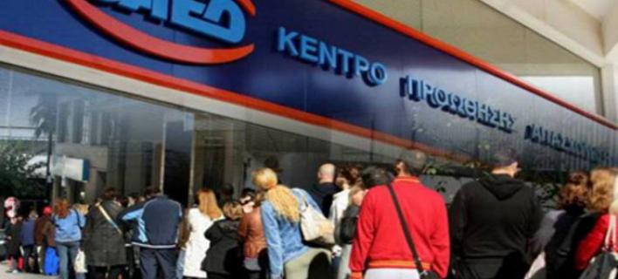
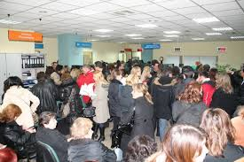
Manpower Employment Organization

Slide 64
What most affected by long-term unemployment?
  Sex: Women, (percentage 54%)
Age: 30 – 44 years old (percentage 38%)
educational level : secondary education, (percentage 48%)
Contrary to what is supported for Europe, in Greece, long-term unemployment affects the most productive age medium educational level, both in absolute numbers and in percentages

Slide 65
Long-term unemployment
First category
Social Exclusion
Diversity
All these people that social conditions keep them far from labor market.
Women
Refugees
Migrants
disabled
former users
people with cultural peculiarities
single parents
people low educational qualifications
ex-convicts

Slide 66
Second category as crisis’ product
The companies they worked closed.
Collective redundancies due to bankruptcy of enterprises
Large industries have moved to other countries
Self closed their businesses due to crisis
Redundant because the position hired a younger with lower salary
They worked in the sectors that affected more from the crisis (construction-automobile –transport)
Farmers that their income is not enough to feed them

Slide 67
What means long term unemployment for the people?
low standard of living
main deficiencies in goods for the children
low standard of health (no prevention/vaccinations)
low self-esteem
family problems (divorce – abuse- alcohol )
depression and suicide
psychological problems
non-active citizens
Social exclusion

Slide 68
What means long term unemployment for the society?
people who can’t pay their taxes
people don’t have social insurance
loss of profits insurance funds
people who can not obtain the necessary
homeless
people who are malnourished or eat from garbage
people with serious health problems
children who faint from hunger at schools
individuals and families in margin
new generation without education
politically spineless citizens
turn to fascism as a tool for fighting the “ethnic injustice”

Slide 69
What happens to the Greek labor market?
European restrictions on the production of the rural economy.
Agricultural products that are paid in too low prices.
Close all industries producing basic necessities or items that enhance the production process (sugar, pasta, clothing, fertilizers)
Abolition of collective agreements
Reduction of basic salary (586,00E per month)
flexible working
closure of SMEs
competition from multinationals
expensive products on the shelves/ high cost of living

Slide 70
What is the labor situation for the workers today, in Greece?
degradation of the Concept of Work
work oriented to quantitative targets
Job loss creativity
underpaid or unpaid workers
feeling of insecurity for workers
unpaid and compulsory overtime
Indirect bullying dismissal
cultivation competitive relationships between employees

Slide 71
How all these problems can be addressed
Investments
infrastructure investment
investment in the real economy
The question is
From whom and for whom,
to what economic system

Slide 72
Investments infrastructure
The previous experience has shown that these sectors of investments product profit only for the investors.
The opinion that offer job to unemployed is rather myth.
They utilize only the skilled artisan, but the workers work hard, many hours with law salary.
The most of big works that were constructive in 2004, (in the context of Olympic games) in Greece, today are abandoned because of the great cost of their maintenance.
Ordinary citizens have economic difficult to use big roads for their daily moving because of the tools.
Even companies avoid to use big roads, because of tools
On the other side, the investors receive profit daily from tolls, fares etc.
The conclusion is that these investments offer more benefits to them, than to society and to citizens. And I’ll give you an example.
Notes:
5/11/2015
Member of Greek Social Workers Action Network

Slide 73
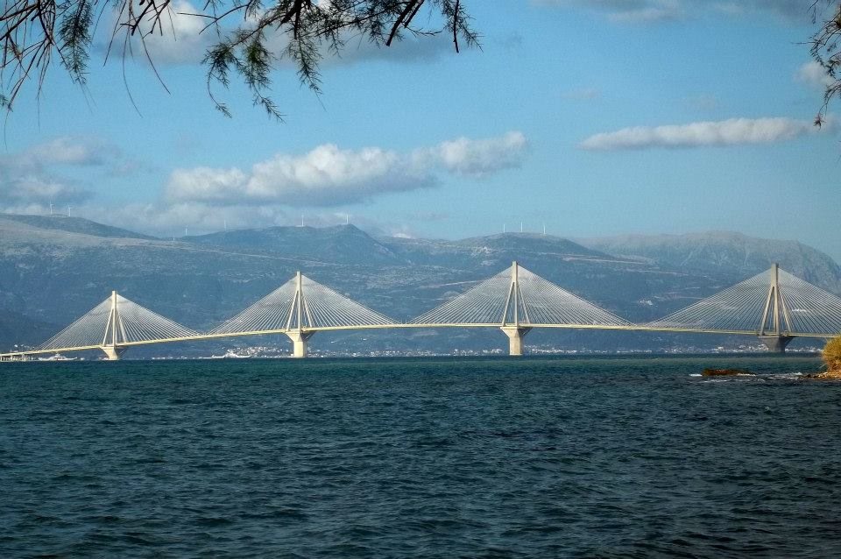
Rion - Antirion Bridge

Slide 74
Investments in infrastructure
It’s the most important work that was constructed in Greece, in 2004
A bridge length 2.8 Km that joins Southwestern Greece
It cost 740.000.000E (10% was paid by manufacturer – 50% was covered by a loan from the European bank with state guarantees – 40% was paid by Greek government)

Slide 75
The manufacturer collects the toll until 2039.
Its net profit calculated to 17500000E annually.
The toll is 26,50E route (go and come back).
The cost is unfamiliar to the average Greek wallet.
So the Greeks often prefer the traditional way to cross the sea. It costs half the amount.

Slide 76
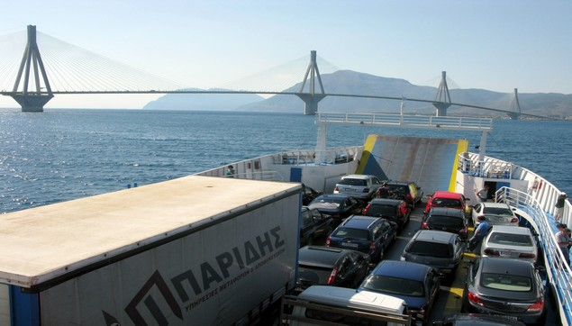

We travel by ferry
But we enjoy a beautiful view

Slide 77
REAL ECONOMY
The part of the economy that is concerned with actually producing goods and services, as opposed to the part of the economy that is concerned with buying and selling on the financial markets.

Slide 78
Investments to real economy
Neoliberal proposals call foreign and local capital to investee in our country utilizing the cheap labor in order to product expensive goods in
Tourism
Education
Health
Communication
Foodstuffs
that the Greeks have not the ability to consume.

Slide 79
What our proposals to survival from the crisis?
Barter economy in solidarity structures
Offer work in solidarity -driven social interest
Exchange products between small producers
Social economy
Cooperative enterprises with the participation of local authorities
Enterprises where every worker will offer within its capabilities
Self-managed production units

Slide 80
In which areas of the economy?
Production and packaging of agricultural products
Recycling
Renewable energy sources
Health and welfare
Shipbuilding
Culture and Sports
Education

Slide 81
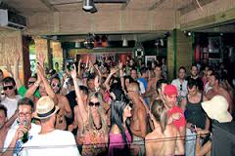

In which areas of the economy?
Until today, Greece is a country that shells sun, sea, food and frenetic entertainment.
Tourism

Slide 82
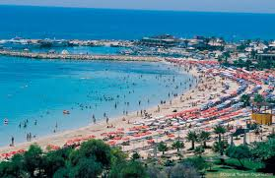

Slide 83
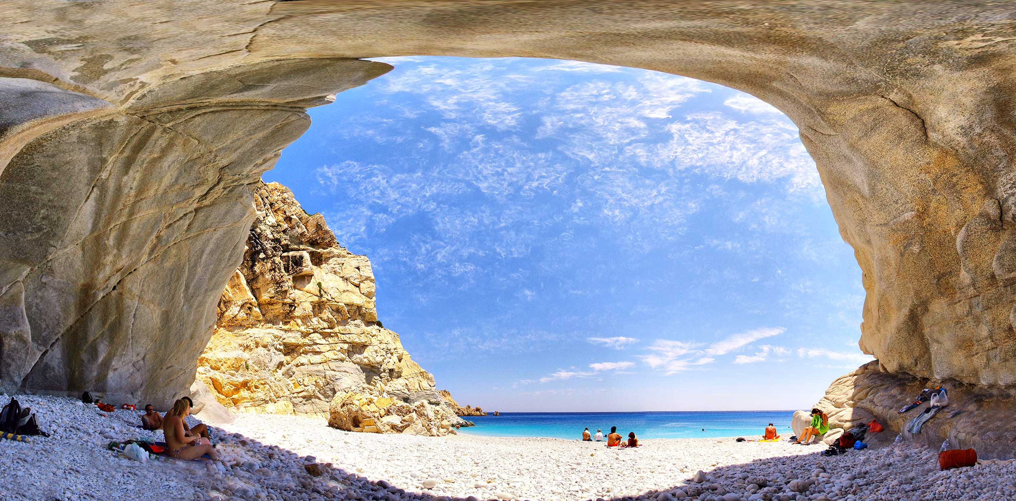

Slide 84
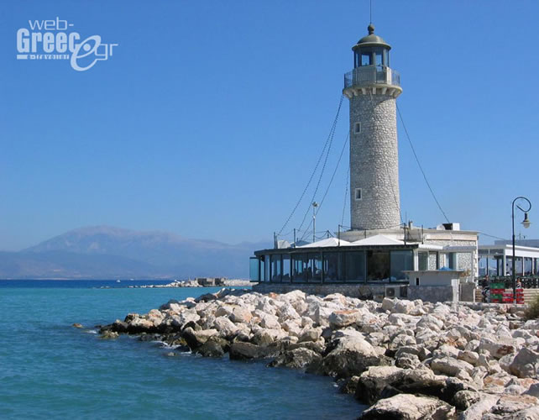

Slide 85
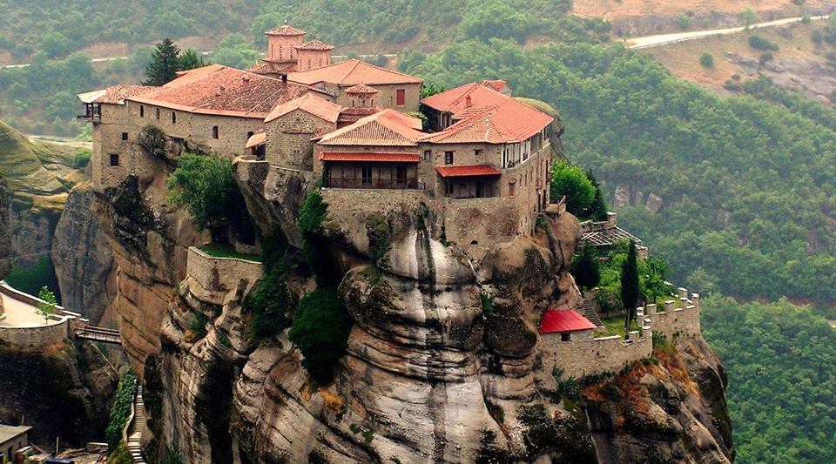

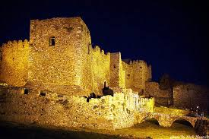

Religion and cultural tourism

Slide 86
What we need?
Adult education especially for long term unemployed in common to obtain skills and positive image for themselves.
Vision - Solidarity - Social cohesion
Anthropocentric economic lives policy
Environmental consciousness
Corresponding friendly markets can afford our products
Partnerships against interventions of raw capitalism

Slide 87
If I had facing me the powerful of Europe will say
Allow us to live independent with justice and we have soul and strength to build a human economy
Thank you

Slide 88


ALLIANCES TO FIGHT POVERTY
Seminar
Human Rights as stepping stones for a social and democratic Europe
Human Rights as stepping stones for a social and democratic Europe
Madrid, 7th May 2015
REDE EUROPEIA ANTI POBREZA

Slide 89
CONTENT OF INPUT
OVERALL APPROACH TO SOCIAL INVESTMENT
RECENT TRENDS AND DEVELOPMENTS IN SOCIAL INVESTMENT
  Early Childhood development
  Policy measures to address social and labour market exclusion
  3. WHAT INVESTMENTS ARE NEEDED? SOME PROPOSALS.

Slide 90
OVERALL APPROACH TO SOCIAL INVESTMENT ____________________________________________
The SIP highlights:
The contribution of social policies to economic growth as well as protecting people from poverty
Welfare systems fulfil three functions: social investment, social protection and stabilization of economy.
Mutual reinforcement of social and economic policies
Strengthening people´s current and future capacities, to “prepare” people to confront life’s risks; enhancement of peoples capacity to participate in social and economic life and in labour market
The complementarity of policies in the following areas: education and care, ALMP, education, retraining and life long learning, healthcare, social services, housing support.

Slide 91
OVERALL APPROACH TO SOCIAL INVESTMENT
____________________________________________
JUNCKER PLAN - An Investment Plan for Europe
First priority is to strengthen Europe's competitiveness and to stimulate investment for the purpose of job creation.
Based on three mutually reinforcing strands:
  The mobilization of finance (at least EUR 315 billion) over the next three years, for public and private investment.
  Making finance to reach the needs of the real economy.
  Improve investment environment.
The European Fund for Strategic Investments will support strategic investments of European significance in infrastructure, notably broadband and energy networks, as well as transport infrastructure, particularly in industrial centers; education, research and innovation; and renewable energy and energy efficiency.

Slide 92
OVERALL APPROACH TO SOCIAL INVESTMENT
____________________________________________
Although all the investment that leads to job creation is welcome, there is a lack of human and social dimension in the Plan.
The question is not only to promote economic growth and job creation but also more and better jobs, higher wages and the protection and improvement of public services and social functions of the state, and at the same time promote a fairer distribution of income, combating inequalities and poverty.
The plan may contribute to accentuate the peripheral nature of the Portuguese economy, the divergence with the other EU countries and the inequalities, and the increasing subordination of national sovereignty to the interests of large economic and financial groups.

Slide 93
RECENT TRENDS AND DEVELOPMENTS IN SOCIAL INVESTMENT
____________________________________________
The impact of the crisis on Portugal was very severe; unemployment has more than doubled since 2008, emigration has reached recorded numbers (more than 300,000 people have left the country in the last 3 years, and the GDP shrank back to 2000 levels.
Policies introduced to response to the economic crisis have compromised the implementation of social investment approach in such areas like: early childhood development, ALMPs, access to healthcare, family support policies.
Were made cuts in some social investment policies: social insurance and income support, ALMP, child and family policies, education and access to health care.
There is a lack of assessment of the social consequences of fiscal consolidation, seen as a “social disinvestment”

Slide 94
RECENT TRENDS AND DEVELOPMENTS IN SOCIAL INVESTMENT
____________________________________________
  Early Childhood Development
  Both the crisis and the austerity measures are causing regressions that affect children´s fundamental rights to health, education, housing and feeding.
  There have been significant cut-backs or increased conditionality and means-testing attached to family benefits
  Child population recorded the highest increase in the risk of poverty or exclusion, going from a rate of 27.8% in 2011 to 31.6% in 2012. This risk for the whole population was around 27.4%.
  The State´s expenditure on education has been visibly reduced, children with special needs or learning disabilities have been particularly affected and the number of school dropouts has increased.

Slide 95
RECENT TRENDS AND DEVELOPMENTS IN SOCIAL INVESTMENT
____________________________________________
  Early Childhood Development
  School´s resources have been affected and the working conditions of teachers are also more difficult than a decade ago.
  Family allowances have also been reduced and half a million children have lost the right to receive it, under the new eligibility criteria, during the last 5 years.
  The economic crisis strengthened “compulsory familialism” since households are obliged to ensure mutual aid especially towards children (but also towards the elderly)

Slide 96
RECENT TRENDS AND DEVELOPMENTS IN SOCIAL INVESTMENT
____________________________________________
  LABOUR MARKET PARTICIPATION
  The right to work has probably been the most affected fundamental right. It has been affected both by the crisis (rise of unemployment) and by austerity measures (e.g. pay cuts, reduction of severance payments and an increase in working hours without additional pay).
  The right to holidays and the right to collective bargaining, as well as the right to social security were also affected. The number of paid days of leave has been reduced, the rules of receiving unemployment benefits, the Social Insertion Income and family allowances have been changed and are more strict.
Notes:
The unemployment rate was 13.9% in 2014, a decrease of 2.3 percentage points compared to 2013 and an increase of 1.2 pp compared to 2011, the year of the bailout to Portugal. Unemployment continues to cover a higher proportion of women (14.3%) than men (13.5%).In 2014, more than a third of young people aged 15 to 24 who were available to work were unemployed (34.8%).

Slide 97
RECENT TRENDS AND DEVELOPMENTS IN SOCIAL INVESTMENT
____________________________________________
  LABOUR MARKET PARTICIPATION
Source: INE, Employment Statistics– 4º Trimester de 2014
Notes:
Between 2008 and 2013 more than 500,000 jobs were eliminated.
The numbers f unemployed are one of the country´s main concerns.
The unemployment rate was 13.9% in 2014, a decrease of 2.3 percentage points compared to 2013 and an increase of 1.2 pp compared to 2011, the year of the bailout to Portugal. Unemployment continues to cover a higher proportion of women (14.3%) than men (13.5%).In 2014, more than a third of young people aged 15 to 24 who were available to work were unemployed (34.8%).
Long Term unemployment is clearly rising.
The figures would be even higher if one took into account those who left the category of active population, due to emigration and the discouraged, those who stop looking for a job.
Salaries also decreased (around 10% between 20110 and 2013
Poverty rate

Slide 98
RECENT TRENDS AND DEVELOPMENTS IN SOCIAL INVESTMENT
____________________________________________
  LABOUR MARKET PARTICIPATION
Source: EU – SILC: Living Conditions Survey
Po – Provisional Value
Notes:
In 2013, 10.7% of workers were in poverty vulnerability.
Since 2011, the year of entry of the troika in Portugal, the risk of poverty among the population with employment increased.
Despite the high percentage of working poor, is with the unemployed population vulnerability to poverty is higher (24.7%). It is important to note that in 2013, 40.5% of the unemployed and 32.4% of "other inactive" were at risk of poverty. Since 2011, the poverty risk rate increased 2.1 percentage points to the unemployed and 3.2 pp for the other inactive.
Families incomes significant fall, and although the fall of the medium income caused a decrease in the poverty threshold the poverty rate has also increased
The poverty rate is one of the highest in the EU, mainly due to the high number of woorking poor (around 10%) and the high unemployment rate (the poverty among the unemployed is around 40%

Slide 99
RECENT TRENDS AND DEVELOPMENTS IN SOCIAL INVESTMENT
____________________________________________
  POLICY MEASURES TO ADDRESS SOCIAL AND LABOUR MARKET EXCLUSION
  Unemployment benefits
  The support system in unemployment in Portugal assent into two main components: the unemployment benefit and unemployment assistance.
  New rules on the granting of unemployment benefits:
  reducing the maximum amount (decreased from 1258 to 1,047 euros),
  10% cut after the first 6 months,
  change of maximum unemployment benefit duration: the minimum 9 to 5 months and the maximum of 38 to 26 months for older workers and longer contributory careers.
Notes:
The number of citizens that not receive any kind of unemployment benefits or other State aid risen by more 250,000 between 2011 and 2012

Slide 100
RECENT TRENDS AND DEVELOPMENTS IN SOCIAL INVESTMENT
____________________________________________
  POLICY MEASURES TO ADDRESS SOCIAL AND LABOUR MARKET EXCLUSION
  Minimum Income
  The changes in the SII profoundly altered the eligibility requirements of the programme, the amounts earned by the beneficiaries and the effectiveness of the measure to combat situations of extreme poverty.
Notes:
Since 2009 and pressured by increasing expenditure and consolidation policies, the protection mechanisms are facing several reductions with conditionality becoming stricter. Benefits like Social Insertion income were affected by a reduction in the number of recipients and in the amount received.
Between 2010 and 2013, the number of beneficiaries decreased from 526 013 to 360 153. In http://www.seg-social.pt

Slide 101
RECENT TRENDS AND DEVELOPMENTS IN SOCIAL INVESTMENT
____________________________________________
  Minimum Income
  The base amount of SII decreased from €189.52 in 2010 for €178 in 2014.
  The average value allocated to a family and an individual has also been declining:
Notes:
Social Insertion Income (SII) has a time length of 12 months and can be renewable upon request of the beneficiary. The application for the renewal must be made two months before the end of the support through the delivery of the application form and, in cases of changes in the household situation, these evidences must be presented.
The Social Insertion Income can end at any moment if some conditions are not fulfilled. Some of these conditions are:
Unjustified noncompliance with insertion contract;
If the household doesn’t report, within 10 days, any change (income, household composition, or other) that can modify the value of the benefit, the benefit can be suspended. The suspension also takes place if the household doesn’t report an address change. After 90 days of suspension, if the household continue to not report these changes, the subsidy ends;
Unjustified nonattendance to any meeting invited to;
False declarations;
A very simple example illustrates the scope of these changes. In early2010, a couple with 2 young children was eligible for SII if they had a monthly income of up to 559 euros. In August 2012, the same couple only be eligible if it had na income under 398 euros.

Slide 102
RECENT TRENDS AND DEVELOPMENTS IN SOCIAL INVESTMENT
____________________________________________
  POLICY MEASURES TO ADDRESS SOCIAL AND LABOUR MARKET EXCLUSION
  ALMPs
  4 Policy areas: training, qualification and employability; flexibility, mobility and transition; entrepreneurship and job creation and economic and social integration of risk groups and disadvantaged.
  The expenditure has decreased on protection (work experience programs), investment (training) and re-commodification (job subsidies).
  Focus of Public Employment Services on “reactive” rather than “proactive” measures.
  Lack of comprehensive and integrated ALMPs strategies and insufficient coordination between social and employment services.

Slide 103
RECENT TRENDS AND DEVELOPMENTS IN SOCIAL INVESTMENT
____________________________________________
  POLICY MEASURES TO ADDRESS SOCIAL AND LABOUR MARKET EXCLUSION
  ALMPs
  Activation principle: the right to be helped implies a corresponding duty to contribute to a socially useful activity, that is, the state should require something in return for the help it provides.
  The requirement to fulfill this duty can put a serious problem of social control and marginalization if the state requires something disproportionate in exchange for his help. This is where that requirement would result in a “blind compulsion” of assisted to work just to justify the grant that grants them.

Slide 104
RECENT TRENDS AND DEVELOPMENTS IN SOCIAL INVESTMENT
____________________________________________
  POLICY MEASURES TO ADDRESS SOCIAL AND LABOUR MARKET EXCLUSION
  ALMPs
  A negative aspect to note is that active policies are accompanied by elevated obligations for the unemployed, and tend to blame them for their exclusion.
  In addition they raise serious labour rights issues. Often, who is participating in activation projects does not enjoy the same rights as other workers regularly employed, namely to negotiate the content, time and working conditions. Finally, they tend to generate a secondary labour market, merely temporary occupations and jobs unsuitable to lead the effective occupational integration of workers activated .
  Occupational trajectories of the activated workers results in an endless sequence of precarious occupations.

Slide 105
RECENT TRENDS AND DEVELOPMENTS IN SOCIAL INVESTMENT
____________________________________________
  POLICY MEASURES TO ADDRESS SOCIAL AND LABOUR MARKET EXCLUSION
  Social Services
  New trends are directly impacting on the quality of the services provided, including the reduction of costs linked to service provision, the shortage of skilled workers, poor working conditions in the services sector, and the growing demand for social and health services due to social and demographic changes and the crisis.
  Social, health and education services are provided by public authorities, not-for-profit NGOs and commercial providers
  Increased contracting out of services to the private sector

Slide 106
WHAT INVESTEMENTS ARE NEEDED?
SOME PROPOSALS
____________________________________________
  The priority given to deficit reduction has to be balanced with the need to maintain the minimum standards of social services, deserving special attention in health and education.
  It is necessary to increase public investment in education.
  The adoption of policies to improve the right to healthcare and to promote equality in access to healthcare (assessing and reviewing the norms regulation health fees and exemptions, transportation and the distribution of NHS).
  Active policies to promote employment are needed, especially policy that take into account the needs of small and medium enterprises and give particular attention to very vulnerable groups (like young people).
Notes:
Education: to reduce the maximum number of studentes per class, invest in special education and to increase the support given to students with special needs, a field where austerity measures have had especially serious effects.

Slide 107
WHAT INVESTEMENTS ARE NEEDED?
SOME PROPOSALS
____________________________________________
  To promote stable working contracts, rather than temporary jobs, which have been one of the most tendencies of the Portuguese LM.
  To address issues like: false independent labour and non declared work, and an assessment of the results of labour law reforms (new flexibility measures, easier termination of contracts and reduction of severance payments).
  Reinforcement of social protection mechanisms, a review of rules of attribution of several social benefits and an increase in the State´s support to the families.
Notes:
Education: to reduce the maximum number of studentes per class, invest in special education and to increase the support given to students with special needs, a field where austerity measures have had especially serious effects.

Slide 108
WHAT INVESTEMENTS ARE NEEDED?
SOME PROPOSALS
____________________________________________
  A review of the current legal regime of Minimum Income would be of great importance in order to allow to meet the basic needs to live a decent life – approaching the concept of “adequate income”.
  Investments in social protection and public health can no longer be seen only as cost, but also as an important factor of economic recovery!
  The belief that, by means of economic growth, resolve the remaining problems of society is a gross deception in societies like the Portuguese, where by default the power inequality, only a few benefit from the wealth generated.
  Job creation which appears as one the flags of the Europe 2020 cannot be the only way to solve the problems of poverty and social exclusion, because Portugal has one of the highest rates of working poor in Europe!
Notes:
Education: to reduce the maximum number of students per class, invest in special education and to increase the support given to students with special needs, a field where austerity measures have had especially serious effects.

Slide 109
Thank you for your attention!
EAPN PORTUGAL
RUA DE COSTA CABRAL Nº 2368
4200 -218 PORTO
TEL: 225420800 – FAX: 225403250
www.eapn.pt

Slide 110
discussion

Slide 111
Naia bistro: plaza de la Paja 3

Slide 112
An alternative social program for Spain
Nacho Alvarez (University of Valladolidad, Spain) and member of Podemos

