Slide 1
Human Rights as stepping stones for a social and democratic Europe
Madrid, 8th of May 2015

Slide 2
Introduction
Michel Debruyne, Beweging.net

Slide 3


The Alliances and RE-InVEST
Informal
Open
Promoting the idea of coalitions to fight poverty
Formal
Closed
Enriching the social investment package

Slide 4
The European Semester 2014-2015: facts and figures
Michel Debruyne and Peter Lelie

Slide 5
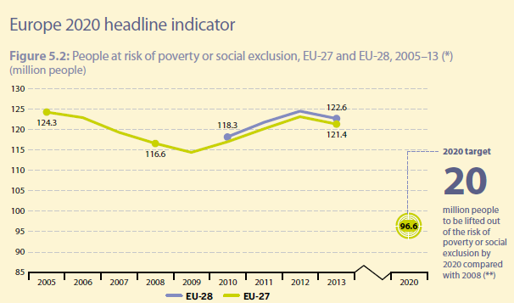
2020 target on poverty and social exclusion

Slide 6
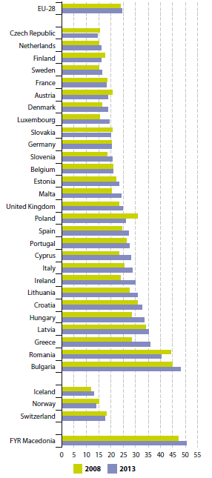

Evolution of risk of poverty or social exclusion by country
2008: 30%
2013: 33%

Slide 7
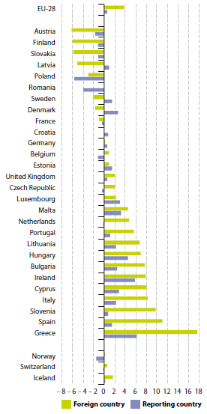

Who is paying the crisis?

Slide 8
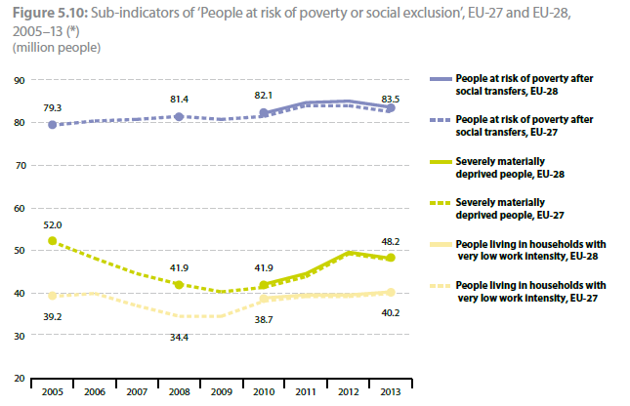
Evolution of the sub-indicators of ‘people at risk’

Slide 9
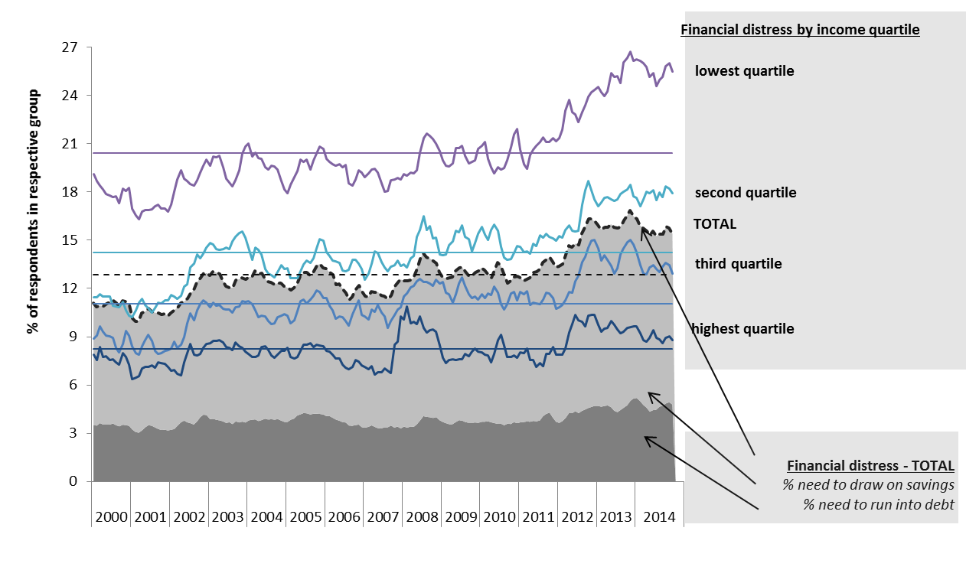
Financial distress by income quartile 2000-2014

Slide 10
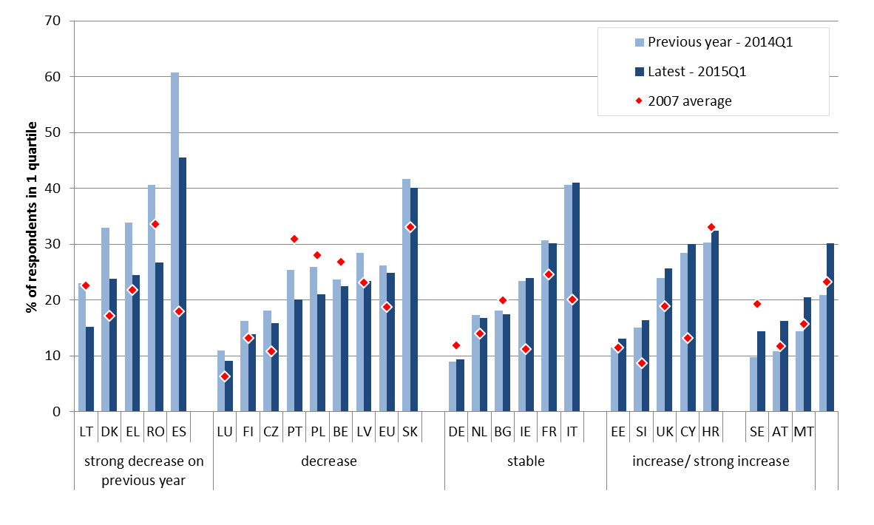
Financial distress (1 income quartile households) in the EU Member States, 2015Q1

Slide 11
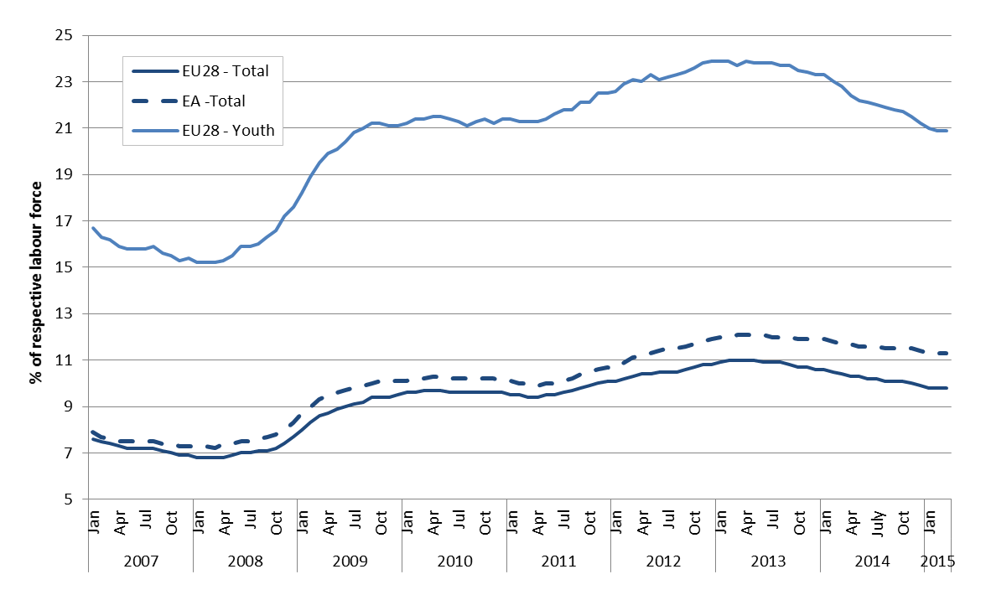
Unemployment rate (total and youth) in the EU and EA

Slide 12
Long-term unemployment rates EU28, 2008-2013

Slide 13
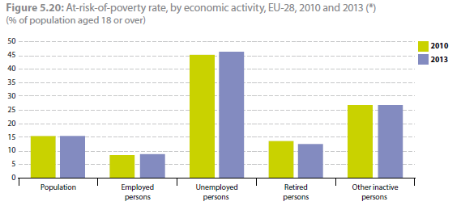
At-risk-of-poverty rate by economic activity

Slide 14
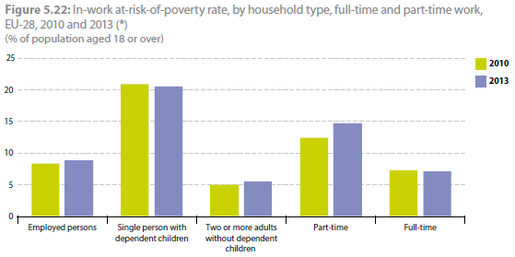
In-work at risk-of-poverty rate

Slide 15
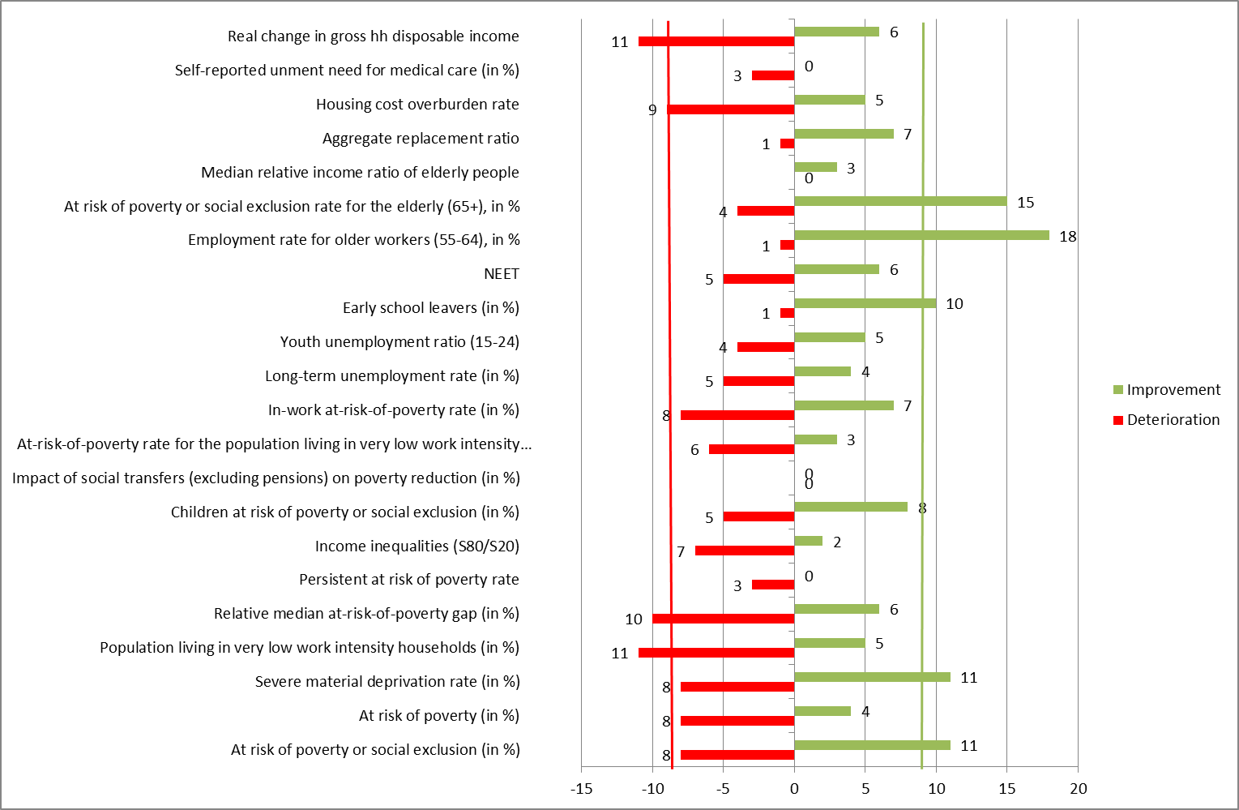
Number of MS showing significant improvements/deterioration in key social indicators (2012-2013)

Slide 16
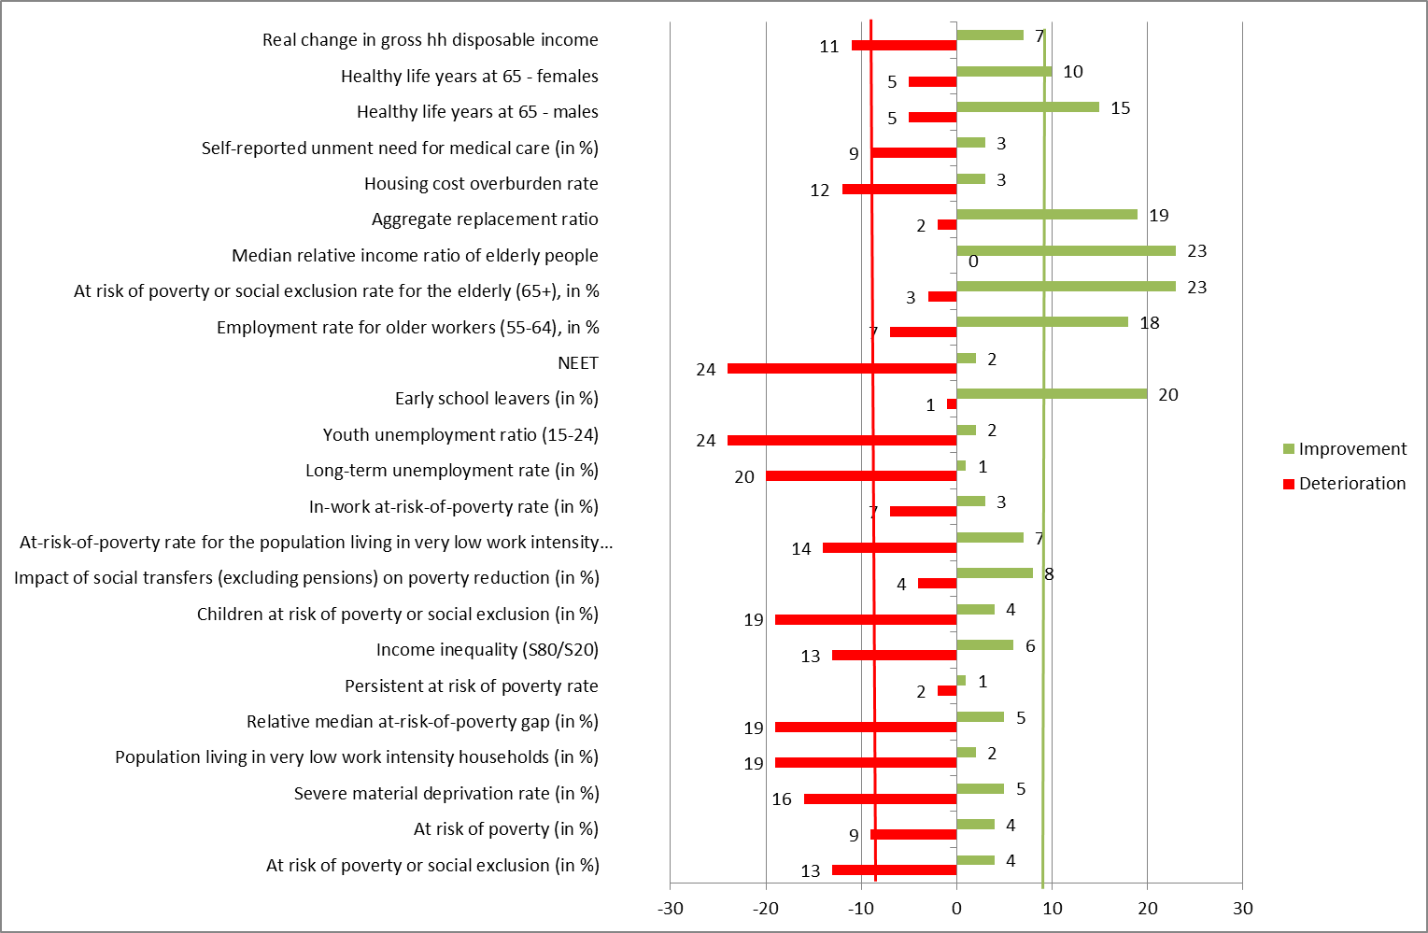
Number of MS showing significant improvements/deterioration in key social indicators (2008-2013)

Slide 17
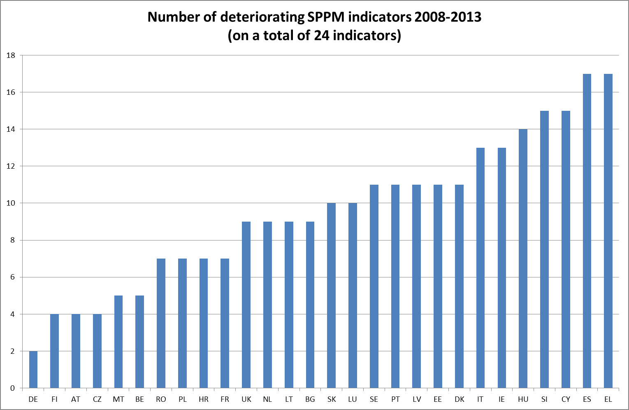
Number of deteriorating SPPM indicators 2008-2013

Slide 18
Conclusions

Slide 19
A social and democratic agenda for the European Semester
Introduction by prof. dr. Jonathan Zeitlin (University of Amsterdam)

Slide 20

Socializing and Democratizing the European Semester
Jonathan Zeitlin
University of Amsterdam
November 2014

Slide 21
Plan of the presentation
I. Socializing the European Semester: significant rebalancing since 2011…
II. But still a participatory deficit
III. Towards better governance: parity, process, participation
IV. New developments: further socializing the European Semester?

Slide 22
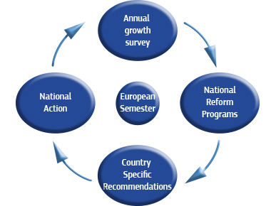
I. Socializing the European Semester

Slide 23
Europe 2020: towards a more social EU?
Europe 2020 Strategy, adopted by EU in 2010, was designed to have a stronger social dimension, compared to Lisbon Strategy for Growth & Jobs (post-2005)
  ‘Inclusive growth’ as one of 3 overarching priorities
  EU-wide poverty reduction goal as one of 5 ‘headline targets’
  ‘European Platform against Poverty’ (EPAP) as one of 7 ‘flagship initiatives’
  ‘Promoting social inclusion & combating poverty’ as one of 10 integrated guidelines

Slide 24
The European Semester as a new post-crisis governance architecture for the EU
EU institutions (COM, Council, European Council) set priorities for the Union in Annual Growth Survey (AGS), review National Reform Programmes (NRPs), & issue Country-Specific Recommendations (CSRs) to Member States (MS), backed up in some case by potential financial sanctions
Brings together in a single annual policy coordination cycle a wide range of governance instruments with different legal bases & sanctioning authority
  SGP, MIP, Integrated Guidelines, Europe 2020 objectives & targets
Process has given EU institutions a more visible & intrusive role than ever before in scrutinizing & guiding national economic, fiscal, & social policies

Slide 25
Founding ambiguities of Europe 2020
Relationship between fiscal/macroeconomic surveillance & thematic coordination?
Role of social & employment actors in European Semester?
Future of the Social OMC?
Poverty/social inclusion goals inserted in Employment Guidelines despite different Treaty base & powers

Slide 26
Initial experiences: worst fears confirmed?
COM disinvestment in Social OMC
  MS no longer requested to produce National Social Reports; COM withdraws from Joint Social Report – exclusive focus on Europe 2020
  EPAP created w/o consultation w/ social actors, & largely repackages pre-existing initiatives (e.g. annual Convention)
First European Semester (2011)
  AGS & CSRs focus on fiscal consolidation
    Emphasis on financial reform of pensions & health care;
    benefit conditionality & ‘making work pay’
    Only 3 CSRs on poverty/inclusion, all to NMS, despite weak national targets
  Prescriptive ‘one-size-fits-all’ approach
    COM seeks to use multilateral surveillance by MS as a tool for additional peer pressure in implementing top-down structural reforms
    Social actors largely excluded from preparation & review of NRPs/CSRs

Slide 27
Rebalancing 2012-14: policy orientations
Annual Growth Survey
  ‘Tackling unemployment & social consequences of the crisis’ added as a key priority
  Focus on education, training, individualized activation services
  Emphasis on improving effectiveness of soc protection systems
  Active inclusion as a vital policy tool for addressing social consequences of the crisis
Employment Package, Compact for Growth & Jobs, Youth Employment Package, Social Investment Package
  New policy commitments, financial measures, recommendations, reporting/monitoring procedures

Slide 28
Rebalancing 2012-2014: progressive socialization of CSRs
2014: 12 MS receive CSRs on poverty/social inclusion
  11 MS receive recs to ensure adequacy & coverage of social benefits; 6 urged to improve accessibility & quality of public social services
19 receive CSRs on health care &/or pension reform
  Purpose is to ensure that systems ‘continue to be socially adequate’ & ‘to provide universal access to high-quality care’, as well as cost-effective & financially sustainable
Still some ‘anti-social’ recommendations
  e.g. decentralization of wage determination (6 MS ); EPL reform (2); unemployment benefit conditionality (1)
But overshadowed by much larger number of positive CSRs, many focused on social investment
  Most MS urged to improve ed, training, & activation systems; many to reduce early school leaving (8); improve skills (12); implement youth guarantee (8); enhance ed outcomes & lab mkt access for disadvantaged groups (7); increase availability of childcare (9); promote employability of older workers, e.g. through lifelong learning (11)

Slide 29
Reviving the Social OMC
2011 Social Protection Committee (SPC) initiative to ‘reinvigorate’ Social OMC
  Endorsed by EPSCO Council
  Update common objectives, continue regular strategic reporting, enhance mutual learning, strengthen analytical capacity (indicators), improve stakeholder involvement
  MS invited to prepare regular NSRs, covering all strands of Social OMC, as input into annual SPC Social Report
  Annual SPC Social Europe Report w/ same core features as previous JSR, feeds into Joint Employment Report

Slide 30
Extended social monitoring
SPC has also established itself as a key player in monitoring, reviewing & assessing nat’l reforms w/in the Euro Semester, alongside EMCO, EPC, EFC
  Contributes with EMCO to Joint Assessment Framework (JAF) for monitoring EU Employment Guidelines
  Developed its own Social Protection Performance Monitor
    Complements EMCO Employment Performance Monitor
    ‘Dashboard’ of indicators to monitor social dimension of Europe 2020 across all OMC strands
    Detailed country profiles & common ‘trends to watch’
  Social indicators inserted into MIP and new EU ‘Social Scoreboard’

Slide 31
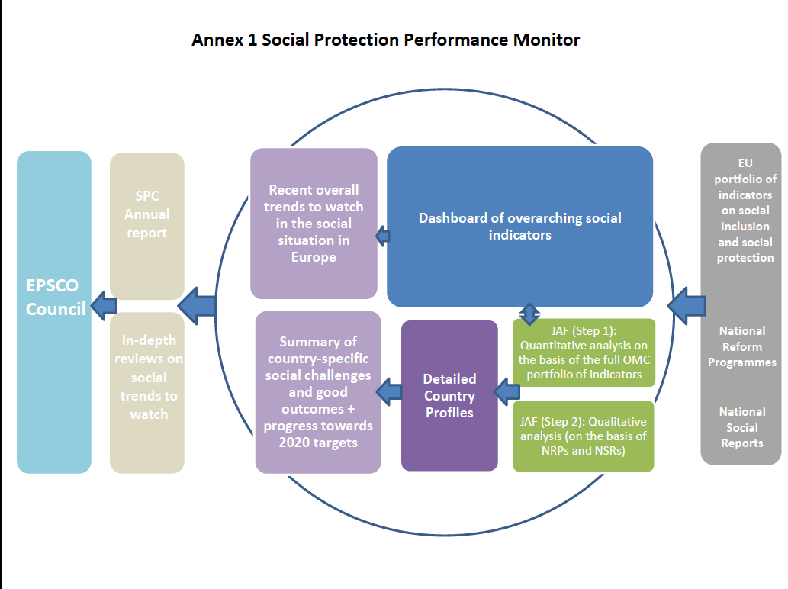

Slide 32
Intensified multilateral surveillance
& peer review
From shallow annual reviews of NSRs to continuous, in-depth thematic & country reviews of NRPs/CSRs
  Emphasis on providing opportunities for mutual learning while building support for reform implementation through MS challenging each other
Innovative pilot programs of ex ante review of major social reforms, linked to voluntary peer reviews
Parallel developments in SPC and EMCO

Slide 33
Enhancing the influence of social
& employment actors
Intensified monitoring, multilateral surveillance, & peer review → enhanced role for social & employment actors in adoption of CSRs, culmination of European Semester
Multilateral examination of COM’s draft CSRs by EMCO & SPC→ successfully proposing amendments to Council, despite high hurdle of qualified majority voting (QMV)
Mobilization by EPSCO over ‘political ownership of social issues’ & push back against over-prescriptive COM approach
  ‘MS need some leeway to choose the implementation path that best suits their national conditions, especially in areas which remain within their competence’
  ‘deeper dialogue’ between COM & MS, ‘both bilateral & multilateral, is essential to ensure CSR quality & ownership’ (Presidency Report to Council 2012)

Slide 34
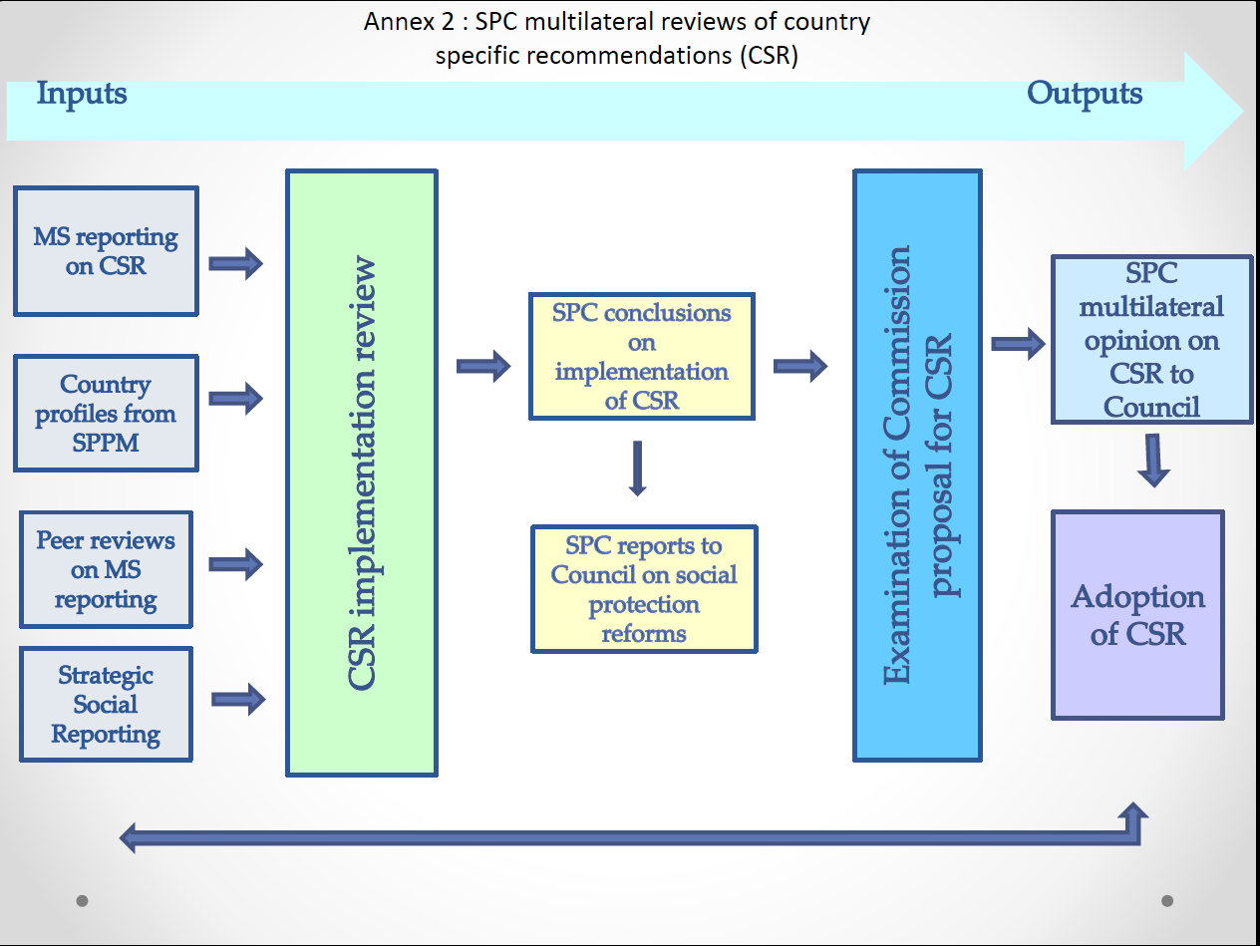

Slide 35
Towards a revised procedural framework for the European Semester
Revised procedural framework for 2013 ES, based on clearer allocation of responsibilities and cooperation between economic, social & employment ctees
  Coordinated review of CSR implementation & draft CSRs by SPC in cooperation with economic and employment committees (EMCO, EPC, EFC), & Council WPPHSL on health care issues
  Amendments justified by results of multilateral surveillance, & supported by QMV to test MS support
  SPC & EMCO produce formal reports on CSR examinations to meet Council’s ‘comply or explain’ obligations for modifying COM’s proposed recommendations
New procedural arrangements reaffirmed, despite some coordination glitches, in 2014

Slide 36
Gradual if partial ‘socialization’ of the European Semester
Growing emphasis on social objectives & targets in CSRs
Intensified social monitoring, multilateral surveillance & peer review
Enhanced role for social & employment actors in EU coordination processes and procedures
  despite continuing jurisdictional struggles with economic policy actors about overlapping issues
  (esp. linked to MIP)
Increased capacity of SPC & EMCO to amend COM draft CSRs, based on evidence from MLS

Slide 37
II. But still a participatory deficit
Limited involvement of civil society & other stakeholders in (social partners, LRAs) in preparation of NRPs
  Despite recital 16 of Empl Guidelines & guidance note from COM SECGEN on preparation of NRPs
Little opportunity for stakeholder input into multilateral reviews of NRPs/CSRs, or annual priority setting (AGS)
Agenda of EPAP Convention & stakeholder dialogues tightly controlled by COM
Deficit recognized by EPSCO conclusions (June 2013)
  Need to improve involvement of civil society & social partners in CSR process ‘in order to ensure broader social acceptance of reforms’

Slide 38
Eppure si muove?
Some signs of movement even on nat’l participation front
COM Social Investment Package earmarks 20% of ESF funds for ‘promoting social inclusion & combating poverty’
Access conditional on preparation of national poverty reduction strategies involving key stakeholders
Evidence that civil society networks in some countries are using this commitment to enhance their involvement in NRPs
  E.g. Poland
Other positive examples of engagement by CSO platforms with preparation of NRPs where government channels are open to them (e.g. ES, FR, IE, SK) -- interest is clearly there

Slide 39
III. Towards better governance
Mid-term review of Europe 2020 & advent of a new Commission offers an opportunity to build on recent developments within the European Semester to ensure that the EU’s post-crisis governance architecture continues to become more socially balanced, contextually sensitive, & learning-oriented
Exploit common ground among EU social actors:
  EMCO/SPC, EPSCO, Semester Alliance/EAPN, DG EMPL
3 ‘P’s: parity, process, participation

Slide 40
Parity
Need for a better balance between the EU’s social, economic, & financial objectives
Refocus the European Semester on delivery of Europe 2020 objectives of smart, sustainable, & inclusive growth, as well as soc, ed, & empl targets
Adopt an integrated & holistic perspective on national reforms in CSRs & COM Country Reports, incl social impact assessment (SIA)
Ensure parity for EU social & employment policy actors -- and indicators -- with their economic counterparts in Semester governance
  Reinforce role of ‘Social Scoreboard’ as an early warning system for social imbalances within and beyond the Eurozone

Slide 41
Process
Institutionalize revised procedural framework for ES, based on a clearer allocation of responsibilities & cooperation between ec, soc, & empl committees
  Allocation of roles should be based on substantive expertise & competences rather than formalized procedures (e.g. MIP)
  Overlapping issues should be jointly reviewed, with decisions based on evidence and argument rather appeals to authority
Orient ex post multilateral surveillance of NRPs & CSRs towards effective mutual learning as well as compliance enforcement, & link it to ex ante reviews of proposed reforms
Ensure that CSRs leave sufficient space for MS to find their own ways of meeting reform challenges, while providing operationally useful guidance in helping them do so

Slide 42
Participation
Need for greater participation by civil society actors in ES at both EU & national levels
Provide stronger guidance to MS about stakeholder participation in drafting & implementation of NRPs
Exploit ESF requirements for preparation of national poverty reduction strategies to encourage stakeholder engagement
COM & Council (+ EU committees) should take the lead in opening opportunities for civil society participation at EU level in each phase of the Semester, from AGS → NRP/CSR review → CSR adoption
Involvement of non-gov stakeholders with direct experience of policy implementation can make a distinctive contribution to the epistemic quality of the ES as an ‘evidence-based’ process, beyond that of COM & committees of MS officials
Like other process improvements, this requires a more realistic timetable for deliberation & revision of key texts (AGS, CRs, NRPs, CSRs)

Slide 43
A renewed role for the EPAP?
Added value of the EPAP widely questioned
  A platform in search of a purpose
Integrate EPAP into the European Semester
  Task it with following up, monitoring, & reviewing progress on social dimension of Europe 2020, at nat’l & EU levels
  Support structured consultation process for stakeholder input into NRPs through creation of national platforms
  Contribute to EU multilateral surveillance & peer review of NRPs/CSRs, by engaging SPC/EMCO as well as COM
  Transform the Convention into the capstone of the annual cycle, through stocktaking & reporting, exchange of good practices, identification of promising approaches to common problems, & debate on ways forward
  Redraw the flow chart of the European Semester to include civil society actors

Slide 44
IV. New developments: further socializing the European Semester?
The new Commission’s ambiguous stance
A revised timeline for the Semester
An enhanced role for EPSCO & its committees
Amending the Integrated Guidelines
Further socializing the European Semester

Slide 45
The ambiguous stance of the new Commission
Juncker’s commitments to ‘Social AAA’, SIA, social dialogue
Annual Growth Survey
  Does not prioritize inclusive growth
  Messages on fighting unemployment & modernizing social protection acknowledge need to combine efficiency & financial sustainability with adequacy of benefits & enabling services
  Proposes to open up Semester process to dialogue w/ parliaments & SPs – but not civil society (wh/ should be more involved in implementation)
Draft Integrated Econ & Empl Guidelines
  Build directly on key messages of 2015 AGS
  Less direct emphasis on fighting poverty & fostering social inclusion than in 2010 Guidelines
  Recitals call for partnership in implementation w/ parliaments, local/regional authorities, social partners, & civil society, but less broadly than in 2010
    no reference to involvement in elaboration, monitoring, & evaluation of NRPs
MT review of Europe 2020 Strategy put off until 2016
  Consultation report acknowledges weaknesses in implementation & stakeholder involvement, lack of visibility of flagships, distance to targets

Slide 46
A revised timeline for the Semester
Publication by COM of a single Country Report (reform agenda + imbalances) earlier in the cycle (March)
Draft CSRs published earlier (May), in order to allow fuller deliberation w/in & between MS
Changes aimed at facilitating multilateral discussions, allowing MS to provide feedback on assessments, & better preparation of discussions on draft CSRs
A direct response to complaints from the Council & its committees
Welcomed by SPC & EMCO as ‘effective in ensuring a deeper multilateral surveillance…& stronger national ownership of CSRs’

Slide 47
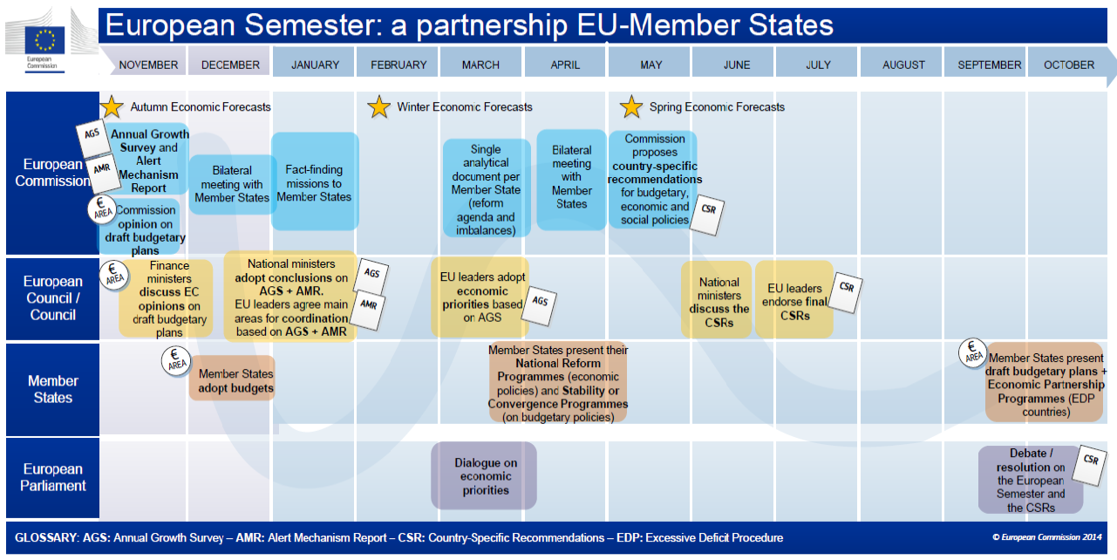

Slide 48
An enhanced role for EPSCO
& its committees
New Council decisions on SPC & EMCO
  Aimed at strengthening role of committees & EPSCO Council in European Semester process, & ensuring consistency in coordination of economic, employment, & social policies
  Ctees should contribute to all aspects of the Semester
  w/in their competence & report on them to the Council
  Ctees should cooperate closely w/ each other as well as other relevant ctees (EPC/EFC, WPPHSL, Education, NoPES)
  SPC should cooperate w/ social NGOs as well as SPs
    Meeting of SPC with Social Platform on 2015 AGS

Slide 49
Amending the Integrated Guidelines
SPC proposals for amendments to new guidelines
  Labor mkt & social system reforms shd promote social cohesion as well as growth & employment (GL 2)
  In shifting taxation away from labor, need to ensure adequate revenue for social protection (GL 4)
  Foster social inclusion by complementing universal w/selective approaches & promoting integrated & preventive approaches (GL 8)
  Appropriate mix of pension options depends on specificities of nat’l systems, sustainability challenges, current & projected future adequacy, & shd be accompanied by broader reforms of active labor market policies & social protection systems (GL 8)

Slide 50
Further socializing the European Semester
SPC and Luxembourg Presidency preparing a series of own initiative reports for autumn 2015
  Social Impact Assessment of structural reforms which have been introduced by MS since crisis
  Distilling benchmarks for evaluating past & prospective reforms from common messages in EU & SPC documents
  Report on ‘further socializing the European Semester’ through ‘3 Ps’ (parity, process, participation)
    Vanhercke & Zeitlin
  Presidency conference on ‘Social AAA’ (October 2015)

Slide 51
The possibility of the sustainability of the welfare state under the conditions of austerity.
Dr. Concepcion Patxot (University of Barcelona)

Slide 52
The possibility of a sustainable welfare state under austerity conditions
Ció Patxot (Universitat de Barcelona)
Centre d’Anàlisi Econòmica i de les Polítiques Socials (CAEPS),
Xarxa de Referència d’R+D+I en Economia i Polítiques Públiques

Slide 53
Intervention scheme
The welfare State from a “static” perspective
I.1. Reasons for State intervention in the economy
I.2. Evaluation
II. Dynamic aspects and extensions
II. 1. Population aging: “fiscal” effects
II. 2. Sustainability of the pension System
  An illustrative calculation of the sustainability in the short and long term
  Simulation models of the pension System
  III. 3. What about the rest of the welfare state?

Slide 54
I.1. Reasons for State intervention in the economy
Neoclassical paradigm: Assuming “perfect competition” (No market power), i. e. :
Perfect information
Homogeneous good
Many sellers and buyers
+ Implicit assumption: rational individuals- consumers and producers-, who seek their individual interest (methodological individualism)
The market is “efficient”, it works: leads to a win-win situation for all, though everyone seeks only individual interest (“invisible hand”)
State intervention needed, for “efficiency” :
Minimum functions, conditions for markets to work: regulate property rights, security, etc.
Provision of pure public goods.
Market failures (of perfect competition conditions)

Slide 55
I.1. Reasons for State intervention in the economy
State intervention needed, for “equity”:
It generates intra generational income redistribution
Must collect resources minimally distorting the markets outcomes.
Welfare state, social conquest of the 20th century, extends the goal of equity. Specifically, it intervenes in two ways:
Transfers in kind: Partial or total provision of “preferent goods”, health, education, housing…
Transfers in cash:
  Poverty reduction
  Income substitution (Retirment pension): Public Insurance because private Markets fail or due to myopia of individuals . Hence, the public pension system implies:
    Intergenerational redistribution of income (Intervention in intra-family transfers from parents to children and vice versa)– instead of market/family. Theoretical justification “under construction”
    Inter temporal movement of funds: Government savings?

Slide 56
I.2. Evaluation: How efficient is achieving equity?
Efficiency of spending on poverty reduction
Labor market protection (keeping work incentives):
  Of the job (increasing firing cost)
  Of the unemployed worker (unemployment benefits)
  The Danish experience : the flexi security

Slide 57
EFFICIENCY
HIGH
LOW
HIGH
EQUITY
LOW
Each one emphasizes a mechanism for resource allocation (State, market, family)
Mediterranean: just low coverage

Slide 58
II.1. Population Aging (demographic transition)
Three main causes: (specially strong and delayed in Spain)
  Baby-boom
    Maximum fertility 3 children per woman 1964, or
    Births >600.000, between 1957 and 1977
  Followed by falling fertility (baby-bust)
  Increase in life expectancy
  In almost all developed countries, but delayed and more abrupt in Spain
Result: Future aging of the population when:
  A numerous, with few children... Generation retires and lives longer: increase in the “dependency rate”
  Demography: dependent/active
    Fiscal: Transfer recipients/contributors
    Illustration using Spanish demographic projection

Slide 59
Dependency rate evolution (Pop>65/Pop 16-65)
2050
1996
2050
Font: INE (2005) Escenari central

Slide 60
Past and future evolution of the dependency rate
Need for reform... Year 2000 best dependency rate in 2 centuries

Slide 62
Credibility of such long-term projections? Assumptions:
Fertility: Does it recover or not?
  It reaches “2” in Nordic countries, France, USA, etc.
  In Spain it’s still very low –in any case, it’s too late...
Mortality: Besides, it will continue to drop (more dependency)
Immigrants, the “solution”?
  “ Required” immigrants from 2022
  The incomings from 2000 and 2007 are close to the baby boomers
  They contribute less and receive other benefits

Slide 63



II.2. Sustainability of the pay-as-you-go pension System
[Funding: Pay-as-you-go versus capitalization]
Return of the Pay-as-you-go System
Depends on : population growth and productivity
Return of the capitalization system:
It depends on the real interest rate (nominal – inflation)
Necessary contributions/possible retirement pensions depending on the population structure:
Low High
Investment in financial assets
Pension System crisis
Pyramid reversal → Pay-as-you-go System crisis
Solution: Transition to capitalization system, but... “Problem of transition”
Currently 2 active burdens: Ancient system and create funds. Unfeasible! But if it’s not public and explicit, it will be implicit.
Financial Crisis makes it less interesting

Slide 64
II.2. Sustainability of the pay-as-you-go pension System
  a) An illustrative calculation : From the budget constraint of the System
Pension level
*/ Active population
*/ Working age population
Nº of retired workers
Contribution rate
Employed population (aprox. contributors)
Activity and employment rates
If the System “contributory”
Pension = Replacement rate *Past salary
Replacement rate
Productivity growth
  Scope for “parametric” reforms (τ i θ ): Pensions (/2) and/or contributions (*2) adjustment

Slide 65
II.2.b) Simulation models of the pension system
Macro approach:
  + It takes into account the “general equilibrium” effects (effect of demographic changes and contribution rates on production and prices –salaries and interest rates)
  Not in Aggregate Accounting Models–EU: Projection of the current profiles by age using demographic projections.
  - It doesn’t consider the agent’s heterogeneity (intra generational income distribution)
Micro approach:
  + It considers intra generational income differences
  - It doesn’t consider general equilibrium differences

Slide 66
Macro Example: Contributory pension System (% GDP)
Compatible Aggregate Model (Generational Compatibility).
20.0%
15.0%
10.0%
Contributory Pensions
5.0%
Social Contributions
Difference
0.0%
1996
2001
2006
2011
2016
2021
2026
2031
2036
2041
2046
2051
2056
2061
2066
-5.0%
-10.0%
Pre-crisis Scenario : Observe short and long term?
Even capitalization doesn’t solve it: The positive difference is lower than the negative... And the crisis shrinks revenues

Slide 67
Sustainability and suitability of the contributory pension System
Results of the micro simulation model (post crisis)
Effect of the 2011 reform
a) Expenditures - salaries ratio (total effect)
b) Change in the Expenditures - salaries ratio

Slide 68
3.What about the rest of the welfare state?
Welfare State rationale
Another interesting “number”: Quantification of transfers between age groups.
Conclusions on the welfare State reform

Slide 69

II. 3.What about the rest of welfare state?
Welfare State rationale
Before welfare State existence: “Large” Families :
Intergenerational transfers:
  Backwards : from children to old parents
  Forward: from parents to children
“PAYG” funding: except for a few “renters” (with no capital market)
Interaction scheme between generations
Subsistence
Health
Care
(or cash transfers)
Savings
...
Subsistence
Health
Care
Education
...
Time

Slide 70
Introduction of public System of pensions
ONLY Substitutes backward transfers
Pay-as-you-go funding: Does it breaks parent-child links?
Risk of financial crisis when facing a demographic change
Subsistence
Health
Care
(or cash transfers)
Savings
...
Subsistence
Health
Care
Education
...
Time
What about children’s cost
In general: Added problem to State intervention in intergenerational transfers. Intra-family: the State assumes the role of saver,

Slide 71
National Transfer Accounts (NTA) in 24 NTA countries

Slide 72
National Transfer Accounts (NTA) Spain, 2000
Private and public consumption– labor income= Life cycle deficit (LCD)

Slide 73

How is the life cycle deficit (LCD) financed ?
Transfers (net) both public (TG) and private (TF –intra or inter family)
Capital Markets (ABR= Asset income – Savings)
$$LCD=TF+TF+ABR$$

Slide 74
The cost of children in Spain is not “socialized” to the same extent than the cost of the elderly
Puzzle: More easy to
An explanation for non fertility recovery?

Slide 75
Net public transfers to children and the elderly (% of consumption)
Children
Elderly

Slide 76
Are public transfers (TG) crowding out private transfers (TF)?

Slide 77
Summary of implications for reform
Considering only PAYG pensions system: if the Dependency Rate doubles
  Options keeping the system
  a) “Double” contributions
  b) “Halve” the pensions
  c) Delaying retirement age – in line with increase in life expectancy
  Note that transition to capitalization also requires a) and/or b).
  Questions under discussion:
  Towards a fully contributory system? The sustainability factor
  Debate on the EU: Sustainability and adequacy, are they compatible?
Considering the whole intergenerational transfers system:
  Pending substituting the ones from parents to children: (socialize the cost of children). A child = future taxpayer (parents contribute double in cash and non cash)
  “Balancing” policy: ¿Pension = children contributions? But violates acquired entitlement :
  Other options in this line
    Family support System of the same size, so that children costs are socialized.
    If transition to capitalization , mixed system: 3 balanced burdens
  A case for free education regardless of income level

Slide 78
Thanks for your attention!

Slide 79
Commentary and discussion.
by ETUI (Sotiria Teodoropoulou)
and EAPN (Sian Jones)

Slide 80
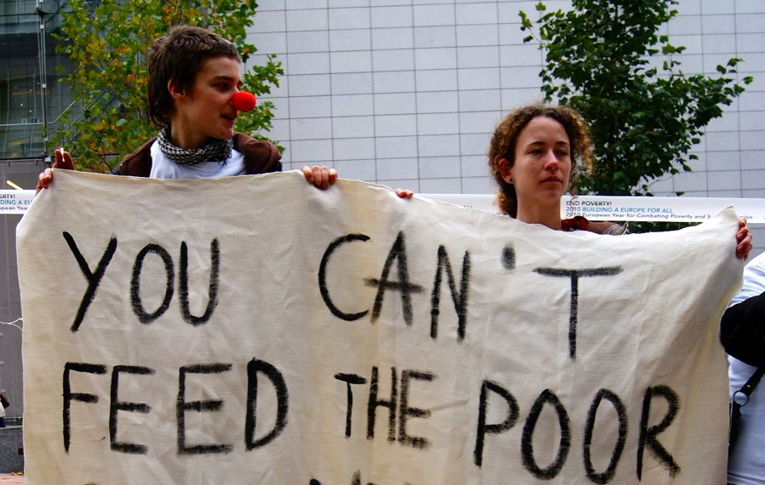
ALLIANCES TO FIGHT POVERTY – Seminar
Socialising and democratizing Europe
May 7 and 8, Madrid
Are we progressing on Socializing and Democratising
the European Semester?
Sian Jones
EAPN Policy Coordinator

Slide 81
Socialising and democratising the
European Semester
Outline
Introducing EAPN and Semester engagement
Opportunities and Threats: European Semester Trends
EAPN 2015 Assessment on the CSRs
What way forward?

Slide 82
Introducing EAPN
Independent Network of NGOs committed to fight against poverty and social exclusion
Started in 1990 – key actor in poverty programmes and development of social OMC, and in Lisbon and now Europe 2020.
Receives financial support from the European Commission (PROGRESS/now EaSi)
31 National Networks and 18 European NGOs as members (6000+ organisations)
Participation of people with direct experience of poverty must be part of the solution.

Slide 83
Introducing EAPN –
approach to European Semester
EAPN committed to engage in civil dialogue on EU processes
European Semester/EU2020: NRP/NSRs and in proposing CSRs
Capacity building exchanges: reviewing NRPs and on CSRs
Yearly assessment reports: EAPN 2014 NRP Assessment Report: -and 2015: EAPN 2015 CSR assessment and alternative proposals
EAPN Advocacy: Conference – 3 October: How will Europe 2020 and the Mid-Term Review reduce poverty and inequality? Letters to EC/Council - AGS key messages – Annual Convention, EP etc.
Working in Alliances: European Semester Alliance involving 16 green/social and trade unions with national pilots (DK, BG, IE ) http://semesteralliance.net/ pilot funding from EC.

Slide 84
Europe 2020 in the Semester
– A Step Forward for Poverty and Participation?
Integrated Social Objectives: Smart, Sustainable and Inclusive growth
Poverty Target (1 of 5): reduce poverty by at least 20 million by 2020 (3 indicators).
European Platform Against Poverty and Guideline 10
Participation: Guideline Recital 16
Reinforced Social OMC with National Social Reports?
2013+14 Annual Growth Survey Objective 4: Tackling unemployment and the social consequences of the crisis.
Delivered through the European Semester/mainstreamed into main economic cycle.

Slide 85
Europe 2020 and European Semester –
Key Weaknesses
Highly complex poverty target – based on aggregate of 3 indicators (At risk of poverty and/or exclusion)
At risk of poverty (60% median household disposable income)
Severe Material Deprivation (deprivation of 4 out of 9 factors)
Low Work Intensity (job-less households)
No explicit strategy to fight poverty - European Platform Against Poverty – flagship initiative/actions:
Delivering action across the policy spectrum
Better use of EU funds
Providing evidence of what works
Work in partnership with CSO
Enhanced policy coordination

Slide 86
Europe 2020 in the Semester –
Key weaknesses
Guideline 10: Social Inclusion and Poverty, within Employment Guidelines/narrow employment only focus
Social OMC – continued but as a parallel, much weaker process with National Social Reports, but no joint reporting
AGS 2013 and 14 Objective 4: Tackling unemployment + social consequences of the crisis, but marginal importance within the overall dominant focus of the EU approach/ AGS prioritising deficit reduction through austerity.
European Semester dominated by stability and growth objectives – so Europe 2020/poverty target sidelined.
Participation: Recital 16: no obligatory guidelines, so little meaningful stakeholder engagement – EAPN reviews.

Slide 87
Governance of the Europe 2020
Europe 2020 five headline targets
Stability and
Growth Pact
Europe 2020 Integrated Guidelines (IG)
Macro-economic
surveillance
Thematic
surveillance
Fiscal
surveillance
National level
National Reform Programmes
Stability and Convergence Programmes
EU level
Commission’s Annual Growth Survey
EU annual policy guidance and recommendations
EU flagship initiatives and levers

Slide 88
Social Investment Package –
Alternative approach to austerity ?
February 2013 : Social Investment Package (SIP) EC : Towards social investment for Growth and cohesion, including implementing the European Social Fund (2014-15).
New framework: ‘to render social protection more adequate and sustainable, to invest in people’s skills and capabilities, and to support people throughout their critical moments across their lives ’
Includes 8 Staff Working Documents 1) Recommendation on Child Poverty, 2) SWD on Active Inclusion and 3) Tackling Homelessness and 4) SWD on Structural Funds.
Social Policy viewed as a benefit not a cost !
But focus on ‘efficiency’/ shift in budgets away from ‘passive social protection’ to activation and early learning.
Little signs that Social Investment ‘owned’ by new Commission, used mainly as support for ‘modernisation’ of social protection.

Slide 89
Europe 2020/Semester - What impact on poverty?
122.6 million at risk of poverty and/or social exclusion (EU SILC 2013) ie nearly 1 in 4 of the population, increase of over 4.8 million since 2008
Shortfall on MS setting national targets (only 12 million not 20)
Largest increases in periphery: EL, ES, IE, HU,CY, MT, LU, BG, LT, IT
Relative poverty more stable except in EL, HR, LU, SE and SI
SMD – substantial increases – over 5pp: EL (9.1), HU (8.9), CY (7.0), MT, IT, LV
Jobless HH – hardest hit by crisis: EL, ES, IE, LV, LT , PT an BG
Increasing working poor: 8.9% with 1/3 of working-age poor in work.
Divided Europe – N/S and periphery: ≥ 40% BG/RO/LA to ≤ 17% in CZ, NL, SE, LU and AT.
Increasing inequality – the top/bottom 10% between and within MS.
New risk groups – youth but also children, older people, single parents, long-term unemployed, homeless, migrants, Roma..

Slide 90
Where are we now? Mid-Term Review and
changes in the Semester.
2015 Mid-Term Review of Europe 2020 with public consultation in 2014, offers opportunity for change.
Short Assessment report March 2015 highlights 4 key findings: - -- Europe 2020 has the right goals/approach
  5 Targets are right
  Flagship Initiatives doing their job, but need more visibiity
  Scope for more ownership, and involvement at national level, ie stakeholders/parliament to get delivery.
But follow up delayed until end of 2015/2016 – official reasons – time to consider proposal, but clear loss of priority….
New Commission President Juncker Political Guidelines are dominant with low profile for Europe 2020

Slide 91
Where are we now?
Changes in the European Semester.
(AGS) Nov 2015: 3 priorities – investment, deficit reduction, restucturing – not poverty/ social inclusion or social investment.
European Investment Plan and ESIF – focus on infrastructures, private funds leverage, ‘growth and jobs?’ not social investment
Proposed changes in Integrated Guidelines reflect new priorities: - loss of focus on Europe 2020 and targets, investment not social investment,
  job creation not quality jobs with increased activation, education and life-long learning replaced by skills.
  Modernisation of social protection, Guideline 10 on social inclusion and poverty replaced by fairness/ employment focussed.
  Recital 6 on participation, reduces stakeholder involvement to support in implementation
Minor changes in Semester process: country reports earlier, shorter CSRs?
Increased concern about ‘ownership’ by Commission, more priority to social partners, but support of COM: ESOs, DG ECFIN,

Slide 92
Mid-Term Review- EAPN assessment
What progress, what went wrong?
Europe 2020 offered a positive development for poverty
Disillusionment as poverty grows
Devestating social impact of crisis – mistaken economic as well as social policies also culprit.
Europe 2020, the poor sister in the European Semester dominated by economic governance
Lack of seriousness about poverty target or stategy for delivery
Employment only solutions not sufficient to reduce poverty, particularly with ‘poor jobs’
Cosmetic approach to participation to ‘get’ implementation

Slide 93
EAPN 2015 CSR Report and Assessment-
Can the Semester offer potential for change?
24 National networks (AT, BE, HR, CY, CZ, DK, EE, FI, FR, DE, IE, IT, LV, LT, LU, NL, PL, PT, SK, ES, SE and UK)
Mixed assessment of positive and negative CSRs
Recognize the growth of more ‘social CSRs’ since 2010, ie on poverty and social inclusion, but majority continue to be undermined by macroeconomic CSRs focused on austerity.
Mixed implementation – members’s assessment depends on whether CSRs seen as positive. Most highlighted some implementation (AT, DK, EE, DE, LV, LT, IE, ES) while others very little (CZ, PL, SK, SE, UK).

Slide 94
EAPN 2015 CSR Report and Assessment?
Some Positive CSRs
Minimum Income – back to work family dividend (IE) or Guaranteed Minimum Income (HR/CY)
Some more support for personalized job support, but often linked to increased conditionality.
Minimum wage – Germany, but CSR in-work poverty dropped (PL) and contradicted in other MS with pressure to reduce wages/index,
Youth Guarantee/labour market integration of NEETs (AT, HR, DK, IE, LU, FR, PT, ES) but effectiveness?eg IE 20.000 youth in receipt of disability/single parent allowance excluded.
Investment in early childhood learning/affordable childcare/tackling educational inequality
Public adminstration reform – but positive? FI or DE/FR/NL

Slide 95
EAPN 2015 CSR Report and Assessment
Main Gaps
Lack of coherent, balanced inclusive growth strategy – macroeconomic CSRs eg CSR1/2 undermine social (BE, CY, DE, DK, ES, LU, PL, FI)
Raising retirement ages without ensuring older workers can stay in decent jobs or access adequate pensions (HR,CZ, FI)
Lack of social investment and few coherent CSRs on poverty
In-work poverty, low investment in quality job creation, focus on reform of wage setting/indexation (BE, LU)
Promoting competiveness of services – putting at risk quality, driving down wages/standards (AT, DK, SI) – eg Housing market not affordable access.
Growth-friendly tax not inclusive – ie focus on consumer tax/labour.
Weak stakeholder engagement, engagement in a formal report, little impact on the NRPs and the CSRs… no CSRs in this area.

Slide 96
Summary of Members Alternative Proposals
on CSRs for Semester 2015
Economic CSRs to contribute to social goals with social impact assessment to prevent negative impact.
Specific CSRs to deliver on poverty reduction – requirement to develop an integrated antipoverty strategy
Promote quality and sustainable jobs with decent wages, tackle long-term unemployment through inclusive labour market/ integrated active inclusion
Invest in social standards ie universal access to social and health services /social protection/ adequate minimum income/affordable home for all
Tackle youth poverty and exclusion not just unemployment
Invest in children, promote gender equality, work life balance
Reduce inequality and promote tax justice
Promote meaningful stakeholder engagement and ensure legitimacy in the Semster – obligatory guidelines, funding through the Semester Officers

Slide 97
Conclusions - Can the Semester be made fit
for purpose?
A Transformative Social and Sustainable Agenda
Confirm European Semester as a coherent economic/social strategy based on Europe 2020 goals and targets based on rights/Treaty obligations.
Clear focus on poverty and social targets, delivering social investment/social protection/ integrated active inclusion
Greater coherence and transparency in the design/delivery/monitoring of CSRS based on Europe 2020 goals, with joint decision-making – Soc/Economic actors.
Prioritise creation of an EU Integrated Strategy to fight poverty– quality jobs, services, social protection with coherent CSRs
Invest in democratic, participative and accountable governance – Equal role for EP, Guidelines for meaningful dialogue with CSOs/ stakeholders and Nat Parl.
6.Using EU Money for Poverty – 20% of ESF on poverty – for integrated strategies/ beyond employment only.

Slide 98

FOLLOW! http://semesteralliance.net | #semesteralliance
Enabling civil-society to participate in the shaping of EU policies and to contribute to progress on the Targets of the Europe 2020 Strategy concerns us all!

Slide 99
Contact and Information
Thank you!
Sian Jones, EAPN Policy Coordinator
Sian.jones@eapn.eu or phone: 0032 22265859
EAPN: Square de Meeus 18, 1050 Brussels
www.eapn.eu

