Slide 1
Democratization of the market
Renaat Hanssens
ACV-Research Department

Slide 2
Democratization of the market
1. What are the main threats in marketisation in your country?
2. What are the consequences for households and the rights of workers?
3. What are possible remedies: what kind of regulation is necessary?

Slide 3
1. What are the main threats in marketisation in your country?
‘Market model’ abused in fields where other approaches have proven to lead to better results
e.g. debate on marketisation of (health) care in the Netherlands
‘market model’ becomes leading principle in organizing society :
  1st goal of new Flemish Gov, is “prospering enterprises”
  Privatisation of public utilities: postal services, public transport /PPS as a preferential (but expensive and not always effective tool ) tool for investment in public infrastructure
  Market relations characterize society, as do other social mechanisms (citizenship, solidarity, …)
→ Usurpation by the market model of areas in society where other models should prevail

Slide 4
1. What are the main threats in marketisation in your country?
Market model needs regulation in the area where it is meant for, the economic sphere
Examples of self-evident classic economic regulation :
    access to professions,
    licenses for garages, pharmacies, supermarkets, …
    anti-trust regulation
    obligations to disclose prices for shops and supermarkets
    accounting rules
    hygiene and food safety rules…
Less evident need for regulaton where economic power distorts functioning of the market:
    Power of big supermarktets to set prices (at the expense of farmers, small producers,… who have to accept whatever price)
    Electricity market: underinvestment in B due to uncertainty about nuclear fade-out
    Labour market

Slide 5
1. What are the main threats in marketisation in your country?
Provisional conclusion :
Market model must be limited to the field it is meant for
To function properly, the market needs regulation
Economic power, weight of lobby groups tend to distort the functioning of the market (cf financial (non)-regulation)
Regulation must be targeted: not to protect narrow group interests and create duality with insiders and outsiders (e.g. : limited number of licences for freight carriers in Greece until recently)

Slide 6
1. Threats in marketisation: the labour market
Power threatens equality in consumers& producers market
Power threatens equality in labour market/market of production factors even more
From the very start, there’s no equality between :
  Those who have only their talents and work capacity to earn a living
  Those who possess capital as a major production factor
  In the group of workers, talents are unevenly divided
After 150 years of social history in industrialised countries, liberal economists still rely mainly on the pure market model to make recommendations on the labour market
Biased by corporate lobbies? academic mainstream? Blunt shortsightedness ?

Slide 7
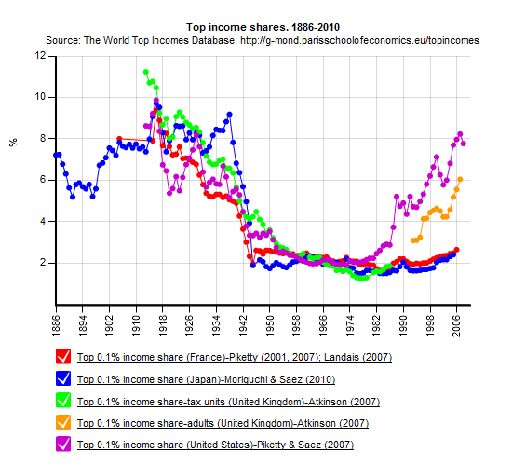
1. Threats in marketisation: the labour market
In labour market : pure market mechanism leads to inequality
Share of income going to top 0.1% (1886-2010)
UK
USA
UK
Japan
France
Japan
The World Top Incomes Database
Facundo Alvaredo, Tony Atkinson, Thomas Piketty, Emmanuel Saez
http://g-mond.parisschoolofeconomics.eu/topincomes

Slide 8
1. Threats in marketisation: the labour market
Protection of labour under pressure by European Commission:
  Trojka record in crisis countries like Greece and Portugal:
    Sectoral and interprofessional (national) collective bargaining under threat
    Sectoral agreements abrogated
    Individual and firm level bargaining promoted
  Stubborn refusal of EC to include enforceable labour clauses in trade & investment agreements
DG ECFIN:
  ‘On governm employment : “Bargaining power of unions is higher when gov absorbs relevant share of workforce”
  “Higher replacement rates & longer duration of unemployment benefits may increase barg power of unions, leading to higher wages”

Slide 9
1. Threats in marketisation: the labour market
“High EPL by raising barg power of the employed raises their ability to resist wage cuts. The higher difficulty of replacing current employed workers with low-wage outsiders induces downward wage rigidity”
This ideological approach is reflected in ‘country specific recommendations’ : e.g. CSR2014 for Belgium :
  ‘Change (=abolish) the indexation system’ (= part of sectoral agreements
  ‘Improve professional mobility’ (by diminishing labour protection)
Direct attack on right to strike by employers organisations at the ILO

Slide 10
1. Threats in marketisation: the labour market
Rightwing political parties reproduce the EC discourse; they are the pillars of the Flemish government and the expected Federal government
  Wage indexation system under pressure
  Favouring collective bargaining at firm level (which means : no negotiations in plenty of SME’s)
  Direct attack on trade unions as counterpower in the labour market :
    unions hamper flexibility in labour market, introduce rigidity – if we diminish power of unions, the labour market will flourish, with more flexible wage formation, leading to more jobs’
    ‘using the stick of the limitation of unemployment insurance will reinforce a flexible supply of labour“

Slide 11
1. Threats in marketisation: the labour market
  REFIT: program of the EC to investigate ‘necessity’ of regulation companies have to deal with & freeze the development of new regulation in the mean time, especially in the field of Safety and Health at work:
    Concluded Hairdressers collective agreement on H&S blocked (= (temporarily?) not confirmed by the EC, which it should do according to EU Law)
    Recognition of new carcinogen products blocked
    Threat of deregulation of existing H&S regulation, also in the context of TTIP

Slide 12
1. Threats in marketisation: the labour market
Transatlantic trade and investment partnership:
  Wants to create a transatlantic free trade zone …
  … by ‘harmonizing’ regulation on technical standards, test procedures for car safety, pharmaceuticals, food safety,…
Expected result of harmonization : new rules in between European ‘severity’ and US ‘laxity’
Which means for the labour market … ?
If no harmonization : European (=ILO) norms under pressure, as EU companies will have to compete more strongly with US companies, which can hire workers at lower wages

Slide 13
2. Consequences for households and rights of workers
Basic instruments to protect workers in the jungle of the free labour market (as it existed in the 19th century and in a lot of developing countries now) under pressure:
  Right to collective bargaining at central level (Germany : huge opt out possibilities – temporary workers not covered)
  Freedom of association : power of unions under threat:
    E.g. : Belgian unions pay out unemployment benefits (and are attractive for that reason) - to be changed in the future ?
Aggregate demand depressed continuously: low wages lead to permanent economic stagnation (cf internal demand in Germany, Japan, …), high unemployment, pressuring wage growth permanently – a vicious circle
cf. slaggering wage development in US, due to low labour participation and pressure on trade unions

Slide 14
3. Possible remedies
  Unequivocal recognition of necessary role of unions as counterweight to the power of capital - this blind spot in eyes of EC-bureaucrats must be healed
  ‘Universal’ unions:
    Belgian unions defend interests of workers ánd unemployed people
    In contrast to many other countries :
    Interests of unemployed and precarious workers less taken into account as a consequence :
      Who defends mini-jobbers in Germany?
      Democratic structure of unions leads to defence of interests of members; voice of outsiders risks not to be taken into account properly
      How could dualization of labour market in Germany, Spain, Italy, grow so deeply ?
  Importance of role of unions can’t be underestimated:

Slide 15
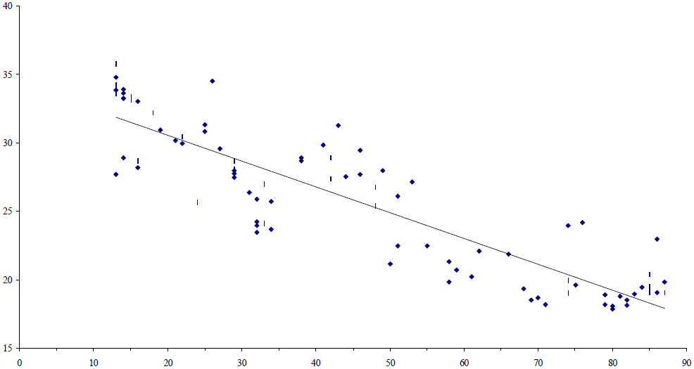
3. Possible remedies
  direct link between degree of unionization and equality:
  data for 16 OECD countries 1966-1994
Inequality (Gini )
% of labour force in trade unions
Gustafsson B, Johansson M. In search for a smoking gun: what makes income inequality vary over time in different countries? LIS Working Paper 172; 1997.

Slide 16
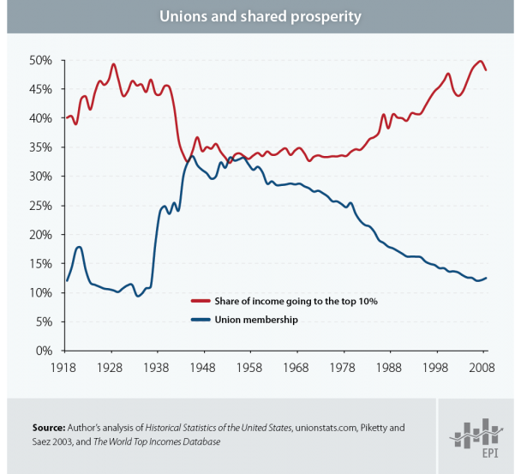

Slide 17
3. Possible remedies
  Apart from strong unions which guarantee a limited inequality of market income , a redistributive tax policy is key to construct societies with a large degree of net income equality: democratic political process must remediate market failures
  Redistribution alone is not enough : ‘society of equal opportunities’ requires strong government, creating equal chances for all, through well functioning education system, public health, accessible public utilities (transport, water and energy supply, affordable participation in sports and culture…)
  Redistributional system built to foster an inclusive society implies the supply of these public goods. Redistribution always consists in a large degree in ‘redistribution in kind’ by free or cheap supply of public goods

Slide 18
3. Possible remedies
  Focussing on right objectives of economic policy:
    Beyond ‘GDP growth’ as the ultimate policy goal, cf ‘Better Life Index’ of OECD
    Market flexibility, smooth adaptation mechanisms of the labour market in case of economic shocks may be good for GDP, not for a rights and opportunities based welfare approach
    e.g. : UK, Ireland: admired for leaving the crisis behind, but at what social cost ?
  Societies with more equality, more decent jobs, integration policy are better societies
  Decent work, a job for everyone who wants a job is far more important for society than skyrocketing GDP especially if the ‘1%’ appropriates an ever larger part of it
  Democratic politics hardly needed to reign in market principle and give power back to the people, not to Capital

