Slide 1
The trend of liberalisation in the new member states: the case of Latvia
Tana Lace
Riga Stradins University
02.10.2014 Marseille

Slide 2
Population
At the beginning of 2014 there were 2 001 468 people permanently living in Latvia.
The number of population in Latvia on 1 July 2014 accounted for 1 995 600.
According to the calculations made by the CSB during the time period from 2000 to 2013, 259 000 people emigrated from Latvia and have not returned.

Slide 3
Latvia

Slide 4
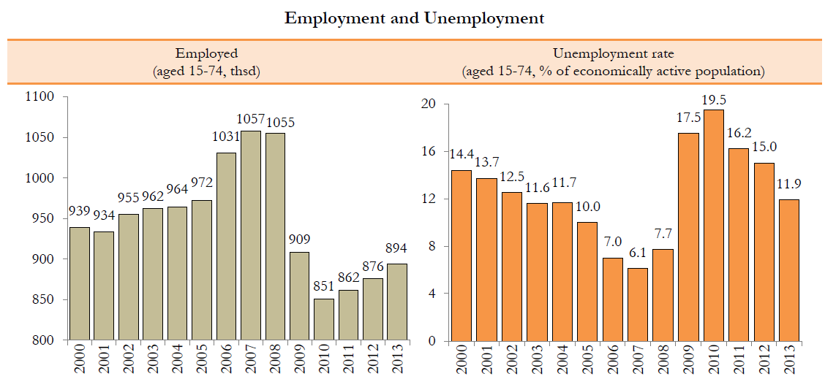

Slide 5
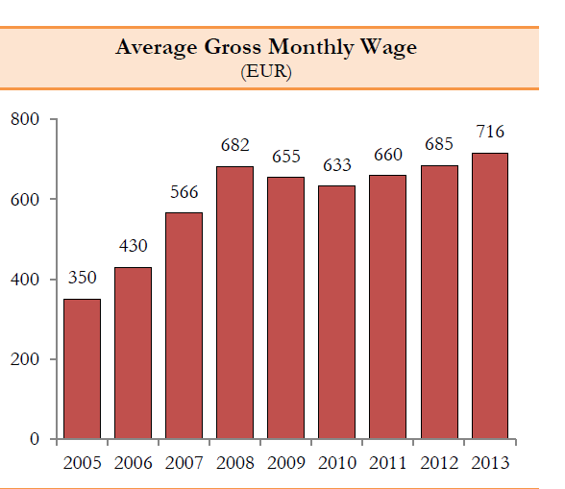

Slide 6
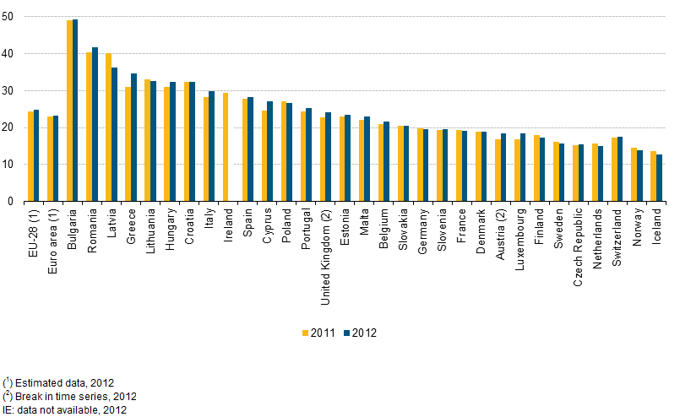
At-risk-of poverty or social exclusion rate, 2011 and 2012

Slide 7
There is no available statistics and comprehensive information about social services provided in local governments to specific at social exclusion risk groups.
At the national level statistical information is collated about a very narrow range of services (long-term social care and social rehabilitation, home care).

Slide 8
Health care sector

Slide 9
During 2009 considerable changes were rapidly implemented in the health sector resulting in
a considerable reduction of the number of employees working in the health sector and of the number of institutions;
a minimum scale of health care services.
For example, the number of hospitals has shrunk:
In 2006 106 hospitals
in 2010 - 39 hospitals

Slide 10
EU-SILC
In the conditions of the crisis there has been an increase in the ratio of individuals who did not undertake the required medical examinations due to the insufficient accessibility of health care – from 10.1% in 2008 to 16.2% in 2011.
If in 2008 6.8% of the respondents recognised that the service was inaccessible due to its high price, then in 2011 this reason was mentioned already by 14.7% respondents.

Slide 11
Latvia has one of the lowest public expenditure indicators for health care among overall government expenditures.

Slide 12
Marketisation of healthcare Latvia
changes that can be associated with the shift towards a market-based provision of healthcare include
the reduction of the share of public financing in total healthcare financing,
the increasing role of private insurance schemes,
and out-of-pocket payments.

Slide 13
Development a new funding system in healthcare
Model No.1 – rights of individuals of the working age to receive planned health care services will depend on the fact if a specific tax has been calculated for the individual’s earned income (paid as an income tax or a social tax).
Model No.2 envisages the introduction of compulsory public health insurance.

Slide 14
The Repše’s proposals:
“I believe that the only solution is to substitute the outdated system steeped in socialism with up-to-date health insurance that operates in the conditions of competition and a free market. The state will buy or at least in part finance the insurance policy for the socially vulnerable groups. There will be an additional opportunity to purchase policies of a higher class, in line with the demands and possibilities of each individual.”

Slide 15
Payment for social services
primary responsibility for the payment for local government-provided social services rests with the client;
if the client is unable to make a full payment for the service, he pays part of the service price;
the outstanding part of the full payment is paid by the bredwinner;
If the bredwinne also fails to make the payment, service costs are covered by the budget of the respective local government.

Slide 16
The number of clients whose social services’ costs have been in part or in full covered by the local government, constitute a very high ratio against the total number of social service recipients.
The local budget has paid, in full or in part:
for home care of 94% of clients,
for 81% of clients – services of long-term social care and social rehabilitation institutions,
for 76% of clients –services of the day care centre,
for 53% of clients – services of crisis centres, crisis hotlines and free hotlines
for 96% of clients – shelter and night shelter services.

