Slide 1
Housing, welfare and the market: an impossible combination?
Pascal De Decker
HaUS - Faculty of Architecture KU Leuven
Alliance to Fight Poverty – Marseille – 3 Oct 2014

Slide 2
Content
Warning
Trends
  Policy
  Housing crisis
Consequences
Way(s) out

Slide 3
Warning
Differences between countries & regions
  Convergency thesis
  Divergency thesis/path dependency
Esping-Andersen classification (social democratic, corporatist, liberal) is problematic
  …without ‘housing’ (housing policies are ‘older’)
  …big differences within the types (see e.g. Scandinavia)
  …does not include Southern Europe
  …does not include Eastern Europe
reality more complex & nuanced
Perspective of poor people

Slide 4
Major (policy) trends
decommodification (postwar-1989: partly in some countries; extreem in Eastern Europe) → recommodification (post-1989: nearly everywhere)
deregulation→more market-led production and allocation of housing
promotion of home ownership → decline social rental housing
bricks & mortar subsidies → housing allowance → drop new house construction
growing ‘obsession’ with tenure/homeownership

Slide 5
Reasons/discourse to encourage home ownership
Historically in some countries: to discipline the workers (‘stake in society’)
Make households build equity (‘property owning society’)
Help households to achieve the preferred tenure or dream
Empower people, create better citizens
Increase involvement in neighbourhoods
Reduce government involvement (Washington consensus)

Slide 6
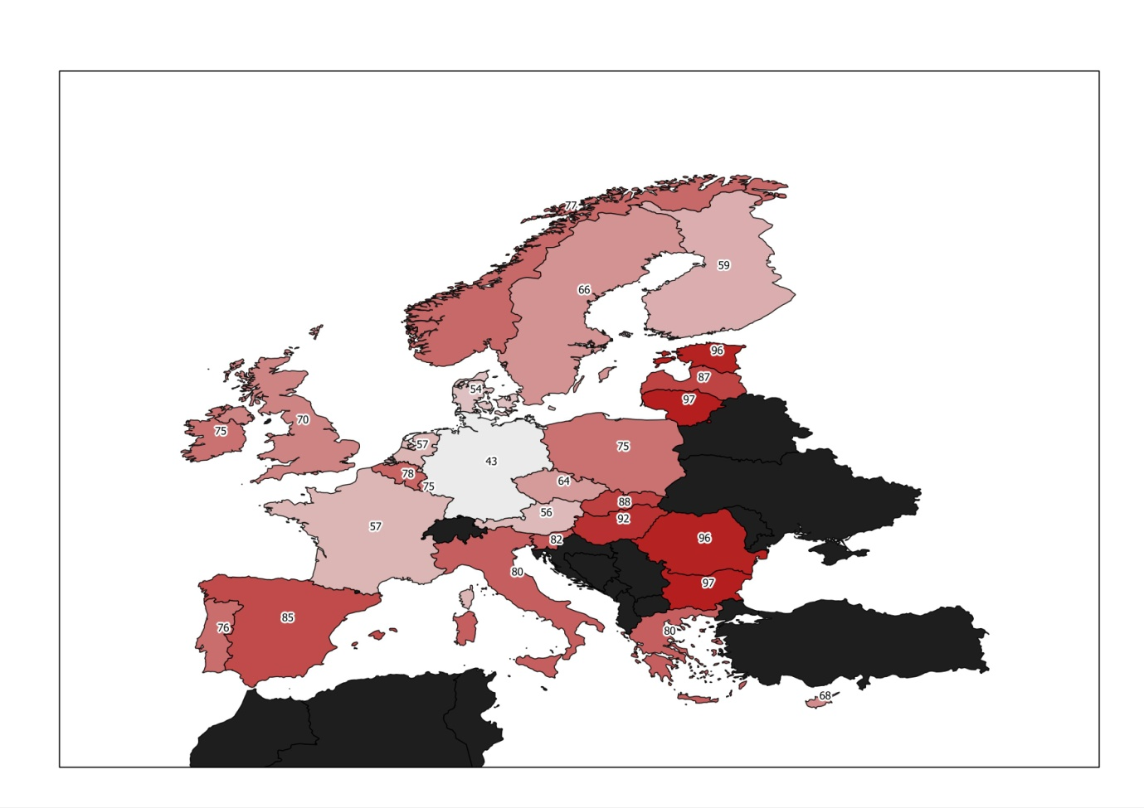
Home ownership in the EU27, EU-SILC 2009
Largest (>75%) in Eastern, Southern Europe, BE
Around 65 - 75%: UK, IE, SE, PL
Relatively low (< 60%) in GE, AT, DE, DK, FI, CZ and NL

Slide 7
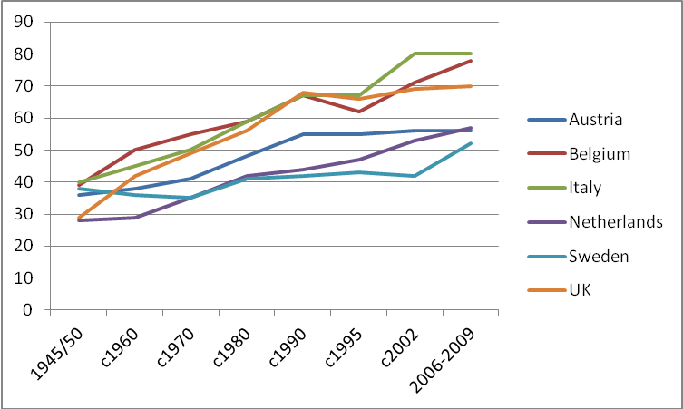
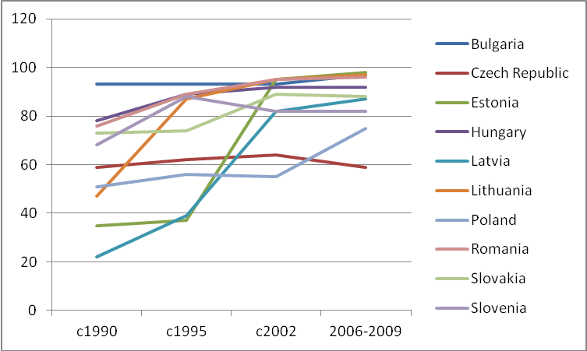
Home ownership in Europe Sources: Catte et al (2004), Scanlon and Whitehead (2007), EMF (2010),MRI (1996), Balchin (1996)
1945-2010 W Euro
1990-2010 E Euro

Slide 8
Home ownership by income quartile, EU-SILC 2009

Slide 9
Rental sector (%) & household income, EUSILC 2009

Slide 10
To take along
Countries with higher incomes do not necessarily have higher homer ownership rates - on the contrary
Home ownership ‘for all’ is not a realistic solution
See e.g. Flanders, 2005-2012, level stable (appr 75%)
- lowest interest rates since WO2
- (probably) the highest government support ever (tax deduction)
- still large supply of building land
- conservative mortgage legislation (no exotic products)
Home ownership as superior tenure: strong beliefs, weak evidence
Once established: deeply ingrained in society

Slide 11
The housing crisis
Steering features
  Low interest rates
  Deregulation
  → Boom of housing finance
    rising mortgage debt in some countries
    exotic products
When econ boom colapsed → …

Slide 12
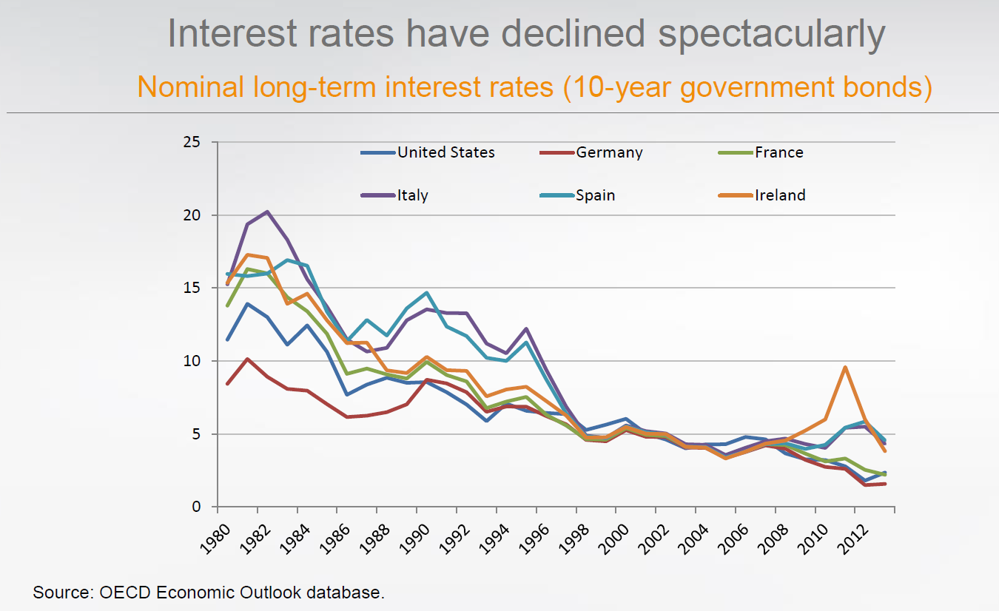

Slide 13
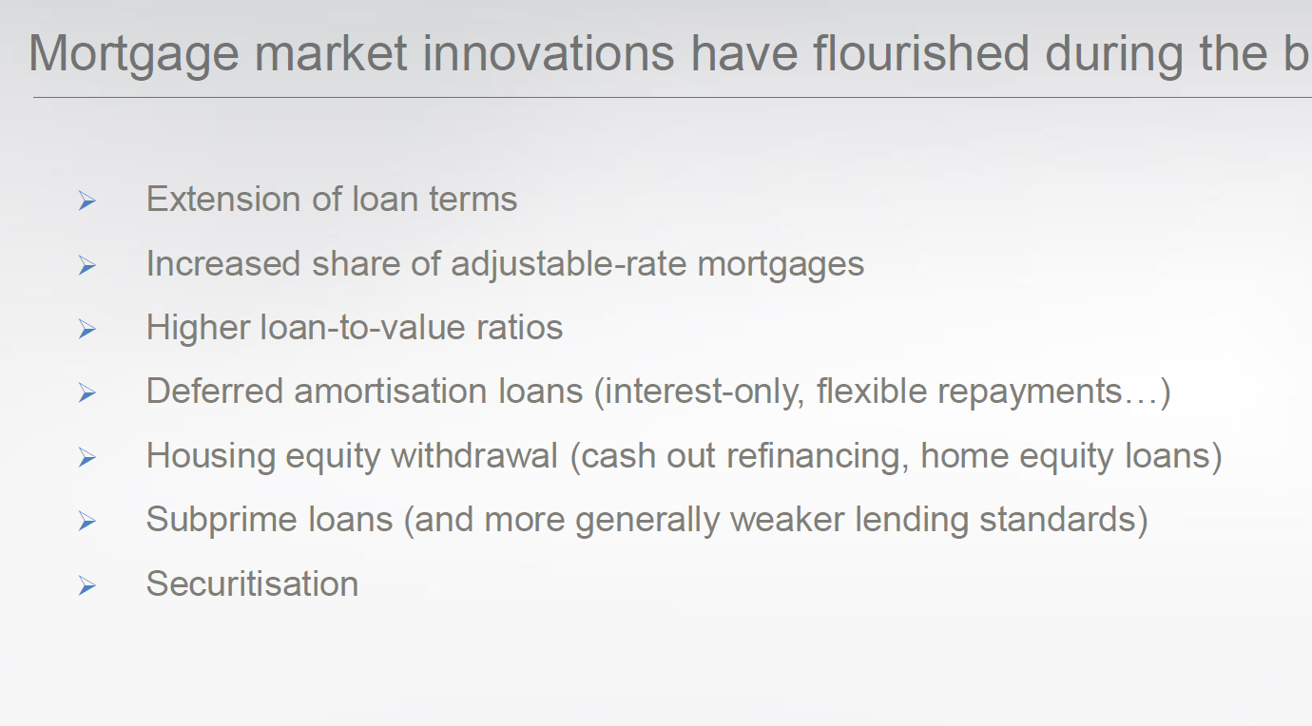
Often: all together…

Slide 14
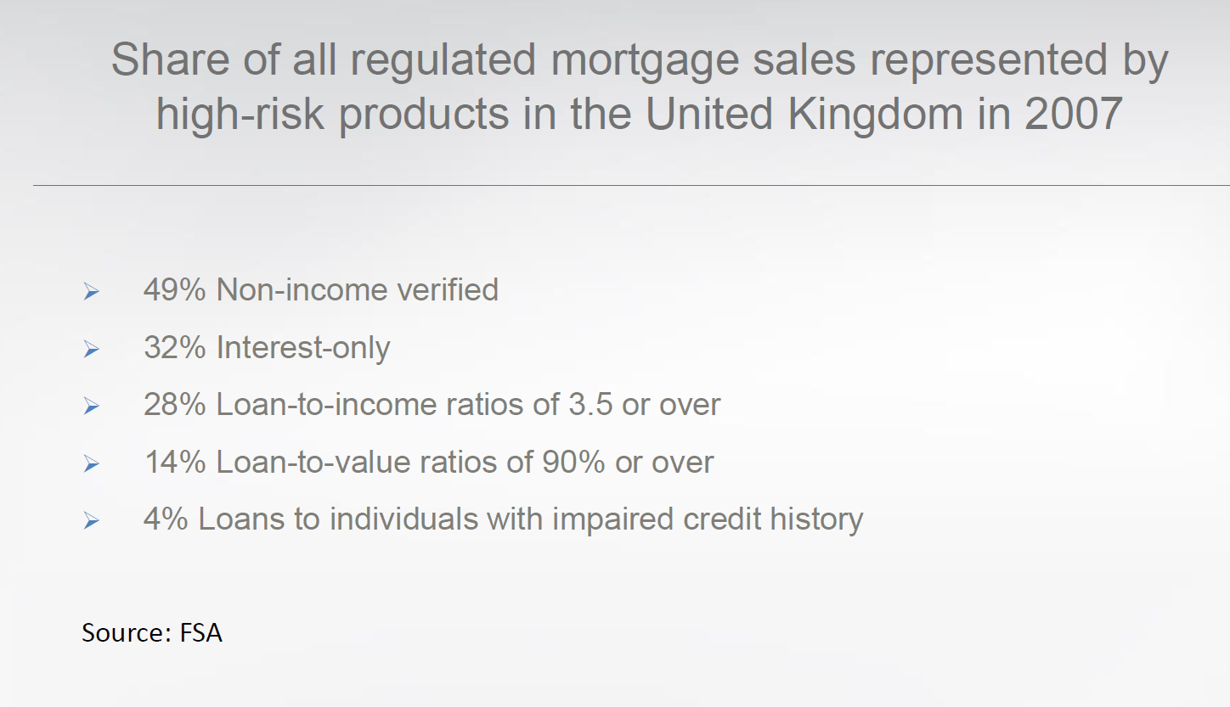

Slide 15
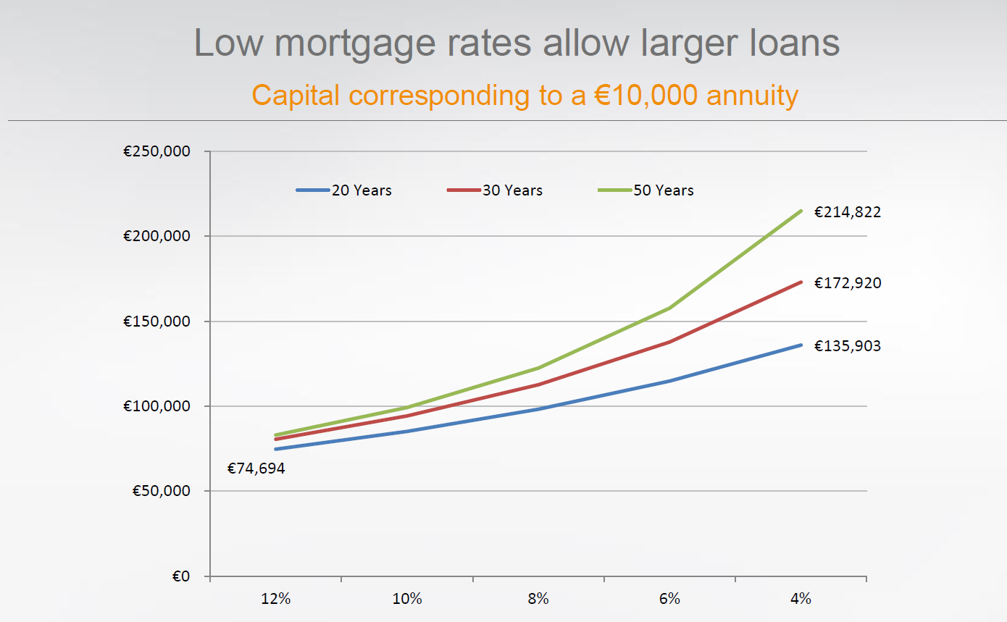

Slide 16
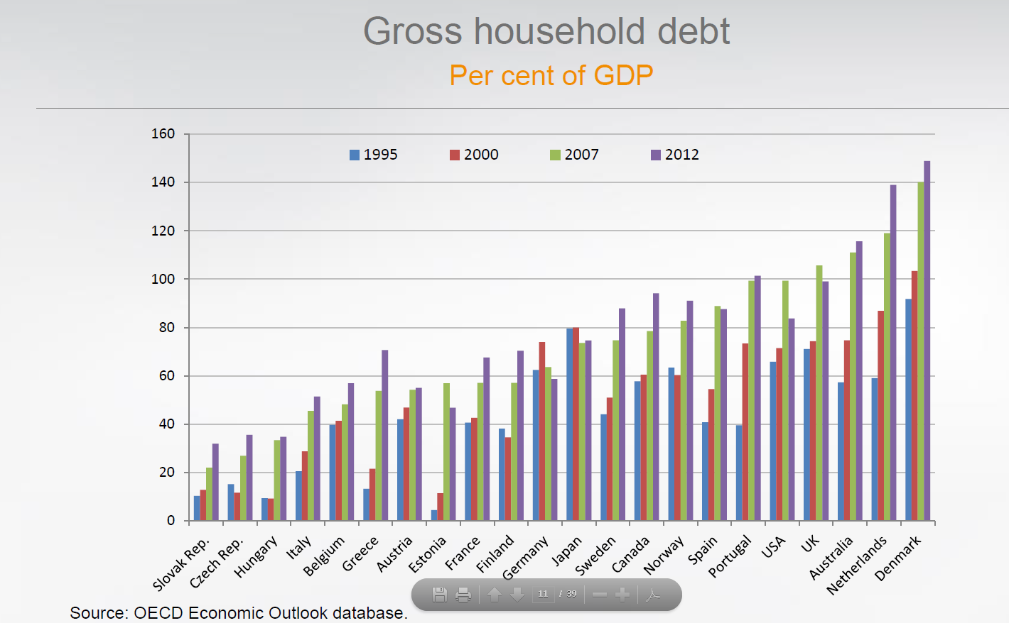

Slide 17
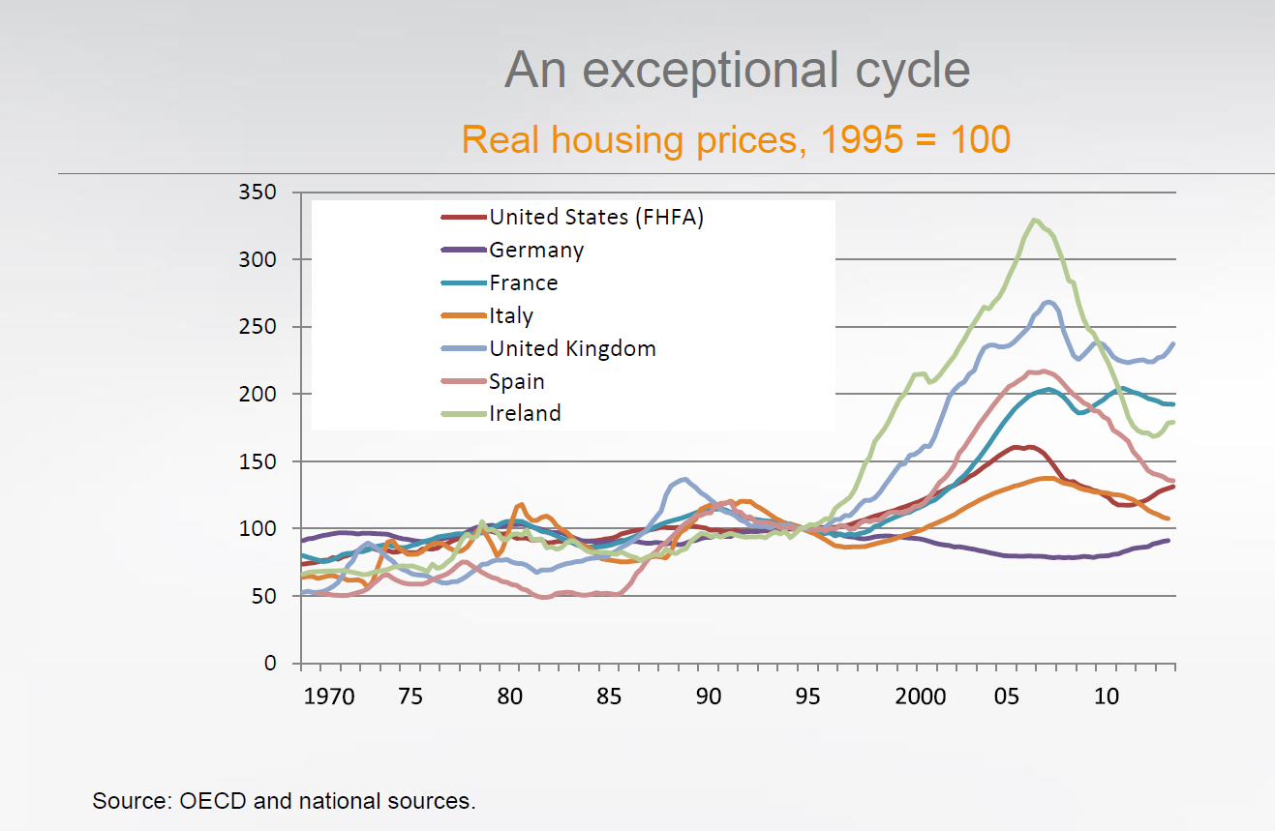

Slide 18
After the crisis
House prices fall in a lot of countries
!! New construction drops (and remains(ed) low)
Numerous people in arrears & repossessions
Housing costs are raising

Slide 19
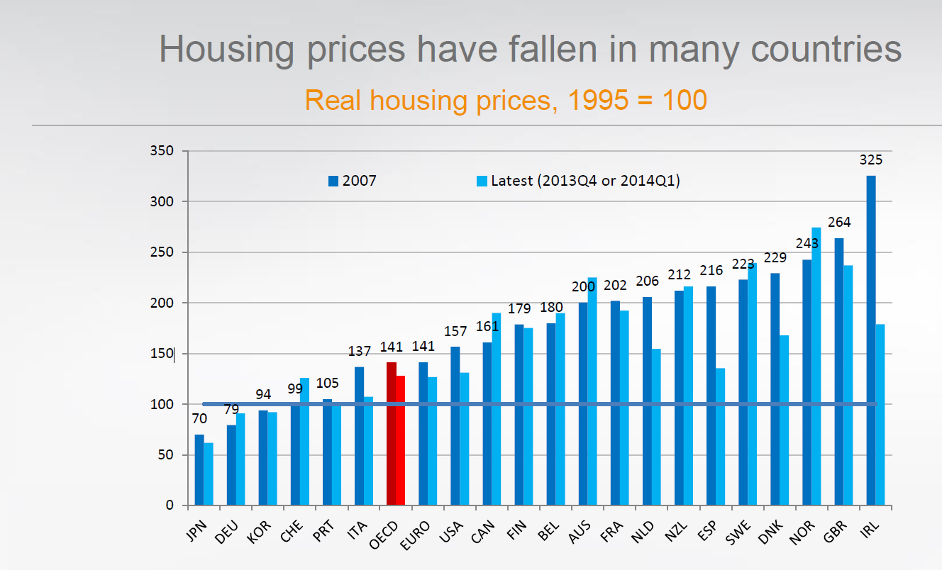

Slide 20
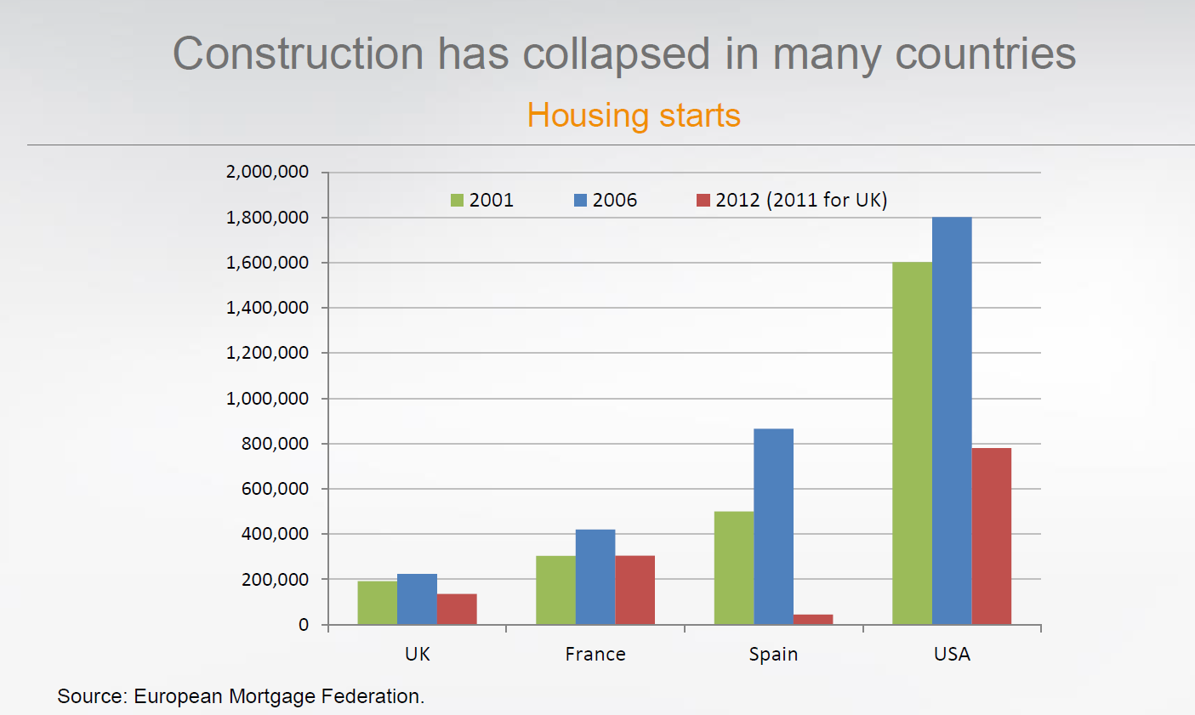
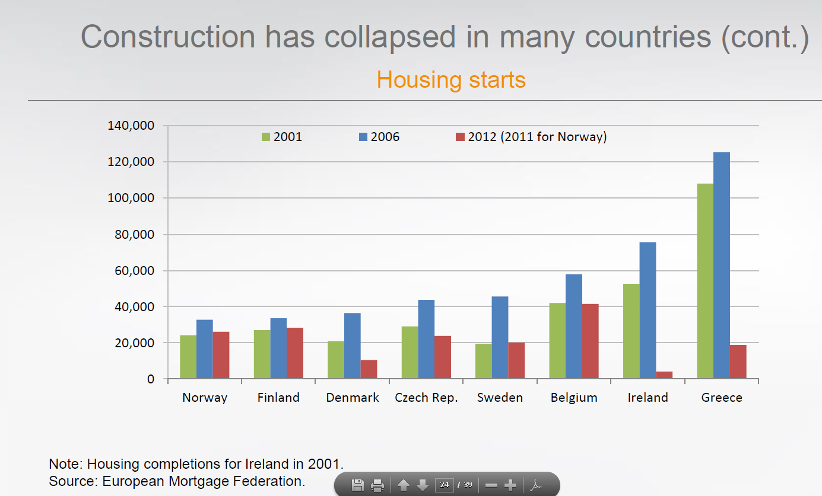

Slide 21
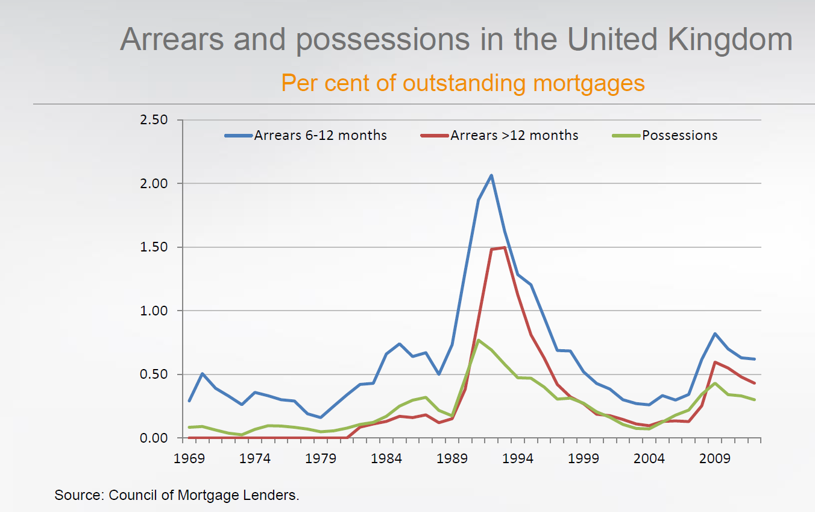

Slide 22
Affordability
Squeezed market

Slide 23
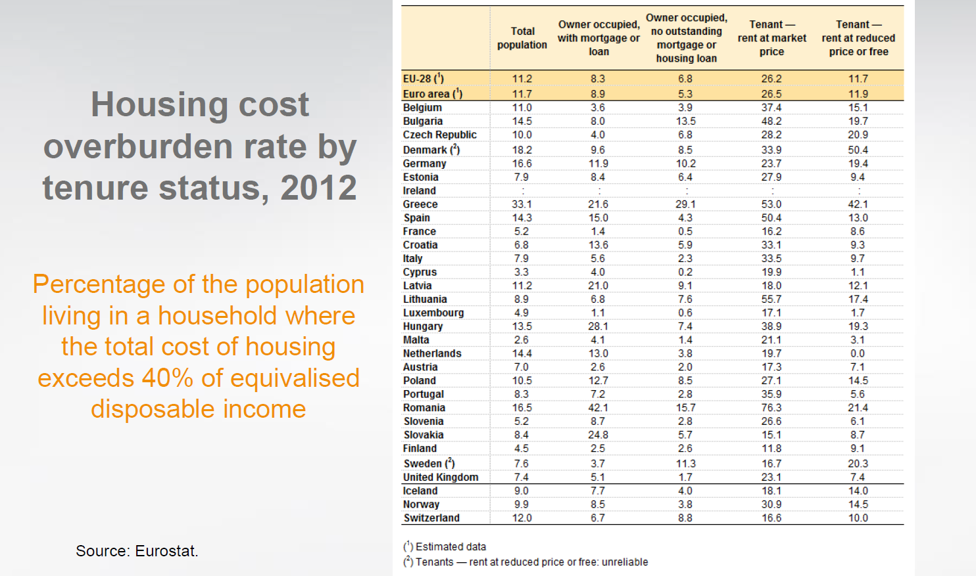
=+20%
Valve of HO &
soc housing has gone

Slide 24
Conclusion
important policy changes (political choice!!)
more market
… pretty bad performance
… but: it should not be suprising… “In no highly economically advanced country – a sadly neglected matter – does the market builds houses that the poor can afford” (JK Galbraith, The culture of contentment, 1992)

Slide 25
Way out…
Be realistic about the role/positon the market and ‘market-led thinking’ has
But, be realistic about what markets are/can/do

Slide 26
Way out…
Markets exist, free market does not exist…
“Markets are social institutions, built up and modified over time.
In order to work, markets are utterly dependent on relations of authority and trust; they need consensual routines, norms and expectations, policing and protection.
Nor do commodities sell themselves for markets to function they need social infrastructures for bringing traders together, carrying out exchange and sharing information.
Considerable labour and organisation is necessary to achieve this all.
These institutional relations will also vary as the types of exchange, commodities, buyers and social setting vary?. Nor do supply and demand simply exist; they too are socially created in complex instituional and culturual ways”
(Barlow & Duncan, 1994)
→ Complex of social relations

Slide 27
So, market provision and allocation has its problems…
…because markets are not perfect
…because the way society functions, intensifies the intrinsic failures

Slide 28
Markets are not perfect, they fail…
Market closure
  …monopolies, cartels and other formal and informal ways to control the market… “Economic agents with common interests will band together to protect their interest”
  →increasing concentration of ownership & control, especially in the credit market
Space & market closure: there can never be perfect information, market coordination or competion… certainly not when agents are located in different geographical and social positions
→ no textbook competition
Negative externalities… substandard, badly located, no concerns of environmental or cultural issues…
Credit allocation… housing is not only determined by consumer demand, but also by the supply of credit
Uncertainty → rational choice=? → wrong → risk is incorporated, counted
Volatility

Slide 29
Verenigd Koninkrijk, House price inflation 1970–2009

Slide 30
Markets are not perfect, they fail…
Barlow&Duncan… “markets even fail if they succeed”
  …what is produced, is what makes the most profit
  …markets allocate goods according to economic demand, not according to need… you must have money to buy…
Bratt, Stone & Hartman (2016)… “The housing market treats housing as a commodity – an item that is bought and sold [rented] for profit. For low-income renters or homebuyers, this creates problems at every step of the housing production, development, distribution and financing process. The final cost of housing is the total cost of housing in the total of many costs involved – including land, building supplies, labor, financing, distibutiond and conveyance. At each phase of the proces, the goal is to maximize profit, which in turn increases costs and reduces affordability”

Slide 31
Market failure is intensified…
Housing problems are deeply ingrained in the operation of our economic system and in ways in wich society functions
  (The growing) income inequality (high & middle incomes ‘set’ the prices)
  Ongoing discrimination
  Depending on debt (financial institutions dominate), fostered debt entrapment & instability
  Inadequate policies
    Ignoring inelasticity (demand subsidies inflate prices)
    Using the bad indicators (price increases)
    Lacking alternatives/discourses of disaster → no real choice

Slide 32
What now?
Less market, since housing is too important
  …more than an investment (is it an investment?)
  …it is a necessity, it is critical to life (we cannot not being housed) and housing cannot be substituted
  …it is central to people’s lives → building block for a range of benefits: health, safety, work, education, economic security, raising children, self-image, outward sight, status…

Slide 33
What now?
Policies… beyond reductionistic criteria (raising sale prices)
Beyond the market… more state (solidarity)
We know what works/need to learn lessons from past models
  Social rental worked in a lot of countries for a long time/today
  Private renting works in e.g. Germany, CH…
  New intermediairies are promising, e.g. SRAs…
  So, there are alternatives...
  Need mixed policies
  New criteria… new forms of collective housing, environmental issues (ageing, changing household structures, mobility)

Slide 34
What now?
What about homeowernship… HO is sustainable, if…
  …households that become owner can stay owner and if others have valuable alternatives
  …the level is not dependent on economic crisis and if it survives longterm economic developments
  …if no government subsidies are necessary to protect its stability and affordability

Slide 35
To end…
“If housing is overcrowded, dilapidated or otherwise inadequate, it is difficult, if not impossible, for family life to function smoothly” (Achterberg & Marcuse, 1986)
“It has become painfully obvious that unregulated markets were not capable of providing housing in the line with either individual or social aspirations” Barlow & Duncan, 1994)

Slide 36
To end
“Unfortunately investors preferred money now,
rather than reward in heaven”
(in Barlow & Duncan, 1994)
Thanks to Marja Elsinga for the first move…

