Slide 1

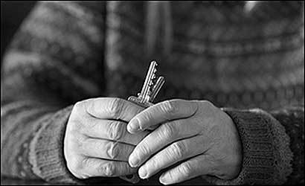

The market and housing: the necessity of regulation
The case of Spain
Alliances to Fight Poverty Seminar
October, 3rd 2014
Marseille

Slide 2

Framing the issue
  Housing is a human right, and necessary to maintain a decent life.
  Widely recognized in many international treaties.
  UN concerns about the housing situation in Spain: it is not consider as a fundamental right, not constitutionally protected
  Article 47 of the Spanish Constitution:
    Housing is a basic right of citizens
    Urges authorities to promote conditions for realizing that right, and to regulate the use of land in accordance with general interest to prevent speculation.
    Absolute predominance of ownership tenure (82,2% in 2012)
    Rent: residual option for those who cannot buy a house (12,1% in 2012)

Slide 3
Some input data/reflections...
  14% of empty homes in 2011 (3.4 millions), but conditions of access to decent, affordable housing remains difficult for a large part of the population.
  Two out of five empty homes are placed in buildings constructed in the 10 years previous to the crisis.
  Property is an asset for pure economic exchange not considering its social function or the Constitutional mandate.
  Crisis has caused a change in society, but not in public policies...
  Structural presence of housing exclusion, worsened by:
    Housing conditions in Spain + over-indebtedness + unemployment
    Lack of attention from public authorities; big cuts in social protection systems
    Lack of comprehensive and inclusive policies
    Loss of housing is a major risk for large sectors of population: evictions

Slide 4
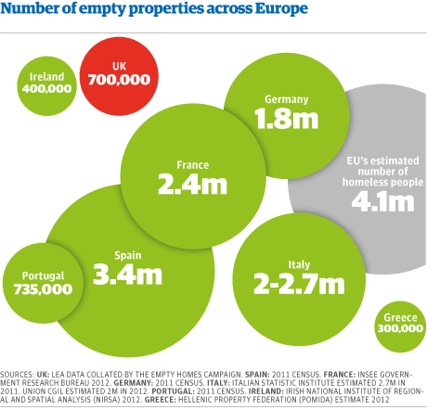
Some input data/reflections...

Slide 5
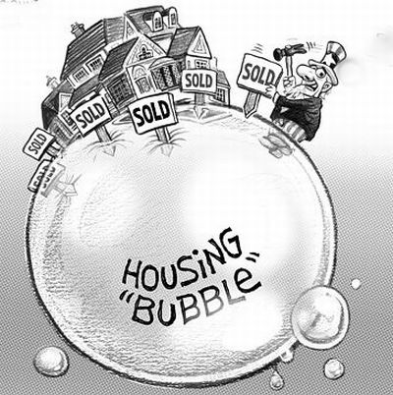
Housing and financial bubbles in Spain
  Why?
    Lowering interest rates
    Increased competition in mortgage markets
    Worst banking practices in lending and speculation
    Voices that warned of the danger of bubbles were not heard
    Deregulation, both housing and financial (1997/7 Act: Measures to liberalize the land)
  Consequences:
    Strong imbalance between housing prices and disposable income
    Dramatic increase of evictions (five times more than before the crisis; almost 400,000 since 2008)

Slide 6
What has the Government done?
  Nothing really effective; requirements of different governmental initiatives leave out an important part of the debtors and the social alarm is increasing…
  Royal Decree-Law 8/2011: Measures to support mortgage holders
  Royal Decree-Law 6/2012: Urgent measures to protect mortgage holders without resources.
  Code of good practices: Financial institutions can join it from a voluntary basis.
  3 phases provided: 1) Loan restructuring (44 cases until now), 2) Release of debt, 3) Dation in payment (8 cases)
  2 years moratorium for evictions, newly expanded for two more years
  Royal Decree-Law 27/2012: Urgent measures to strengthen protection for mortgage holders.
  1/2013 Act: Measures to strengthen the protection to mortgage debtors, debt restructuring and social rent (after PLI...; lack of results, no solutions for people previously evicted)

Slide 7

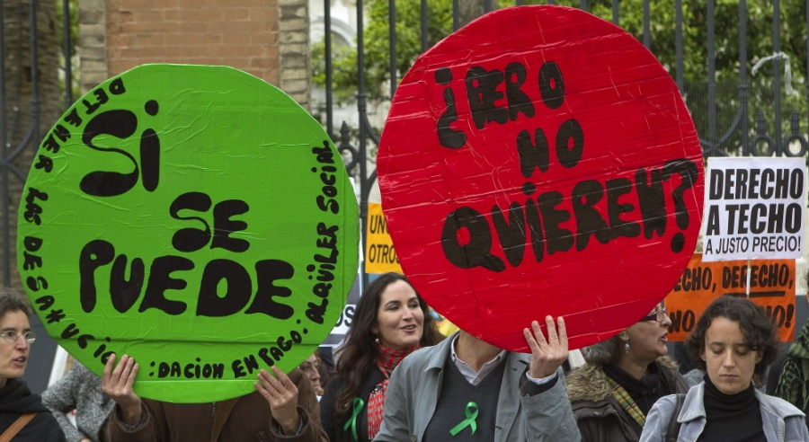
Large and intense social movement
  Led by the PAH (Platform of people affected by
  mortgages); more than a housing demand...
  Launched a Popular Legislative Initiative
  (more than 1,5 million signatures), declare admissible but poorly taken into account by the Government.
  They ask for:
  Retroactive dation in payment
  Stop evictions
  Social rent

Slide 8

Social Housing Fund
  Participants: National and regional authorities, Banks, other stakeholders…
  Main goal: Social use of empty houses owned by banks (due to social alarm caused by evictions…)
  First year (2013): 67.189 evictions; 6.000 available houses; 750 applications; 410 deliveries
  Restrictive conditions, not a widespread solution…
  In 2014: more flexible access conditions; let’s see...

Slide 9
Rent is the great forgotten
  Large percentage of evictions due to unpaid rent.
  4/2013 Act: Measures to ease and promote housing rental market.
    Penalizes and unprotect the tenant.
    Insist on the idea of housing as an speculative good, not as a right.
    Lack of rental policies to really promote the use of empty housing (banks –most of them rescued during the crisis- own between 200.000 and 600.000 empty houses).

Slide 10
Public housing: limited, expensive, poorly planned
  It never has been a political priority...
  National and regional governments are in the process of selling their housing stock (most of them to investment funds)
  At this moment, due to rental market prices adjustment, social rent is more expensive than private!
  Clear downward trend in social/public housing
  Need to adopt a public policy that boost social housing

Slide 11
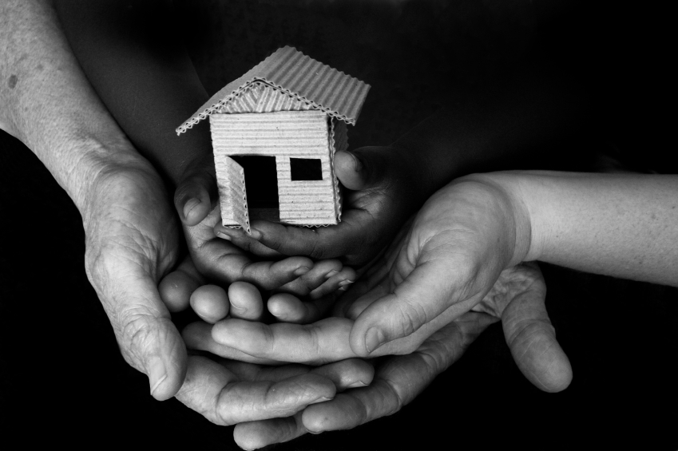
Housing Exclusion, a problem with many faces
  Housing as a pre-condition for a decent life and for inclusion.
  Housing exclusion includes different groups:
  Homeless people
  Roma population
  Older people
  Single parent families
  Young people
  Immigrants
  People with disabilities
  Other disadvantaged groups

Slide 12
Housing Exclusion, a problem with many faces 2
  Residential discrimination: prejudices, irregular conditions imposed by banks, lack of information, lack or weakness of social networks...
  Housing situation: overcrowding, substandard housing, settlements, segregation...
  Not only a problem of housing tenure, also energy poverty...
  Unemployment:
    24,4% in august 2014;
    53,7% in youth under 25.
  Systematic reduction of wages; loss of purchasing power

Slide 13
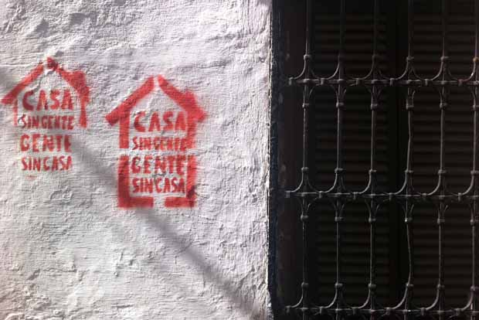

Slide 14

Contact:
Patricia Bezunartea
RAIS Fundación
www.raisfundacion.org
+3491 110 89 84
patriciab@raisfundacion.org
Follow us:
Síguenos en
www.facebook.com/RAISfundacion
https://twitter.com/RAISFundacion
www.youtube.com/user/RAISfundacion
www.linkedin.com/company/rais-fundaci-n

