Slide 1
Ending a Fatal Addiction:
Re-regulating Europe’s Financial Markets
Jeremy Leaman, Loughborough
For REINVEST Conference,
Marseille, October 2 2014

Slide 2
Structure
Why Regulation?
Why Deregulation?
What were the consequences of Deregulation and financialised capitalism
What progress has been made in re-regulating financial services
What remains to be done?
Towards ‘Decent Capitalism’ or a new paradigm?

Slide 3
Point of Departure
Shared priorities of REINVEST & JL!
The construction of a sustainable economic order in Europe’s political economy, based on social justice, intergenerational equity and trans-generational respect for the environment
This paper has both a normative and a scientific dimension.

Slide 4
Why regulation?
Pre-condition for the expansion of dynamic capitalist forms of production was the establishment of a set of statutory norms, enforced by the central authority of a dominant political order/ state and acknowledged by the overwhelming majority of economic agents.
Such norms have expanded with the increasing complexity of economic societies

Slide 5
Regulation & Modernization
Wagner’s Law: strong correlation between the rise of the state ratio and socio-economic modernisation
The growing importance of public goods, c.f. Wendell-Holmes: ‘Taxes are the price we pay for civilized society’
The price of selective/ inadequate non-regulation, faith in market allocation:
1914-1945

Slide 6
Civil War of Advanced Economies
Imperial rivalries of great powers
Protectionism and autarkism in asymmetrical global political economy 1919-1939
Depression, inequality, national and international distributional conflicts, ethno-nationalism, war and genocide
Post-45 regulation based on (partial) insight into international ‘disorder’

Slide 7
New Regulatory Paradigm
Twin pillars of:
National compromise between capital and labour re: distribution of NI and social power; interventionist, redistributive state
International ordering of trade and payments through stabilised currency relations, rooted in US leadership (Dollar/Gold standard): exchange controls/ limited speculation + benign context of growth & reconstruction

Slide 8
No Clearing Union
Keynes’ proposal of international clearing union to address both chronic trade/ payments surpluses and deficits – was not implemented >
Contributed to the subsequent contradictions of global unequal development

Slide 9
Keynesian Paradigm Overturned
1971 (Floating of ERs); US weaker
1973-5 First Oil Shock to Complacency of post-colonial world
Stagflation = critical threat to Keynesian assumptions >
Critique of neo-liberals and monetarists (Chicago School): crisis is the product of (Keynesian) state and intractable information asymmetries (market knows best)

Slide 10
Triumph of Deregulation
Varoufakis: ‘Global Plan’ replaced by ‘Global Minotaur’ = hegemonic ability of the Dollar-bloc to recycle global surpluses
New pre-conditions:
Petro-dollars, vagabond capital, widening current account disparities: chronic surpluses of Germany and Japan
Regional dominance of German central bank; global influence of Federal Reserve

Slide 11
Major Elements of Deregulation
Flexible Exchange Rates
Abandonment of Exchange Controls
No‘rigorous prudential supervision’ (OECD)
The ‘big bang’ in financial services (1986)
Permissive regulation
Privatisation of key public utilities
‘Self-regulation’
Technological reduction of time and space
Tertiarisation/ sectoral crisis of manufacturing

Slide 12
Transformation of Banking
Key role of major international banks in channelling new financial surpluses/ vagabond capital
Financial Services became strategic gatekeeper in the global circulation process
Growing Concentration in banking
Chronic ratio of banking assets to GDP

Slide 13
Bank Mergers in Europe 1990-2004

Slide 14
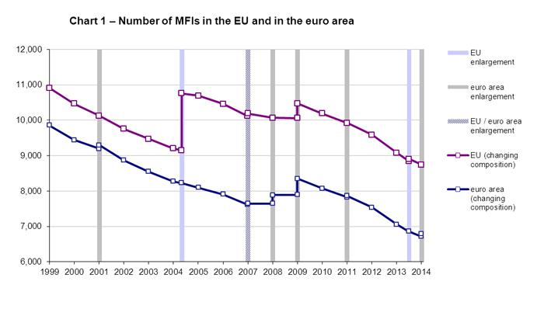
Number of Banks in the EU
1999-2014

Slide 15
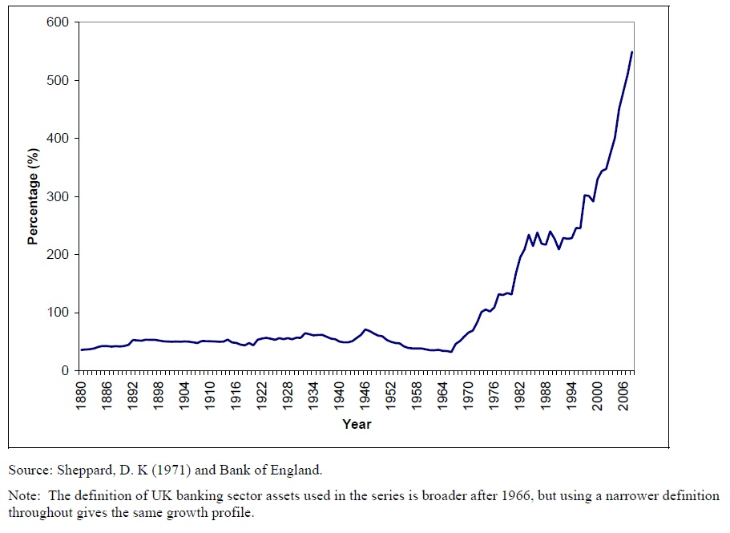
UK Bank Assets as Proportion of GDP 1980-2006

Slide 16
Ratio of Bank Assets to GDP

Slide 17
Key developments
The emergence of oligarchic financial institutions that were subsequently deemed ‘too big to fail’;
The emergence of multi-tiered organisational structures of both ownership and liability;
The emergence of the process of ‘securitization’ and hyper-leveraging;
The acceleration of the turnover of financial assets;
The diversion of finance capital away from real investments to fictional assets and speculation;

Slide 18
Key Developments
The sanitisation/ sanctification/fetishisation of derivatives the associated emergence of shadow banking beyond the control of regulatory authorities
The skewing of macro-economic income/ wealth distribution in favour of economic elites
The substitution of real income increases with the deliberate promotion of private debt;

Slide 19
Developments
The emergence of an unsustainable culture of material expectations, based in hyper-individualised consumption and, within elites,
>> new criminogenic norms of economic behaviour

Slide 20
Creating Secrecy and Complexity: the Curse of Offshore
Of the top 100 FTSE companies, 98 have subsidiaries in tax havens (a total of 8,311 subsidiaries)
banking is the ‘most prolific user of tax havens; in 2013 a total of 1,780 bank subsidiaries (57.3 percent of total) registered in tax havens (Actionaid 2013: 17),
Likewise 61.1 percent of the shadow banks (predominantly hedge funds and private equity groups)

Slide 21
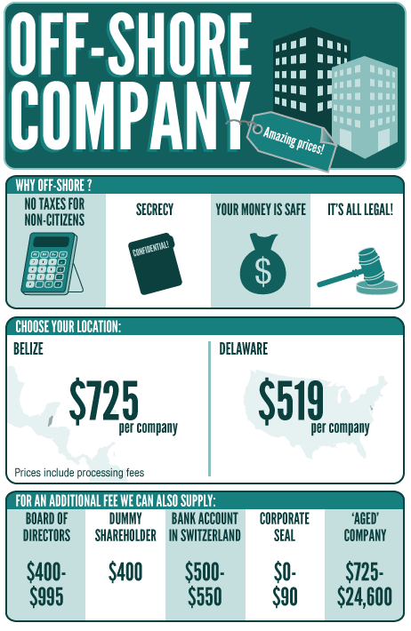
Special Purpose Vehicles (SPVs)
SPVs’ primary purpose to remove liabilities from parent bank balance sheets:
Brass-plate shell companies
on sale in every financial
Centre >> US Advert >>>>>
Bogus, deceitful skullduggery
>> facilitating securitization

Slide 22
Securitization
Modern ‘securitization’:
The conversion of the original borrower’s illiquid assets, like long-term mortgages, into a tradeable security, which is sold on to short-term investors at a lower rate of interest than is demanded for the repayments on the original mortgage(s).
Facilitates hyper-leveraging

Slide 23
Hyperleveraging
Using ‘assets’ based on debt to ‘create money out of thin air’ (Mellor) >
‘Liquidity factories’ (Phillips)
Central culpability of Credit Rating Agencies: blessing junk with AAA ratings
Gillian Tett: ‘the AAA anointment’
Martin Wolf: ‘Fraud or near-fraud’

Slide 24
Descent into High-Speed Trading
Table 1.Global Currency Transactions 1979-2013 (Daily Turnover in $Trillions)
Source: Bank for International Settlements
1979 | 1989 | 1992 | 1995 | 1998 | 2001 | 2007 | 2010 | 2013
0.12 | 0.59 | 0.82 | 1.19 | 1.49 | 1.21 | 3.3 | 4.0 | 5.3
Annualised Currency Turnover
1979: $43.8 Trillion
2013: $1,934 Trillion (or $1.9 Quadrillion
High Frequency Trading now accounts for over half of equity trading

Slide 25
Diversion of Finance Capital from real to fictional investments

Slide 26
Declining Real Investments (UK, D) 1980-2012

Slide 27
Financialisation and Growing Inequality
Inequality not just pre-occupation of the Left
World Bank, IMF, OECD, Bank of England, European Union, the World Economic Forum 2014 (!!!)
Mark Carney:
‘unjust sharing of risk and reward contributed directly to inequality
Perversity of banks offering easy debt to compensate for declining wage share of GDP

Slide 28
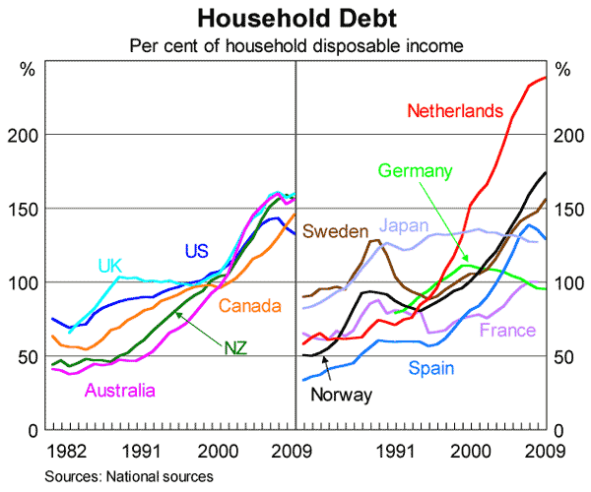
Inequality and Debt

Slide 29
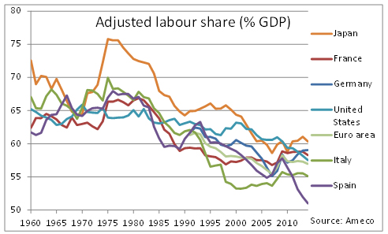
Gross Wages Ratio Selected OECD Economies 1960-2011

Slide 30
Re-regulation: Avoiding Catastrophe
Banking and Shadow Banking:
Much higher Capital Adequacy Ratios than Basel III (minimum of 20 percent equity to total assets) despite negative effect on growth (Miles/ Wolf: possibly as high as 45 percent
Lower leverage ratio (10:1) [2008: 50:1]
Separation of retail from investment banking
De-concentration: ‘too big to fail’ (diseconomies of bank mergers)

Slide 31
Stricter control of monopolies
Weak competition policy at global level:
Massive earnings for banks from M&A advice/ financing
New aggressive wave of hostile takeovers
Therefore: strong European global governance of market power and economic concentration: to enhance investment, research and development; innovation

Slide 32
Towards a new Global Taxation Compact
Mayhem of global taxation: main obstacle to effective reform. Therefore at least in EU
Harmonisation of CT and PIT (minimum rates to avoid tax competition)
Common Consolidated Corporate Tax Base
Country-by-Country Reporting
Formulary Apportionment
Phase out ‘flat tax’ regimes in CEECs; add principle of progressivity to Acquis

Slide 33
Tax Compact
Eliminate ‘offshore’ IN EUROPE and its affiliate tax havens > UK, Lux, Ned, Switz
Eliminate ‘free-rider abuse’ and tax competition between states through multi-lateral agreement (G20/ UN/ UNCTAD/WTO)
Reduce Complexity, Secrecy & Opacity
Restore principles of Transparency and Tax Justice

Slide 34
Conclusion
Financialised capitalism has generated the worst economic crisis in modern economic history through deluded faith in market efficiency, greed, indifference to inequality and stupidity (Emperor’s New Clothes).
FC has reinforced other trends which have ‘deformed’ Europe’s economic order:
Privatisation of natural monopolies and emergence of strategic gatekeepers

Slide 35
Milking Monopoly Income Streams
Easy returns from monopolies/ oligopolies/ monopsonies > higher Rates of Return (ROR)
Easy returns from sovereign bonds 1980s
Easy returns from privatised utilities/ natural monopolies
All contributed to madness of Bank targets of 20-25% ROR on equity capital!!!
>> Diversion of savings/ capital from real productive investment & innovation

Slide 36
The deformation of Europe’s political economy cannot therefore be reversed by financial reregulation alone. Corporate abuse of weak regulatory regimes is merely one element of an institutionally corrupted mode of accumulation which has manoeuvred millions of pensioners into a more intractable form of dependency. Recalibrating European capitalism, reversing the inequalities and underinvestment of the current system, will take considerably more imagination, solidarity and wise foresight than tightening up on bank regulation and international taxation, when that task will be challenging enough. (C.f. Leaman, full paper)

Slide 37
Collective Solidarity
Even more important is the need to neutralise the deformation and corruption of economic behaviour by nurturing individual capabilities within the dynamic framework of intra- and trans-generational global justice and social solidarity:
Restore the courageous state (Murphy)

