Slide 1
Poverty and Social Exclusion in the EU and the Mid Term Review of Europe 2020
Peter Lelie
Alliances to Fight Poverty - Marseille - 3 October 2014

Slide 2
Contents
1. Poverty and social exclusion in the European Union
2. The Mid Term Review of the Europe 2020 strategy
3. Conclusion

Slide 3
1. Poverty and Social Exclusion in the EU
The EU At-Risk-of-Poverty or Social Exclusion Target
The Social Protection Performance Monitor Dashboard and the Social Trends to Watch
The new Scoreboard of Key Employment and Social Indicators

Slide 4

Annual Report of the
EU Social Protection
Committee on the
Social Situation in the
European Union
2013
http://ec.europa.eu/social/BlobServlet?docId=11503&langId=en

Slide 5
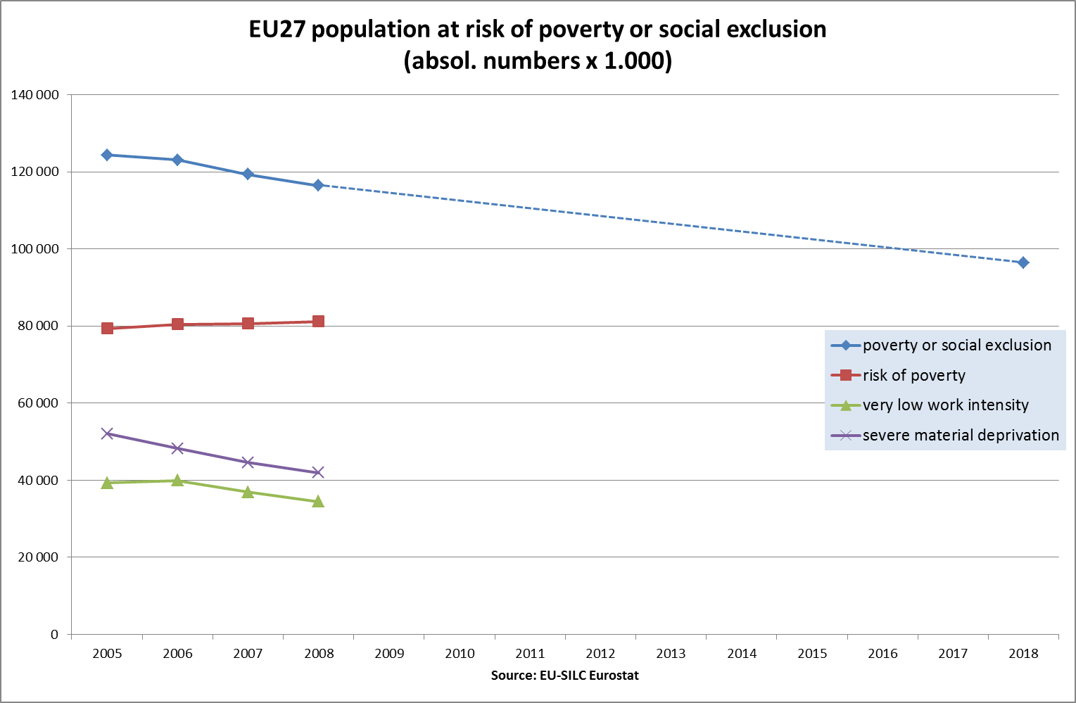

Slide 6
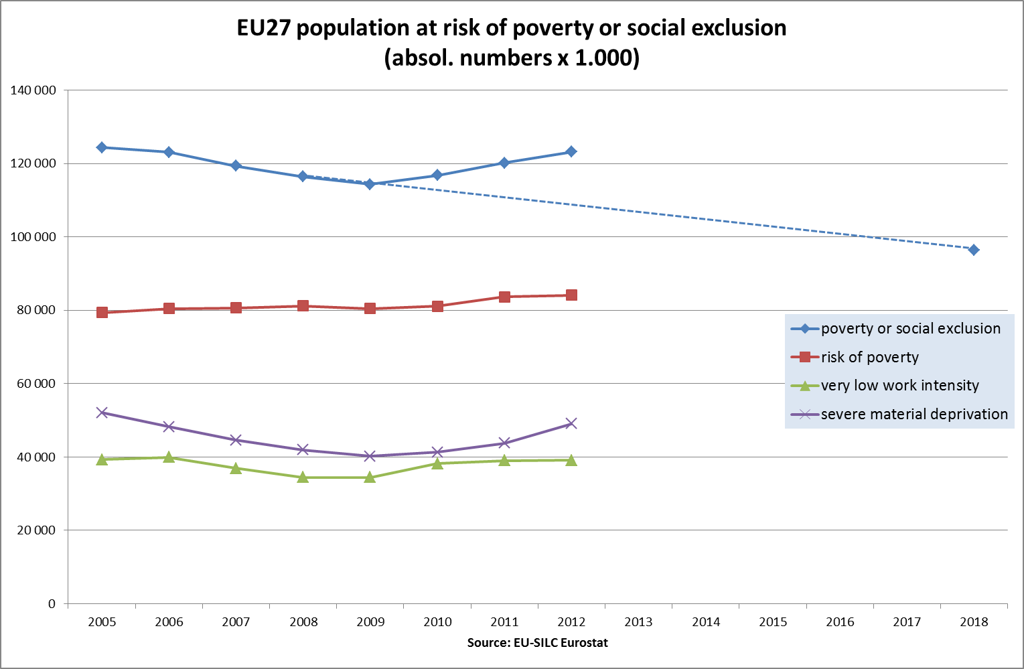

Slide 7
% change in the EU27 population at risk of poverty or social exclusion 2005 - 2008 -2012
Source: EU-SILC Eurostat

Slide 8
Source: EU-SILC Eurostat
Break in series: AT, UK (2012)

Slide 9
SPPM
DASHBOARD
21 indicators
- Europe 2020 (4)
- Intensity poverty risk (1)
- Income inequalities (1)
- Child poverty (1)
- Effectiveness of social
protection systems (2)
Social consequences of
labour market situation (2)
- Youth exclusion (3)
- Active ageing (1)
- Pension adequacy (3)
- Health (2)
- Decent housing (1)
Dimensions | SPPM results
Europe 2020 |  | EU27 | BE | BG | CZ | DK | DE | EE | IE | EL | ES | FR | IT | CY | LV | LT | LU | HU | MT | NL | AT | PL | PT | RO | SI | SK | FI | SE | UK
 | At risk of poverty or social exclusion (in %)
 | 2011 | 24,2 | 21,0 | 49,1 | 15,3 | 18,9 | 19,9 | 23,1 | : | 31,0 | 27,0 | 19,3 | : | 23,5 | 40,1 | 33,4 | 16,8 | 31,0 | 21,4 | 15,7 | 16,9 | 27,2 | 24,4 | 40,3 | 19,3 | 20,6 | 17,9 | 16,1 | 22,7
 | 2010-2011 change in pp | ~ | ~ | 7,5 | 0,9 | ~ | ~ | 1,4 | : | 3,3 | 1,5 | ~ | : | ~ | 2,0 | ~ | ~ | 1,1 | 1,1 | 0,6 | ~ | -0,6 | -0,9 | -1,1 | 1,0 | ~ | 1,0 | 1,1 | ~
 | 2008-2011 change in pp | ~ | ~ | 10,9 | ~ | 2,6 | ~ | 1,3 | : | 2,9 | 4,1 | ~ | : | 1,1 | 6,3 | 5,8 | 1,3 | 2,8 | 1,8 | 0,8 | -1,7 | -3,3 | -1,6 | -3,9 | ~ | ~ | ~ | 1,2 | ~
 | At risk of poverty (in %)
 | 2011 | 16,9 | 15,3 | 22,3 | 9,8 | 13,0 | 15,8 | 17,5 | 16,1 | 21,4 | 21,8 | 14,0 | 19,6 | 14,5 | 19,3 | 20,0 | 13,6 | 13,8 | 15,4 | 11,0 | 12,6 | 17,7 | 18,0 | 22,2 | 13,6 | 13,0 | 13,7 | 14,0 | 16,2
 | 2010-2011 change in pp | ~ | 0,7 | 1,6 | 0,8 | ~ | ~ | 1,7 | 1,1 | 1,3 | 1,1 | ~ | 1,4 | ~ | -2,0 | ~ | -0,9 | 1,5 | ~ | 0,7 | ~ | ~ | ~ | 1,1 | 0,9 | 1,0 | ~ | 1,1 | -0,9
 | 2008-2011 change in pp | ~ | ~ | ~ | ~ | 1,2 | ~ | -2,0 | ~ | 1,3 | 2,2 | 1,3 | ~ | -1,2 | -6,3 | ~ | ~ | 1,4 | ~ | ~ | ~ | ~ | ~ | -1,2 | 1,3 | 2,1 | ~ | 1,8 | -2,5
 | Severe material deprivation rate (in %)
 | 2011 | 8,8 | 5,7 | 43,6 | 6,1 | 2,6 | 5,3 | 8,7 | : | 15,2 | 3,9 | 5,2 | : | 10,7 | 30,9 | 18,5 | 1,2 | 23,1 | 6,3 | 2,5 | 3,9 | 13,0 | 8,3 | 29,4 | 6,1 | 10,6 | 3,2 | 1,2 | 5,1
 | 2010-2011 change in pp | ~ | -0,2 | 8,6 | ~ | ~ | 0,8 | ~ | : | 3,6 | -0,1 | ~ | : | 1,1 | 3,5 | -1,0 | 0,7 | 1,5 | 0,6 | 0,3 | ~ | -1,2 | -0,7 | -1,6 | ~ | -0,8 | 0,4 | ~ | ~
 | 2008-2011 change in pp | ~ | ~ | 12,1 | ~ | ~ | ~ | 3,8 | : | 4,0 | 1,4 | ~ | : | 1,9 | 11,9 | 6,2 | ~ | 5,2 | 2,3 | 1,0 | -2,5 | -4,7 | -1,4 | -3,5 | ~ | -1,2 | ~ | ~ | ~
 | Population living in very low work intensity households (in %)
 | 2011 | 10,0 | 13,7 | 11,0 | 6,6 | 11,4 | 11,1 | 9,9 | : | 11,8 | 12,2 | 9,3 | : | 4,5 | 12,2 | 12,3 | 5,8 | 12,1 | 8,3 | 8,7 | 8,0 | 6,9 | 8,2 | 6,7 | 7,6 | 7,6 | 9,8 | 6,8 | 11,5
 | 2010-2011 change in pp | ~ | 1,1 | 3,1 | ~ | 1,1 | ~ | 1,0 | : | 4,3 | 2,4 | ~ | : | ~ | ~ | 3,1 | 0,3 | ~ | ~ | 0,5 | ~ | -0,4 | -0,4 | -0,1 | 0,7 | ~ | 0,7 | 0,9 | -1,6
 | 2008-2011 change in pp | 1,0 | 2,0 | 2,9 | ~ | 3,1 | ~ | 4,6 | : | 4,4 | 6,0 | ~ | : | ~ | 7,1 | 7,2 | 1,1 | ~ | ~ | ~ | ~ | -1 | 1,9 | -1,5 | ~ | 2,4 | 2,5 | 1,4 | 1,1
Intensity of poverty risk | Relative median at-risk-of-poverty gap (in %)
 | 2011 | 23,3 | 18,6 | 30,0 | 17,2 | 21,4 | 21,4 | 26,0 | : | 26,1 | 30,8 | 17,1 | : | 18,9 | 31,7 | 28,7 | 15,7 | 18,3 | 17,7 | 15,5 | 19,0 | 21,4 | 23,2 | 31,8 | 19,9 | 22,8 | 13,5 | 18,5 | 21,1
 | 2010-2011 change in pp | ~ | ~ | ~ | -3,9 | ~ | ~ | 2,8 | : | 2,7 | ~ | -3,1 | : | 1,1 | 2,3 | -3,9 | -2,9 | 1,8 | ~ | ~ | 1,8 | ~ | ~ | 1,2 | ~ | -2,9 | ~ | -1,2 | ~
 | 2008-2011 change in pp | 1,6 | 1,4 | 3,0 | -1,3 | 3,4 | ~ | 5,7 | : | 1,4 | 7,2 | 2,3 | : | 2,4 | 3,1 | 3,0 | ~ | 1,0 | -2,7 | ~ | 3,7 | ~ | ~ | ~ | ~ | 4,7 | -2,2 | ~ | ~
Income inequalities | Income quantile ratio (S80/S20)
 | 2011 | 5,1 | 3,9 | 6,5 | 3,5 | 4,4 | 4,5 | 5,3 | : | 6,0 | 6,8 | 4,6 | : | 4,3 | 6,6 | 5,8 | 4,0 | 3,9 | 4,1 | 3,8 | 3,8 | 5,0 | 5,7 | 6,2 | 3,5 | 3,8 | 3,7 | 3,6 | 5,3
 | 2010-2011 % change | ~ | ~ | 10,2 | ~ | ~ | ~ | 6,0 | : | 7,1 | ~ | ~ | : | ~ | ~ | -20,5 | ~ | 14,7 | ~ | ~ | ~ | ~ | ~ | ~ | ~ | ~ | ~ | ~ | ~
 | 2008-2011 % change | ~ | ~ | ~ | ~ | 22,2 | -6,3 | 6,0 | : | ~ | 25,9 | ~ | : | ~ | -9,6 | ~ | ~ | 8,3 | ~ | -5,0 | ~ | ~ | -6,6 | -11,4 | ~ | 11,8 | ~ | ~ | -5,4
Child poverty | Children at risk of poverty or social exclusion (in %)
 | 2011 | 27,0 | 23,3 | 51,8 | 20,0 | 16,0 | 19,9 | 24,8 | : | 30,4 | 30,6 | 23,0 | : | 21,8 | 43,6 | 33,4 | 21,7 | 39,6 | 25,8 | 18,0 | 19,2 | 29,8 | 28,6 | 49,1 | 17,3 | 26,0 | 16,1 | 15,9 | 26,9
 | 2010-2011 change in pp | ~ | ~ | 7,2 | 1,1 | ~ | -1,8 | ~ | : | ~ | 0,8 | ~ | : | ~ | 1,6 | ~ | ~ | ~ | ~ | 1,1 | ~ | -1,0 | ~ | 0,4 | 2,1 | ~ | 1,9 | 1,4 | -2,8
 | 2008-2011 change in pp | ~ | 2,0 | 13,4 | 1,4 | 3,3 | ~ | 5,4 | : | 1,7 | 4,3 | 1,6 | : | ~ | 10,4 | 4,0 | ~ | 6,2 | 2,3 | 2,5 | -1,2 | -3,1 | ~ | -2,1 | 2,0 | 1,7 | 1,0 | 1,3 | -2,7
Effectiveness of socia protection systems | Impact of social transfers (excluding pensions) on poverty reduction (in %)
 | 2011 | 35,2 | 45,0 | 17,7 | 45,6 | 54,2 | 37,1 | 29,7 |  | 13,7 | 26,8 | 43,3 |  | 37,8 | 29,3 | 37,1 | 50,0 | 52,2 | 32,8 | 47,4 | 49,4 | 26,6 | 29,1 | 23,7 | 43,8 | 33,3 | 50,0 | 49,8 | 46,9
 | 2010-2011 change in pp | ~ | ~ | -5,9 | ~ | ~ | ~ | -6,8 |  | ~ | ~ | ~ |  | ~ | ~ | ~ | ~ | ~ | ~ | ~ | ~ | ~ | ~ | ~ | ~ | -6,1 | ~ | ~ | ~
 | 2008-2011 change in pp | ~ | ~ | ~ | -9,4 | ~ | ~ | 8,7 |  | ~ | 8,2 | ~ |  | 7,5 | 14,1 | 10,6 | 6,8 | -7,0 | ~ | ~ | ~ | -6,1 | ~ | ~ | ~ | -7,4 | ~ | -7,4 | 11,6
 | At-risk-of-poverty rate for the population living in very low work intensity households (in %)
 | 2011 | 57,7 | 62,9 | 76,2 | 58,3 | 41,4 | 68,7 | 72,8 | : | 54,1 | 60,4 | 54,3 | : | 48,6 | 68,1 | 64,7 | 41,0 | 56,3 | 61,2 | 42,6 | 54,3 | 56,9 | 54,6 | 51,6 | 58,1 | 65,6 | 57,7 | 63,5 | 47,8
 | 2010-2011 change in pp | ~ | 7,5 | ~ | ~ | -3,0 | 1,4 | 2,9 | : | 15,0 | 3,3 | ~ | : | -1,9 | -3,6 | ~ | -4,9 | 3,5 | -1,7 | 5,9 | ~ | ~ | -3,3 | 7,0 | 2,0 | 4,1 | -2,3 | 1,9 | -9,5
 | 2008-2011 change in pp | 1,9 | 8,2 | -1,6 | 2,9 | ~ | 4,5 | -9,5 | : | 13,8 | 5,2 | 4,2 | : | -7,5 | -14,9 | -1,7 | -8,4 | 7,8 | ~ | 2,9 | 4,1 | 7,7 | 1,4 | 1,2 | 3,1 | 12,5 | 1,4 | 12,1 | -15,3
Social consequences of labour market situation | In-work at-risk-of-poverty rate (in %)
 | 2011 | 8,9 | 4,2 | 8,2 | 4,0 | 6,4 | 7,7 | 7,9 | : | 11,9 | 12,3 | 7,6 | : | 7,2 | 9,3 | 10,1 | 9,9 | 6,1 | 6,0 | 5,5 | 5,4 | 11,1 | 10,3 | 19,0 | 6,0 | 6,3 | 3,9 | 6,9 | 7,9
 | 2010-2011 change in pp | ~ | -0,3 | ~ | 0,3 | ~ | 0,5 | 1,4 | : | -1,9 | -0,4 | 1,4 | : | ~ | -0,4 | -2,2 | -0,7 | 0,8 | ~ | 0,4 | ~ | ~ | 0,6 | 1,7 | 0,7 | 0,6 | ~ | ~ | 1,1
 | 2008-2011 change in pp | ~ | ~ | ~ | ~ | 1,3 | ~ | ~ | : | -2,4 | 1,6 | 0,9 | : | 1,2 | -1,7 | ~ | ~ | ~ | 1,0 | ~ | -1,0 | ~ | -1,5 | 1,3 | ~ | ~ | -1,2 | ~ | ~
 | Long-term unemployment rate (in %)
 | 2011 | 4,1 | 3,5 | 6,3 | 2,7 | 1,8 | 2,8 | 7,1 | 8,6 | 8,8 | 9,0 | 4,0 | 4,4 | 1,6 | 8,8 | 8,0 | 1,4 | 5,2 | 3,0 | 1,5 | 1,1 | 3,6 | 6,2 | 3,1 | 3,6 | 9,2 | 1,7 | 1,4 | 2,7
 | 2010-2011 change in pp | ~ | ~ | 1,5 | ~ | ~ | ~ | ~ | 1,9 | 3,1 | 1,7 | ~ | ~ | ~ | ~ | ~ | ~ | ~ | ~ | ~ | ~ | ~ | ~ | ~ | ~ | ~ | ~ | ~ | ~
 | 2008-2011 change in pp | 1,5 | ~ | 3,4 | ~ | 1,3 | -1,2 | 5,4 | 6,9 | 5,2 | 7,0 | 1,1 | 1,3 | 1,1 | 6,7 | 6,8 | ~ | 1,6 | ~ | ~ | ~ | 1,2 | 2,2 | ~ | 1,7 | 2,5 | ~ | ~ | 1,3
Youth exclusion | Early school leavers (in %)
 | 2011 | 13,5 | 12,3 | 12,8 | 4,9 | 9,6 | 11,5 | 10,9 | 10,6 | 13,1 | 26,5 | 12,0 | 18,2 | 11,2 | 11,8 | 7,9 | 6,2 | 11,2 | 33,5 | 9,1 | 8,3 | 5,6 | 23,2 | 17,5 | 4,2 | 5,0 | 9,8 | 6,7 | 15,0
 | 2010-2011 change in pp | ~ | ~ | -1,1 | ~ | -1,4 | ~ | ~ | ~ | ~ | -1,9 | ~ | ~ | -1,4 | -1,5 | ~ | ~ | ~ | -3,4 | ~ | ~ | ~ | -5,5 | ~ | ~ | ~ | ~ | ~ | ~
 | 2008-2011 change in pp | -1,4 | ~ | -2 | ~ | -2,9 | ~ | -3,1 | ~ | -1,7 | -5,4 | ~ | -1,5 | -2,5 | -3,7 | ~ | -7,2 | ~ | -4,6 | -2,3 | -1,8 | ~ | -12,2 | 1,6 | ~ | -1,0 | ~ | -1,2 | -2
 | Youth unemployment ratio (15-24)
 | 2011 | 9,1 | 6,0 | 7,3 | 5,4 | 9,6 | 4,5 | 9,1 | 11,7 | 13,0 | 19,0 | 8,4 | 8,0 | 8,7 | 11,2 | 9,6 | 4,2 | 6,4 | 7,1 | 5,3 | 5,0 | 8,7 | 11,7 | 7,4 | 5,9 | 10,0 | 10,1 | 12,0 | 12,4
 | 2010-2011 change in pp | ~ | -1,3 | ~ | ~ | ~ | ~ | -3,5 | ~ | 3,0 | 1,2 | ~ | ~ | 2,0 | -2,7 | ~ | ~ | ~ | ~ | ~ | ~ | ~ | 3,5 | ~ | ~ | ~ | ~ | -1,0 | ~
 | 2008-2011 change in pp | 2,2 | ~ | 3,5 | 2,3 | 3,8 | -1,0 | 4,1 | 5,0 | 6,3 | 7,3 | 1,3 | 1,4 | 4,9 | 5,6 | 5,5 | -1,0 | 1,4 | ~ | 1,4 | ~ | 3,0 | 4,9 | 1,7 | 1,4 | 3,8 | 1,3 | 1,3 | 3,2
Active ageing | Employment rate for older workers (55-64), in %
 | 2011 | 47,4 | 38,7 | 43,9 | 47,6 | 59,5 | 59,9 | 57,2 | 50,0 | 39,4 | 44,5 | 41,5 | 37,9 | 55,2 | 51,1 | 50,5 | 39,3 | 35,8 | 31,7 | 56,1 | 41,5 | 36,9 | 47,9 | 40,0 | 31,2 | 41,4 | 57,0 | 72,3 | 56,7
 | 2010-2011 change in pp | 1,1 | 1,4 | ~ | 1,1 | 1,1 | 2,2 | 3,4 | ~ | -2,9 | ~ | 1,7 | 1,3 | -1,6 | 2,9 | 1,9 | ~ | 1,4 | 1,5 | 2,4 | ~ | 2,9 | -1,3 | -1,1 | -3,8 | ~ | ~ | 1,8 | `
 | 2008-2011 change in pp | 1,8 | 4,2 | -2,1 | ~ | 1,1 | 6,2 | -5,2 | -3,7 | -3,4 | -1,1 | 3,3 | 3,5 | ~ | -8,3 | -2,6 | 5,2 | 4,4 | 2,5 | 3,1 | ~ | 5,3 | -2,9 | -3,1 | -1,6 | 2,2 | ~ | 2,2 | -1,3
Pension adequacy | At risk of poverty or social exclusion rate for the elderly (65+), in %
 | 2011 | 20,5 | 21,6 | 61,1 | 10,7 | 16,6 | 15,3 | 17,0 | : | 29,3 | 22,3 | 11,5 | : | 40,4 | 33,2 | 32,5 | 4,7 | 18,0 | 21,5 | 6,9 | 17,1 | 24,7 | 24,5 | 35,3 | 24,2 | 14,5 | 19,8 | 18,6 | 22,7
 | 2010-2011 change in pp | ~ | ~ | 5,2 | ~ | -1,8 | ~ | -2,0 |  | 2,6 | ~ | -1,3 |  | -1,9 | -4,5 | 2,5 | -1,4 | 1,2 | ~ | ~ | 1,3 | ~ | -1,6 | -4,6 | 1,4 | -2,2 | ~ | 2,7 | ~
 | 2008-2011 change in pp | -2,7 | -1,3 | 2,6 | -1,8 | -2,0 | ~ | -23,9 |  | 1,2 | -5,9 | -2,4 |  | -8,7 | -24,9 | -5,6 | ~ | ~ | -4,9 | -2,8 | ~ | -2,2 | -3,2 | -13,9 | ~ | -7,4 | -4,1 | 3,1 | -5,8
 | Median relative income ratio of elderly people
 | 2011 | 0,9 | 0,7 | 0,7 | 0,8 | 0,7 | 0,9 | 0,8 | : | 0,8 | 0,8 | 1,0 | : | 0,7 | 0,9 | 0,9 | 1,1 | 1,0 | 0,8 | 0,9 | 0,9 | 0,9 | 0,9 | 1,0 | 0,9 | 0,9 | 0,8 | 0,8 | 0,8
 | 2010-2011 % change | ~ | ~ | ~ | ~ | ~ | ~ | ~ | : | ~ | ~ | ~ | : | ~ | 10,4 | -5,4 | ~ | ~ | ~ | ~ | ~ | ~ | 6,1 | ~ | ~ | ~ | ~ | ~ | ~
 | 2008-2011 % change | ~ | ~ | 9,1 | ~ | ~ | ~ | 21,0 | : | -5,8 | 6,4 | ~ | : | 6,6 | 57,4 | 22,5 | 8,2 | ~ | 9,6 | ~ | ~ | ~ | ~ | 18,8 | ~ | 8,9 | 8,3 | ~ | 9,5
 | Aggregate replacement ratio
 | 2011 | 0,5 | 0,4 | 0,4 | 0,5 | 0,4 | 0,5 | 0,5 | : | 0,5 | 0,6 | 0,6 | : | 0,4 | 0,5 | 0,5 | 0,7 | 0,6 | 0,5 | 0,5 | 0,6 | 0,6 | 0,6 | 0,6 | 0,5 | 0,6 | 0,5 | 0,6 | 0,5
 | 2010-2011 % change | -9,4 | ~ | ~ | ~ | ~ | ~ | ~ |  | 7,1 | 5,7 | ~ |  | 5,6 | 17,4 | -13,3 | 8,8 | ~ | ~ | ~ | -6,3 | ~ | 5,7 | ~ | ~ | ~ | ~ | ~ | ~
 | 2008-2011 % change | -4,0 | ~ | 20,6 | ~ | ~ | 15,9 | 20,0 |  | 9,8 | 14,3 | ~ |  | 15,2 | 80,0 | 18,2 | 27,6 | ~ | 11,9 | 7,0 | -11,8 | ~ | 9,8 | 30,6 | 6,8 | 14,8 | ~ | -6,5 | 11,6
Health | Self-reported unment need for medical care (in %)
 | 2011 | : | 1,5 | 9,9 | 1,1 | 0,9 | 1,8 | 7,4 |  | 7,6 | 0,6 | 2,4 | : | : | 16,1 | 3,2 | 0,6 | 2,7 | 1,1 | 0,5 | 0,4 | 8,1 | 1,5 | 12,2 | 0,1 | 2,2 | 4,5 | 1,3 | :
 | 2010-2011 change in pp | : | 1,1 | ~ | ~ | ~ | ~ | 2,5 |  | 2,1 | ~ | ~ | : | : | ~ | ~ | ~ | 1,0 | ~ | ~ | ~ | ~ | ~ | 1,2 | ~ | ~ | ~ | ~ | :
 | 2008-2011 change in pp | : | 1,0 | -5,5 | ~ | ~ | ~ | ~ |  | 2,0 | ~ | ~ | : | : | 6,1 | -2,4 | ~ | ~ | 1,1 | ~ | ~ | 1,8 | ~ | 1,2 | ~ | ~ | 3,7 | -1,2 | :
 | Healthy life years at 65 - males
 | 2011 | : | : | 8,6 | 8,4 | 12,4 | 6,7 | 5,6 | : | : | 9,7 | : | : | : | 4,8 | 6,1 | 11,5 | 6,0 | : | 10,4 | 8,3 | : | 7,9 | 5,3 | 6,2 | 3,5 | 8,4 | 13,9 | :
 | % change to 2008 |  |  | ~ | 12,0 | ~ | 6,3 | 40,0 |  |  | ~ |  |  |  | ~ | 5,2 | 7,5 | 7,1 |  | 5,1 | 12,2 |  | 17,9 | -32,1 | -32,6 | 16,7 | 5,0 | 6,1
 | Healthy life years at 65 - females
 | 2011 | : | : | 9,7 | 8,7 | 13,0 | 7,3 | 5,7 | : | : | 9,3 | : | : | : | 5,0 | 6,7 | 11,8 | 6,0 | : | 9,9 | 8,3 | : | 6,4 | 4,7 | 6,9 | 2,9 | 8,6 | 15,2 | :
 | % change to 2008 |  |  | ~ | 6,1 | ~ | 9,0 | 35,7 |  |  | 6,9 |  |  |  | ~ | ~ | ~ | -6,3 |  | ~ | 10,7 |  | 16,4 | -40,5 | -26,6 | 7,4 | ~ | 8,6
Access to decent housing | Housing cost overburden rate
 | 2011 | 11,0 | 10,6 | 9,0 | 9,5 | 19,9 | : | 7,4 | : | 24,3 | 12,1 | 5,3 | : | 2,8 | 12,4 | 10,7 | 4,2 | 11,8 | 2,8 | 14,5 | 4,8 | 10,2 | 7,2 | 9,9 | 4,7 | 8,4 | 4,4 | 7,9 | 16,4
 | 2010-2011 change in pp | 1,0 | 1,7 | 3,1 | ~ | -2,0 | : | 1,4 | : | 6,2 | ~ | ~ | : | ~ | ~ | ~ | ~ | ~ | ~ | ~ | ~ | 1,1 | 3,0 | -5,1 | ~ | ~ | ~ | 1,4 | ~
 | 2008-2011 change in pp | ~ | -1,9 | -4,3 | -3,3 | 2,8 | : | 3,8 | : | 2,1 | 4,1 | 1,2 | : | 1,2 | 4,0 | 5,9 | ~ | ~ | ~ | ~ | ~ | ~ | ~ | -8,8 | ~ | 2,8 | ~ | ~ | ~

Slide 10
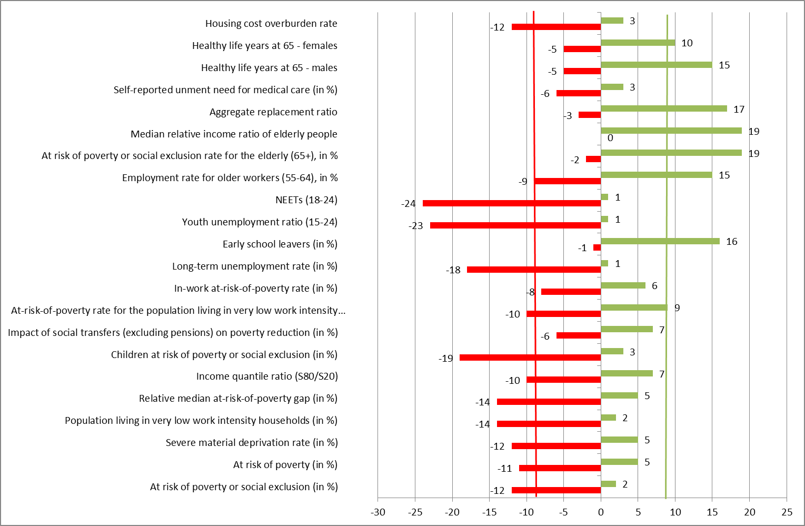
Number of Member States showing significant improvements or deterioration in key social indicators (2008-2012)

Slide 11
Key negative EU "social trends to watch" (2008-2012)
Youth exclusion:
  NEETs (24 MS)
  youth unemployment ratio (23 MS)
Child poverty or social exclusion (19 MS)
Long term exclusion from the labour market:
  long term unemployment (18 MS)
  share of the population in quasi jobless households (14 MS)
Risk of poverty or social exclusion (12 MS)
Housing cost overburden rate households (12 MS)
Income inequality S80/S20 (10 MS)

Slide 12
Key positive EU social trends (2008-2012)
Risk of poverty or social exclusion of the elderly (19 MS)
Relative income of the elderly:
  Median relative income (19 MS)
  Aggregate replacement ratio (17 MS)
Rate of early school leavers (16 MS)
Employment rate of older workers (15 MS)
Healthy life years for men (15 MS) and women (10 MS)

Slide 13
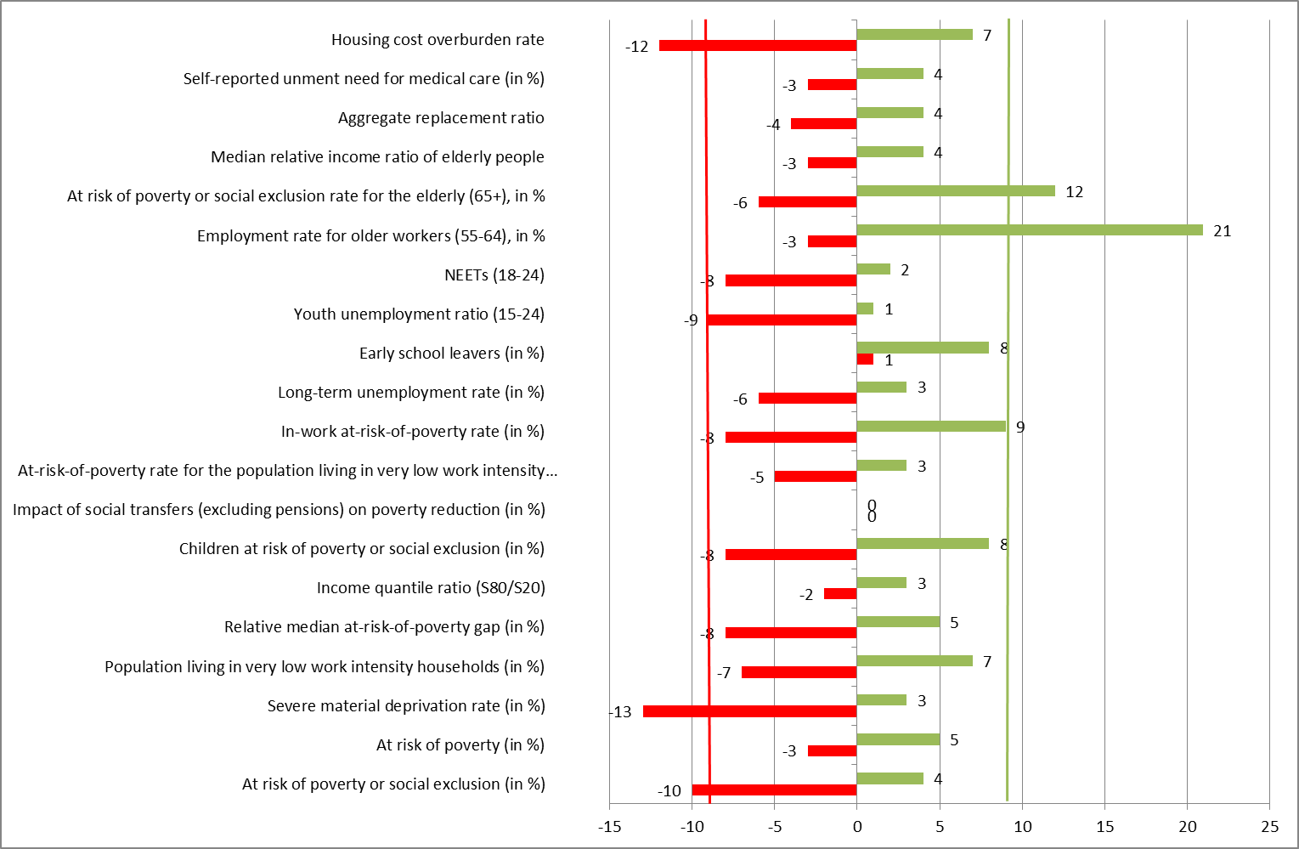
Number of Member States showing significant improvements or deterioration in key social indicators (2011-2012)

Slide 14
The Scoreboard of key employment and social indicators
To ensure greater visibility and to make it easier to identify major employment and social trends that may affect the good functioning of the EMU and may warrant a closer follow up in the European Semester
Unemployment rate (15-74)
NEET rate and youth unemployment rate (15-24)
Real gross household disposable income
At-risk-of-Poverty rate (15-64)
Income inequality S80-S20 (share ratio)

Slide 15
Groupings of EU Member States
North and Core Euro Area:
AT, BE, DE, FI, FR, LU, NL
South and Periphery:
EE, EL, ES, IE, IT, CY, MT, PT, SI, SK
EU 17 Euro Area
EU27/28

Slide 16
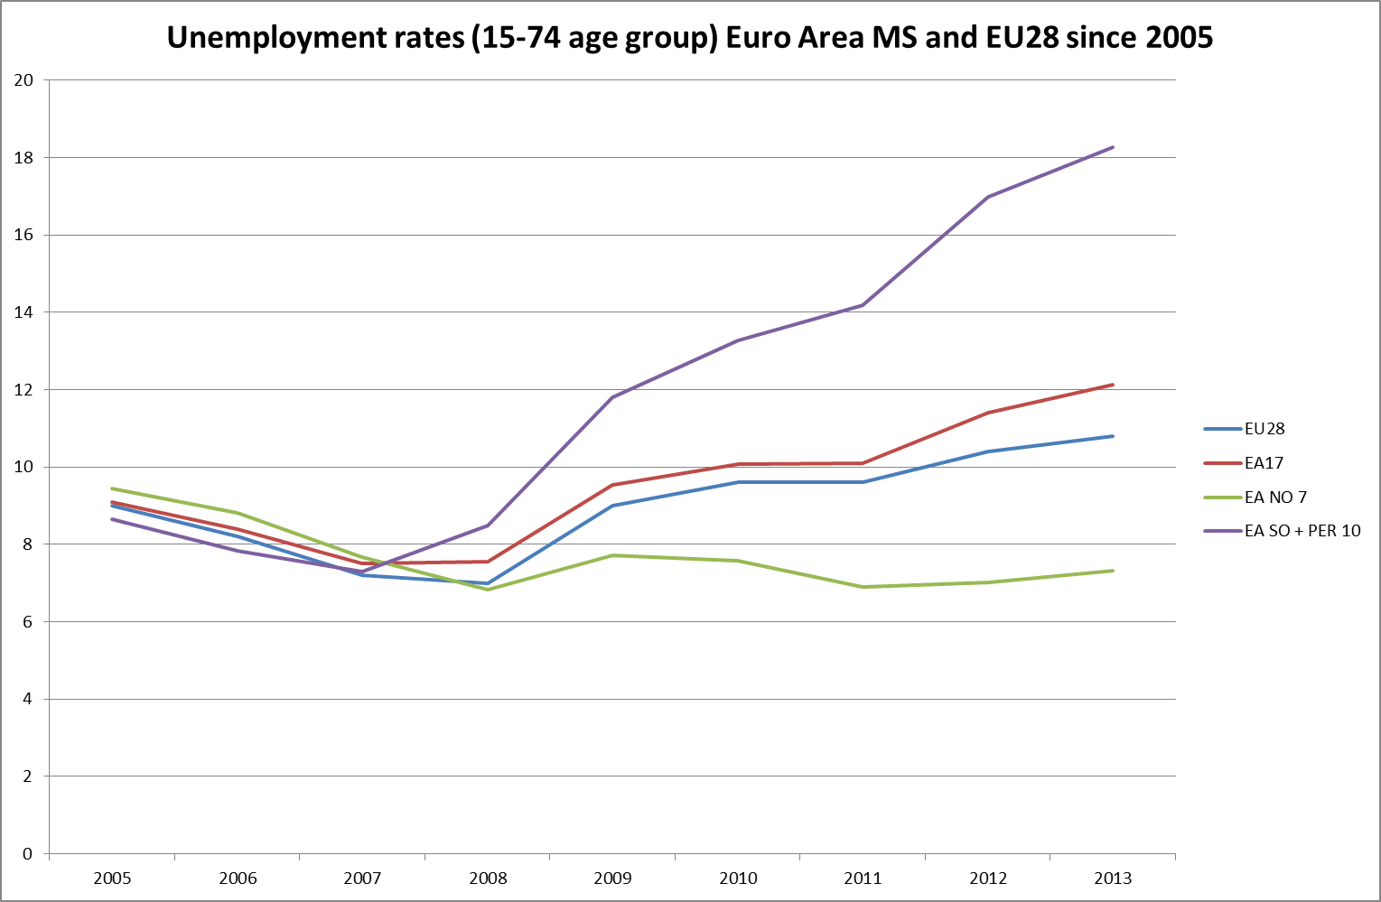

Slide 17
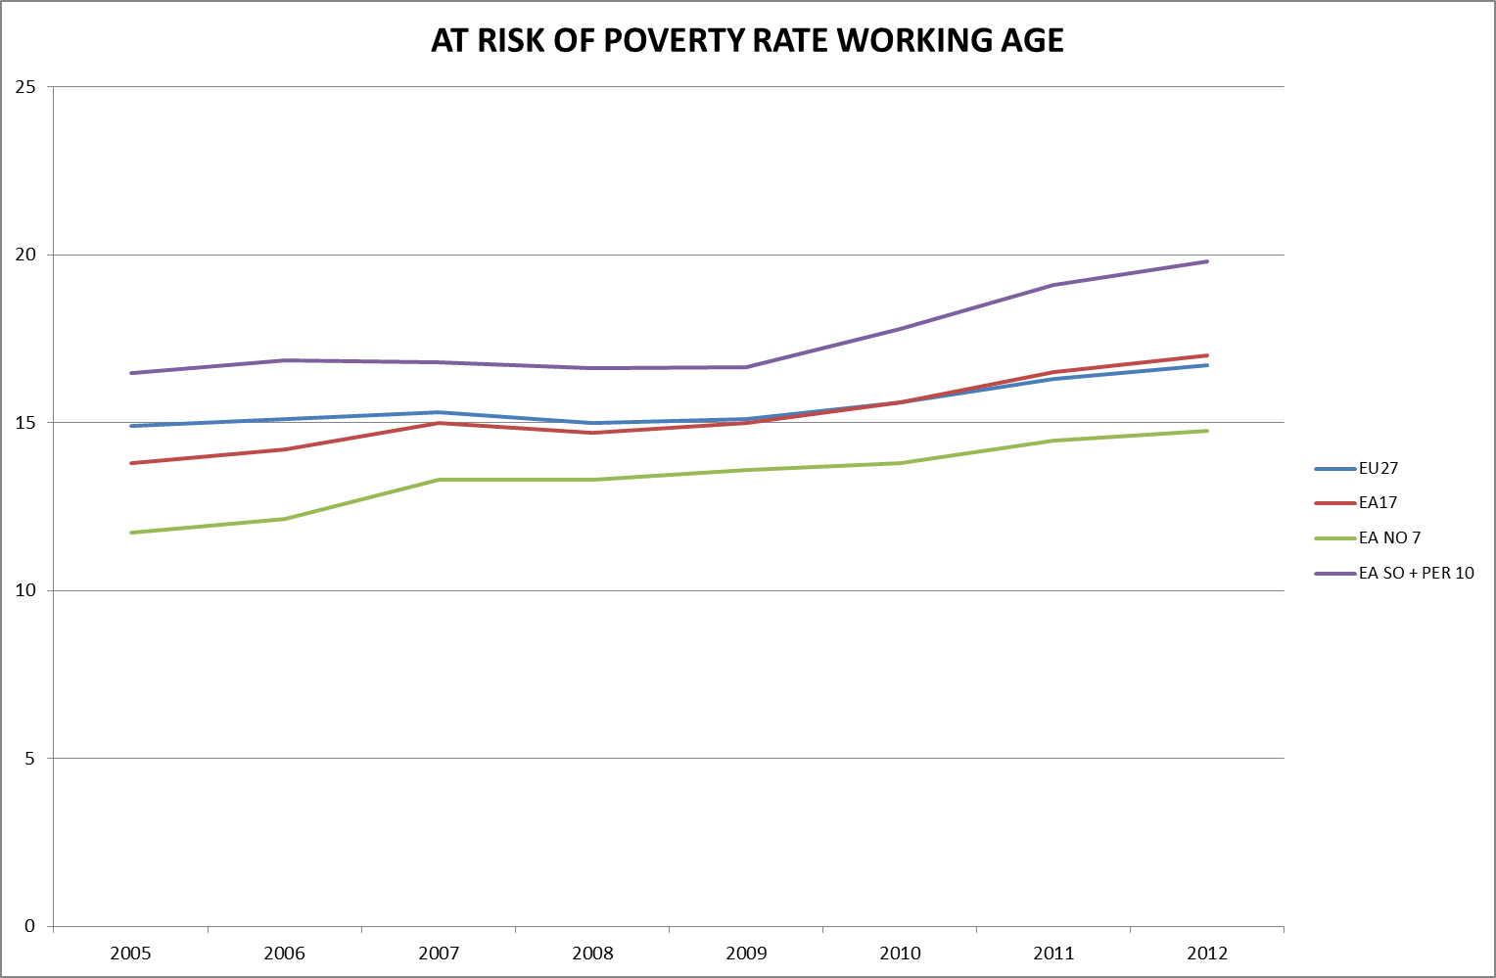

Slide 18
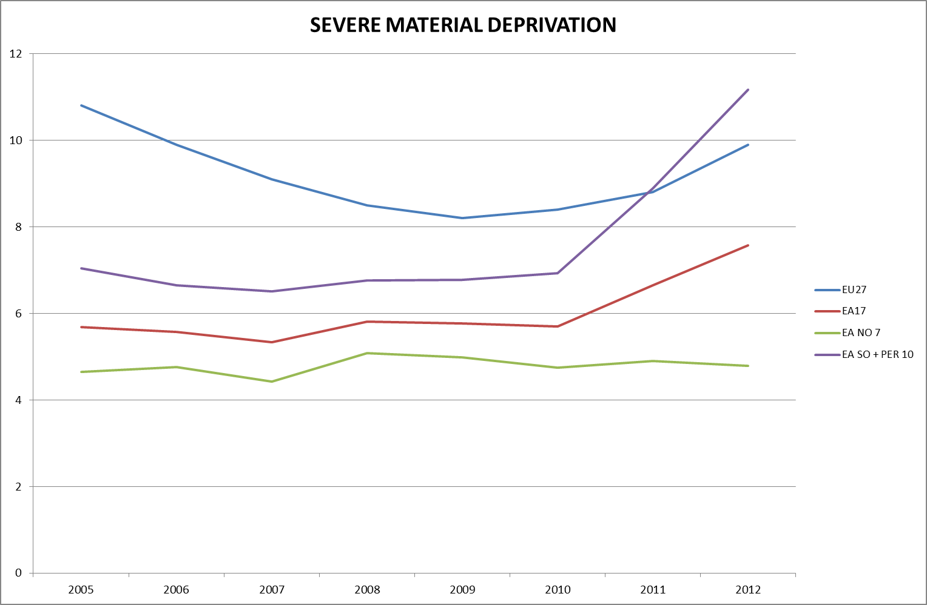

Slide 19
2. The Mid Term Review of the Europe 2020 Strategy Roadmap
Commission communication ‘Taking stock of the Europe 2020 strategy’ (19 March 2014)
Public consultation until 31 October 2014
Advisory committees of the Council prepare an opinion of the Council Formations
Proposal by the New Commission (start 2015)
Decisions to be taken early in 2015 (Spring Council)

Slide 20
The Europe 2020 strategy after 4 years
From the start focus on immediate economic and budgetary impact of the crisis, far less on long term goals of Europe 2020
Tighter economic and budgetary surveillance: Macro Economic Imbalance Procedure and reinforced Stability and Growth Pact
Because of the social impact of the crisis, budgetary consolidation and macro economic policy the strategy needs rebalancing and a renewed emphasis on the inclusive growth dimension

Slide 21
Changes to the set up of the strategy?
Overall architecture
Integrated guidelines
Targets
Flagships
European Semester
Country specific recommendations

Slide 22
EU Targets: Commission’s assessment:
Broadly achievable:
  Education
  Environment
Unlikely to be met:
  R & D (2,2% instead of 3 %)
  Employment (72% instead of 75%)
  Poverty and social exclusion (close to 100 million instead of 96,4 million)

Slide 23
Poverty and Social Exclusion target at EU and national level
EU target: Change of the level of ambition? Change of the target indicator? Is there a need for additional targets?
National targets : the EU target was set top down instead of bottom up: according to the Commision sum of national targets is AROPE population reduction by around 12 million instead of 20 million.

Slide 24
Targets at the level of the Member States
Belgium | AROPE | Luxembourg | AROPE
Czech Repub | AROPE | Hungary | AROPE
Greece | AROPE | Malta | AROPE
Spain | AROPE | Austria | AROPE
France | AROPE | Poland | AROPE
Croatia | AROPE | Portugal | AROPE
Italy | AROPE | Slovenia | AROPE
Cyprus | AROPE | Slovakia | AROPE
Lithuania | AROPE | Finland | AROPE
Bulgaria | AROP
Estonia | AROP
Romania | AROP
Denmark | VLWI
Netherlands | VLWI
Latvia | AROP / VLWI
Germany | LT UNEMPL
Sweden | QUASI AR
Ireland | CONSIS POV
UK | CHILD POV

Slide 25
Performance Member States 2008-2012
Belgium | AROPE | Luxembourg | AROPE
Czech Rep | AROPE | Hungary | AROPE
Greece | AROPE | Malta | AROPE
Spain | AROPE | Austria | AROPE
France | AROPE | Poland | AROPE
Croatia* | AROPE | Portugal | AROPE
Italy | AROPE | Slovenia | AROPE
Cyprus | AROPE | Slovakia | AROPE
Lithuania | AROPE | Finland | AROPE
Bulgaria | AROP
Estonia | AROP
Romania | AROP
Denmark | VLWI
Netherlands | VLWI
Latvia | AROP / VLWI
Germany | LT UNEMPL
Sweden | QUASI AR
Ireland | CONSIS POV
UK | CHILD POV
* Croatia 2011-2012

Slide 26
Flagship the European Platform Against Poverty and Social Exclusion (EPAP)
Social agenda of the Commission in the field of poverty and social exclusion (2/3 implemented)
Eclipsed by the Social Investment Package
Most visible element is the annual convention: the remodelled Social OMC Round Table on Poverty and Social Exclusion
Visibility and impact, stakeholder involvement?
Commission stocktaking: value added is not self evident

Slide 27
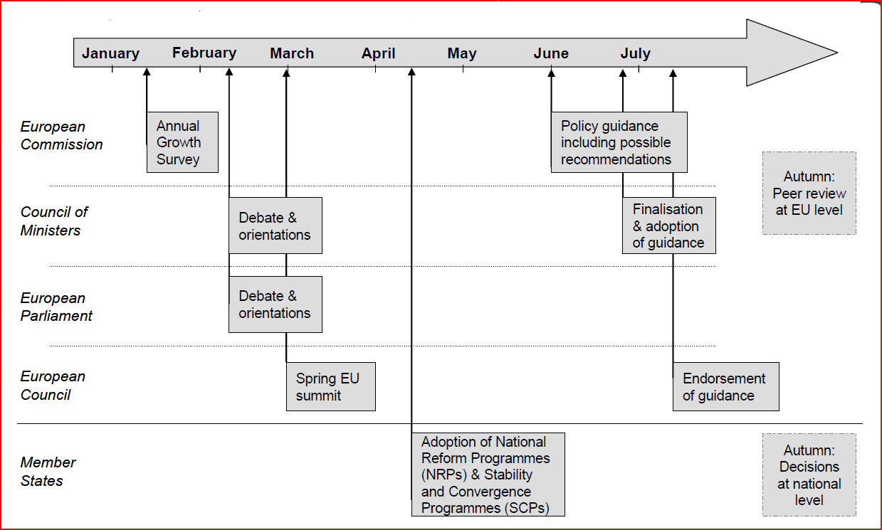
The European Semester of Policy Coordination

Slide 28
The European Semester
ECOFIN Council is dominant in the European Semester (MIP, SGP…)
According to the treaty the organisation of social protection remains largely the responsibility of the member States (subsidiarity)
…but very specific economic and budgetary recommendations e.g. on pensions and health care have an important impact on social protection in the MS
Need for a more balanced approach and for effectively involving the EPSCO Council (ministers of social affairs) in the issues for which they are responsible (policy formulation and implementation at national level)

Slide 29
The European Semester
The EU Social Protection Committee has a general mandate to cover social protection affairs in the treaty (art 160) but its role in the European Semester is insufficiently recognized
It participates through EMCO as one of the EPSCO preparatory committees in the discussion on country specific recommendations

Slide 30
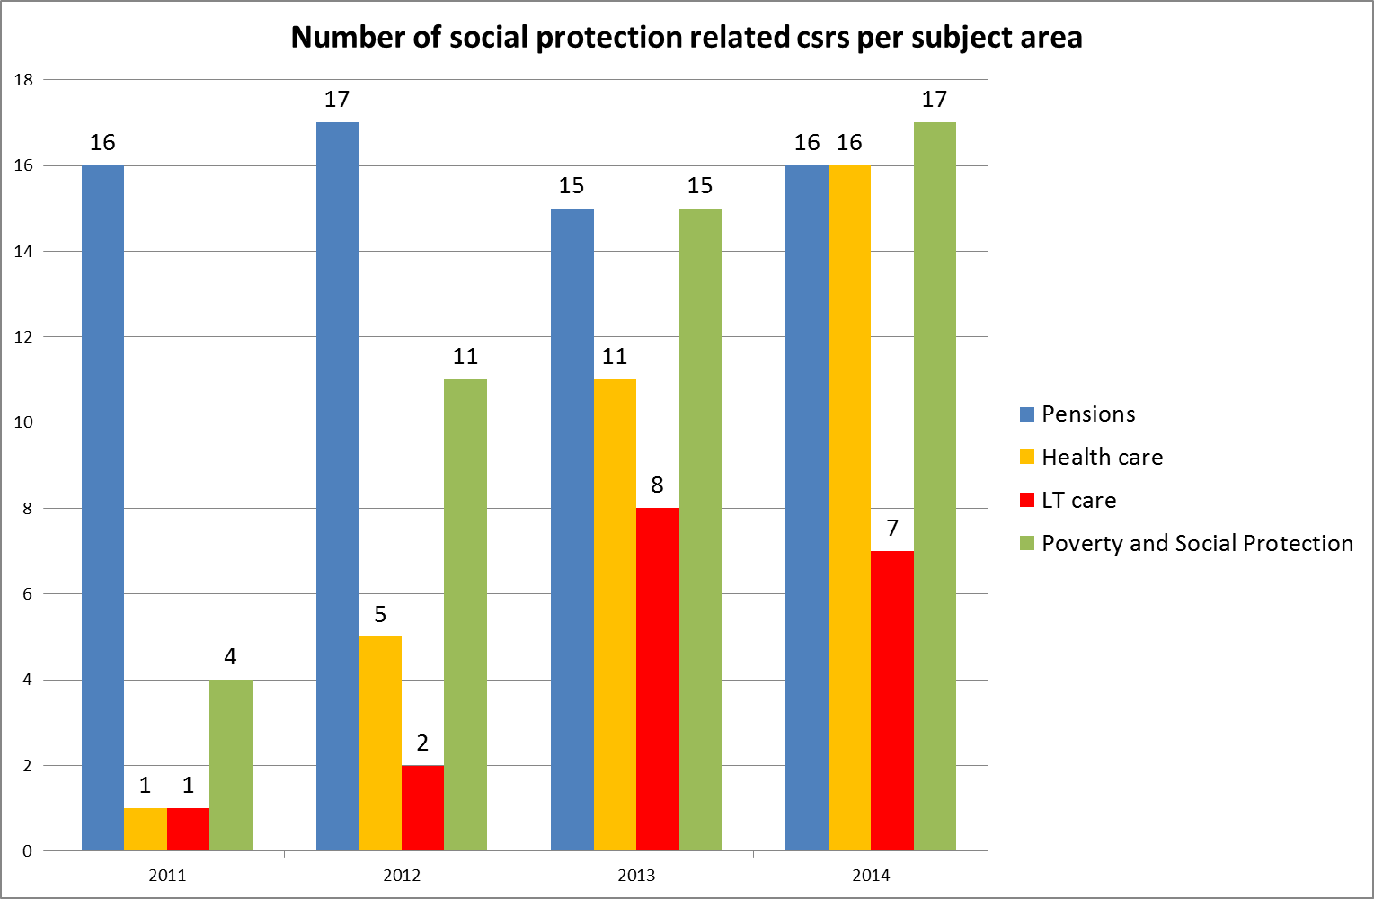
Country specific recommendations on social protection (Social Protection Committee)

Slide 31
Country specific recommendations on social protection (Social Protection Committee)
Most recommendations on pensions, health and long term care are focussed on financial sustainability. Some are very prescriptive.
Basis is the EU fiscal sustainability report: focus on the budgetary situation and the estimated cost of ageing (WGA)
CSRs on Pensions and healthcare systems are categorized as public finances CSRs in the Europe 2020 Commission communication
Adequacy and accessibility are only very exceptionally the aim of these recommendations

Slide 32
CSR’s on social protection: better ownership by Member States and Stakeholders
Better dialogue between Commission and Member States regarding the analysis (early publication of Commission analysis)
More time for analysis and discussion of proposed CSRs with relevant actors
Involve all Council committees whose competence is affected
Better reviews of MS policies in response to CSRs
Less prescriptive CSRs: leave room for manoeuvre, consultation and discussion at national level

Slide 33
3. Conclusion
The deteriorating social situation as a major challenge.
The Mid Term Review as an opportunity to adapt and rebalance the strategy. The choices made by the Juncker Commission will be important.
There seems to be little support in the EPSCO Council committees for dramatic changes to the set up. Rebalance the strategy by focussing more on the inclusive growth dimension and use instruments and processes more effectively. Boost ownership of the strategy by Member States and Stakeholders.

Slide 34
Thanks for your attention!
Peter.Lelie@minsoc.fed.be

