Slide 1
The necessity of an enhanced social and civil European dialogue
Seminar 24th of April 2014

Slide 2
European Minimum Wage: a tool against poverty and inequality ?

Slide 3
European Minimum Wage: a tool against poverty and inequality ?
Which strategy for an adequate European Minimum Wage?
Michel Debruyne, ACW

Slide 4
European Minimum Wage Policy: a social right!
Community Charter of Fundamental Social Rights for Workers of the EU from 1989:
“All employment shall be fairly remunerated. To this end, in accordance with arrangements applying in each country, workers shall be assured of an equitable wage i.e. a wage sufficient to enable them to have a decent standard of living” (Title 1,5)

Slide 5
The context
European anti-crisis policy: basic assumption
Lowering labour costs is the key to regain competitiveness (strategy of internal devaluation)
  Direct Interventions in current wage developments (wage cuts/freezes)
  “Structural reforms“ of collective bargaining systems in order to increase downward flexibility of wages

Slide 6
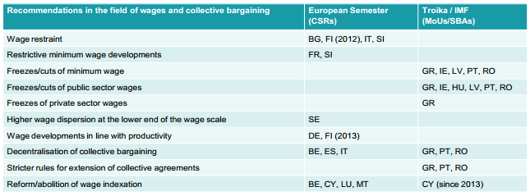
The context
New European wage policy interventionism 2011-2013

Slide 7
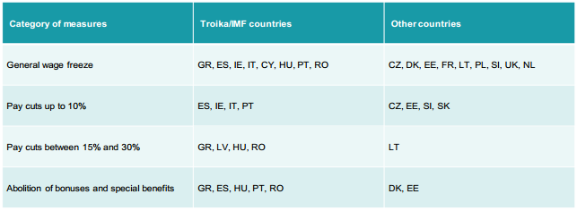
The context
Wage cuts and freezes in the public sector, 2008-2013

Slide 8
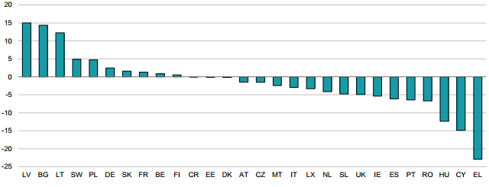
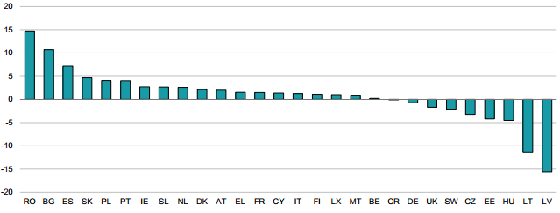
The context
Development of real wages: 2007-2009 and 2009-2013

Slide 9
The context
The consequences of the European wage policy
The consequences:
  Wages viewed as cost factors
  Wages as a key variable for competitiveness
  Pressure towards restrictive wage developments
  Increasing wage inequality
  Extension of low wage sector and working poor
  Social dialogue under pressure or eroded

Slide 10
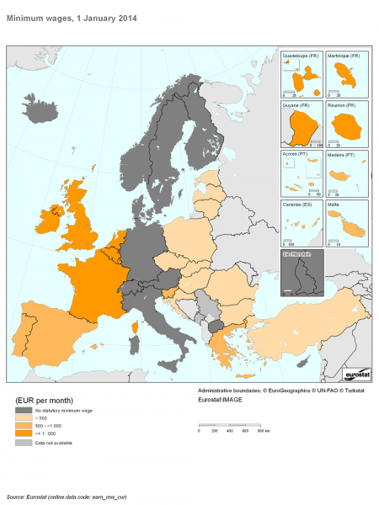
State of the art
Not one minimum wage regulation
A national minimum wage as an universal wage floor : 21 EU Members
Only sectoral or occupational minimum wages with no universal wage floor : 7 EU Members

Slide 11
State of the art
Alternative models of MW setting in Europe
 | Statutory regulation | Collective agreements
Single national MW as a universal wage floor | Western countries: Luxembourg, Netherlands, Ireland and UK Southern countries: Malta, Spain, Portugal Eastern countries: Croatia, Czech Republic, Hungary, Latvia, Lithuania, Romania, Slovenia | Bipartite Agreements: Belgium, Estonia, Greece Tripartite Agreements: Bulgaria, Poland Slovakia
Sectoral and occupational MW | Cyprus | Nordic countries: Denmark, Finland, Norway, Sweden Continental countries: Austria, Germany, Italy

Slide 12
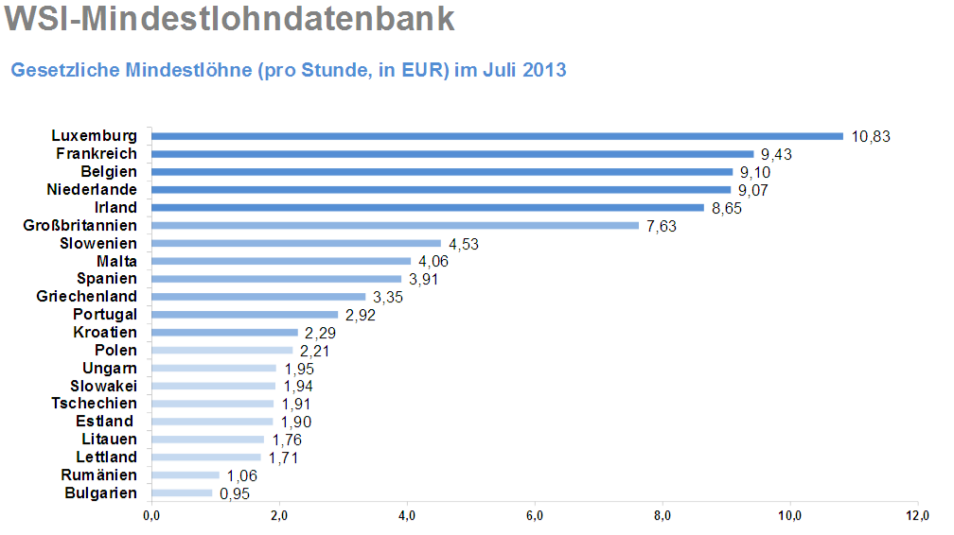
State of the art
Variety of Minimum Wage levels in Europe 2013

Slide 13
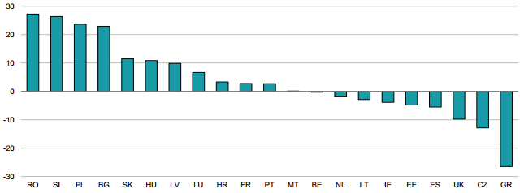
State of the art
Development of real hourly minimum wages, 2008-2013

Slide 14
Discussion
A European Minimum Wage: strategy?

Slide 15
Discussion
Topics to discuss
Necessity of MW?
Which MW?
A MW for short-time work?
One MW for all?
Strategy?

Slide 16
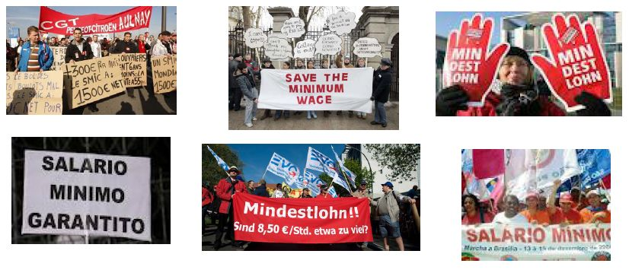
Discussion
Why an European MW Policy?
The wage struggle = discussion on a societal level?

Slide 17
Discussion
Why an European MW Policy?
A European MW Policy based on human rights asks a development based on higher wages and a more equitable wage distribution to sustain the aggregate demand
MW as a fundamental labour standard
  Preventing downward wage competition
  Stabilising private demand since workers with low income will spend a large part of the additional income
  Promote a more egalitarian distribution of income
  Limiting the low wage sector and preventing working poor by ensuring a decent living standard

Slide 18
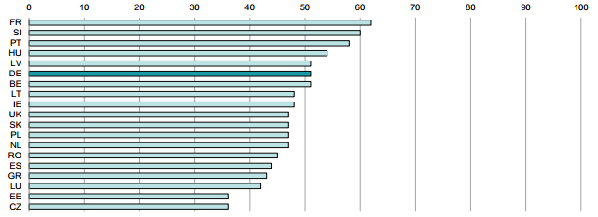
Discussion
Living wage or a minimum wage?
Minimum wages in % of median wage of full-time employees, 2012
Notes:
50% threshold
60% threshold
De 2015: 50%??????

Slide 19
Discussion
Living wage or a minimum wage?
Living wage = wage paid for a standard working week meeting basic needs of workers and their families and to provide some discretionary income
  Living wage > minimum wage
  Budget standards?
Minimum wage: the level should be at least 50% of the national average and at least 60% of the national median wage

Slide 20
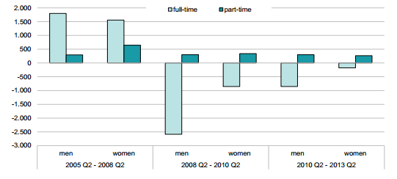
Discussion
An other Minimum Wage for part-time work?
Shifts in the job structure 2005-2013

Slide 21
Discussion
An other Minimum Wage for part-time work?
Higher minimum wage for short-time work?
  Negative stimulus for employers
  Positive income effect
Stimulus for collective bargaining on short-time work

Slide 22
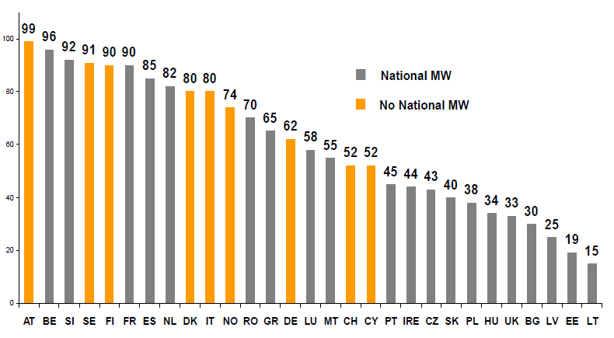
Discussion
One fits all?
Collective bargaining coverage 2008-2010

Slide 23
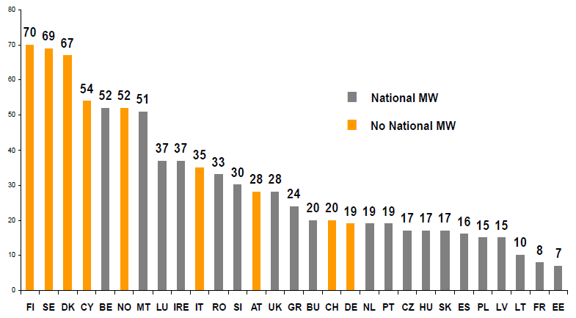
Discussion
One fits all?
Union density 2008-2010
Notes:
Countries with higher bargaining coverage and stronger organisational power of the unions are more likely to have no national minimum wage
From union points of view national MWs set by the state are second best solutions
National MWs and high bargaining coverage could also be complementary
National MWs have the advantage of an universal applicability

Slide 24
Discussion
One fits all?
How do we answer the doubts from social partners?
Autonomy of social partners?
MW regulation will reduce wages?
MW = only for industrial, standardized production where cost-reduction is the factor in the competition
Enhancing rich diversity?
Different MW depending of type of production?
  Sectoral or firm level?
National standards?
  Collective bargaining national level
Eu standards or common norms
  methodology: monitoring – blaming/shaming – sanctioning ?

Slide 25
Discussion
Which strategy?
Different strategies?
  Strategy on the national level
    Sectoral MW?
    National MW? (common norms)
  Strategy on European level
    Method of open coordination?
    Titel 11 of Treaty

Slide 26
Thank you

Slide 27
An enhanced social and civil dialogue for a more social, sustainable and democratic Europe

Slide 28
The social dialogue in times of crisis
Dr. Stephen Bach

Slide 29
Madrid April 24th 2014
Social Dialogue in times of Crisis
Stephen Bach
King’s College, London Stephen.bach@kcl.ac.uk

Slide 30
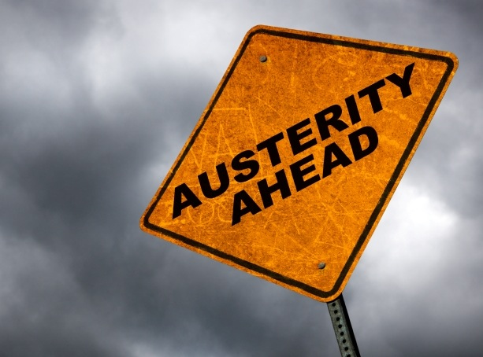
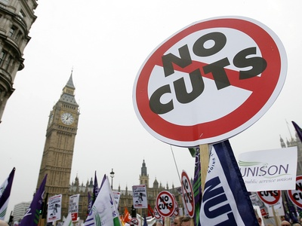
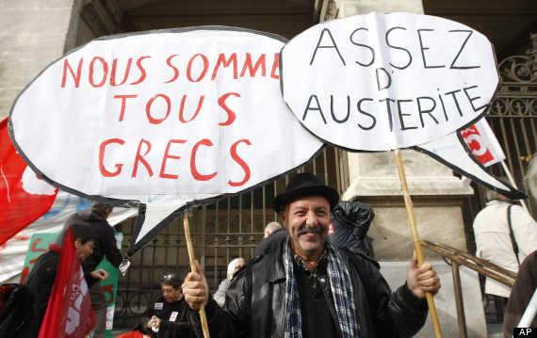

Slide 31
Presentation structure
Social Dialogue and the European social model
Challenges to social dialogue in the crisis
Public sector social dialogue in tough times:
- EC funded comparative research project (2011-13)
- six countries: focus on municipalities
Themes:
- can effective social dialogue survive austerity?
- variations in role of social dialogue
- challenges: citizen involvement ; new economic
governance

Slide 32
Social dialogue
‘All types of negotiation, consultation or simply exchange of information between or among, representatives of governments, employers and workers, on issues of common interest relating to economic and social policy’ ILO
Tripartite
Bipartite: Collective bargaining
Joint consultation
Cross-border:
- sectoral social dialogue committees

Slide 33
Social Dialogue in Europe
Social dialogue core value of the EU (TEU - Maastricht)
- stronger role for social partners
Charter of Fundamental Rights:
- Freedom of assembly and association
- Information and consultation within the undertaking
- Collective bargaining and action
Social dialogue as a central component of the European social model – at EU level and in the member states

Slide 34
Levels/Forms
Company: rights to be informed & consulted
- economic and social matters
- future prospects
Company: transnationally – European Works Councils
Nationally: Member State level – big variations
- tripartite: social dialogue at national level
- collective bargaining – often at sectoral level

Slide 35
European social dialogue
TFEU – Lisbon 2009
Recognition/promotion role of social partners at EU level & Tripartite social summit (Art 152 TFEU)
- consultation of social partners by the Commission &
support for their dialogue (Art 154 TFEU)
- ‘contractual relations’ including agreements, can be
concluded by the social partners (Art155 TFEU)
Sectoral social dialogue:
- 41 committees
- response to the crisis

Slide 36
Social dialogue issues
Involve all national social partners: variable involvement
- ensures legitimacy
- achieves effective outcomes/national follow-up
Consultation and administrative capacity:
- to enable involvement in the European policy-making
process and timely responses
- capacity depends on that of national affiliates
Some agreements: Hospitals – sharp injuries

Slide 37
The crisis: intensified threats
High (youth) unemployment: growth and job creation
Debt crisis public sector austerity measures: Blyth (2013)
‘European fixation on austerity as the only possible way forward’
Effect on social dialogue in the public sector
Austerity/new economic governance – jeopardises democratic process (see Wolfgang Streeck)

Slide 38
Commitment to social dialogue
Commissioner Andor:
‘Collective bargaining and strong social dialogue remain major attributes of our European Social Model. Social partners’ involvement in the EU economic governance, at national and EU level, is crucial to provide renewed impetus i n our efforts to deliver a job-led recovery and growth (Tripartite social summit 18/12/12)
State of social dialogue:
- new member states
- ‘programme’ countries
Views of policy elites:
- Ireland : Croke Park/Croke Park 2

Slide 39
Public sector: overall trends
A return to unilateralism:
- imposition wage freezes or wage cuts
- bypassing social dialogue channels
Removal of collective bargaining rights:
e.g. UK/US
Narrowing/altered scope of collective bargaining:
- mandatory arbitration
Undermining (direct or indirectly) trade unionism:
e.g. limitations on work time to carry out union duties

Slide 40
Austerity and social dialogue: Research
Starting point:
A) stronger SD institutions/practice = acceptable IR change
B) austerity overwhelms scope for consensual change
Country selection:
Czech Republic; Denmark, France, Italy, Netherlands, UK – variations: size/traditions
Data collection:
Phase 1: meeting with EU social partners
Phase 2: analysis of national experience
Phase 3: case studies of local government

Slide 41
Research Questions
What have been the main drivers and measures of austerity adopted in each country?
How have these changes been implemented and to what extent has social dialogue contributed to the change process at national, sectoral and workplace level?
How have institutions of social dialogue influenced industrial relations processes and outcomes in the public services?

Slide 42
Drivers of Austerity
External/ Internal
High/ Low pressure
Austerity Measures
Budgetary cuts
Staffing policies (e.g. replacement ratios)
Alterations in wage fixing
Social Dialogue
Tripartism
Collective bargaining
Joint consultation
Cross-border
Restriction
Resilience
Reconfiguration
Austerity Outcomes
Employment reductions
Wage cuts
Pay freezes
Pension reform
Work intensification

Slide 43
Drivers: General Government Consolidated Gross Debt

Slide 44
Drivers: General Government Deficit/ Surplus

Slide 45
Source of pressure
Drivers of Austerity : retrenchment pressures
Implications for social dialogue
External
Market Reaction
Italy
Lagged Response
France
Coalition for change
Czech Republic
Netherlands
UK
Steady State
Denmark
Internal
Degree of pressure
Low
High
Adapted from OECD (2011) Restoring Public Finances

Slide 46
Measures
Pay Cuts
Czech Republic 10%
Italy 5-10% (linked to earnings)
Pay Freeze
France (2010-2012 index point value)
Netherlands (2011-13 central govt; education)
UK (2011-2013)
Employment reductions
Czech Republic (5.5% 2009-12)
Denmark (2%: 2010-12)
France (5% state administration 2008-10)
Italy (10% 2008-14)
Netherlands (cuts planned up to 2014)
UK (12% 2008-12)
Pension Reform
Czech Republic
Denmark
France
Italy
Netherlands
UK

Slide 47
Role of Social Dialogue: Variation
Institutions (structure) and practice (agency)
Restriction – institutional suspension & shift to
unilateralism
Resilience – institutional maintenance
- alterations in practice
Reconfiguration – institutional reform
- redirected to different ends

Slide 48
Findings
National level: restriction re wage developments:
- new factors (markets) and new actors (Troika)
- little input employers/unions
- ‘hollowing out’ of IR: time scales
- legislative/budgetary instruments dominate
Czech Republic; Italy; UK
More participation at sectoral/local level

Slide 49
Resilience
Denmark
France
Netherlands
Influences on findings:
- employer strategy
- trade union responses
- different institutional/legal traditions e.g. works
councils

Slide 50
UK: Restriction
Austerity measures 2010-
- 2010-15/16 expenditure reductions
- 27% local government cut
Government policy: competition and privatisation
- outsourcing, shared services, withdrawal
Outcomes:
- employment reductions,
- work intensification and fear of job loss

Slide 51
Trade union density in the Public Sector (UK)
Source: BIS (2012)_available at: https://www.gov.uk/government/publications/trade-union-statistics-2012

Slide 52
Consequences: Disputes
Source: ONS

Slide 53
Example: Mid-Town
 | Mid-Town
Background | District Council Labour 2010 – present
Population | 151,900 (2011 Census)
Workforce Size (Headcount) | 1,206 (1,140 FTE) as of 2012 Q2
Social Dialogue | Extensive
Union exclusion | Low
Employment Reduction | Few
Pay Reductions | Yes, removed increment; ‘partnership payment’
Changes to terms & conditions | Yes, by local collective agreement
Industrial action | No

Slide 54
Mid-Town
Reconfiguration
Social dialogue: Intensive
- direct and indirect involvement
- supported living wage: £7.45; €9.04 v. £6.31; €7.66
National Minimum Wage
Employer approach: in-house services refocused
- 20: 20 approach; work reorganised:
‘It’s people on the frontline that that will come up with the solution if you give them the space to do it’ ‘CEO
Advantages in-house provision:
- control/trading

Slide 55
Rewards: Partnership payment
Response to 2010 coalition cuts
3 year national pay freeze but incremental pay
£400 annual partnership payments - subject to:
  Meeting corporate efficiency improvement target
  Appraisal targets achieved
  Improve attendance (<12 days per year)
Result: 25% cost reduction - 90% targets met
Halved sickness - 14 days to 7 days
Workforce reduction 10% (few mandatory redundancies)

Slide 56
Mid-Town Implications
Scope for social dialogue:
- UK limited institutional requirements for dialogue
- mixture of direct and indirect involvement
Reconfiguration:
- influence of lack of national pay award
- built workforce acceptance for change
- reconfiguration around progression/increments:
individualised performance - attendance, appraisal

Slide 57
Emerging issues in social dialogue
Increased emphasis on citizen participation:
-individual consumer rights perspective v. Services of general interest
Responses of trade unions:
- engage? alliances
- concerns? Civil society as substitute
representativeness? Workplace presence?
New economic governance – European Semester:
- growth-friendly fiscal consolidation

Slide 58
Conclusions
Public sector remains a distinctive employer:
- political domain/scope for unilateralism/centralism
- but less sheltered: new actors and factors
Variation in outcomes:
- restriction; resilience; reconfiguration:
- social partner role: workplace involvement
Implication for key actors:
- unions severely weakened
- ambiguous effects on employers
- government shift towards unilateralism &
less interest in role of social partners

Slide 59
References/Further information
Social Dialogue under austerity project website:
http://www.kcl.ac.uk/sspp/departments/management/Social-Dialogue-and-Austerity-EU.aspx
Bach, S. & Bordogna, L. (2013) ‘Reframing public service employment relations’: The impact of Economic Crisis, European Journal of Industrial Relations, 19(4) 279-294.
IR in Europe Report 2012: (focus on public services – chs 3 and 4)
http://ec.europa.eu/social/keyDocuments.jsp?type=0&policyArea=0&subCategory=0&country=0&year=0&advSearchKey=IRIE&mode=advancedSubmit&langId=en

Slide 60
The European civil dialogue: a legitimization foR Europe?
Dr. Eva Heidbreder

Slide 61

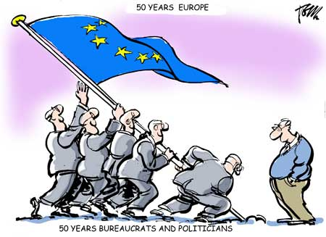
Legitimacy through Civil Society Participation?
Eva G. Heidbreder
Professor for EU Integration
Heinrich Heine University
Alliances to fight Poverty – Seminar
The necessity of an enhanced social and civil dialogue for a more social, sustainable and democratic Europe.
Notes:
BACKGROUND:
Living review by barbara finke >> update
my background EU and not CS studies
BUT: valuable topic, especially looking at new „democraticing“ procedures in EU governance
Hope interesting for you, too
COMMENTS WELCOME !

Slide 62
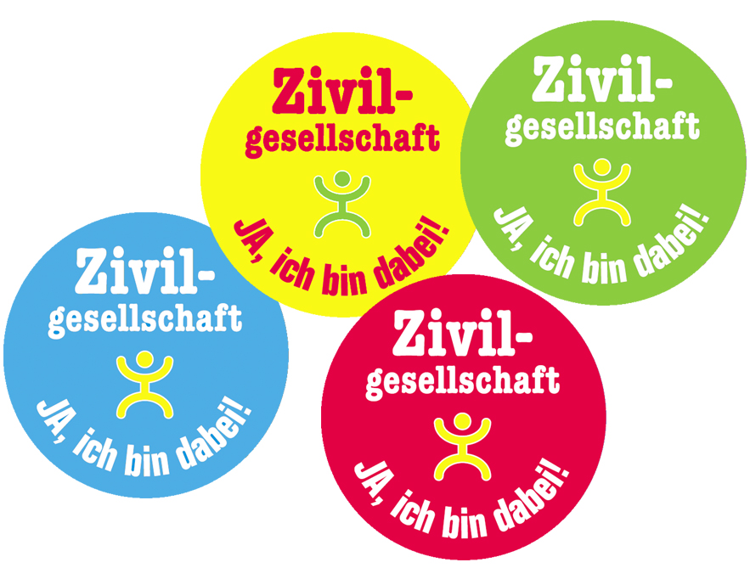
Civil Society – in the EU?
Main interest and
research agenda:
Does
civil society enhance the
democratic quality
of the EU?
Notes:
MAIN PUZZLE
Leading to the emergence of CIVIL SOCIETY in EU STUDIES
>> generally: civil society as a topic with civil movements in US, etc
BUT: the general notion that EU ≠ state ≠ no polis … civil society basically not an issue till 1990s
WHY THEN > we will see …

Slide 63
Overview
What is ‘civil society’ (CS)?
  > Competing conceptual definitions of CS in EU research
Which roles does civil society in the EU?
  > Scholarly and applied approaches to civil society
Does, can & should civil society fulfil its ascribed role?
  > Normative and evaluative views

Slide 64

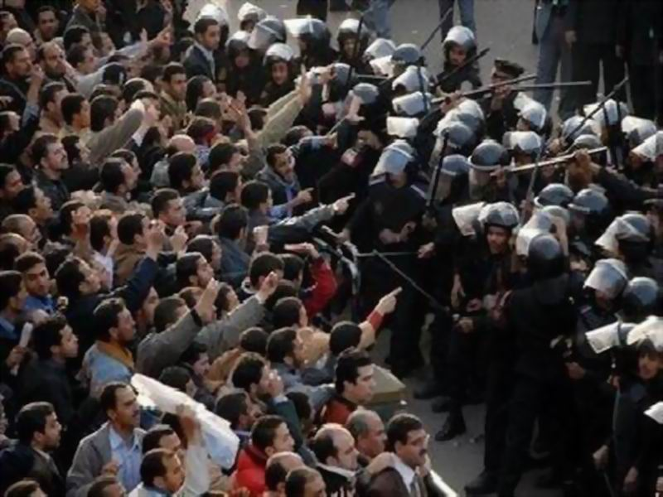
1
What is civil society?
Notes:
Picture: egypt ... Typical debate on CS .... One standard definition
>> keep in mind these pictures – two underlying and partially incompatible role attributions (and normative claims) on CS

Slide 65
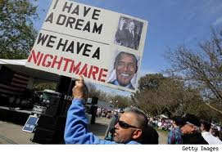
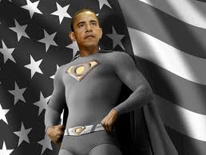
Definitions of CS
Brief look into the past … Locke, Tocqueville, Marx, Montesquieu, Hegel
  CS as opposition to the state, both autonomous & distinct spheres
  Integrative state-society relations, CS constitutive part of state
Following up on latter, recent accounts often start from notion of civility
  Well-ordered social arrangement: civil vs “uncivil” society (departure from state of nature)
  Communitarian notion:
  significance of active citizenship & political community
  Transferability: is EU a political community?
  Procedural notion:
  deliberative democracy in common legal framework to associate
  and communication in public sphere
  Transferability: formally possible (arguable: existence of a public sphere?)
Notes:
TWO IMMAGES → Imagine OBAMA!
OPPOSITION TO STATE
Locke > liberal accounts > neolibs
Marxist > deliberative democracy (in part)
INTEGRATIVE approach
Montesquieur, (Hegel?), Gramsci
Modern welfare state systems (consortional democracies)
NOTE: TEA PARTY !!!

Slide 66
Civil society is …
… counterweight challenging
public authorities (state)
Or
… constitutes CIVILITY in
organisation of societal interests
➔ QUESTION:
how can this play out in multilevel polity
that lacks basic state features?

Slide 67
Definitions of civil society in the EU
Transfer of CS definitions to EU context, one dominant interest:
Can CS enhance democratic quality of the EU?
Competing conceptions in scholarship (Kohler-Koch, 2011):
  EU = multilevel institutional setting
  > CS = sum of non-governmental, non profit-oriented associations
  > role CS: transmission belt in political system, policy input (besides experts)
  EU = multilevel governance including private actors
  > CS = stakeholders and affected citizens of EU policies
  > role CS: co-producers of governance, shaping/implem. policies,
  EU = polity in the making, based on transnational public sphere
  > CS = engaged citizens/non-profit organisations, shape public discourse
  > role CS: society vs. EU politics, pol. order, pub. discourse, transnat. dialogue

Slide 68
Sum:
What is the EU civil society?
Ambiguous Concept:
dependent on image of EU,
on definition of ‘democratic deficit’
and normative stand-point on CS
Two scholars who refer to civil society and the EU may not necessarily mean the same thing
(Finke 2007)

Slide 69
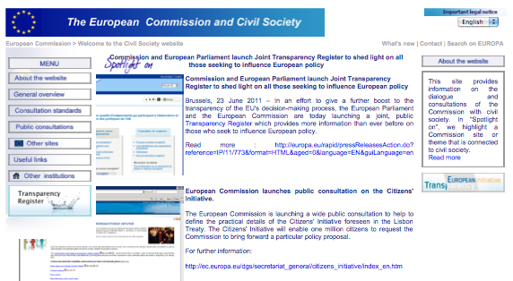
2
Which roles for civil society in the EU?

Slide 70
Civil society on the EU agenda
Traditional role of civil society: limited
  EU integration as elite project until early 1990s
  Shift with Treaty of Maastricht:
  political union + new policies + diversification of coordination
  ➔ end of permissive consensus (Hooghe / Marks 2009)
Declaratory Documents → Inclusion of civil society
  White Paper on Governance (Commission 2001): participation of CS to promote input and output legitimacy
  → consultation regime
  Laeken Mandate (2001): “bringing EU closer to citizens”
  → Convention on the Future of Europe (“constitutional treaty”)
  Lisbon Strategy (2001): making EU most competitive and innovative area in the world
  → Open Method of Coordination

Slide 71
Who participates?
Civil society on EU level = mainly civil society organisations
  Challenges: specialised expertise to participate in EU policy making + funding
  EU input: funding (to non-industry groups) + ‘activation’ strategy by Commission
  Consolidation: professionalisation + transparency attempts (registry)
  Drawback: Persistent gap between ‘Brussels’ and grass-root level
Inclusion in policy process, Commission
  Challenge: increase input and output legitimacy (participation and expertise)
  EU input: Commission’s consultation procedure (additional tools: seminars, hearings…)
  Consolidation: more routine and better functioning online consultations
  Drawbacks: limitation to EU CSOs (independence?) + territorial, sector-specific, resource-dependent variance + no effective communicative discourse into public sphere

Slide 72
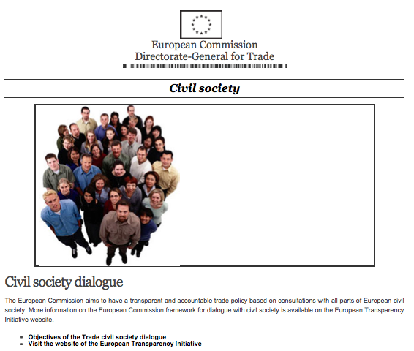
Example: Consultation Regime
Consultation Regime
of the Commission:
partially endogenously evolved out of ‘Social Dialogue’ (since 1985)
part exogenously triggered out of claims in certain policies (environment, social affairs, development) and need to better legitimise EU (Commission)
example social dialogue: reluctance of traditional state-centred groups (trade unions) to reorient to EU level
Notes:
Policy = the content ...
Very hands on!
Obvious: why it should be useful to get some basic insights into this for an MPP
History of discipline:
Form very enthusiastic believe in „good policy planning“ to more critical analysis
Prescirption = complex and difficult
FURTHER:
why?
Effects!
72

Slide 73
Three Generations of Consultation Regime
(Quittkat/Finke 2009)
1 European Economic Integration:
intense, informal, ad hoc dialogue
between Commission and economic experts
2 Mid 1980s: move to ‘partnership’ in EU policies
  Social Dialogue vitalised
  dialogue with NGOs in certain areas → ‘civil dialogue’
  → Social platform
3 As from 2001: move to ‘participatory democracy’
  Partnership with civil society

Slide 74
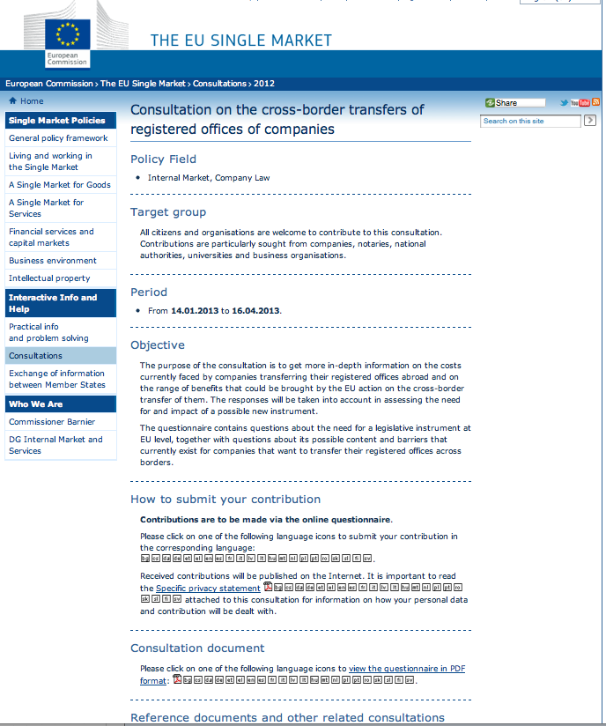
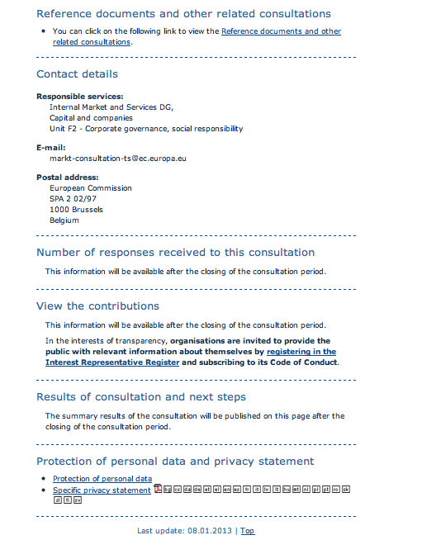
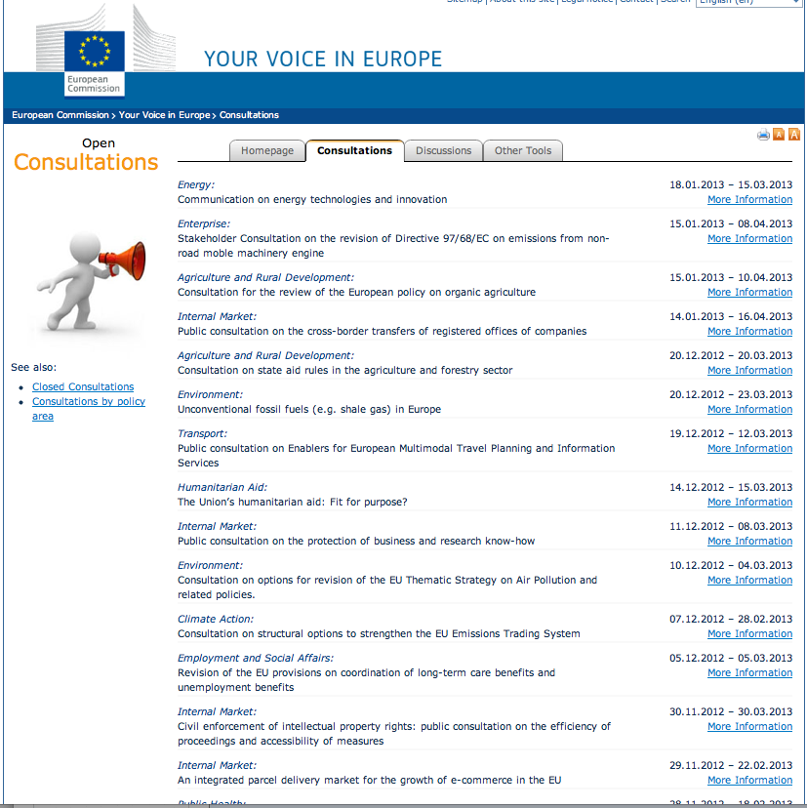
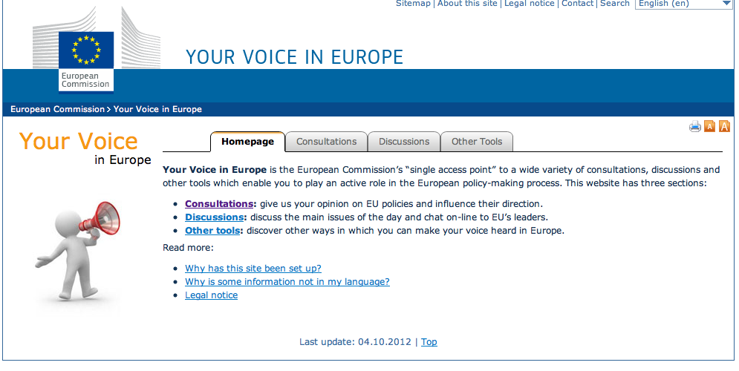

Slide 75
Other Instruments
The Convention Method
Expectation: discursive space + activation of CS as public sphere
Findings: activation did not work + communicative discourse failed largely
The Open method of Coordination
Expectations: inclusion of private actors (on all levels of governance)
Findings: both in- and output legitimacy very limited
Citizens initiative (introduced in Treaty of Lisbon)
Expectation: mobilisation not only of institutionalised CSOs but also individuals
Findings: effective since Jan 2012, so-far: blocking instrument
Questions: mobilisation across “demoicracies”, non-bindingness …

Slide 76
Various instruments raising expectations in both definitions of CS …
… empirically: largely disappointed.
Commission’s consultation system
= most elaborate instrument to include civil society
as ‘stakeholder/expert/coalition

Slide 77
Sum:
What role has civil society in the EU?
Organisational characteristics of CS in EU policy making
CS = stakeholders, in form of institutionalised CSO
CS = professionalised on EU level, fail to create ‘transmission belt’
CS / NGOs = close to COM / EP preferences (financial dependence?)
Roles and Functions of CS in EU policy making
Supportive functions in policy formulation / implementation (mainly to COM)
BUT: no effective accountability control of COM (consultation = voluntary practice) – instead often financial dependence on COM
Failure to act as transmission belts to grass-root level
Image of civil society as actors in EU policy process
dominates (expert, partner, organised CS).

Slide 78

3
Does, can and should civil society fulfil its ascribed role?
Notes:
FOR WHOM IS THE COURSE:
Especially also for NON-EUROPEANS !!!
Focus first at all: policy process!
EU = example, some specificities compared to states ... But then: each state is special!

Slide 79
Empirical Evaluation: Does and can civil society fulfil its ascribed role to enhance EU’s democratic quality?
Does CS fulfil its ascribed role to enhance EU’s democratic quality? – No.
Input side: “the promise of ‘involving civil society’ has not bridged the gap between Europe and the people, but rather sponsored a Brussels-based CSO elite working in the interest of deeper integration” (Kohler-Koch 2010)
increased exchange EU / CSO do “not support emergence of larger engaged public & deliberation in the general public sphere” (Dabrowska 2007)
Output side: doubtful balance due to multiple biases (territorial, sectoral, resources), same so far also reproduced in online consultations
Can CS fulfil its ascribed role to enhance EU’s democratic quality? – Unlikely.
Input side: move to binding accountability control by civil society contradicts constitutional logic of EU + practical difficulty to bridge ‘Brussels professionalism’ and grass-route + underdeveloped national CS structures
Output side: depending image of EU and CS, potential for increased stakeholder (expertise) inclusion (one, limited image of CSO), but open question if online participation and direct democratic instruments may still unfold

Slide 80
At best mixed empirical balance,
expectations on
‘improving democratic quality’
largely unfulfilled!
Questionable:
Future of new participatory instruments?

Slide 81
Normative Evaluation: Should CS play a democracy enhancing role in the EU?
Should CS play a democracy enhancing role in the EU?
  clash with underlying principle of representative democracy
  accountability control of COM contradicts logic of EU polity set-up
  reproduction of problems of ‘democratic deficit’ rather than solution
What would be the conditions for it to do so
(1 = stakeholder/active participant; 2 = civil society vs. state/EU)?
  1: formal strengthening of CS, also individual access
  2: strengthening of European identity, transnational public sphere
Is it desirable to create such conditions?
  Depends in part on image of EU (and desired finalité in mind)
  Depends on normative stands on civil society and democracy (cf. Schattschneider)

Slide 82
Independent of normative stands,
EU as it is today:
questionable whether civil society (organisations)
can enhance democratic quality.
General question:
Compatibility of new instruments with
representative democracy?

Slide 83
And so …
... don’t see EU as different but complementary
... don’t concentrate on one actor, play all levels in parallel.
… overcome national dividing lines for content coalitions
… overcome compartments for networks.
… take representation and democracy seriously
… take EU democracy seriously: demand politics!

Slide 84
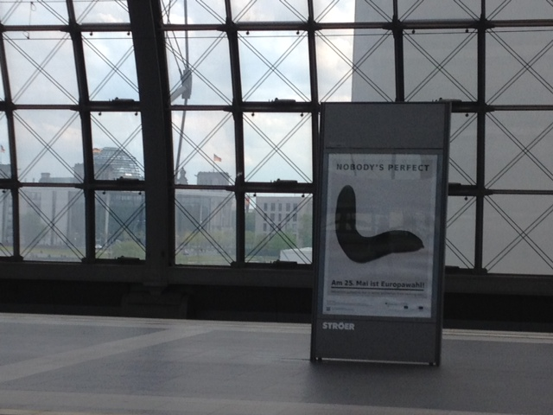
Nobody’s perfect
European Elections 25 May

