Slide 1
Poverty reduction by supply side economics
Swedish experiences

Slide 2
Outline
The government’s strategy- Less benefits more jobs
Unemployment benefits failing to provide protection
Vulnerability increases
The way forward

Slide 3
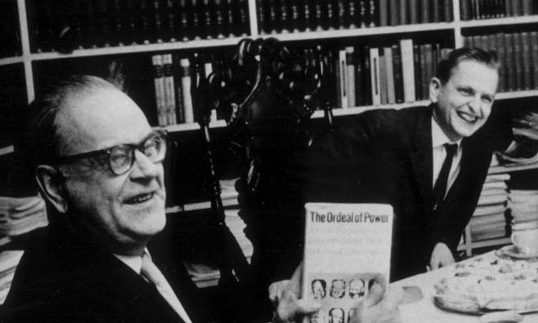

Slide 4
Government’s policy
“In the Government’s opinion, work creates the conditions for social inclusion by providing income, admittance to the social security systems and social inclusion. A policy for raising employment and reducing unemployment is therefore the best way to promote social inclusion and counteract poverty. The Government therefore believes that Sweden's national targets for social inclusion should have a strong labour market link and should be based on the Government’s ambition to reduce exclusion”.

Slide 5
Change in net replacement rate unemployment benefits 2001-2010

Slide 6
Sweden in the bottom of OECD ranking
United States | 48
Sweden | 47
Turkey** | 46
Romania | 45
Korea | 44
Lithuania | 43
Ireland | 38
Poland | 36
Greece | 34
Malta | 30
New Zealand | 26
Australia | 23
United Kingdom | 13

Slide 7
Consequemces
Almost half of those on social welfare recieve welfare because of unemployment
The third most frequent reason was sick-leave
The government’s attempt to reduce sick leaves through time limits has failed. Most people return to sick leave and not to work.

Slide 8
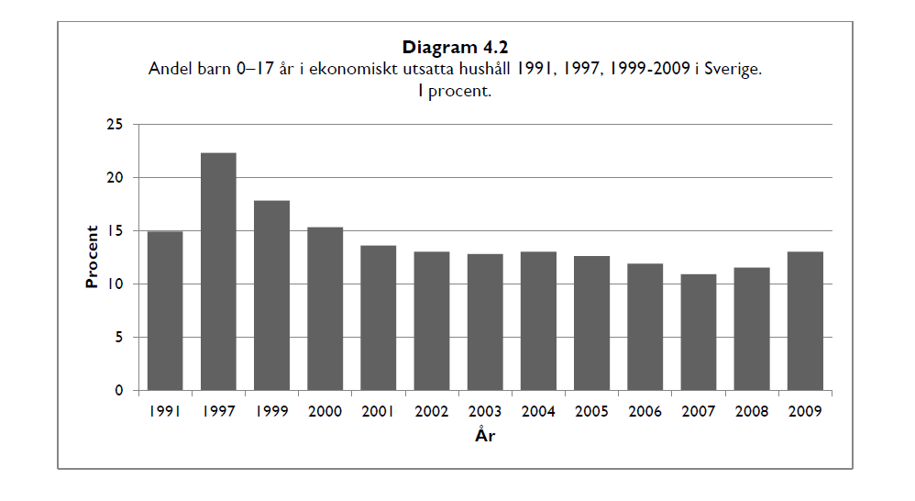
Child poverty

Slide 9
A pattern emerging
Measures
Consequences
Laval
Economic governance
EU 2020 (EUs Growth Programme)
”Smart Regulation”
Limitation trade union rights to strike
Limitations in economic policy
Intrusion into Social Partner’s Autonomy
No possibilities for Member States or trade unions to strengthen EU directives

Slide 10
Neoliberal consensus

Slide 11
The way forward
Strengthen education and training
More people must be covered by a better unemployment insurance.
Reduce income gaps

