Slide 1

The CNCA works in order to:
Study and to develop knowledge
Support the circulation of information and the sharing of experiences
Promote the exchange of good and innovative practices
Develop Regional, National and European projects
Take part to national and regional technical working groups

Slide 2
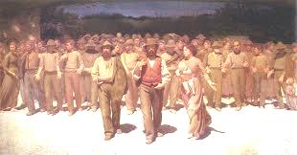









The campaigns

Slide 3

The network

Slide 4




Slide 5


Slide 6


Slide 7



Slide 8


Slide 9



Slide 10





Slide 11



