Slide 1
Strategies and methods for action – civil society alliance building around democratic, economic and social alternatives
Dr Mary Murphy
NUI Maynooth and Claiming Our Future
15 Nov 2012

Slide 2
Crisis an opportunity?
Imperative to recast our values for a sustainable, equal and caring society
Not a policy debate, requires a different paradigm
How to achieve this – ideas, interests and institutions
How Change Happens
Ideas
Interests
Institutions
What do we want?
How can we get it?

Slide 3
Coalitions across progressive agendas
What ideas – values or policy
Who – which interests and new alliances
Where –new society led public spheres
Ideas/What
Institutions/where
Interests/Who

Slide 4
Trying to do something different
Edwards (2004)
Civil society - tripartite relationship
Associational activity,
Normative values/ideas
Public sphere to deliberate/negotiate
Collective, creative and values-based action
Normative values
Associational activity
Public Sphere
Civil society and change
Ideas, Interests, Institutions

Slide 5
IDEAS
No progressive political project
SD backed into narrow defensive corners - legitimate economic consensus
Marxists alternatives largely formulaic statist responses, lack credibility or vision.
Richer forms of participatory democracy focused on decentralised local governance.
High energy democracy - capacity to imagine/ articulate alternative ways
Utopianism involves a rejection of what is, hope for an alternative and strategy for its implementation
Explore the design of alternatives to existing institutions that would help realise moral ideals of justice and human flourishing
Embrace the tension between dream and practice, seek out viable ideas and accessible way stations that take us in the direction of our deepest aspirations
Empirical or theoretical framework to achieve values
Tragic narrowing of our political imagination (Unger 2011)
Erik Olin Wright Envisioning Real Utopias 2012

Slide 6
Not starting from stratch
‘Political struggle does nevertheless depend in part on the ability to imagine alternative worlds’ Anne Marie Smith (1998:7)
Spring Alliance
Compass Plan B
Memoeurofound
Altersummit
Without struggle about ideas no political struggle (Roberto Unger)
How to engage members in creation of new political agenda
Issues of silos and sectoralism
Tweaking or thinking big
Dont reinvent wheel
Challenges

Slide 7
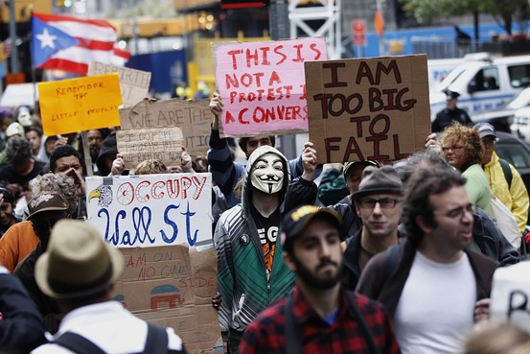
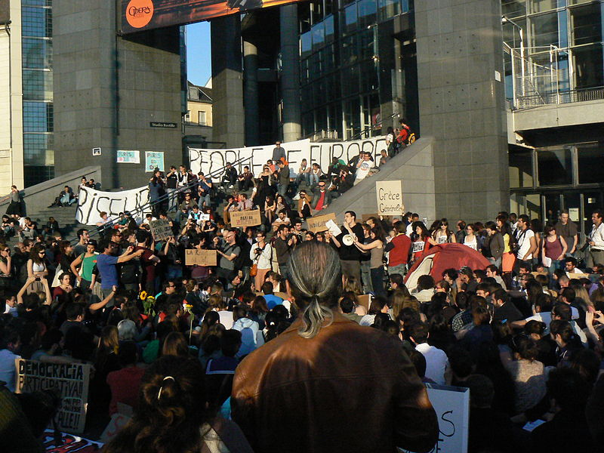
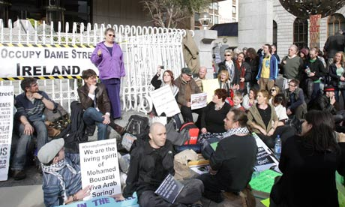
Interests
Indignados, Occupy Wall Street, Dame St
Too big to fail
Gender, Labour Movement , Poor, Migrants
Left History very different in each country
99%

Slide 8
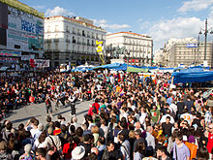

Social movement Social network
Social movement
Social network

Slide 9
Vertical v horizontal
Occupy
May 15th
Flat
Undeveloped political agenda
Action focused
Sustainable
Trade unions
NGO’s
Hierarchical
Difficult to deliver action
Policy focus but silos
Disempowering
Longer lasting
Horizontal
Vertical

Slide 10
Different cultures
Social partners
Different traditions of corporatism/CB
Different roles of TU’s
Spain, Greece, Belgium – questioning of legal validity of collective bargaining
Street mobilisation
Greece, Spain
Portugal and Ireland
TU
Street politics

Slide 11
Institutions Civil society/state
State capture
Consensus/partnership
Exclusive
Policy language
Meetings
One dimensional
State free
Conflict/adversarial
Inclusive
Accessible
Creative engagement
Cross sectoral
Formal
Informal

Slide 12
Repression Nature of cleavages
SP Act to prohibit 10-15 persons and arrests
German prohibition on political strikes
Ireland – legal curtailment on use of state funding
NGO’s
Social Movement
Political Parties - gov
Trade Unions
Local, regional, national, transnational
Nature of democracy
Class, Religion
Language, Regional

Slide 13
Claiming our Future
An Irish example
Definition of Stupidity
Doing the same thing and expecting different results!
A case study of trying to do something different

Slide 14
Absence of ideas
  Collectively Ireland bought myths
  ‘that there is no alternative’
  Passive, stagnant & cynical citizenship 2%
  Ideas: Power elites/media/group think – limited public sphere
  Interests: Society of ‘partnership’ and ‘illusion of consensus’
  Institutions: Nature of clientalistic politics & and Irish (Catholic) education
Poverty of political ambition
Poverty of imagination

Slide 15
Limitations of interests
Greece, Spain - broad protests – Irish protest more muted, fragmented, local and sectoral
Early Alliances – ICTU March, The Poor Can’t Pay, Community Platform, Is Feidir Linn, local
Small scale and defensive, anti austerity
Offensive crisis as opportunity to realign policy towards a sustainable model of development, standing ‘for’ alternatives
Oppositon to proposition

Slide 16
Ideas and Interests -
Community Platform 2008 Is Feidir Linn 2009
Sustainable
Productive
Economy
Democracy
&
Participation
Redistributive
Justice
Balance
Equal
Status
High Quality
Common Goods/Services
Shaping our future

Slide 17
Growing interests around alternatives ... Claiming Our Future
IFL
Global
TU
Rights
Faith
L left
T left
Equality
Cross sectoral
Values
State free public sphere
Deliberative space
National-local
Action
SD Left
eco
Community

Slide 18

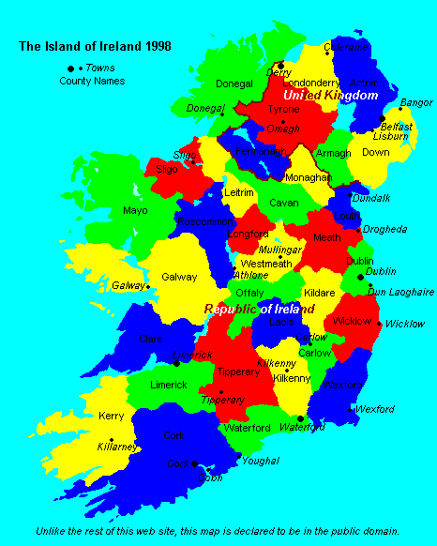
Institutions : Creating new deliberative public spheres
Values & Policies
Social media
Free Deliberative Events
Equality, Sustainability, Democracy
Actions/campaigns
Minimum wage, Gender Quotas, Bank Debt, Wealth Tax, Plan B

Slide 19
Lessons
Leadership
Actions
Time
Relevance
Hope
Alliances
Work of skilled organizers in making moments ;
Success in getting people, once these events end, to keep meeting over and over and over again;
Promote public policy solutions organically linked to the quotidian lives of its supporters;
Supportive cultural capital of progressive intellectuals/writers/artists/professionals
Yeselson –

Slide 20
Ongoing issues
What are you doing that no one else is/what else might you do
Terrible urgency of now - ‘future’ ‘for’ v ‘present’ ‘against’
Emerging oppositional ‘space’ (or absence of…)
Quality v Quantity - capacity and sustainability
Social movement or social network , organizations/individuals
Cross sectoral mobilisation
Short term v long term outcomes

Slide 21
Interests
Building a social left in Latin America
Argentina, Ecuador, Bolivia, and Venuezeula (Silva, 2009).
Translate local protest by individual movements, into ‘a nationwide force of diverse social actors
Unions took initial mobilisation lead but popular sectors replaced due to the weakening of unions.
Over several waves of popular mobilisation in concrete issues, they built forms of collective power from the late 1980s up to the 2000s, eventually creating the conditions and the constituency for the emergence of strong new left governments.
Crisis used as opportunity to create/ use political ‘space’.
Alliances built with often quite marginal political leaders, thereby strengthening greatly their positions.
Broad-based alliances across and between sectoral interests.
Transnational ideas/networks utilised to sustain alliances.
Pragmatic reformist agendas that achieved
Patient coalition building
Decades long process
Six key lessons

Slide 22
Fox Piven – Power from below
Three power resources
Disruptive power
Electoral power
Solidarity
1932, Fr Cox - march of the unemployed on Washington,
Audience with Pres H Hoover.
"government of the bankers, for the bankers and by the bankers," .
Inspired a raft of financial reform, including the Glass-Steagall Act, Federal Deposit Insurance Corp and Securities and Exchange Commission.
Nothing ever happens with people demanding it
Power from below

Slide 23
Celebrate victory
There are alternatives being heard – paradigm.....
Portugal 15th Sept resisted new progressive taxation
Ireland national min wage 1 euro cut reversed
Iceland – new constitution
Spain – no forced evictions of most vulnerable
Some recent successes

