Slide 1

“ALLIANCES TO FIGHT POVERTY”
Worker’s rights and working conditions: a state of play in Portugal
Brussels, 15th November 2012
Maria José Domingos

Slide 2


Objectives
The consequences of the Portuguese Troika Programme
Poverty today in Portugal
www.eapn.pt

Slide 3
The troika programme consequences
Financial sector regulation and supervision
Implementation of the law for recapitalization from the banks with public funds
Fiscal-structural measures
Create new rules to evaluate the Public-Private Partnerships (PPP)
Sale of State's position in the energy sector
www.eapn.pt

Slide 4
The troika programme consequences
Taxes
The increase on Maximum VAT tax: 23%
VAT increased to the maximum tax in Electricity and Distributed Gas
The increase of the Property Tax, taxes on vehicles (ISV) and tobacco
Independent workers pay 30,7% for social security
Pensioners will have an additional cut from 3,5% to 10% on their income
www.eapn.pt

Slide 5
The troika programme consequences
Privatisation plan
The plan covers the areas of transport (Airports of Portugal, TAP, and freight trains), energy, communications and insurance as well as a number of smaller firms
Housing Market
The reform program limits the possibility of transmitting the house renting contract to first degree relatives such as children and widows
IMI (Property Tax) will be updated every three years for private housing and annually for commercial real estate
Between January and September 4400 houses were delivered to banks
www.eapn.pt

Slide 6
The troika programme consequences
Public Transports
A major reform in public transport took place, highlighted by two price increases during the last year and the restructuring of supply and the fusion of various companies
Ended the tariff for students and elderly in public transports
Health
In 2012 there is a decrease in the number of users and the use rates of medical visits
A survey indicates that about 20% of the users not acquired all of the prescribed drugs, and among these are mostly women, unemployed and the elderly
www.eapn.pt

Slide 7
The troika programme consequences
Education
A cap to family tax exemptions based on education expenses
Cuts in child benefits (from 1 830 479 beneficiaries in 2010 to 1 363 615 in 2011)
The tightening of the budgets of local authorities has impacted on education as it results in less funds being available locally to support public schools
www.eapn.pt

Slide 8
The troika programme consequences
Education
The amounts of scholarships for higher education students decreased and the accessing conditions were tightened
In 2012 the number of students per class increased (from 28 to 30)
The number of unemployed teachers boosted these year. Teachers are in the 2nd position in the table of occupations with the largest growth in the number of unemployed
www.eapn.pt

Slide 9
The troika programme consequences
Income
In 2011: was an extraordinary surcharge applied on the income tax on the Christmas allowance (50% above 485 Euros); freezing of wages in the public sector, that has consequences in the private sector
In 2012: civil servants and pensioners had a surcharge of 100% on the Christmas allowance (above of 600 Euros)
In 2013: there will be a reduction of personal income tax brackets from the current eight to five ranks, which means that the average effective income tax will rise from 9,8 to 13,2% and an extra surcharge of +4%
www.eapn.pt

Slide 10
The troika programme consequences
Labour market
Commitment to not to increase the National Minimum Wage for the period of the program of financial assistance to Portugal
New rules concerning the unemployment insurance system: reduction in the maximum amount of the benefit (from 1258 to 1048 Euros), after six months, the allowance has a cut of 10%; the maximum duration of the unemployment benefit also suffered changes: it varies from a minimum of 5 months up to a maximum of 26 months for older workers and long contribution careers
www.eapn.pt

Slide 11
The troika programme consequences
Labour market
The dismissal based on inadequacy become possible even if changes were not introduced in the workplace
The introduction of the “bank of hours” allows a company to save on overtime, making the worker to increase the effective period of daily work, which can be compensated with free time, more vacation or a cash payment (value which may be less than the overtime compensation)
www.eapn.pt

Slide 12
The troika programme consequences
Labour market
Sickness allowance: reduction of the subsidy from 65% to 55% for cases of temporary disability
Compensation in dismissal: In a first amendment to the Labour Code, already in place, the Government determined that all the people who signed a contract after 1 November 2011, are now only entitled to a lower compensation: 20 days base salary and seniority payments per year worked (against the previous 30 days), with no minimum and the maximum of 12 months (116 400 Euros or wages)
www.eapn.pt

Slide 13
The troika programme consequences
Labour market
Cuts in overtime: The compensatory time off will drop by half, bringing the total to 25% in the first hour of the day, following by 37,5% and 50% on the weekly rest day or holiday
Elimination of 3 vacations days and 4 holidays
The access to Social Insertion Income is more conditioned, for example those who have properties or bank accounts over 25 000 Euros, will not have access
www.eapn.pt

Slide 14
The troika programme consequences
Civil society and trade unions
The Economic and Social Council is a constitutional body for consultation and social dialogue between the Government, Social Partners and remaining representatives of organised civil society
Its main goals are to promote the participation of economic and social agents in decision-making procedures of the organs of sovereignty, within the scope of socioeconomic issues
www.eapn.pt

Slide 15
The troika programme consequences
Civil society and trade unions
In January 2012, the Government, the employers’ confederations and UGT, signed an agreement designated as a “Commitment to Growth, Competitiveness and Employment.” This agreement is undoubtedly a setback in the conditions of workers in relation to the clear weakening of social security, a clear decline and violent rights that employees have in working conditions
www.eapn.pt

Slide 16
The troika programme consequences
Civil society and trade unions
In July 2011, the Government and nongovernmental organisations and charities signed a Cooperation Protocol of 2011 / 12 with a mandate to examine legislation that fits the social responses
Budgetary austerity has had an important impact on the work of nongovernmental organisations and charities
Many of these organisations face an unprecedented increase in requests for support and assistance
www.eapn.pt

Slide 17
The troika programme consequences
Civil society and trade unions
The European Trade Union Confederation (ETUC) sounded the alarm regarding the continuation of the austerity measures and their negative effects on the life and future of the Portuguese workers and citizens
UGT and CGTP have called a general strike in November 2011 which was considered "one of the largest general strikes that took place in Portugal", transport, schools, universities, hospitals, services and many factories stopped. During 2012, there were several strikes in the civil aviation sector and in the transport sector. In July 2012, doctors also completed a two-day strike in defence of the National Health Service.
www.eapn.pt

Slide 18
The troika programme consequences
Civil society and trade unions
Several social movements have emerged against the austerity measures and do not accept the inevitability of the rescue called Troika, such as: March 12 Movement, Platform 15 October, Occupy Lisbon Initiative, For a Citizen Audit of Public Debt
On the 15th of September 1 million people demonstrated
against a new tax, the government gave up
www.eapn.pt

Slide 19
Poverty today in Portugal
A study by the European Commission indicated that these measures have had a disproportionately negative impact on the poorest of the country’s population;
(Social Situation Observatory – Living Conditions and Income Distribution 2011);
The most vulnerable social groups have been the hardest hit by austerity measures implemented in Portugal (particularly the children, the elderly and Roma);
The risk of poverty is now more and more generalized, with increasing severity amongst the most fragile
www.eapn.pt

Slide 20
Poverty today in Portugal
Impact of Government Policy
An economy under structural adjustment
Increasing tax burden and inequality
Labour Market severely affected by unemployment and precariousness
A more expensive cost of living
  The non-registered economy - 25,4% of GDP in 2011 (OBEGEF, FEP, 2011), comparing to 9,4% of GDP in 1970
www.eapn.pt

Slide 21
Poverty today in Portugal
Risk of Poverty Threshold (2004 - 2010) - INE
Unit: Euros
Reference year | 2003 | 2004 | 2005 | 2006 | 2007 | 2008 | 2009 | 2010 (Po)
Risk of poverty threshold- annual (€) | 4149 | 4317 | 4386 | 4544 | 4886 | 4969 | 5207 | 5046
EU-SILC | 2004 | 2005 | 2006 | 2007 | 2008 | 2009 | 2010 | 2011 (Po)
P_{o} – Interim Value
EU-SILC: Living Conditions Survey
www.eapn.pt

Slide 22
Poverty today in Portugal
Poverty and income inequality indicators , Portugal, EU-SILC 2008-2011
Unidade: %
Reference year | un. | 2007 | 2008 | 2009 | 2010 (Po)
At risk of poverty rate
Before social transfers | % | 41,5 | 41,5 | 43,4 | 42,5
After social transfers relative to pensions | % | 24,9 | 24,3 | 26,4 | 25,4
After social transfers | % | 18,5 | 17,9 | 17,9 | 18,0
Indicators of income inequality
Gini Coefficient | % | 35,8 | 35,4 | 33,7 | 34,2
EU-SILC |  | 2008 | 2009 | 2010 | 2011 (Po)
P_{o} - Valor provisório
EU-SILC: Inquérito às Condições de Vida e Rendimento
www.eapn.pt

Slide 23
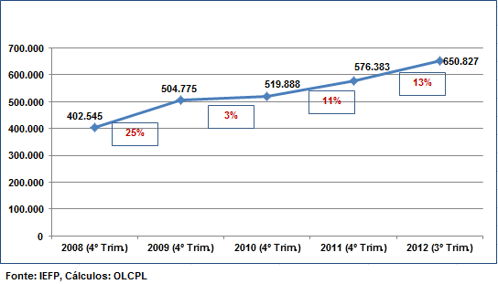
Poverty today in Portugal
Unemployment variation between 2008 and 2012 was 61.7%
www.eapn.pt

Slide 24
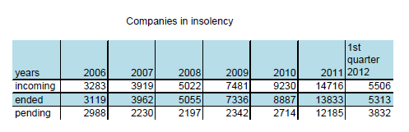
Poverty today in Portugal
In July 2012, unemployment reached 15,7%, while youth unemployment reached 36,4%
In 2011, more than 6000 people in Portugal called insolvency, which represents an increase of 154% compared to 2010. For companies, insolvency proceedings were up to 14%
Source: Pordata
www.eapn.pt

Slide 25
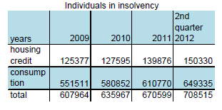
Poverty today in Portugal
Source: Pordata
According to the Portuguese Employment Institute in last July, there was an increase of 4388 of unemployed couples when compared with the same period of last year. This means an increase of 99,3%
The rate of long-term unemployment reached 8 percent, more than half of the total rate
www.eapn.pt

Slide 26
Poverty today in Portugal
At risk Poverty Rate according to employment status (EU-SILC2004 - EU-SILC2011)
Reference Year | 2003 | 2004 | 2005 | 2006 | 2007 | 2008 | 2009 | 2010 (Po)
Total with employment | 12,4% | 11,9% | 11,2% | 9,7% | 11,8% | 10,3% | 9,7% | 10,3%
Total without employment | 27,8% | 26,6% | 26,3% | 26,9% | 24,8% | 24,4% | 24,5% | 24,3%
Unemployed | 32,0% | 28,4% | 31,1% | 32,2% | 34,6% | 37,0% | 36,4% | 36,0%
Retired | 25,8% | 25,1% | 22,9% | 23,1% | 20,1% | 17,4% | 18,5% | 17,9%
Other inactive | 29,0% | 27,9% | 29,0% | 30,2% | 28,3% | 29,9% | 28,0% | 28,4%
EU-SILC | 2004 | 2005 | 2006 | 2007 | 2008 | 2009 | 2010 | 2011 (Po)
Po – Interim Value;
EU- SILC: Survey on Income and Living Conditions
Note: the indicators on employment status was considered the total population aged 18 years and over
www.eapn.pt

Slide 27
Poverty today in Portugal
The rate of at risk of poverty among employees, in Portugal, is the third highest in the European Union and is still rising
According to the calculations of a portuguese newspaper based on data from Eurostat and INE show that the number of working poor - those living on less than 434 Euros per month - increased nearly 12% from 2009 to 2010, and than that means 1,2 million working poor
www.eapn.pt

Slide 28
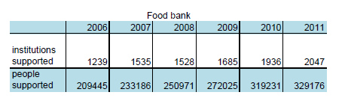
Poverty today in Portugal
Source: Pordata
www.eapn.pt

Slide 29
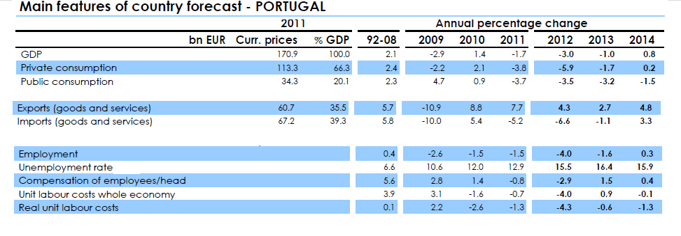
Poverty today in Portugal
Source: European Comission
www.eapn.pt

Slide 30

Thank you for your attention
Rua de Costa Cabral, 2368 | 4200-218 Porto
Telf: 225420800 Fax. 225403250
e.mail: lisboa@eapn.pt
Aveiro Beja Braga Bragança Castelo Branco Coimbra Évora Faro Guarda Leiria Lisboa Portalegre Porto Santarém Setúbal Viana do Castelo Vila Real Viseu
www.eapn.pt

