Slide 2
Welcome to the 4th conference of Alliances to fight poverty

Slide 4
All documents you will find on
alliancestofightpoverty.wordpress.com

Slide 5
Housing market in time of crisis: case-studies
France
Christophe Robert
Fondation Abbé Pierre
France

Slide 6
Housing market in time of crisis: case-studies
Romania
Ramona Sinca
FDAAM
Roumania

Slide 7
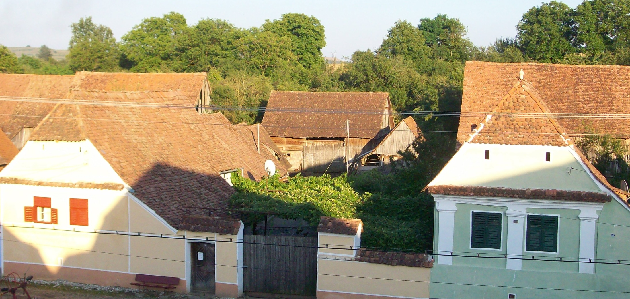
Housing in Romania

Slide 8
Timeline of a developing issue
1945: Forced collectivization
1950 – 1970: Intensive industrialization and urbanization
1967 – 1980: Demographic boom
1974: Rural and urban systematization
1980-1990: Dropout of systematic investments in the maintenance and development of the housing stock
1990: Massive selling of state properties
1990-2012: Restitution of nationalized houses. Rural-urban migration. Housing crisis.

Slide 9
RO housing, in it’s current nutshell
*Population and Housing Census - 2011
Population: 19.0 million (19,042,936) people
> 52.8% in urban areas, 47.2% in rural areas
Households: 7.1 million (7,086,717) households
Housing units: 8.5 million
Buildings: 5.1 million buildings (5,117,940 establishments: 5,103,013 residential and 14,927 residential buildings with collective spaces).

Slide 10
Characteristics
Property : 97% of Romanians own a home (objective reality, cultural norm); 3-4% pay rent for it;
Housing stock: in crisis;
  construction rate declining since 1992 ;
  the migration from villages to towns puts a pressure on the urban housing market;
  the “children” of the demographic boom (1967-1980) are now families claiming housing.
Housing need: acute for 9% of Romanians, potential for 13%;
  96% of the people in need for a new house can’t afford it;
Living area of the household smaller than anywhere else in EU - 12-15 m2/person;
  Average number of tenants/household: 2.66 (2.53 in towns; 2.83 in municipalities);
  Average number of rooms/dwelling: 2.7 (2.5 in towns; 2.9 in municipalities);

Slide 11
Characteristics
Housing facilities: precarious in rural areas, better in urban settings
  Access to water supply, sewerage: 54% (88% in towns, 17% in municipalities);
  Electricity: 97.97%;
  Gas: 42.86% (74.65% in towns, 8.21% in municipalities);
  Central heating: 38.55% (71.83% in towns, 2.27% in municipalities).
Housing conditions
  23% of houses are in an improper condition;
  35% of urban dwellings need urgent infrastructure rehabilitation.
Household maintenance costs: 44%-55% of revenue;
  in urban areas, 32% of households can’t afford the heating costs in winter time; 23% have public debts for more than 3 months;
  in rural areas, 2.6% of households have no heating, while 1.4% use easily exhaustible fuels
INS, ACOVI, 2002

Slide 12
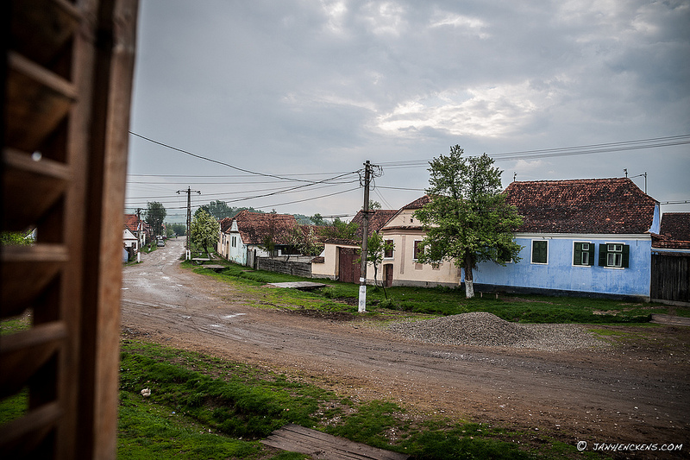

Slide 13
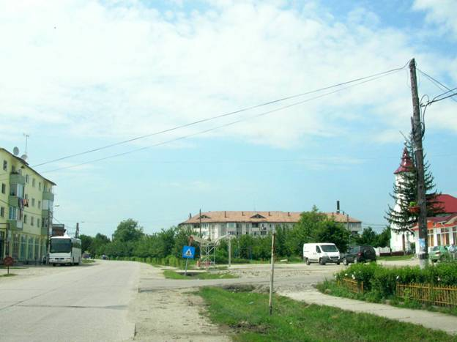
Notes:
Smart shrinking

Slide 14
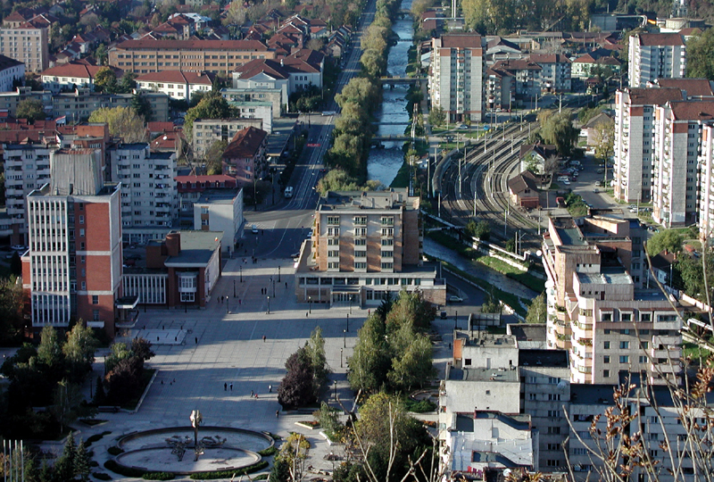
Notes:
Majoritatea oraselor, in general de rang II si mai mic, au o forta economica redusa, ceea ce sugereaza cresterea rolului oraselor de categoria I (municipii de importanta nationala cu influenta potentiala la nivel european). Orasele mici si mijlocii stagneaza iar accesibilitatea mult mai redusa reduce si mai mult sansele acestora de a-si dezvolta un rol teritorial.

Slide 15
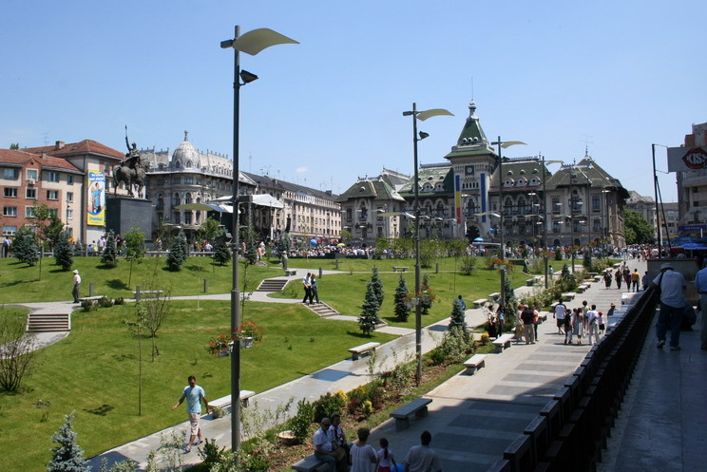
Notes:
Orasele se extind. Dincolo de limitele oraselor si ale comunelor, dupa 1990, s-a construit in ritm rapid si din fonduri private, locuinte individuale. Este vorba de o categorie de proprietari care doresc sa-si schimbe modul de viata din locuintele colective cu unul adecvat standardelor de confort si noii situatii economice. Extinderea se realizeaza prin parcelarea terenurilor agricole, iar asigurarea cu utilitati reprezinta rolul demersurilor individuale.
MEGAS – Bucuresti, Timisoara

Slide 16
Access to housing
Determinants:
  Socio-demographic
  Socio-economic
  Unequal wealth distribution
  Labile state support
Specific social groups exposed to environmental hazard & housing exclusion: youngsters, single or many parent families, unemployed and minorities (Rroma population).

Slide 17
Housing state support in Romania
Social housing - an intended right for people at disadvantage
Housing Law 114, 1996
  Social housing – a to-do for the local authorities
  Options: building social houses / rearranging the current stock
  2010: 7500 social apartments vs. a demand of 200.000
National Housing Agency (ANL) programs:
  Houses for Young People: rental system; land and utilities ensured by local authorities; building costs covered by ANL;
  Residential Mortgage Loans (Prima Casa):
    Beneficiaries: people who want to contract a home built by ANL, regardless of age;
    Home types: apartments in buildings with a higher degree of finish and individual houses;
    Financing is made exclusively by banks, according to their specific lending norms.
    The loan is granted for a maximum period of 30 years, at a variable interest of about 4% (for loans in Euros) or 2.5% (for loans in Lei); minimum advance: 5%.
  Reviving the Romanian villages: housing benefits for specialists who want to establish themselves in rural areas; the Agency builds up to 10 establishments in each municipality; then the local council rents it to specialists.
Notes:
Conform legislaţiei româneşti în vigoare,
orice persoană aflată într-o situaţie de precaritate a veniturilor (situate sub minimul
garantat) poate solicita consiliului local al localităţii de domiciliu închirierea unei
locuinţe, la un preţ subvenţionat. În măsura disponibilităţilor locale, solicitantul
poate primi o astfel de locuinţă pe o perioadă limitată. Ocuparea unei locuinţe
sociale este dependentă de stocul de locuinţe sociale disponibile la un moment dat
în timp, la nivel local. Dreptul instituit prin lege nu devine efectiv decât în măsura
în care consiliile locale au în administrare astfel de locuinţe şi pot subvenţiona din bugetul local sau alte surse.
De o locuinţă socială pot beneficia persoane sau familii care au „…un venit
mediu net lunar realizat în ultimele 12 luni sub nivelul venitului net lunar pe
familie, pentru care se acordă ajutor social potrivit legii, majorat cu
10%”(L114/1996, art. 42, alin 1) şi care nu:
a) deţin în proprietate o locuinţă;
b) au înstrăinat o locuinţă după data de 1 ianuarie 1990;
c) au beneficiat de sprijinul statului în credite şi execuţie pentru realizarea
unei locuinţe;
d) deţin, în calitate de chiriaş, o altă locuinţă.(L114/1996, art. 48).

Slide 18
Conclusion
The state has failed in ensuring the right to decent housing and living. Will the people claim it or will they handle it the Romanian way?
The housing problem should be a key point in the strategies for social and economical development, at all levels.

Slide 19
Thank you
Notes:
LOCUINTE PENTRU TINERI - Descrierea programului
Programul de constructii locuinte pentru tineri, destinate închirierii se adreseaza tinerilor cu vârste de pâna intre 18-35 de ani la data depunerii cererii, care nu îsi permit sa cumpere un apartament sau sa închirieze o locuinta de pe piata libera.
Tinerii pot primi repartitii in cel mult 12 luni de la implinirea varstei de 35 de ani. Locuintele sunt construite pe terenuri puse la dispozitia Agentiei Nationale pentru Locuinte de catre consiliile locale, conform prevederilor legale si cu respectarea documentatiei de urbanism legal aprobate.
Printr-o conventie încheiata cu ANL, autoritatile locale au obligatia de a asigura viabilizarea terenului (utilitatile) si dotarile edilitare ale caror costuri sunt suportate din bugetele locale. Investitiile privind constructia de locuinte în regim de închiriere sunt finantate de la bugetul de stat si/sau bugete locale, precum si din credite interne/externe si din alte surse legal constituite. Autoritatile locale repartizeaza locuintele construite prin ANL pe baza cererilor depuse de solicitantii care îndeplinesc criteriile stabilite prin lege.
Cererile pentru locuintele în regim de închiriere sunt analizate de catre comisiile sociale din cadrul consiliilor locale care stabilesc ordinea repartitiilor în functie de punctajul obtinut de fiecare solicitant în parte în urma verificarii dosarelor.

Slide 20
Housing market in time of crisis: case-studies
Brussels
Olivier Lambert
Advisor MOC
Belgium

Slide 21

The stakes of housing in the Region of Brussels
Olivier Lambert
« Alliances to fight povrety »
Dublin Seminary
11th of may 2012

Slide 22

Stakes of housing in the Region of Brussels
Summary
The context in Belgium
The stand of things in the region of « Brussels Capital »
General state of health
  Private rental lease
  Public social housing
Perspectives
  Priorities of the government: refurbish and create dwelling units
  Control of rents and rental charges
  Fight against inoccupied dwellings
  Reallocation of offices into dwellings
  New or alternate paths: from housing to « habitat »
Conclusions
Notes:
22

Slide 23
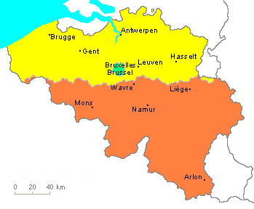
Stakes of housing in the Region of Brussels
The context in Belgium
11 millions inhabitants
Federal state (3 Regions + 3 Communities)
  And a further 10 provinces
  And yet 589 communes (=administrative districts) that exercise competences in housing
The right of housing entitled in our Constitution
Regionalised public housing
Private housing is yet federal
  Rental leases being regionalised
  Taxes remain a federal matter
70% owners occupying the dwellings
over the country
Notes:
23

Slide 24
Stakes of housing in the Region of Brussels
Stand of things in the Region of « Brussels-Capital »
Around 1.130.000 inhabitants
  Among which 28% speak a foreign mothertongue
City limited to its 19 communes
  161 km²
Region historically poorly financed
  Since then : special bill on 12th of January 1989
« Brussels syndrom » since World's Fair in 1958
  From 600.000 m² to 3.300.000 m² offices in 20 years
Notes:
24

Slide 25
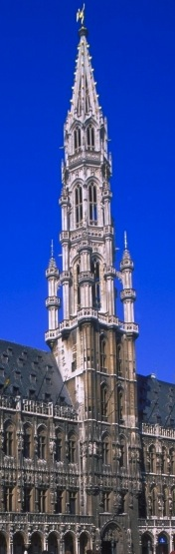
Stakes of housing in the Region of Brussels
Stand of things in the Region of « Brussels-Capital »
Multicultural city
  46% foreigners and 25% muslims
  Heart of the European Institutions
Drift of the middle class, then demographic boom
  14000 new households a year
  BUT a quarter of them under the poverty line
Large discrepancies between communes
  100m² dwellings around 1.200 euros in Watermael
  100m² dwellings around 600 euros in Anderlecht
Notes:
25

Slide 26
Stakes of housing in the Region of Brussels
I. General state of health
Private rental lease
Real estate was very cheap before the 80's
Prices raised since :
  1st stock exchange crisis at the end of the 80's
  Setting up of the European Institutions in Brussels
Households need a 2,000 Euros monthly income in order to pay their rent and not to exceed 30% of their monthly income
Notes:
26

Slide 27
Stakes of housing in the Region of Brussels
I. General state of health
Private rental leases
As opposed to Germany, France or the Netherlands, there exists no public regulations for the private rental market
Conclusions : since the last 10 years,
  Rents raised by 50%
  Salaries raised by... 15%
The poorest are the primary victims
  50% of Brussels citizens spend over 40% of their income in their rent
  The 30% poorest can only access 4% of the dwelling offer (vs 12% 15 years ago)
Notes:
27

Slide 28
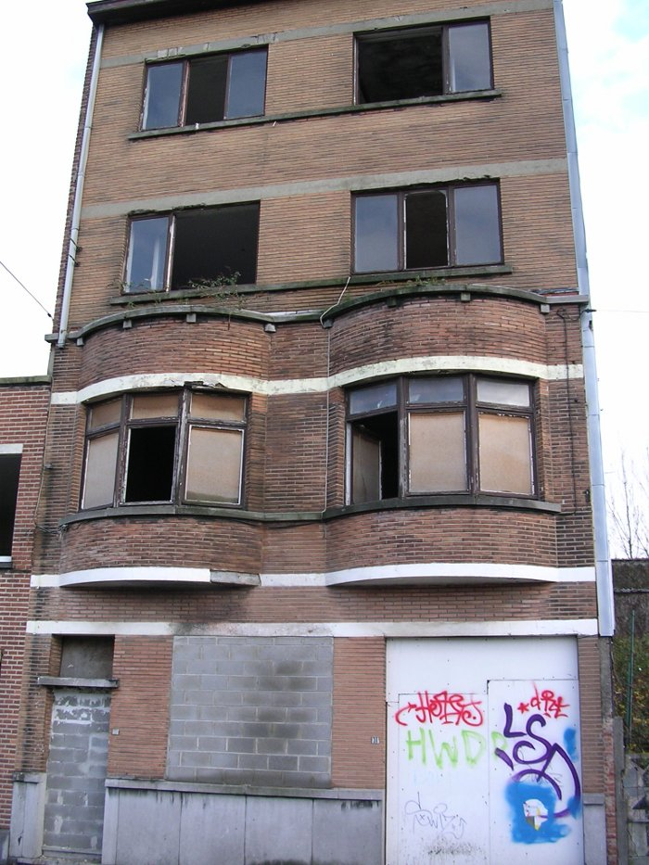
Stakes of housing in the Region of Brussels
I. General state of health
Private rental leases
Paradox: according to estimations, Brussels sheltered in 2010:
3.000 homeless people including
965 children
15.000 to 30.000 empty dwellings
  80% being private and
  20% owned by the state
Notes:
28

Slide 29
Stakes of housing in the Region of Brussels
I. General state of health
Public social housing
Shortage of dwellings
  Social dwellings represent 8% of the total offer vs
    17% in France
    21% in Great Britain
    35% in the Netherlands
  Over 50% Brussels citizens are in the terms of entitlement to a social dwelling
    38.000 households are on the waiting list (delay : 2 to 10 years)
    ...for 38.000 currently occupied dwellings
Notes:
29

Slide 30
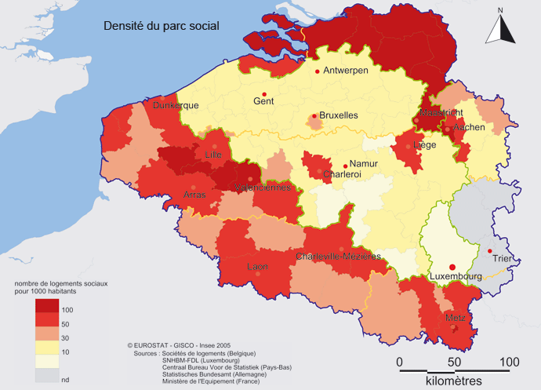
Stakes of housing in the Region of Brussels
Public social housing
I. General state of health
Notes:
30
30

Slide 31
Stakes of housing in the Region of Brussels
I. General state of health
Public social housing
Main causes of the shortage
  Before the competence was transferred to Regions
    Low investment by the federal state
    Lack of maintenance of the existing pool of dwellings
    Delay in building of new state-owned dwellings
  Dilapidated state of the existing pool
    Given the regional subsidies, it will take another 20 years to bring the entire pool up to the current norms
    Potential closing down of thousands of dwellings
Notes:
31

Slide 32
Stakes of housing in the Region of Brussels
I. General state of health
Public social housing
Main causes of the shortage
  Administrative apathy: 43 months min. to realize a building project (town planning authorisations, mandatory consultations, public contracts...)
  Increasing scarcity of the land: The Region of Brussels is limited to the territory of its 19 communes
  Turnaround of tenants is low and even slowing down due to their impoverishment
Notes:
32

Slide 33
Stakes of housing in the Region of Brussels
II. Perspectives
Government's priorities: creation and refurbishment
For social housing
Target: 15% of public dwellings (to be determined)
  Hence creation of 35.000 dwellings in 10 years
Allocate them primarily to households with limited income
  40% low -, 40% precarious -, 15% average income
Speed up the rotation: 9 years leases as from January 2013
Put the accent on refurbishing the existing dwellings
  'Low energy' norm (75 millions euros in 2012)
For conventioned housing
Support to the AIS (social real estate agencies): 23 AIS for 3.000 dwellings in 10 ans
Notes:
33

Slide 34
Stakes of housing in the Region of Brussels
II. Perspectives
For private rental leases: control of rents and rental charges
To regulate the market of private leases
  Setup a reference grid
  That takes the energetic performance into consideration
To grant a housing benefit that does not stimulate a similar rise of the prices
  As of today, there are only ADIL (Moving-Settling-Rent Allocation) and benefit for tenants of non social public dwellings
  Extend benefit to any low income tenants
To create joint committies that settle disputes on rent determination
Notes:
34

Slide 35
Stakes of housing in the Region of Brussels
II. Perspectives
Fight against unoccupied dwellings
30.000 empty dwellings (frequently above stores)
Communal and regional taxes on empty dwellings
  Regional administration in place since 2012
Right of public management
  Extended to social housing companies
Requisition of buildings (unapplied so far)
Free spaces above stores
Precarious occupation conventions
  From now on for social housing companies
  2.120 empty social dwellings in 2010 (half of them for works)
Notes:
35

Slide 36

Stakes of housing in the Region of Brussels
II. Perspectives
Reallocation of offices into dwellings
2 millions unoccupied square meters
Request for proposal and subsidisation of start-up costs
  Feasibility study, request for planning permission
On volontary basis before
more coercive measures?
Notes:
36

Slide 37
Stakes of housing in the Region of Brussels
II. Perspectives
New or alternate paths: from housing to « habitat »
The Community Land Trust
  Land ownership is separated from dwelling ownership
  The land remains a collective property
  As a result the cost of the dwelling is reduced
Promotion of diversified types of housing
  Transgenerational or 'kangaroo'
  Socially-cohesive housing (but individualization of the rights)
  Recognition of mobile home, etc.
Notes:
37

Slide 38
Stakes of housing in the Region of Brussels
II. Conclusions
With respect to the magnitude of the crisis, no single prevailing solution
Since the Region was created, Brussels has found itself in a seemingly hopeless race against the clock:
Rents raise faster than incomes
The population increases faster than the creation of affordable dwellings
Any line of approach should be encouraged, :
To deal along with the themes of housing and homelessness
To take into account of the energetic dimension at all levels
To give priority to the poorest, yet ensuring a mixity.
Notes:
38

Slide 39
Stakes of housing in the Region of Brussels
II. Conclusions
Gather all forces for a basic right approach
Having a decent housing is a precondition to exercise other basic rights:
We have to make alliances around that right. In Brussels, civil society has built an Alliance for the right of housing (RBDH)
Housing is not a direct competence of the European Union, even after having recognised housing as a basic right in the fight against social exclusion several times.
Michel has indicated the huge differences between countries. How can the social movements rise their voice for a European project that guarantees that essential right of housing?
Notes:
39
39

Slide 40

Stakes of housing in the Region of Brussels
Thanks a lot for your attention…
Notes:
40
40

Slide 41
Homelesness as a sign
of the European housing crisis
Ruth Owen
FEANTSA
Brussels

Slide 42
Homelessness caused by housing crisis:
Some reflection & European actions
Contribution of FEANTSA to ACW-EZA-FOCUS conference

Slide 43
FEANTSA
Who?
  European homeless sector
    Shelter and supported housing
    25 EU member states
What?
  Research
  Lobbying
  Exchanges
  Communication
Housing working group
  Leads on housing issues…

Slide 44
Recent trends in homelessness (1)
Numbers
  Stable or small increases
    Central, North, and Eastern Europe
    Long-term vs short-term homelessness
  Sharp increases
    England
      2,181 rough sleepers in autumn 2011 (compared to 1,768 in autumn 2010)
    Greece, Spain, Portugal …
      Link with EU surveillance??
  Decreases
    Scotland
      20 % fall in homelessness applications and assessments between autumn 2010 and autumn 2011
      Drops in the number of people being made homeless were recorded in 28 out of 32 local council areas
    NRW…
Profile
  Increase in youth homelessness
  New homeless
    Impoverished middle class and homeowners
      Greece

Slide 45
Recent trends in homelessness (2)
Causes
  Crisis
    Housing
      Repossessions & Evictions
      Increasing rents
      Spain, UK, Portugal, Greece,…
    Employment
      Youth (and migrants) most vulnerable…
  Policies
    Countries with effective policies and protected budgets more resistant to impact of crisis on homelessness
      Scandinavia,…
    Countries with no policies/strategies and/or important budget cuts/reduced ambition
      Greece +20%, England +15%, Spain +15%

Slide 46
Recent trends in homelessness (3)
Policies
  Tendency to criminalise homelessness
    Hungary, local level,…
  Shift of responsibility to local level
    England – local authotrity cuts/Supporting People
  Reemergence of deserving – undeserving
    Migrants
    Gatekeeping
  (Re)focus on emergency intervention
    More beds in night shelters / Cuts in supported housing
    Belgium, Eastern Europe, UK, France (link to public pressure/NGOs)
  Focus on Housing First
    Cost-effectiveness argument…
    Unsustainable homeless system

Slide 47
EU level action
Economic surveillance
  Prevent Housing Booms/Busts
    Impact?!
  Employment / Free movement
    Less protection?!
Funding
  ERDF 2007 – 2013
    Housing for marginalised communities until 2013
  ERDF 2014 – 2020
    Health & Social infrastructure
    Urban regeneration
    Energy efficiency in (social) housing
  ESF
    20% for social inclusion?

Slide 48
EU level action
Research
  Repossession and right to housing (DG EMPL)
  Migration & homelessness (DG EMPL)
  Security of tenure (DG R&D)
Exchanges
  Innovation
    Housing First…
Homeless strategy
  Slow progress but hopeful
  NRP
    Priority/issues in app. 15 member states
      Recognition of extreme social effects of austerity/ec policy by Min of Finance!!

Slide 49
FEANTSA resources
Research on social housing allocation systems
  Room for better use of scarce resource…
    Targeting on basis of need
Social innovation
  Research/Experiments on Housing First approach to homelessness
    Momentum at EU level
    Cost-effective
      Growing evidence – housing and health
  Toolkit on Social Rental Agencies
    Responsibilising the private rental market
Monitoring of homelessness policies
  1st European report
    Crisis impacts…
    Progress possible in difficult context

Slide 50
Focus on crisis: danger or opportunity?
There are bigger problems
Increase of homelessness too limited ?!
Ringfenced budgets for homelessness
Difficult link with employment
  Pressure on EU to become social policy player
    Commitments in response to expectations…
    Delivery?
BUT
Progress possible in difficult circumstances
Manageable problem
Policies are knowledge driven
  Pressure on EU to deliver impact
    Added value of EU action

Slide 51
Thank you for listening
Questions
Ruth.Owen@feantsa.org

Slide 52
Towards a sustainable housing policy
Marja Elsing
University of Technology Delft
The Netherlands

Slide 53
Housing policy in Europe
Towards a sustainable policies
Marja Elsinga

Slide 54
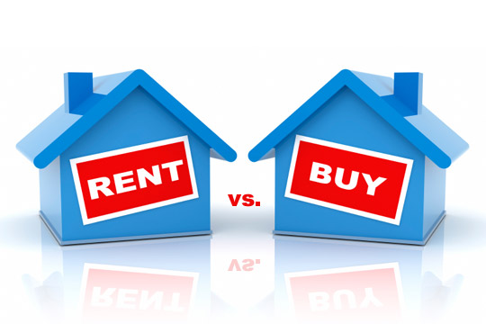
Some figures
Meaning of housing tenure
Housing tenure and policy
Towards a sustainable policy?

Slide 55
Home ownership by income quartile, EU-SILC 2008

Slide 56
Housing tenure in Europe, Cecodhas, 2007

Slide 57
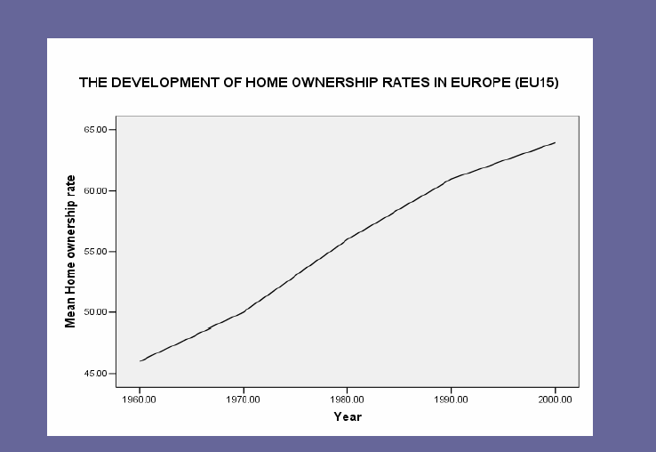
Growth of home ownership in Europe, Doling 2006

Slide 58
Floor space per person(in m2),
Housing Statistics in the European Union, 2004

Slide 59
Source: CECODHAS European Social Housing Observatory (2008)

Slide 60
Conclusions
The higher the income, the higher the home ownership rate (Household)
The higher the income, the lower the home ownership rate (country)
Home ownership is increasing
Different rental models

Slide 61
Some figures
Meaning of housing tenure
Housing tenure and policy
Conclusions

Slide 62

Without a steady job and at a very young age my Dutch friends buy!! Just imagine, what an obligations.
Why not RENT and enjoy the freedom?

Slide 63

You should really BUY a house now! Get your foot on the property ladder as soon as possible.

Slide 64
Young entrent households by tenure, LSE, Cecodhas, 2006

Slide 65

Home ownership a European dream?
Home ownership ideology is strongest in Anglo Saxon countries

Slide 66
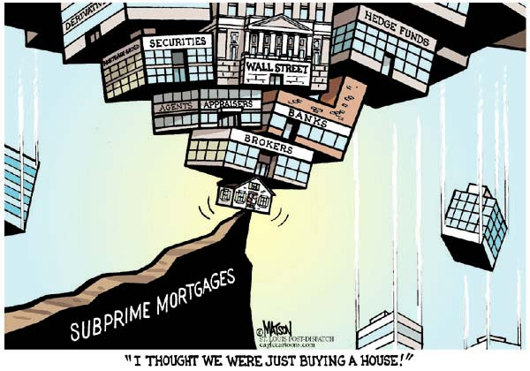
More than just owning a house

Slide 67
Is home ownership good for people and societies?
Some evidence:
Housing satisfaction
Empowerment

Slide 68

Are home owners more satisfied than tenants

Slide 69
Data and Method
Multiple regression on European Community Household Panel, 1994-2001
Housing satisfaction
Explanatory variables
  Tenure
  Housing characteristics
  Household characteristics
In 11 of 12 countries home owners are significantly more satisfied with their housing situation

Slide 70
Are home owners more empowered than tenants?

Slide 71
Data and Methods
Are buyers of their (social rented) home more empowered than renters?
Research population of 14 housing associations who offered their renters their home for sale in 2005-2008
Telephone surveys among owners & tenants:
Identical questions on empowerment measures,
Empowerment scale: dependent in analyses
Home owners score higher than tenants!!!!

Slide 72
BUT: Multivariate regression analysis: control over life
 | significant
Age
Education | +
Income | +
Country of birth | -
Tenure
Area, home owner dominated or not
Housing history | +

Slide 73
Conclusions
The meaning of tenure depends on context
Home ownership is rather an indicator than a cause of empowerment
Positive effects of home ownership are often over estimated

Slide 74
Some figures
Meaning of housing tenure
Housing tenure and policy
Conclusions

Slide 75
Home ownership and policy in EU
Housing policy is a responsibility of the member states
Member states are responsible for policies towards home ownership, housing subsidies and social housing
BUT

Slide 76
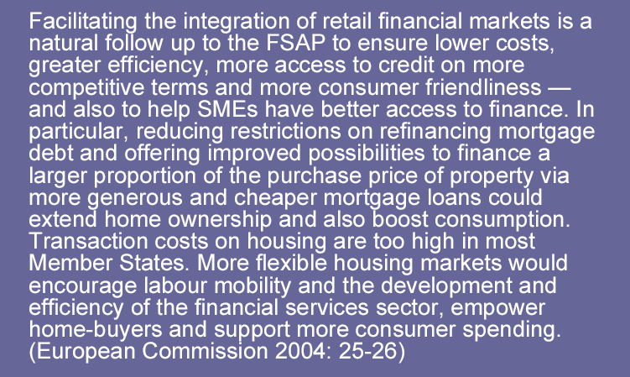
EC housing policy by stealth

Slide 77
EC housing policy by stealth
SGEI
Competition
Discussion on definition of social housing
The end of the unitary model???

Slide 78
Reasons to encourage home ownership
Help households to achieve the preferred tenure
More responsible citizens
Empower people
Better involvement in neighbourhoods
Make households build equity
Strong beliefs, weak evidence

Slide 79

Ways to promote home ownership
Why do people not buy?
  They can not afford to buy
  They prefer renting

Slide 80
How to make home ownership affordable or more attractive
Make it cheaper:
  Subsidies or lowering tax
Reduce risks:
  Cover part of the risk
Make rental sector less attractive

Slide 81
Subsidies or lowering tax
Allowances
Grants
Tax exemption (capital gain, property tax, imputed rent)
Tax reduction of interest (income tax)
Sell social rental dwellings with reduction

Slide 82
Reduce risk
Regulation by financial supervisors (prevent housing arrears)
Mortgage insurance/guarantee (reduce risk of negative equity + repossession)
House price insurance (reduce risk of house price decrease)
Housing expenses insurance (reduce risk of arrears when income drops)
Intermediate tenures (reduce risk of house price decrease and arrears)
Housing allowance (reduce risk of arrears)
Maintenance contract (reduce risk of maintenance)
Encourage renting (avoid all risk of buying)

Slide 83
Policy on home ownership, OSIS 2007
 | Be | Ge | Fi | Hu | Ne | Po | Sw | UK
Encourage homeownership | + | + | + | + | + | + | + | +
Mortgage guarantee | + | + | + | - | + | - | + | -
Subsidised saving | - | + | + | + | - | ? | - | -
Subsidies/ Grants | - | - | + | + | - | + | - | -
Allowance | - | + | + | + | + | - | + | +
Interest deduction | + | - | + | + | + | + | + | -
Tax on imputed rent | + | - | - | - | + | - | - | -
Home ownership rate | 63 | 42 | 63 | 92 | 54 | 76 | 55 | 70

Slide 84
Increasing home ownership, does housing policy matter, Atterhog, 2005
Government support matters in particular in non Anglophone countries
NB in these countries policies make owner occupation more attractive
In Anglophone countries home ownership is preferred and policy can only challenge and stretch the limit of growth

Slide 85
Policy on renting, OSIS 2007
 | Be | Ge | Fi | Hu | Ne | Po | Sw | UK
Social housing | 6 | 5 | 11 | 3 | 35 | 3 | 18 | 20
Rent control social renting | + | + | + | - | + | + | + | +
Rent control private | + | + | - | - | + | - | + | -
Security of tenure social | + | + | + | + | + | ? | + | +
Security of tenure private | 3 y | + | - | - | + | ? | + | 6 mths
Housing allowance | - | + | + | + | + | + | + | +

Slide 86
Social housing in Europe, Whitehead and Scanlon, 2007
http://vbn.aau.dk/files/13671493/SocialHousingInEurope.pdf
Huge differences between countries: size, target group taks
General trends:
  More involvement in neighbourhood management
  Attracting private investment
  Energy efficiency
Update of the book, a new book????

Slide 87

Conclusions
EC-policy affects housing and indirectly encourages home ownership
Almost all member states encourage home ownership
Home ownership policies are most effective
in countries with low home ownership rates.
The most effective way of increasing
home ownership is to make renting less attractive

Slide 88

Housing asset based welfare

Slide 89
Home owners without a mortgage and those with a mortgage – as a % of total population EQLS, Mandic, 2010

Slide 90
Do people intend to use housing equity?
Eurobarometer, 2009/2009

Slide 91
Plans and considerations of the ‘non-retired’ and the (carried out) plans of the ‘retired’(Eurobarometer 2008)

Slide 92
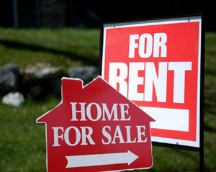
Implications for housing policy
The positive effects of home ownership are over estimated
The positive effects of a good functioning rental market are underestimated
  Positive effect on social inclusion
  Enables labour market mobility
Housing policy should aim at providing adequate housing,
no so much on a particular tenure
More focus on:
  How can housing market risks be reduced
  How can labour market mobility be supported by the housing market
  How can housing contribute to social inclusion

Slide 93
Sustainable policy
Not ignore problems, keep them on the political agenda:
  Affordable housing
  Good quality (house, neighbourhood, energy efficiency)
Housing and welfare?
  Home ownership not the solution for the welfare problem!
  Housing plays an important role for social inclusion and quality of neighbourhoods
  Social housing needs innovation

Slide 94
Questions and debate
Chaired by
Catherine Mahler
Focus Ireland

Slide 95
LUNCH
Till 2.00 pm

