Slide 1
Minimum social standards at EU-level
European social conference: Balancing social and economic policy of Europe during the first semester
Brussels 20th September 2011
Anne Van Lancker

Slide 2
Social standards are needed
No ‘trickle down’ effect of growth on social inequalities
Social cohesion and social justice should be actively persued, also by EU
Internal market requires social policy as productive factor
Ensure people’s support: high expectations, low delivery

Slide 3
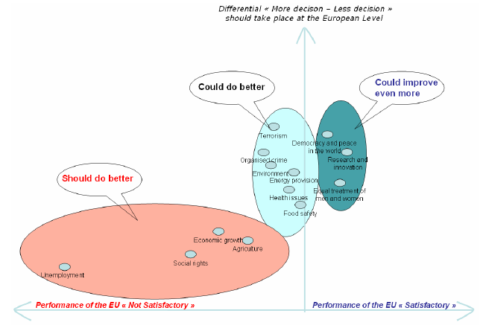
Notes:
Hoge verwachtingen en teleurstelling in EU prestaties m.b.t. sociale rechten, strijd tegen werkloosheid

Slide 4
Notes:
Majority of Europeans (62%) in favour of harmonisation of welfare systems
- desire very strong in new Member States
- only Finland and UK against
- young and higher educated respondents in favour

Slide 5
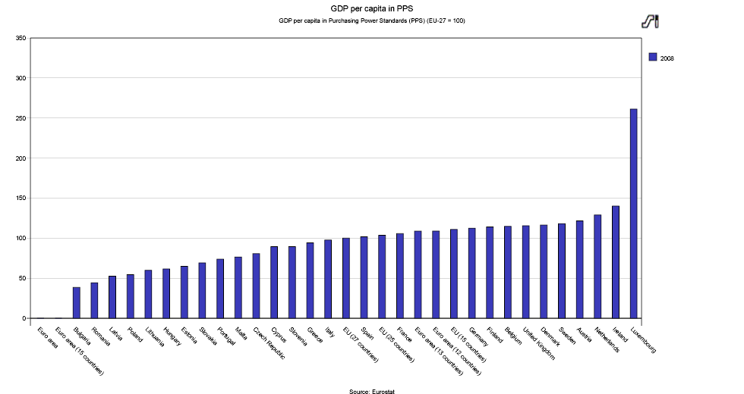
Social situation in Europa:great diversity
BBP/capita

Slide 6
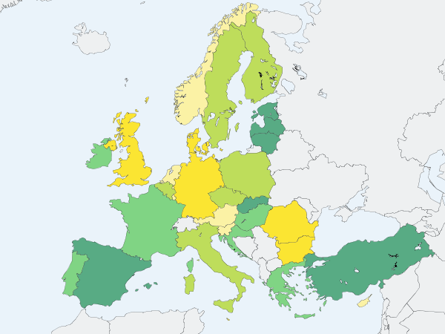
Social situation in Europa: great diversity unemployment

Slide 7
Social situation in Europe: great diversity (child) poverty

Slide 8
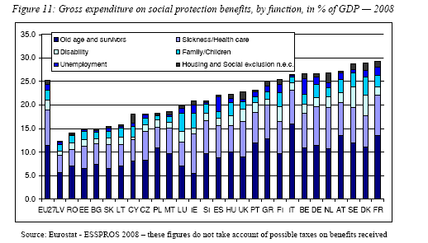

Slide 9
Social standards between subsidiarity and economic integration
Treaty changes have gradually increased EU competence in social field
Reasonable results on labour law, non-discrimination, equal opportunities…
But compared with strong economic integration, social policy remains largely with Member States
Division of labour: EU creates market, Member States develop welfare state

Slide 10
Social standards between subsidiarity and economic integration
‘separate worlds’ = illusion!
Free movement of people + equal treatment: access to social benefits not restricted to national citizens
Internal market and competition rules also apply to social and health services: public procurement, state aid
Liberalisation of ‘second pillar’ pension schemes and health insurance

Slide 11
EU common values and elements of shared identity (symbolic boundaries)
Trans-national sharing schemes
A2
Nation –based
welfare state
A
EU economic space
(EMU)
Cross border
Private insurences schemes
A1
B
EU Social space
Supra national
Sharing schemes
A4
C
Sub-national & cross-regional schemes
A3
D
Based on Maurizio Ferrera, Mapping the components of Social EU

Slide 12
EU action on social standards on income
In ‘70thies: Poverty Programmes
1992 Council recommendation on common criteria concerning sufficient resources and social assistance in social protection systems: Member States to recognise the basic right of a person to sufficient resources and social assistance to live in dignity; progressively set a guaranteed minimum income; adapt social protection systems
Common principles and guidelines to achieve convergence toward common objectives such as poverty reduction

Slide 13
EU action on social standards on income
Lisbon strategy 2000 includes social objectives, including ‘eradication of poverty’
Social OMC: common goals, indicators (including at-risk-of-poverty treshold 60% of median income), NAPs, joint reports
But poverty rates remain high and almost no change

Slide 14
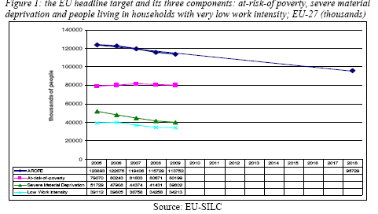

Slide 15
EU action on social standards on income
2008 Commission recommendation on active inclusion of people excluded from the labour market: three strands: adequate income support, inclusive labour markets, access to quality social services – explicit reference to 1992 council recommendation criteria

Slide 16
Social policy after Lisbon Treaty
Strong common social values and objectives
Charter of Fundamental Rights, including social rights
Horizontal social clause: mainstreaming of social objectives in all policies
Role of social partners and civil society strengthened
Coordination of social and employment policy of Member States

Slide 17
Social policy after Lisbon Treaty
But no new competences in social field
No EU competence on wages
EU law on minimum standards on social security: unanimity required
Coordination of Member States’ policy on poverty and social exclusion, pensions, health care: ‘soft’ OMC

Slide 18
Europe 2020: new opportunities for more social EU?
Better coordination of economic, environmental, employment and social policies
Poverty reduction = headline target + guideline 10 of integrated guidelines
Flagship European Platform Against Poverty
Stronger governance: European semester, NRPs, recommendations including on poverty

Slide 19
Europe 2020: new opportunities for more social EU?
But in practice: strong dominance of ECOFIN, focus on budgetary discipline, austerity measures, structural reform
No recommendations on poverty
Social OMC needs strengthening: more binding targets, stronger involvement of parliaments, social partners and civil society
But future of social OMC still uncertain

Slide 20
Right to decent minimum income as a first new social standard
Rights to decent minimum income could become first EU social standard of new generation
Poverty is longstanding priority on EU agenda, but soft power is not working
Most Member States have minimum income schemes, but most are insufficient for life in dignity
Minimum income, together with inclusive labour market and access to quality services, is key in fight against poverty

Slide 21
Right to decent minimum income as a first new social standard
But resistance of Member States: « national competence, subsidiarity »
« No EU legal competence for law on income»
Big differences between Member States in adequacy of minimum income schemes, take-up and coverage
Legimacy of at-risk-of-poverty treshold (60% of median income) questioned
High budgetary cost: 130 billion EUR, big differences in efforts needed in MS

Slide 22
Right to decent minimum income as a first new social standard
Subsidiarity respected: poverty treshold on basis of median national income
Legal base for minimum income of last resort: minimum standards for integration of people excluded from labour market (TFEU art 153, 1,h)
Progress on minimum income could trigger progress on social security benefits and minimum income

Slide 23
Right to decent minimum income as a first new social standard
EU Network of independent experts on social inclusion: «combined effort of adequate minimum income and other policy measures» should reach 60% treshold
Use of ‘budget standards’: basket of goods and services to live a life in dignity
Establish ‘country roadmap’, with national timeframe to achieve goal

Slide 24
Right to decent minimum income as a first new social standard
EAPN campaign supported by Social Platform, ETUC, S&D group, Greens and GUE in European Parliament
THANK YOU FOR YOUR ATTENTION!

