Slide 1
Emploiment et pauvreté en ES
Bruxelles 19 et 20/9/11
Antonia Ramos Yuste
UGT- Espagne

Slide 2

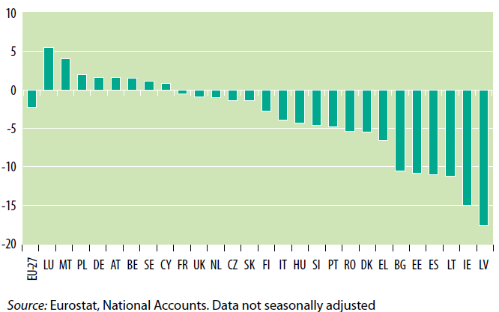

Slide 3

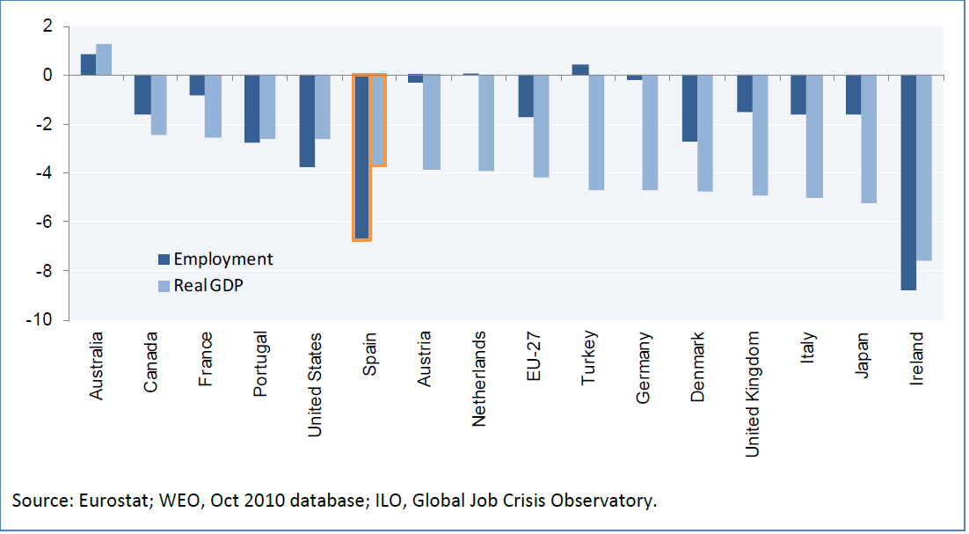

Slide 4
Employment and unemployment
Employment rate (2010) 58.6 %
Emp. Rate (2007) 65.6
Change in Employment (2007/10) -7 pp
Volume of employment 2011 18,2 millions
Unemployment rate 2011 21.1%
Change in unemployment (2008/11) +10 pp
People unemployed 2011 4,9 millions

Slide 5
Employment: composition
Volumen d’emploi 18.2 millions
Salariés 15.2 millions
CDI 11.4 millions
CDD 3.8 millions
Taux cdd 25,6%
Taux temp partiel 13%

Slide 6
Targets in national reform program(nrp)
objective 2020: taux d’emploi = 74% ( 20-64 ans)
(taux d’emploi 2010 = 62,5%)
objective 2015: taux d’emploi = 66%
sub-objective 2020: taux d’emploi femmes= 68,5% ( 20-64 ans)
(taux d’emploi femmes 2010 = 55,8%)

Slide 7
Taux de risque de pauvreté 2008
(en %). Source: EUROSTAT
 | Total | 0 a 17 ans | 65 ans et plus | Ayent un emploi
UE | 17 | 20 | 19 | 8
ES | 20 | 25 | 28 | 11
DE | 15 | 15 | 15 | 7
FR | 13 | 17 | 11 | 7
IT | 19 | 25 | 21 | 9
BE | 15 | 17 | 19 | 8

Slide 8
Evolution of the % of people at risk of poverty or social exclusion
(2005-2009)
 | 2005 | 2006 | 2007 | 2008 | 2009 | Change pp
EU 27 | 26 | 25 | 24.5 | 23.6 | 23.1 | - 2.9
ES | 23.4 | 23.3 | 23.1 | 22.9 | 23.4 | 0.0
DE | 18.4 | 20.2 | 20.6 | 20.1 | 20 | 2.1
FR | 18.9 | 18.8 | 19 | 18.6 | 18.8 | 0.0
IT | 25 | 25.9 | 26.1 | 25.3 | 24.7 | -0.3
BE | 22.6 | 21.5 | 21.6 | 20.8 | 20.2 | -2.4

Slide 9
Share of people AROP after social transfers, 2005-2009 (%)
 | 2005 | 2006 | 2007 | 2008 | 2009
UE 27 | 16.4 | 16.5 | 16.7 | 16.4 | 16.3
ES | 19.7 | 19.9 | 19.7 | 19.6 | 19.5

Slide 10
Severe material privation; 2005-2009
( en %)
 | 2005 | 2006 | 2007 | 2008 | 2009
UE27 | 11 | 10 | 9.1 | 8.4 | 8.1
ES | 3.4 | 3.4 | 3 | 2.5 | 3.5

Slide 11
Expenditure on social protection, 2007
 | PPS per capita | % of GDP | On pension % of GDP
EU 27 | 6.522 | 26.2 | 11.8
EA 16 | 7.522 | 27 | 12.3
ES | 5.526 | 21 | 9.0
DE | 7.943 | 27.7 | 12.4
FR | 8.264 | 30.5 | 13.3
IT | 6.773 | 26.7 | 14.6
BE | 8.658 | 29.5 | 10.7

Slide 12
National Target for reduction of poverty and social exclusion
Total number of people AROP (2009): 10,6 millions
Target reduction 2020-NRP : 1.4-1.5 millions
Target rate arop 2020: 19,3-19.5%

Slide 13
