Slide 1

Austrian
National Reform Programme
Tanja Buzek
ÖGB Brussels office

Slide 2
Main features of the
Austrian model
Stable collective bargaining system (mandatory membership of employers in the Chamber of Economy) and legal standards (working time law, law on agency work)
‚Responsible‘ wage and working time policy (wage restraint)
High levels of segmentation, inequality and exclusion including segmentation in the educational system

Slide 3
Main features of the crisis
Crisis started in fall 2008 and accelerated in the first half of 2009
GDP fell by 3.6%, unemployment increased by 1.4% (2009)
According to the national measurement unemployment reached 7.2% in 2009; 9.5% including those in training (2009)
Particularly affected were agency workers: the number decreased by 16% from 2008 to 2009; 33% in the manufacturing sector

Slide 4
Main features of the crisis
Agency workers were also the first to be re-hired, whereas 50,000 permanent jobs were still missing in the manufacturing sector by the end of 2010
Growth started to pick up again in the second half of 2009 and increased by 2% in 2010
Summary: the recession was deep but short – accompanied by intensive labour market measures

Slide 5
Main responses to the crisis
Generous banking sector rescue package (100 billion euro; 7.3 billion were actually used)
Investments and subsidies for companies (3 billion euro)
Three labour market packages (243 million euro)
Tax reform (5.7 billion euro)
Short-time working as part of the labour market packages (114 million euro)
Reduction of overtime hours (in 61% of to top 250 companies)
Austerity measures from 2011 to 2014 (15.5 billion euro)

Slide 6
Labour market measures
3 Labour market packages developed in high-level social partner meetings
Short-time working: at the peak of the crisis 300 companies on short-time affecting 37,000 workers
But: Less companies actually switched to short-time working than announced they would do
Government estimates that short-time working saved 30,000 jobs; all labour market measures together 75,000

Slide 7
Current economic forecast
real growth of the GDP of 2.5% (2011), and 2.1% (2012-2014) after minus 3.9% in the year 2009
Both for 2011 and 2012 inflation rate above the medium-term inflation goal of ECB, primarily credited to the pricing pressure for crude oil, industrial crude material and food

Slide 8
Current employment forecast
Since 2010, unemployment continuously decreased. Also, continuous rise in employment growth with working employees
February 2011 unemployment rate (in % of persons gainfully employed) was 4.8%, third-lowest figure in all EU27 following the NL and LUX (EU27: 9.5%; Euro zone 9.9%).
Until 2014, further decrease of the unemployment rate (according to EU definition) from 4.4% in the year 2010 to 3.9%.

Slide 9
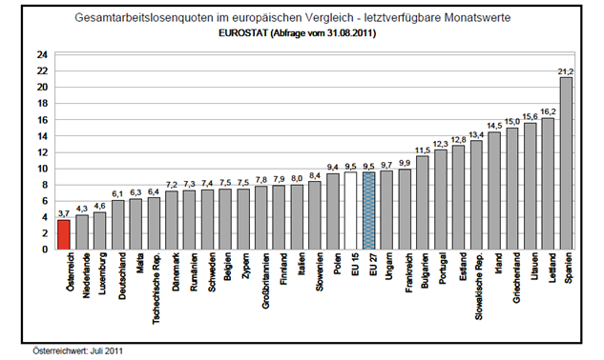

Slide 10
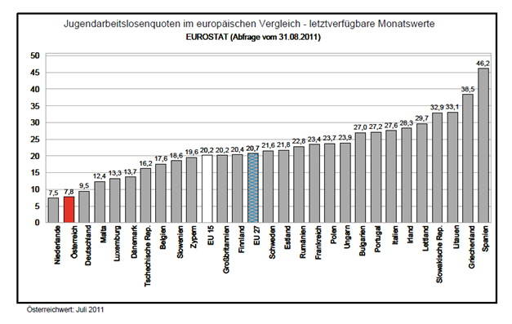

Slide 11
National Reform Programme
Austrian government focuses on the effects of growth and employment, social balance and competitiveness
Many stakeholders actively involved in implementing and shaping programme
Not all measures are directly integrated in the NRP e.g. NAP for Integration
Only small portion of measures financed by EU funds

Slide 12
National Reform Programme
Most crucial macro-structural growth barriers
Implementation of fiscal consolidation
Strengthening of the financial sector
Strengthening the domestic demand by reinforcing competitiveness
Further increase in labour force participation in the context of an ageing population
Enhancing a knowledge-based and innovative economy

Slide 13
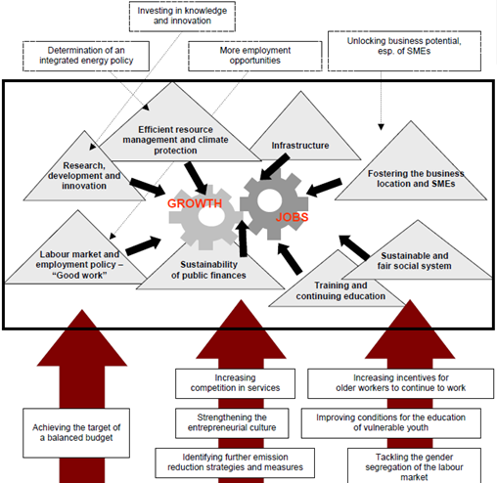

Slide 14
How have models fared during the crisis?
Revival of (converted) social partnership – strong coordination and quick reaction: Stabilising demand, labour market packages, short-time work etc.
Noticeable increase in unemployment, problems for youth and elderly workers (but low in comparison with other member states)
Negative effects of austerity policy: Growing inequality, weaker social cohesion, interrupted cultural development

Slide 15
Unresolved problems
Overall: Anti-crisis measures rather traditional and conservative (no new deal, not future-oriented)
Gender gap (in wages and employment rates) and conservative welfare state
The misery of the public sector (including research and universities)

Slide 16
Labour force participation
With employment rate of 74.7% (2009) very near to the Europe 2020 goal, 2010 figure was at 74.9%
Employment rate of older employees in 2010 was at 42.4% and relatively low
Employment rate of women at 69.6%
Employment of juvenile employees at 53.6%
Focus on making employees staying longer in gainful employment

Slide 17
National employment targets
employment rate of 77 to 78 % is targeted for women and men in the age group of 20 to 64 years
Employment rate of women with 69.4% considerably above EU average (62.5% in 2009)
focus on significantly higher employment rate among older employees by raising the effective retirement age
Most important challenges are participation of older emloyees, women and juvenile persons, with migration background and low-qualified as well as quality of work

Slide 18
NRP Labour market measures
Older employees
Stricter requirements for the access to pensions granted for unemployability owing to disability by mandatory rehabilitation
Reform of the special retirement scheme for long-time insured manual workers („Hacklerregelung“)
Fit2work and central occupational medical examination
Women
Development of all-day school models (allocation of special funds amounting to 80 million euro)
National Action Plan for Gender Equality (continuous increase of day-care centers; information offensive to encourage fathers to take paternal leave and ‘Dad’s month’ in the public services)

Slide 19
NRP Labour market measures
Young people
Guarantee of qualification (adequate assistance for juvenile person finding a suitable apprenticeship place, 2011 nearly 180 million euro)
Quality of work
Law combating wages and social benefits dumping
Income reports to be made public on the Workplace (Creation of income transparency)
Most recent: new job initiative ‘my chance – your benefit’ for disabled employees

Slide 20
National target on poverty
Currently 1 million persons (12%) at risk of poverty
Target to reduced poverty risk for 235.000 persons
Special focus on raising employment figures and inclusion into the labour market
Most important challenges are compatibility of family and job, long-term unemployment, better income opportunities of women, reduction of child poverty (later career opportunities), measures for good health
Downside: NAP on poverty included in NRP

Slide 21
NRP poverty measures
Mandatory year in kindergarten before primary school
Beneficiaries of need-oriented guaranteed minimum income

Slide 22
Economic governance and European semester
Strong trade union opposition to current political course within the EU
In particular: interventions in national collective bargaining and the dismantling of social dialogue
Austria advocating strongly at Council level in favour of the autonomy of Social partners and rejecting interventions in pension system

Slide 23
Austerity measures
Tax increases (6.3 billion euro) including solidarity tax for banks, higher taxes on cigarettes, gasoline, and plane tickets, and a capital gain tax for financial assets
Except for bank tax, major part of additional revenues comes from consumer taxes, very limited distributive effect
Cuts in welfare state provision, including cuts in care benefits and family allowances (1.3 billion euro)
Education, research, art and culture (333 million euro)
Low-income families particularly affected by cuts
Summary: two thirds on expenditure and one third on revenue side

Slide 24
Commission analysis
Crisis took its toll on public finances, also as result of the adoption of the stimulus packages
Budgetary projections too favourable towards the end of the stability programme period
Average tax wedge in Austria is among the highest in the EU
Employment rate of older workers well below the EU average (early retirement schemes and disability pensions widely used)
Female employment rate relatively high (one of the highest rates of part-time work, second highest gender pay gap with 25.4 %)
Outstanding challenges in the areas of fiscal policy, education, competition and innovation

Slide 25
Recommendations
accelerate the correction of the excessive deficit (4.6% in 2010)
aligning legislative, administrative, revenue-raising and spending responsibilities across (i.e. area of health care)
further limit access to early retirement scheme and reduce the transition period for harmonisation of the statutory retirement age between men and women
Reduction of effective tax and social security burden on labour
Improve availability of care services and of all-day school

Slide 26
Measures Euro Plus Pact
Foster competitiveness (e.g. 80 million euro annually for universities, same invest

Slide 27
Conclusions
Austria managed crisis relatively well,
due to intensive stimulus packages
Trade unions highly involved in shaping and implementing national programmes
Inclusion into the labour market primary key
to reaching the poverty target
Labour market maesures need to focus
even more on existing problem groups
Futher urgent action needed on investment
in education and creating more revenues
e.g. FTT

Slide 28
Austrian National Reform Programme
Thank you for your attention!
Tanja Buzek
ÖGB Brussels office
tanja.buzek@oegb-eu.at
www.oegb-eu.at

