Slide 1
What can we learn from Ireland?
Camille Loftus, Poor Can’t Pay Campaign
Alliances to Fight Poverty: European Social Conference
Brussels, 19th September 2011

Slide 2
Ireland: bust to boom to bust …
Employment rate, 15-64
Unemployment rate, 15-64

Slide 3
Response to fiscal crisis
Initial commitments to ‘protect the most vulnerable’
  Welfare rates rise in Oct-08 budget
As crisis deepens, first welfare cuts
  Payment rates for working age, additional payment at Christmas, severe cuts for young unemployed
  Cuts in child income supports
  Tax changes nominally progressive
Following agreement with EU-IMF
  Further cuts in working age & child payments
  More taxes from low paid
  Cut in minimum wage (restored this year)

Slide 4
Summary of key budget changes
 | Welfare | Tax
Budget 2009 (Oct-08) | Payment rates rise by 3% | Income levy introduced
Supplementary Budget (Apr-09) | Christmas Bonus abolished Cuts for unemployed <21 Early Childcare Supplement halved, then abolished | Income & health levy rates doubled PRSI ceiling raised
Budget 2010 (Dec-09) | Working age welfare cuts 4% Further cuts for 21-25 year olds Child Benefit cut by 10% (welfare compensated)
Budget 2011 (Dec-11) | Working age welfare cuts 4% Child Benefit cut by 10%, no compensation for welfare families | Universal Social Charge (replaces income & health levies) Cuts in tax credits Restricted tax relief on employee pension contribution

Slide 5
Distributional impact: complex
Social welfare
  Initial gains change to losses for working age – particularly severe for young unemployed
Child income support cuts affect all
  Last round did not protect welfare families
New taxes for employees
  Initially more progressive in structure
  New USC: minimum wage workers can pay at highest rate
Retired fare best
  No cuts to welfare, occupational pensions didn’t fall
Notes:
Tax increases
Initially targeted higher earners
New Income Levy, & in Health Levy increases for incomes >€100k, then >€75k); low paid (<€15k) exempt
Social insurance ceiling raised to €75k
New USC only exempt if income <€4k, top rate (7%) applies on income >€16k

Slide 6
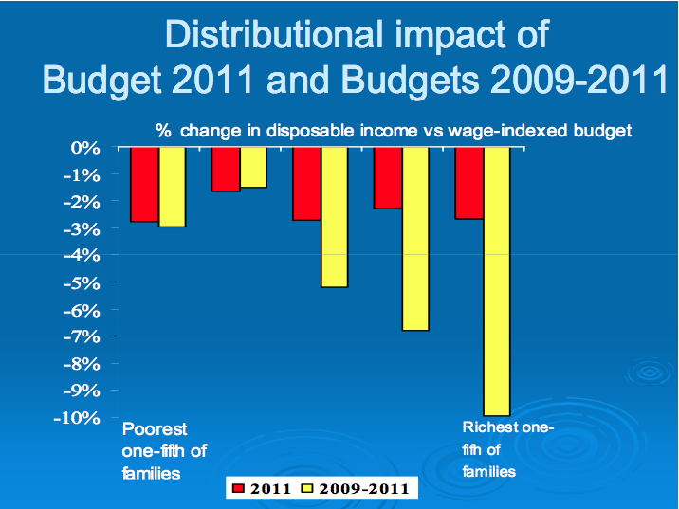

Slide 7
Impact on poverty & inequality
Scale of income losses, from all sources, across income distribution means:
  Income inequality has fallen
  At-risk-of-poverty threshold fell in 2009; the percentage at-risk-of-poverty remained unchanged
Evidence of increasing economic strain:
  Sharp rise in numbers in arrears with bills or loans
  Higher proportions going into debt to meet ordinary expenses
  Sharp rise in deprivation

Slide 8
Increased deprivation …
Rising deprivation
Distribution of deprivation

Slide 9
… means increased poverty
Consistent poverty
Consistent poverty = at-risk-of-poverty + deprivation
Increase driven by rising deprivation
  Only captures first round of cuts
Three-quarters are in jobless households
More than 4 in 10 are children
Over half are working age

Slide 10
Current context
New government elected February 2011
  Remains committed to reducing deficit to 3% GDP by 2015
Key points from Programme for Government:
  No increase to top marginal rates of taxes on income
  Maintain social welfare rates
  Reverse the recent cut in the national minimum wage
  A range of measures to tackle the problem of welfare fraud
  Tax and Social Welfare Commission to examine … elimination of disincentives to employment
A win for the Poor Can’t Pay campaign?

Slide 11
Future cuts: possible strategies
Restrict entitlements
  Important, but little commented upon, strategy to date
  Difficult to communicate to public
Cut public services
  Has already affected some of most vulnerable
  Can have life long scarring effects
  But difficult to capture poverty impact
New taxes
  e.g. property, water taxes
  Likely to be flat rate household charges – regressive
Anti-poverty response more challenging

Slide 12
Where to now?
Changing discourse on poverty
  Not something we can afford to care about
Government reviewing Anti-Poverty Strategy:
  … how Government can set out different levels of ambition for poverty reduction having regard to the economic circumstances, the likely economic & fiscal scenario for the immediate years ahead & EU/ECB/IMF Troika agreement
  A de facto acceptance of more poverty?
A broad, coordinated, anti-poverty response, at both national & EU levels, is urgently required

