Slide 1
Is the
‘Social Dimension of Europe 2020’
an Oxymoron?
MOC/ACW Seminar
« Alliances to Fight Poverty »
Rome, RIPA Hotel, 28 April 2011
Bart Vanhercke, Co-Director,
European Social Observatory
Notes:
1

Slide 2
Outline of the Talk
Introduction
  About oxymorons
From Lisbon to Europe 2020
  Some progress for Social Europe
Risks attached to Europe 2020
Where do we go from here?
  Alternative futures
Conclusion and Outlook
  Alliances needed
Notes:
Europe 2020 and Pensions
2

Slide 3

Questions/Clarifications during presentation?
Interrupt me!

Slide 4
Introduction
Remember an Oxymoron?
A figure of speech, or a phrase, that combines two notions that seem to be the opposite of each other
Examples are ‘deafening silence’, ‘extremely average’, ‘virtual reality’ and ‘known secret’
→ Contradiction in terms

Slide 5
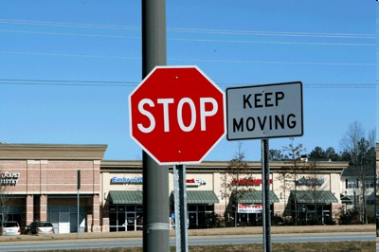

Slide 6
Why would the social dimensions of Europe 2020 be an oxymoron?
  First reading of the EU‘s new socio-economic governance:
    social issues (employment, social protection and social inclusion) seem far from central

Slide 7
Europe 2020
Integrated Guidelines
Stability and Growth
Pact
1. Macro-economic surveillance
(Integrated Guidelines 1-3)
2. Thematic coordination
(Integrated Guidelines 4-10)
Monitored through 5 EU
Headline Targets
3. Fiscal
Surveillance
National Reform Programmes
(NRPs)
(including national targets)
Member States - April
Stability and Convergence
Programmes (SCP)
Member States – April
synchronized
Notes:
Europe 2020 and Pensions
7

Slide 8
Outline of the Talk
Introduction
  Oxymorons and other animals
From Lisbon to Europe 2020
  Some progress for Social Europe
Risks attached to Europe 2020
Where do we go from here?
  Alternative futures
Conclusion and Outlook
  Alliances needed
Notes:
Europe 2020 and Pensions
8

Slide 9
Lisbon and Europe 2020 compared: some progress for Social Europe
Lisbon Strategy: weighed on the scales… and found wanting by many (Titanic 2010)
Europe 2020 provides some progress, when compared to its predecessor…

Slide 10
At first sight
The mere idea that the EU’s new Strategy for the next decade could be a vehicle to develop Europe’s (weak) social dimension, seems quite a contradiction

Slide 11
Europe 2020 presents a more all-encompassing strategy
Rather comprehensive political agenda for Europe (incl. environmental targets, continued EES)
Smart, Sustainable and Inclusive Growth: return to the original Lisbon Strategy
  more than just growths and jobs (socioeconomic policy triangle), as compared to Revised Lisbon (2005)

Slide 12
Increased pressure on targets and monitoring of progress
Poverty target:
  the mere existence is a step forward (even though it is less ambitious than many hoped)
  Social cohesion/inclusion: now the same status as the other political priorities
  Adoption of national targets:
    No more escape
    High pressure on Member States -> taken more seriously than in the past decade (?)
  ► towards “hard soft law”?

Slide 13
Social protection and Social Inclusion are back in (compared to 2005)
  Increased potential visibility and importance of social issues:
    Several Integrated Guidelines (in particular Guideline 10)
    European Platform against Poverty (EPAP): one of seven flagship initiatives (but lacks ambition)

Slide 14
Lisbon and Europe 2020 compared:
some progress for Social Europe
Window of opportunity: can still be seized
But, let us beware what we wish for
There is not only a “keep moving” sign for social Europe

Slide 16
Outline of the Talk
Introduction
  Oxymorons and other animals
From Lisbon to Europe 2020
  Some progress for Social Europe
Risks attached to Europe 2020
Where do we go from here?
  Alternative futures
Conclusion and Outlook
  Alliances needed
Notes:
Europe 2020 and Pensions
16

Slide 17
Risks in relation to Europe 2020
1. No room for complacency
Pursuing the wrong paradigm
  growth, growth, growth (instead of smart, sustainable and inclusive growth)
Criticism (repeat some of Lisbon‘s flaws):
  supply-side measures; market-based understanding of growth
  absence of an optimal policy-mix (e.g. no stricter wage coordination in Europe; no mechanisms to balance external economic asymmetries)
  Lack of qualitative considerations (“decent work”)

Slide 18
Social Dimension subsumed into economic objectives
  Innovation and social progress tied to fulfilment of debt criteria
  Close link NRPs and Stability and Convergence Programmes

Slide 19
Europe 2020 - Integrated Guidelines
Stability and Growth Pact
Macro-economic surveillance
(Integrated Guidelines 1-3)
Thematic coordination (IGs 4-10)
Monitored through 5 EU Headline
Targets
Fiscal
Surveillance
National Reform Programmes (NRPs)
(including national targets)
Member States - April
Stability and Convergence Programmes (SCP)
Member States – April
synchronized
Spring European Council: Debate and Orientation
(Progress towards headline targets) - March
Policy Guidance (Opinions and Recommendations)
European Commission – June
Supported by:
EU Flagship Initiatives
Single Market Relaunch
Trade and External Policies
EU Financial Support
Debate and Orientation
European Parliament and
Council of the EU –February
Finalisation and Adoption of Opinions and Recommendations
Council of the EU (ECOFIN and EPSCO) – June
Annual Growth Survey: Progress and Orientation
European Commission – January
Endorsment of Opinions and Recommendations
European Council – June
European Semester
European Semester
Domestic Semester
Domestic Semester
Finalisation of National Budgets
Policy measures at national level
Notes:
Europe 2020 and Pensions
19
19

Slide 20
In such a framework
  Unclear: to what extent will country-specific Recommendations focus on Social Inclusion (Guideline 10?)
  And what if (say) Germany of Poland do not set poverty targets, or miss them (by far?): AGS? Policy warning?
  See first round of NRPs (ECOFIN/EPC)

Slide 21
Social Protection and Social Inclusion reduced to fighting poverty
What about common objectives on pensions and health care?
  ► enter mainly insofar as they contribute to the social exclusion goals
Social Inclusion Guideline framed as Employment Guideline
  Responsibility for monitoring, implementation?

Slide 22
Risk that social protection and social inclusion may be reduced to social inclusion only
with the latter focusing narrowly on increasing access to employment, but not on the outsiders

Slide 23
What role for the Social OMC?
Governance structure still unfinished
Many questions remaining about the future of the Social OMC:
      National Strategic Reports?
      Joint Reports?
      Indicators?
      Mutual Learning?
      Which role for Stakeholders?
  → Being discussed in the SPC… as we speak!

Slide 24
In sum:
  Synchronisation (budgetary, macroeconomic and thematic strands) involves serious risks for the Social dimension of Europe…

Slide 25
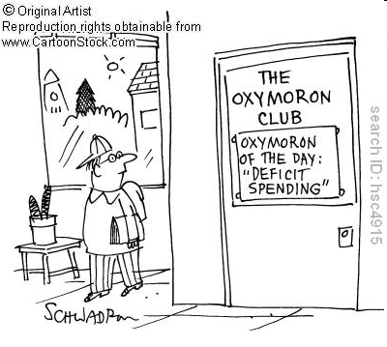

Slide 26
Outline of the Talk
Introduction
  Oxymorons and other animals
From Lisbon to Europe 2020
  Some progress for Social Europe
Risks attached to Europe 2020
Where do we go from here?
  Alternative futures
Conclusion and Outlook
  Alliances needed
Notes:
Europe 2020 and Pensions
26

Slide 27
Where do we go from here?
Safeguarding Europe 2020`s Social Dimension
2 possible future scenarios:
minimum scenario ↔ paradigm shift

Slide 28
Minimum Scenario:
Ensuring a role for the social stakeholders (EPSCO, EMCO, SPC)
Continue a broad OMC (all 3 strands)
Beefing up its instruments (monitoring, horizontal clause)
Greater involvement of stakeholders (NGOs, etc.)
Financial support (e.g. ESF): conditionality
Paradigm Shift:
Social Stability Pact:
“corridor model”: link the size of the welfare states to the level of economic development
Coordination of wages, minimum income and taxes
Common European targets within a redesigned OMC

Slide 29
Outline of the Talk
Introduction
  Oxymorons and other animals
From Lisbon to Europe 2020
  Some progress for Social Europe
Risks attached to Europe 2020
Where do we go from here?
  Alternative futures
Conclusion and Outlook
  Alliances needed
Notes:
Europe 2020 and Pensions
29

Slide 30
Conclusion and Outlook
Proof of the pudding is in the eating (still early days)
New opportunities when compared to the Lisbon Strategy:
  rather all-encompassing; increased visibility (IG 10, headline target, EPAP)
But also serious risks:
  Dominance of economic considerations (growth objectives and synchronisation); reduction to social inclusion; Social OMC?

Slide 31
Still room for building the Social Dimension of Europe 2020 (it‘s a new-born)
Strong Alliances needed (up to the Social players)
  It will also be up to the social players to determine whether the ‘Social dimension of Europe 2020’ is really an oxymoron

Slide 32
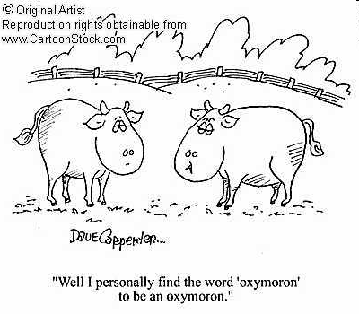

Slide 33
In which case the “Social dimension of Europe 2020” may simply be an apparent contradiction…
which can be overcome

Slide 34
Thank you very much for your attention!
And see you at the presentation of
Social Developments in the EU 2010: Brussels, 30 May 2011
http://www.ose.be/EN/agenda.htm

Slide 35
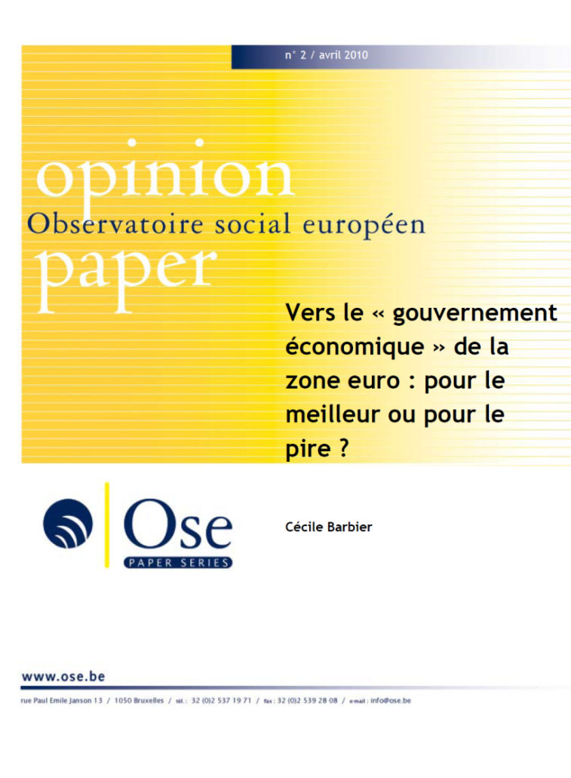
Download our publications, Newsletters and events agenda from www.ose.be (Eng-Fr)
Opinion papers
Research papers
Briefing papers

