Slide 1
The Social Situation in the EU and the Europe 2020 Strategy
Peter Lelie
Alliances to Fight Poverty Rome 28 April 2011

Slide 2
What I intend to cover…
1. The social situation in the European Union after the Lisbon strategy.
2. The Europe 2020 Strategy and its social dimension.
3. The difficult birth of the poverty and social exclusion target: reconsidering the concept of poverty.
4. The Platform against Poverty: an effective tool for delivering on the target?
5. The European Semester: the experience so far…

Slide 3
1. The social situation in the EU after the Lisbon strategy: two pieces of evidence
What does the Social OMC’s headline indicator on poverty, the at-risk-of-poverty rate, tell us?
The Social Protection Committee evaluation of the impact of the Lisbon strategy on social protection and social inclusion.

Slide 4
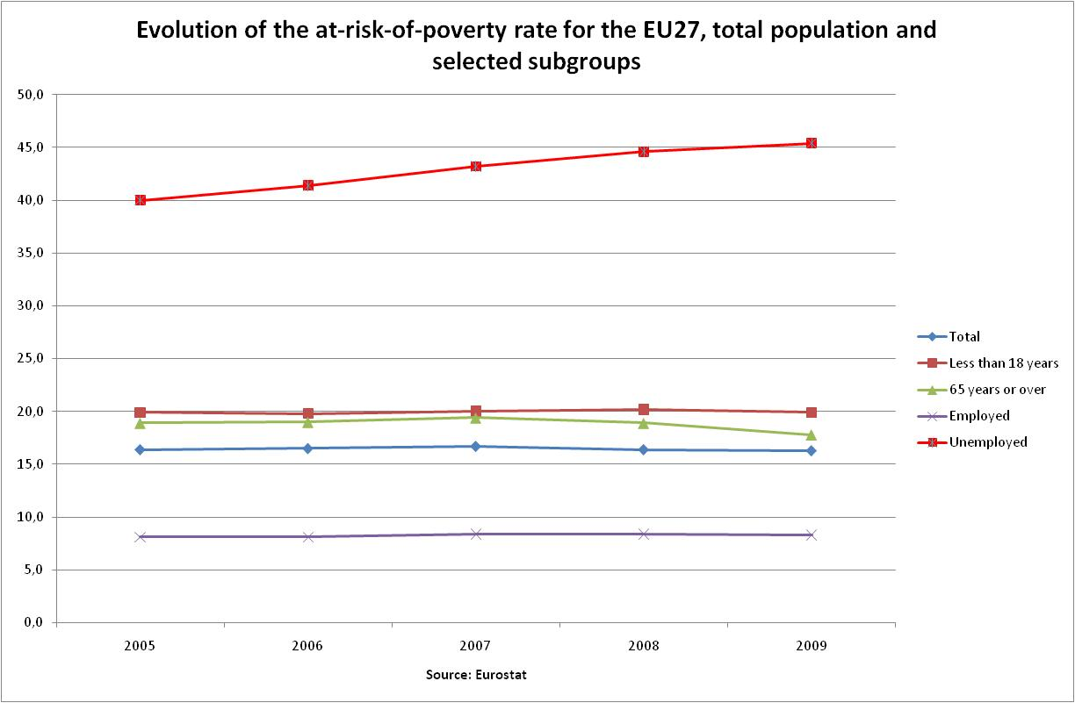
1.1 The population at-risk-of-poverty in the EU

Slide 5
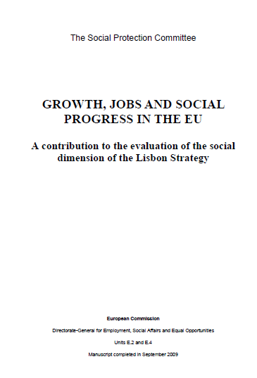
1.2 The SPC evaluation of the impact of the Lisbon strategy on social protection and inclusion
Growth, Jobs and Social Progress: a contribution to the evaluation of the social dimension of the Lisbon strategy. Social Protection Committee Report. September 2009.
http://www.lavoro.gov.it/NR/rdonlyres/4502C661-F4FC-4B1D-AC80-A581DAF05E07/0/Lisbon_TF_Final_report.pdf
Four key messages:
- impact economic growth
- impact employment growth
- impact of social protection system reform
- impact of the economic and financial crisis

Slide 6
The impact of economic growth
Economic growth has in general improved overall living standards and has allowed many governments to devote more resources to social policy.
But in spite of the redistributive impact of social protection, inequalities have often increased and poverty and social exclusion remains a major issue in most EU countries, although with substantial differences across Europe.

Slide 7
The impact of employment growth
Having a job remains the best safeguard against poverty and social exclusion but recent employment increases have not sufficiently reached those furthest from the labour market and jobs have not always succeeded in lifting people out of poverty.
There are problems of:
- poor access to training for the low skilled;
- lack of enabling services;
- poor design of benefit systems creating financial disincentives;
- labour market segmentation and poor job quality;
- high levels of in work poverty.

Slide 8
The impact of social protection system reform
Reforms of social protection systems have improved the long term financial sustainability but issues of accessibility and adequacy of social protection remain.
Higher employment rates, longer working lives and increased healthy life expectancies can contribute to adequacy and sustainability of social protection.
- Modernisation is needed to ensure effective access to quality services. Effective health care and long term care can be instrumental in improving health.

Slide 9
The impact of the crisis
Social protection systems can play a crucial role as automatic stabilizers and sustain the productive capacity of the economy.
In some Member States there are significant weaknesses and loopholes in the social safety nets.
Financial sustainability may be an issue and in countries with major public finance imbalances there is little room for manoeuvre.
- Promoting labour market participation while improving fairness, efficiency and effectiveness of social spending is crucial in the current context.

Slide 10
2. The Europe 2020 strategy and its social dimension
- The new strategy should be seen against the background of the financial and economic crisis.
- The overall aim is much stronger coordination of economic and budgetary policies of the Member States. The main priorities will be budgetary consolidation, structural reforms and growth enhancing measures.
- The new strategy will be integrated: synchronisation of the Europe 2020 strategy and a reinforced Stability and Growth Pact.
- New timing to maximise impact: the European Semester.

Slide 11
The big picture
Europe 2020 Strategy
Growth and Stability
Pact
Three strategic priorities
Ten integrated guidelines
Five headline targets
Macro-economic
Surveillance
Thematic coordination
Fiscal Surveillance
National Reform
Programmes
Stability and Convergence
Programmes

Slide 12
Three strategic priorities
- smart growth: strengthening knowledge and innovation as drivers of future growth;
- sustainable growth: promoting a more resource efficient, greener and more competitive economy;
- inclusive growth: fostering a high-employment economy delivering social and territorial cohesion.

Slide 13
Ten integrated guidelines
1 | Ensuring the quality and sustainability of public finances
2 | Addressing macroeconomic imbalances
3 | Reducing imbalances in the euro area
4 | Optimising support for R&D and innovation, strengthening the knowledge triangle and unleashing the potential of the digital economy
5 | Improving resource efficiency and reducing greenhouse gases emissions
6 | Improving the business and consumer environment, and modernising and developing the industrial base in order to ensure the full functioning of the internal market
7 | Increasing labour market participation of women and men, reducing structural unemployment and promoting job quality
8 | Developing a skilled workforce responding to labour market needs and promoting lifelong learning
9 | Improving the quality and performance of education and training systems at all levels and increasing participation in tertiary or equivalent education
10 | Promoting social inclusion and combating poverty

Slide 14
Guideline 10
The extension of employment opportunities is an essential aspect of Member States' integrated strategies to prevent and reduce poverty and to promote full participation in society and economy. Appropriate use of the European Social Fund and other EU funds should be made to that end. Efforts should concentrate on ensuring equal opportunities, including through access for all to high quality, affordable, and sustainable services, in particular in the social field. Public services (including online services, in line with guideline 4) play an important role in this respect. Member States should put in place effective anti-discrimination measures. Empowering people and promoting labour market participation for those furthest away from the labour market while preventing in-work poverty will help fight social exclusion. This would require enhancing social protection systems, lifelong learning and comprehensive active inclusion policies to create opportunities at different stages of people's lives and shield them from the risk of exclusion, with special attention to women. Social protection systems, including pensions and access to healthcare, should be modernised and fully deployed to ensure adequate income support and services — thus providing social cohesion — whilst remaining financially sustainable and encouraging participation in society and in the labour market.

Slide 15
Five headline targets as proposed by the European Commission
1. Employment
  - 75% of the 20-64 year-olds to be employed
2. R&D / innovation
- 3% of the EU's GDP (public and private combined) to be invested in R&D/innovation
3. Climate change / energy
  - greenhouse gas emissions 20% (or even 30%, if the conditions are right) lower than 1990
  - 20% of energy from renewables
  - 20% increase in energy efficiency
4. Education
  - reducing school drop-out rates below 10%
  - at least 40% of 30-34–year-olds completing third level education
5. Poverty and social exclusion
  - at least 20 million fewer people at risk of poverty
EU level targets are to be translated in national targets.

Slide 16
Seven Europe 2020 Flagship initiatives and three EU levers for growth
Seven Flagship Initiatives
Smart Growth
Digital Agenda
Innovation Union
Youth on the Move
Sustainable Growth
Resource-efficient Europe
Industrial Policy for the globalisation era
Inclusive Growth
Agenda New Skills & Jobs
European Platform Against Poverty
Three EU levers for growth
Single Market Relaunch
Trade and external policies
EU financial support

Slide 17
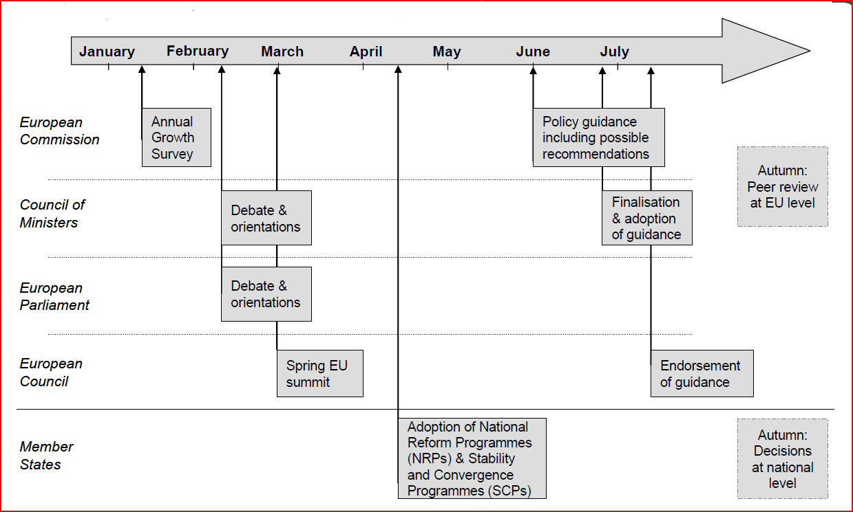
The European Semester of Policy Coordination

Slide 18
Social Protection and Social Inclusion in the new strategy…
After being sidelined in 2005/2006 the Social Protection and Social inclusion process is back in!
- Strategic priority inclusive growth…
- Integrated guideline on promoting social inclusion and combating poverty…
- Headline target on poverty and social exclusion..
- Flagship Initiative European Platform against Poverty
But it seems that there may be a price to pay…
The best of both worlds?

Slide 19
3. The difficult birth of the poverty and social exclusion target: reconsidering the concept of poverty
- EU level target proposed by the European Commission: Reducing the population at risk of poverty by one fourth by 2020, lifting some 20 million of people out of poverty.
- The at-risk-of poverty rate (headline indicator for measuring poverty in the EU) is defined as the percentage of people with an equivalised disposable income below 60% of the national equivalised median income.
- The indicator reflects the official definition of poverty adopted by the European Council in 1975. The poor are those individuals whose resources are so low as to exclude them from the minimum acceptable way of life in the country where they live.

Slide 20
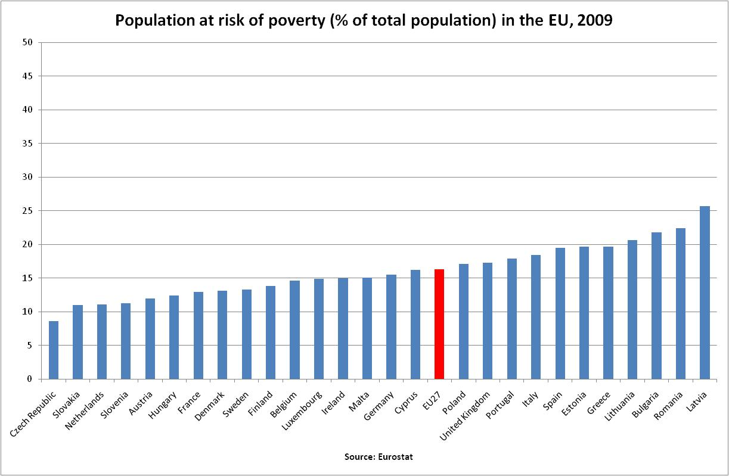
The at-risk-of-poverty rate

Slide 21
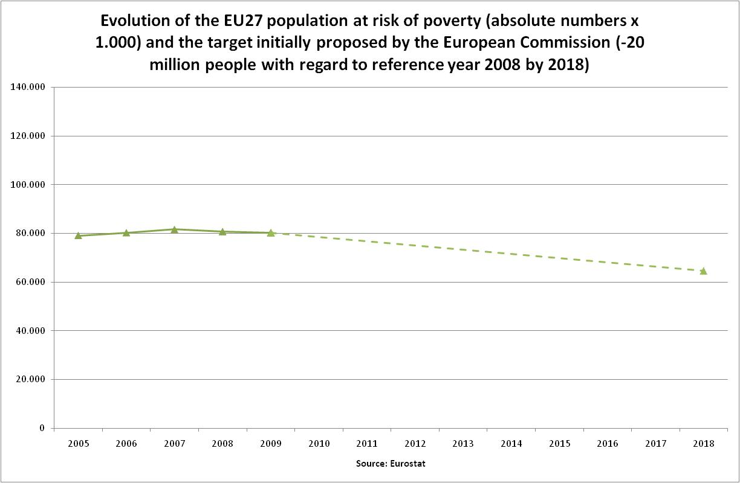
Commission proposal EU Poverty target

Slide 22
Member States’ reaction to the proposed poverty target
- Spring European Council March 2010:
Agrees on the other targets but asks for more work on the poverty target: Further work is needed on appropriate indicators. The European Council will revert to this issue at its June 2010 meeting.
- Member States’ positions:
Reflect very diverse political and institutional concerns, including subsidiarity. There is no consensus on using the at-risk-of-poverty rate as the headline indicator for measuring poverty and social exclusion.
- After long en tense discussions two extra indicators were brought into the picture:
- severe material deprivation (less relative, more absolute dimension of poverty and social exclusion);
- living in a (very) low work intensity household (link to the labour market).

Slide 23
The severe material deprivation rate
People are considered "severely materially deprived” if they experience at least 4 out of 9 deprivations: being unable to afford to:
1) pay their rent or utility bills;
2) keep their home adequately warm;
3) face unexpected expenses;
4) eat meat, fish, or a protein equivalent every second day;
5) enjoy a week of holiday away from home once a year;
6) have a car;
7) have a washing machine;
8) have a colour tv;
9) have a telephone.

Slide 24
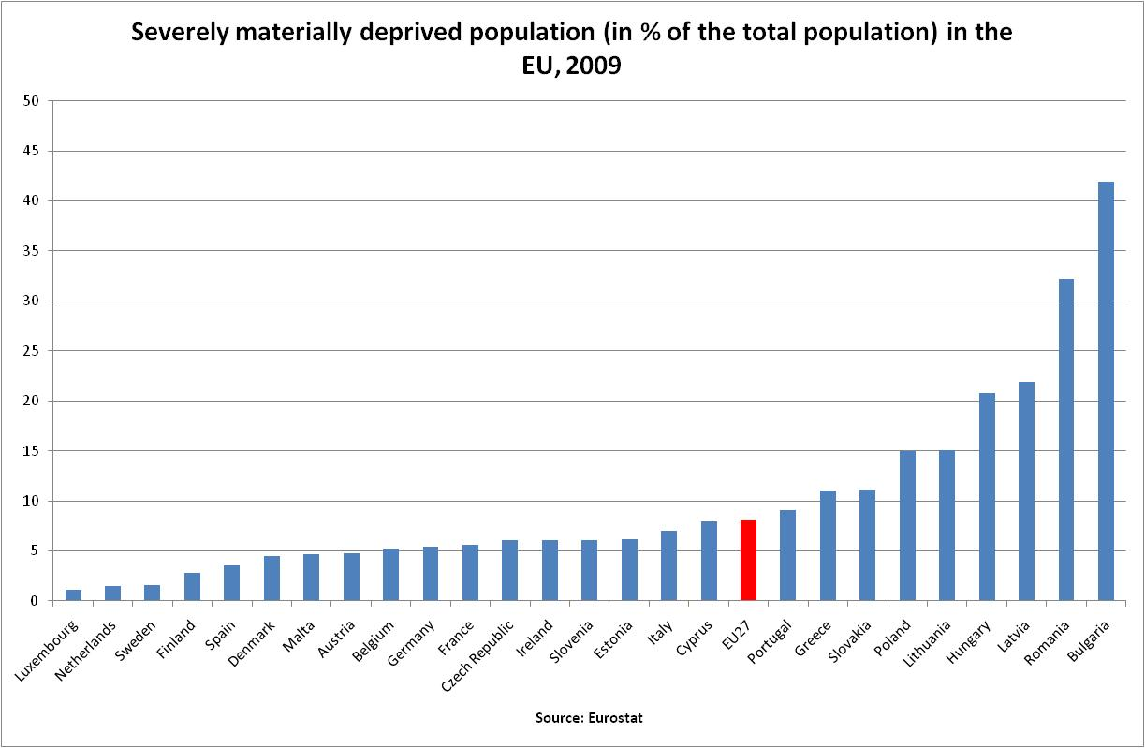
The severe material deprivation rate

Slide 25
Population living in households with very low work intensity
People living in households with very low work intensity are people aged 0-59 living in households where the adults have worked less than 20% of their total work-time potential during the previous twelve months.

Slide 26
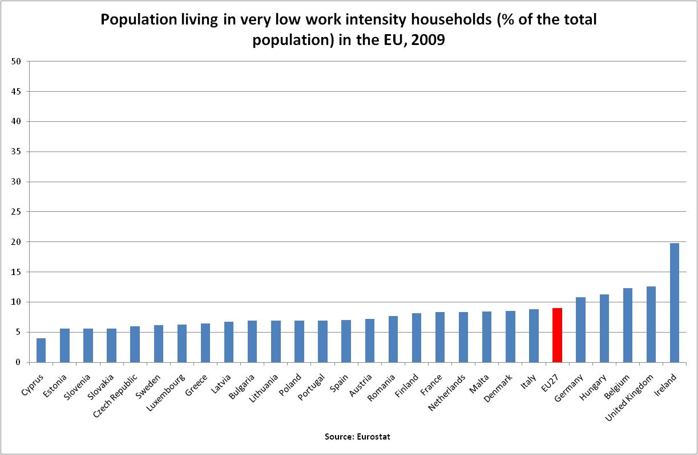
Population living in very low work intensity households

Slide 27
Decision European Council June 2010 on the poverty target
Promoting social inclusion, in particular through the reduction of poverty, by aiming to lift at least 20 million people out of the risk of poverty and exclusion.
The target population is defined as the number of persons who are at risk-of poverty and exclusion according to three indicators (at-risk-of-poverty, material deprivation, jobless household), leaving Member States free to set their national targest on the basis of the most approriate indicators, taking into account their national circumstances and priorities.
- The targetindicator is in fact the union of the three subindicators: people are at risk of poverty and social exclusion if they are covered by at least one of the three criteria.

Slide 28
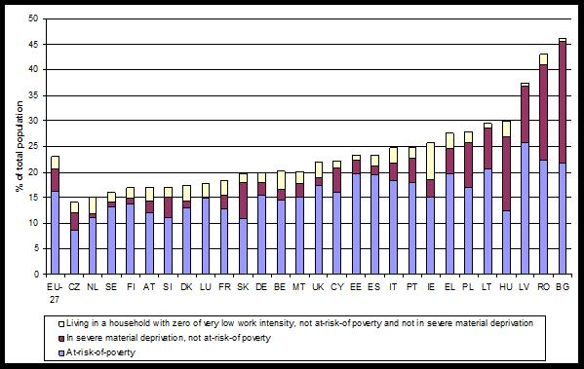
Population at risk of poverty and social exclusion in the EU Member States

Slide 29
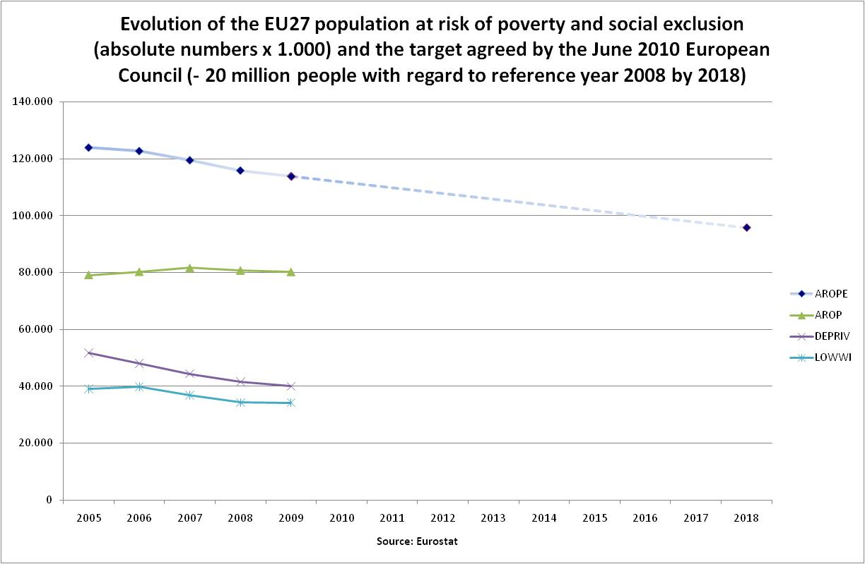
Population at risk of poverty and social exclusion

Slide 30
Groups at risk of poverty and social exclusion
Source: EU-SILC (2009).
Taken from the SPC assessment of the social dimension of the Europe 2020 Strategy

Slide 31
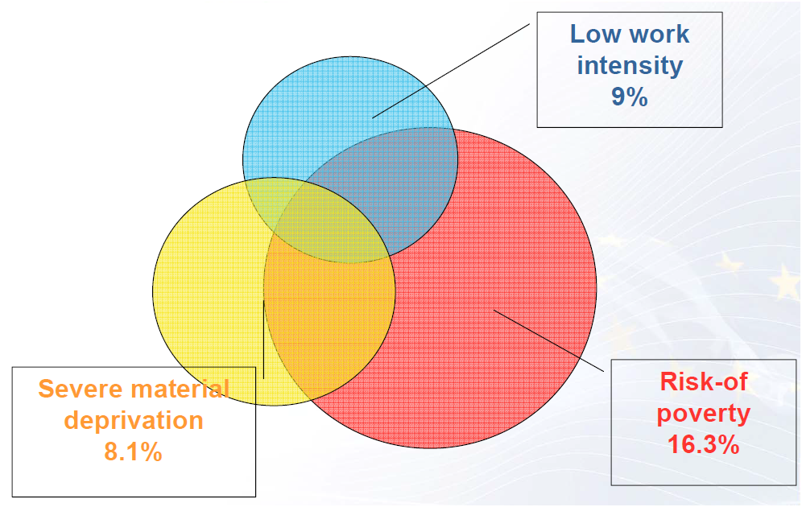
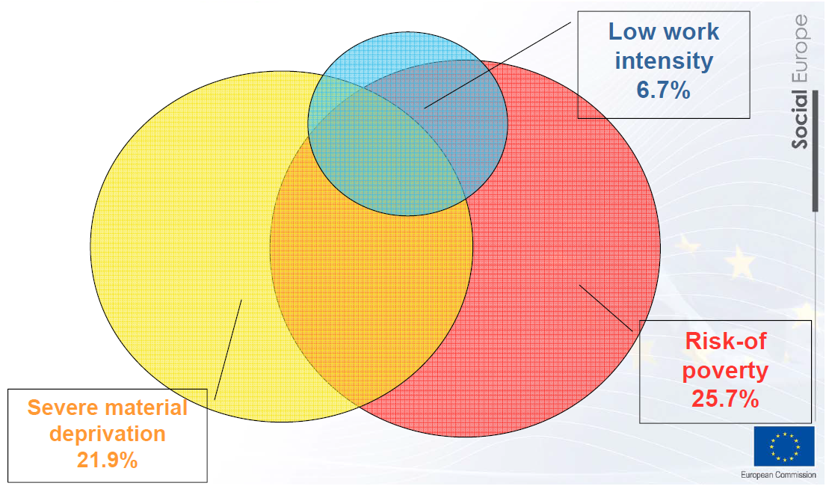
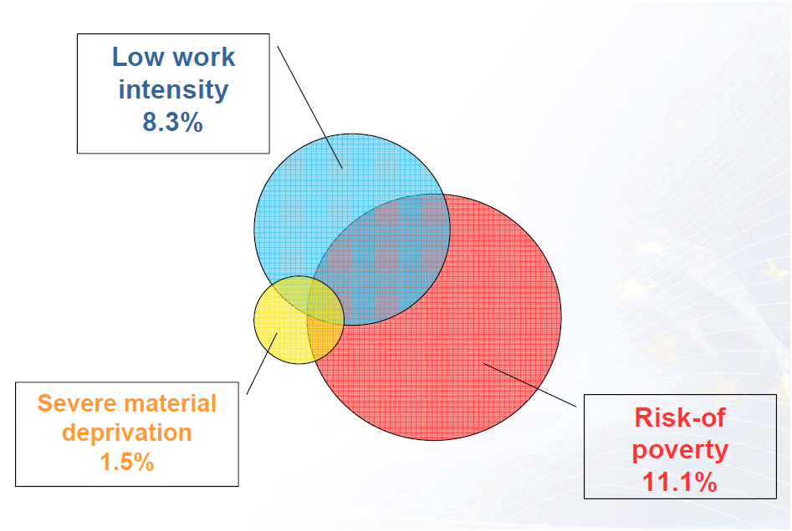
The population at risk of poverty and social exclusion compared: EU27, LV, NL
EU27
Latvia
The Netherlands
Source: European Commission

Slide 32
Ranking Member States on the target indicators

Slide 33
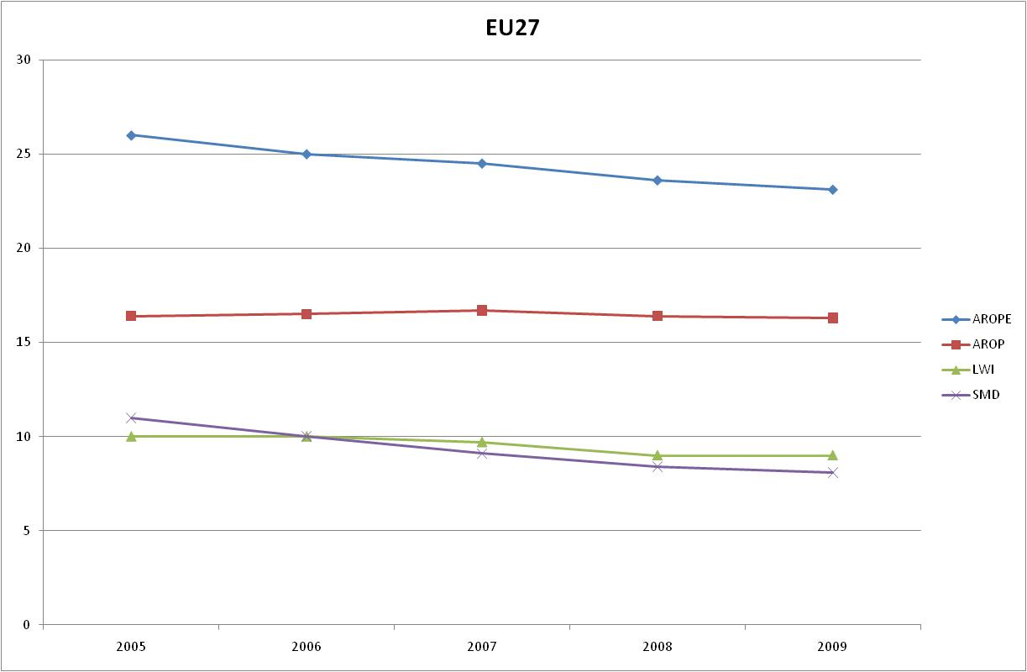
Year on Year changes in the population at-risk-of-poverty and social exclusion EU27

Slide 34
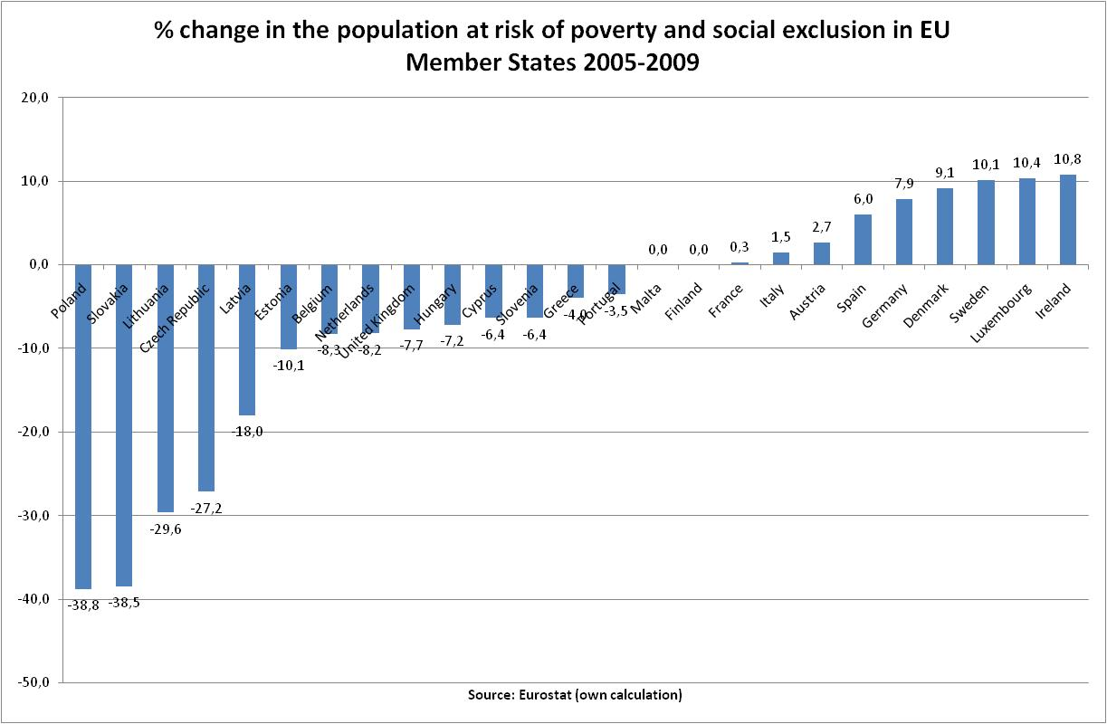

Slide 35
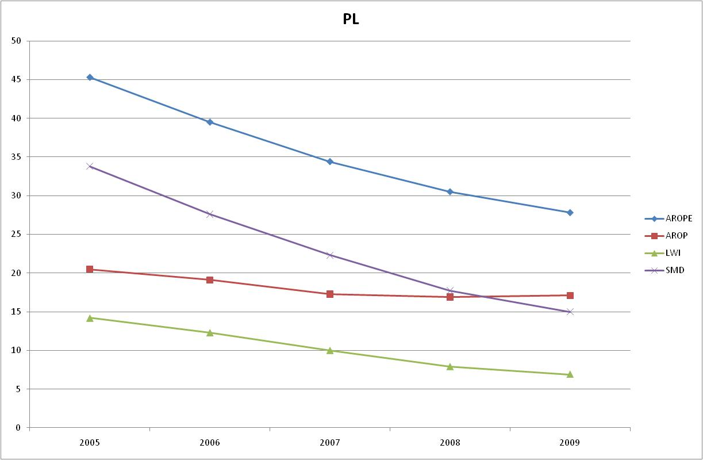
Poland

Slide 36
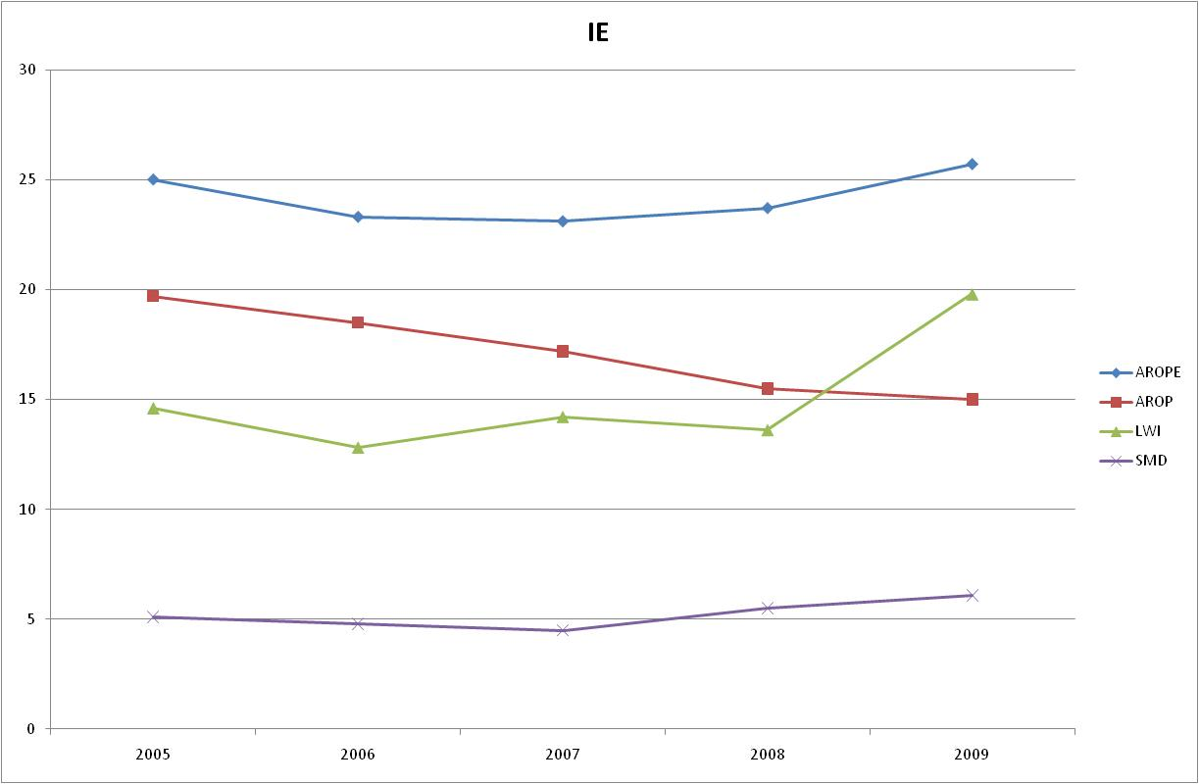
Ireland

Slide 37
Europe 2020 targets set by Member States in their draft NRP’s (source: Annual Growth Survey)
 | Agreed EU targets | Estimate Jan 2011 (draft NRP’s)
Employment rate | 75% | 72,4%-72,8%
R&D in % of GDP | 3% | 2,7%-2,8%
Emission reduction | -20% | -20%
Renewable energy | 20% | 20%
Energy efficiency | 20% | Less than 10%
Early school leaving | 10% | 10,5%
Tertiary education | 40% | 37,3%
Reduction in poverty | 20.000.000 | -----

Slide 38
Choice of target indicators (draft NRP’s)

Slide 39
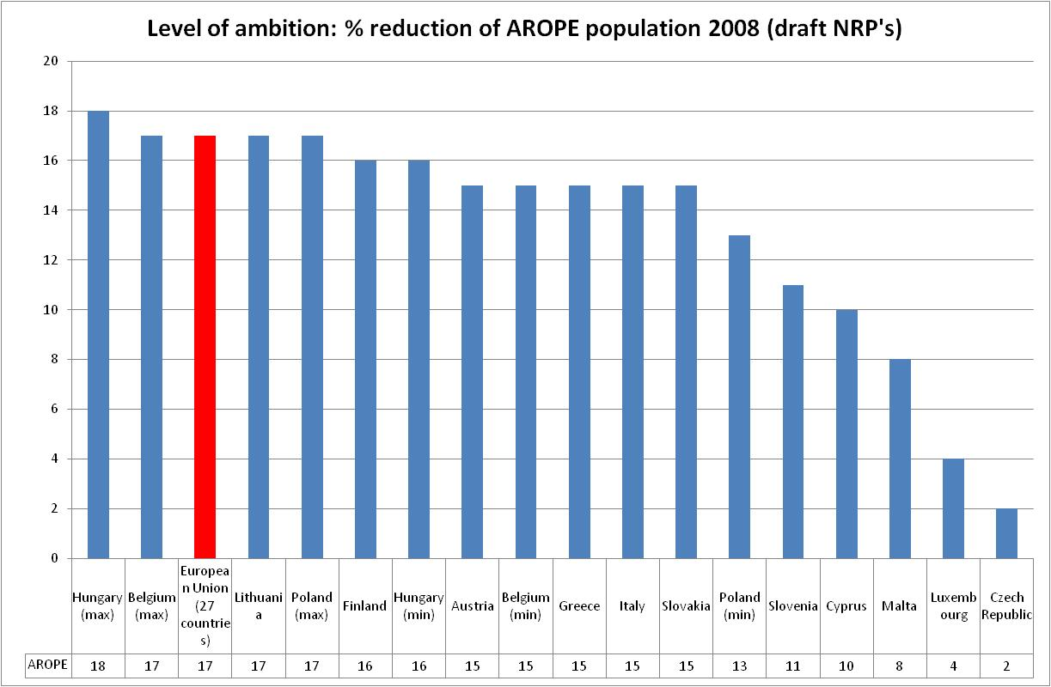
At risk of poverty and social exclusion targets in the draft NRP’s

Slide 40
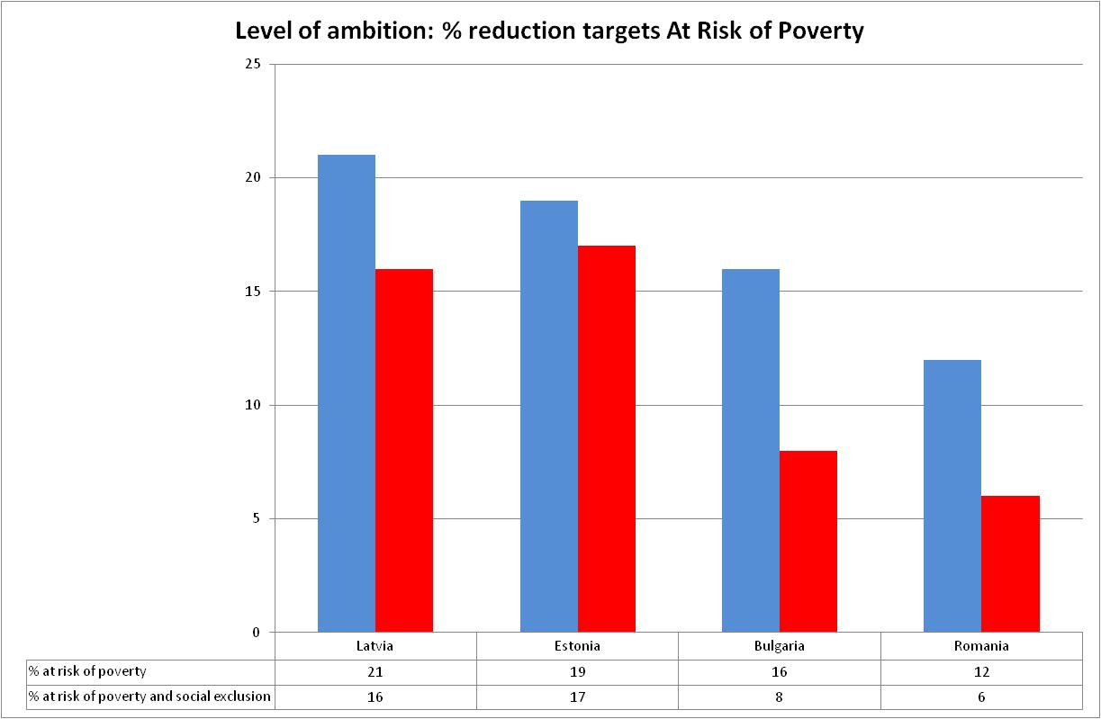
At risk of poverty targets in the draft NRP’s

Slide 41
4. The Platform against poverty: an effective tool for delivering on the target?
‘The Commission will work to transform the OMC on social exclusion (sic!) and social protection into a platform for cooperation, peer-review and exchange of good practice and into an instrument to foster commitment by public and private players…’ (March 2010 Commission Communication on the Europe 2020 strategy)
  - A platform?
  - A platform against poverty? Why poverty and not social exclusion? What about the social protection strands of the OMC (pensions, health and long term care) and the logic of streamlining?
  - The Commission? What about Member States, the EU Social Protection Committee?

Slide 42
By October / November 2010 it had become clear that Member States and stakeholder networks were not willing to give up the Social OMC. The question was how the Platform and the OMC would relate to each other.
The Platform Communication was eventually published in December 2010. It is in fact a kind of social agenda (framework for action), bringing together a broad range of initiatives in the social sphere not necessarily piloted by DG EMPL.
The name of the Platform was broadened to Platform against Poverty and Social Exclusion.

Slide 43
Five areas for action
1. Delivering action across the policy spectrum
2. Making EU funds deliver on the social inclusion and social cohesion objectives
3. Developing an evidence-based approach to social innovation and reforms
4. Promoting a partnership approach and the social economy
5. Stepping up policy coordination between the Member States

Slide 44
1. Delivering action across the policy spectrum (1)
1.1 Access to employment
  Communication on active inclusion, 2012
1.2 Social protection and access to essential services
  White paper on Pensions, 2011
  Further develop quality framework on social services (sectoral approach on homelessness)
  Follow-up to communication on health inequalities
1.3 Education and youth policies
  Recommendation on early school leaving, 2011
  Recommendation on child poverty, 2012

Slide 45
1. Delivering action across the policy spectrum (2)
1.4 Migration and integration of migrants
  New European Agenda on Integration , 2011
1.5 Social inclusion and antidiscrimination
  EU framework for national Roma Integration Strategies , 2011
  Follow-up to 2010 consensus conference on homelessness and housing exclusion
1.6 Sectoral policies
  Implementation of energy internal market legislation
  Combating the digital divide (implementation of Digital Agenda)
  Legislative initiative on access to basic bank services, 2011
1.7 The external dimension
1.8 Social impact assessment

Slide 46
2. Making EU funds deliver on the social inclusion and social cohesion objectives
- 2010 Budget review stresses need to link more directly structural funds and ESF to Europe 2020 headline targets (including poverty target)
- Commission Proposals for next Multi-Annual Financial Framework (2011) will explore the following options:
  Enhancing ESF contribution to achievement of poverty target
  Devoting necessary resources to social inclusion
  Reinforcing support to disadvantaged groups
  Simplified access and tailored made grant schemes for local partnerships
  Greater synergies and complementarities between EU funds

Slide 47
3. Developing an evidence-based approach to social innovation and reforms
- Build on existing tools (peer reviews, mutual learning…) to guide structural reforms, promote more effective and efficient interventions
- Major social experimentation initiative, possibly focusing on social assistance (2011):
  Pooling resources from various EU funds
  Fine-tuning methodology
  Development of wider scale experiment
  Communication and dissemination

Slide 48
4. Promoting a partnership approach and the social economy
- Strengthening existing partnerships and involving new actors (social partners, local authorities, NGOs…)
  Voluntary guidelines on stakeholders’ involvement and participation of people experiencing poverty (2012)
  Regular dialogue on thematic priorities
- Harnessing the potential of the social economy
  Improving legal structures (e.g. foundations)
  Social Business Initiative (2011) to support socially innovative corporate projects (Single Market Act)

Slide 49
5. Stepping up policy coordination between the Member States
- Strong social dimension within Europe 2020. Make full use of the new governance structure
  National Reform Programmes to define national target, strategies, stakeholder involvement
- Commission will work with Member States and stakeholders to adapt working methods of the OMC to governance of Europe 2020 and best combine:
  Integration and focus
  Continuity and innovation
  Simplification and accountability
  Coordination and subsidiarity
Report presented by the end of 2011 following discussion with involved actors on the basis of the experience of the first European semester

Slide 50
Institutional innovation?
Round Table transformed into a wider Annual Convention of the European Platform:
  Bring together all relevant key actors
  Take stock of progress made towards headline target
  Review implementation of activities
  Suggestions for future action
  Will take place in proximity to 17 October (International Day for the Eradication of Extreme Poverty).

Slide 51
How does it all add up?
Too early to tell whether the Platform will make a difference. The communication often lacks clarity.
Broad scope (mainstreaming) is positive. Several interesting initiatives.
Social innovation per se a good idea but it remains unclear exactly how this will be a major breakthrough.
Major disappointment is the lack of concrete initiatives on social impact assessment.
Instutionally weak.
No concrete proposal on the future of the Social OMC.
…

Slide 52
5. The European Semester. The experience so far…
- The draft National Reform Programmes (November 2010)
- The Annual Growth Survey (January 2011)
- The Spring European Council conclusions (March 2011)

Slide 53
In conclusion…
There may be a social dimension in the Europe 2020 strategy, but there is cause for concern…
Thanks for your attention.

