Slide 1
Alliances to fight Poverty Working Seminar: Rome April 28 2011
Failed Markets, Distribution and the State: The Fiscal Challenges of Poverty Reduction
Dr Jeremy Leaman, Loughborough (Euromemorandum Group)

Slide 2
Euromemorandum Group
“The European Economists for an Alternative Economic Policy in Europe (the EuroMemo Group) is a network of European economists committed to promoting full employment with good work, social justice with an eradication of poverty and social exclusion, ecological sustainability, and international solidarity”
Established 1995
Annual conference > Annual Report
Focus on policy alternatives to EU and member states
http://www.euromemo.eu/euromemorandum/euromemorandum_2010_11/index.html

Slide 3
Euromemorandum Core Principles
Heterodox Economics/ Political Economy: holistic approach to socio-economic analysis
Strong conception of social justice and fair distribution of material and cultural resources
Rejection of ‘efficient market’ hypothesis, endorsement of active political management of economic relations
Strong support for international cooperation in reregulation and monitoring of global political economy
Poverty is a symptom of failure, not a functional precondition of an ‘efficient’ economic order

Slide 4
Crises as Context of Poverty Reduction
1. Cardiac Arrest of Global Financial Markets 2008: systemic crisis of ‘monetary accumulation’ (Altvater)
2. Global Slump in Output and Trade
3. Fiscal Crises of European States
4. Crisis of the EU’s Policy Architecture
5. Crisis of European Demography
6. Dangerous asymmetries of GPE
7. Shift in geo-economic axis of GPE
7. The Global Crisis of Ecological Sustainability
8. Viability Crisis of the EU?
9. Crisis as Opportunity

Slide 5
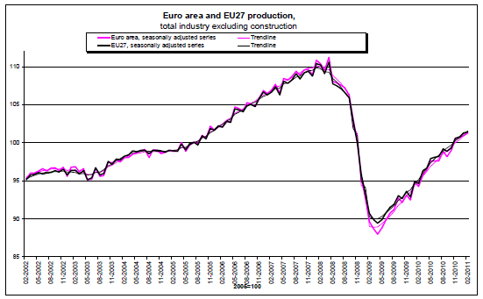
Slump and Partial Recovery 2008-2011

Slide 6
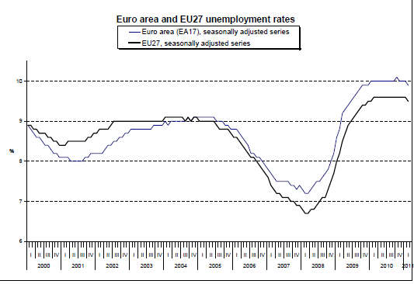
Cyclical and Structural Unemployment
EU 80s: 5.7%; 90s: 8.4%
2011 Forecast:
9.6%

Slide 7
The costs of financial meltdown
World output loss in 2009: $4 Trillion (€2.8 Trillion) [Haldane]
European bank bailouts 2008-2009: €2.99 Trillion [Trichet]
Cumulative permanent loss to world output (assuming 3% real growth): $60-$200 Trillion [Haldane]
Unemployment 2007-09: +19% from 178 to 212 million [ILO]
Youth unemployment 2007-09: +10.7% to 81 million [ILO]
European youth unemployment 2009: 19.6% [Eurostat]
(Sp: 37.8%; Latvia: 33.6%; Lithuania: 29.2%; Greece: 25.8%; Italy: 25.3%; Ireland: 24.4%)
>> Demonstrable ‘Wage scar’ for young unemployed [Gregg & Tominey 2004]
EU27 state debt up by €1.44 trillion to €8.69 (2007-2009)

Slide 8
State Indebtedness
14 MS over 60% SGP Ceiling

Slide 9
EU Responses
Contradictions:
A) Extensive bailout support for financial services in EU15, approved by Commission
B) Anti-cyclical stimulus programmes in EU15, approved by Commission
C) Immediate pro-cyclical consolidation measures urged by the Commission on several Central and Eastern European member states – despite lower deficits and total debt levels
EU15 total debt (average): 2008: 57% 2010: 72.8%
EU10 total debt (average): 2008: 26.6% 2010: 39.1
Knock-on effects of Brussels’ inconsistency >>>>

Slide 10
Fiscal Disparities in EU and Deeper Recessions in CEECs 2009

Slide 11
EU Contradictions: Origins
One-eyed approach to fiscal policy:
Neo-liberal Obsession with State Expenditure and Debt (Crowding-Out) > Maastricht, SGP, Enlargement benchmarks
Consistent Neglect of Revenue Benchmarks – except for VAT
Failure to Insist on Progressivity in Income Taxation for new MS
Failure to Harmonise Corporation Tax Rates and Bases
Failure to Prevent Harmful Tax Competition: ‘Accelerating Downhill’ (Genschel et al.)
Failure to establish principles of fiscal viability and fiscal justice:
A) How to cover expenditure commitments in all weather conditions
B) How to distribute tax burdens fairly (> social policy)

Slide 12
Tax Ratios in the European Union as percentage of GDP 2008

Slide 13
Fiscal Weaknesses Revealed by Crisis
Countries with lowest tax ratios, i.e. with inadequate critical mass of revenue were the most vulnerable to financial meltdown and sovereign debt crisis:
EU15: Greece (33.5) Ireland (34.0) Portugal (37.0)
EU10: Latvia (30.4) Lithuania (20.9) Estonia (31.1)
Some CEECs had added disadvantage of high exposure to foreign debt denominated in strong currencies (> devaluation of Hungarian Forint by 11.5% against Euro in 2009) and severe Current Account Deficits (Lat: -15.1%; Est: -10.8%; Lith: -14.9%)
C.f. EU15 Average: -1%; Portugal: -12.1%; Greece: -14.4%

Slide 14
Erosion of Progressivity in Income Taxation

Slide 15
Higher reliance of EU10 on Indirect Taxes (as % of total revenue)
Source: Taxation Trends 2010

Slide 16
Consequences of Fiscal Policy for Social Policy
Gradual General Shift of Tax Burden to Indirect Taxation and reduction in CT and PIT rates: Regressive effect, affecting poorer households disproportionately
Downward pressure on Social Transfers before 2008 despite increased risk of poverty (Social Exp Ratio EU: 1996: 27.8; 2006: 26.9)
Tax Relief Measures favouring capital increases general disparities of income distribution

Slide 17
Functional (Mal-)Distribution of Income
Source: IMF, April 2007

Slide 18
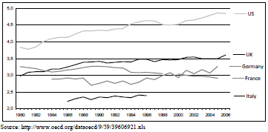
Trends in Wage Dispersion 1950-2006 US, UK, Germany France and Italy

Slide 19
EU Social Policy & Global Crisis
PARADOX: High quality of internal and commissioned research on social policy, exclusion and poverty BUT weak translation of perceptions of best practice into policy reality in individual MS
Reflected in 2010 Joint Report on Social Protection and Social Inclusion
Rhetoric of Multi-Dimensional Approach to SP: ‘Balanced active inclusion strategies, combining adequate income support, access to the labour market and to social services, can reconcile the goals of fighting poverty, increasing labour market participation, and enhancing efficiency of social spending

Slide 20
EU Joint Report: Insights
JRSPSI acknowledges existing problems:
Diversity of social protection systems
Divergence of social welfare cultures
Disparity in state capacities:
‘Not all MS have the financial means to meet rising demand and some have large gaps in their safety nets. Narrowing these gaps is now a priority’ (p.2)

Slide 21
Obstacles to Effective Realisation
Subordination of Social Policy to dominant macro-economic/ macro-political preferences:
deflationary imperative, debt-reduction, debt-management, attracting/ maintaining loyalty of capital
dominance of ‘efficiency’ and ‘affordability’ in objectives
Joint Report should be read in conjunction with ‘The Road Map for a Stronger European Economy’ from 13 April 2011
Business as usual, supply-sidism – no social dimension
http://ec.europa.eu/news/economy/110413_en.htm
Extensive abuse of tax avoidance and low-tax jurisdictions by corporations and ‘high-net-worth’ individuals

Slide 22
Poverty and Distribution
Market distribution often neutralises state redistribution.
Example New Labour administration in UK 1997-2010
Blairite supply-sidism tolerated the emergence of inflated top salaries and City bonus culture
‘We are intensely relaxed about people getting filthy rich’ (Peter Mandelson)
The results were predictable >>
Despite marked increases in spending on public services, including ‘tax credits’ for poorer households >>

Slide 23
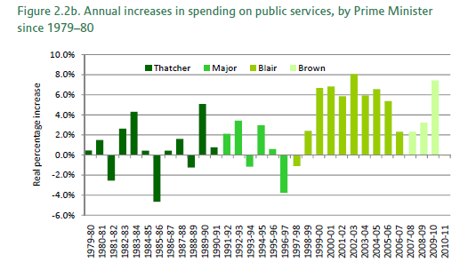
UK Public Spending Growth 1979-2011

Slide 24
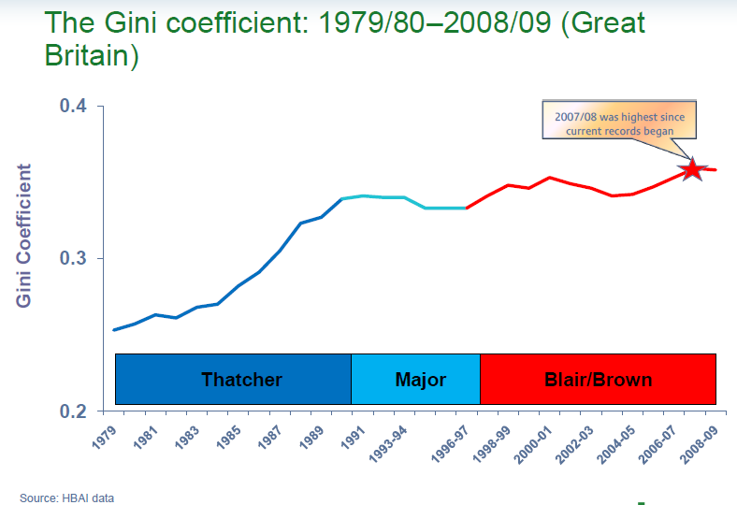
Post-Transfer Distribution is Worse
After Taxes and Transfers

Slide 25
Lesson for EU Social Policy
UK Poverty Targets have been predictably missed, because the state has ignored the effect of market distribution on households before transfers
The inequalities of market distribution need to be addressed as a primary source of injustice
Poverty has had a clear functional value to capital accumulation; increasing inequalities was a functional precondition of neo-liberal economic ‘reforms’;
C.f. George Gilder on ‘the enriching mysteries of inequality’

Slide 26
Austerity will compound poverty
Austerity, qua cutbacks in state expenditure in social welfare, pensions, education, health and social infrastructures, will affect the material living standards of the poor disproportionately.
Austerity, qua pro-cyclical withdrawals of disposable income and state consumption, will reduce effective demand within European societies and, with it, the incentive for enterprises to increase capacity to satisfy domestic demand
Pro-cyclical austerity will weaken growth and state-funded initiatives to promote sustainable development (c.f. Italy)
‘Crowding-in’ assumptions are highly questionable: rise in structural unemployment and jobless/ vacancy ratio

Slide 27
Consolidation of Structural Unemployment

Slide 28
Crisis + Austerity Threat to Democracy
Unequal burden-sharing
Disproportionate effect on young people:
 | EU15 | EU27 | EU10
Adult unemployment 2008 | 6.3 | 7.0 | 6.3
Adult unemployment 2009 | 8.3 | 8.9 | 10.1
Youth unemployment 2008 | 15.6 | 14.9 | 14.6
Youth unemployment 2009 | 19.9 | 20.7 | 23.1

Slide 29
Austerity: Threat to Recovery
Speed of ‘consolidation’ plans is wrong
Danger of L-shaped depression is high
Danger of negative growth considerable
Threat to competitiveness of whole region
Threat to welfare capitalist model of EU states

Slide 30
Conclusions
EU Policy is characterised by an asymmetrical policy architecture and contradictory preferences
Subordination of fiscal policy to monetary policy
Subordination of social policy to macro-economic priorities
Wide disparities in state capacities
Weak coordination and harmonisation
Self-defeating fixation on austerity
Poverty cannot be combated in isolation from macro-policy framework

Slide 31
Poverty Reduction: Recommendations
New Policy Architecture based on institutional coordination and international cooperation
Location of Social Justice and Poverty Reduction at the Core of Macro-Policy Objectives: ‘More equal societies almost always do better’ (Wilkinson & Pickett)
Stabilisation of European state finances with a new Code of Solidarity: Commitment to Progressive Taxation, Elimination of Tax Competition, Stabilisation Facility based on common Eurobonds
Rectification of chronic external balances within EU27 by refocussing on convergence (common deficit and surplus reduction) >> European Clearing Union?

Slide 32
Recommendations 2
Eliminate the programmatic tax and regulatory arbitrage of TNCs
Close down European and offshore ‘tax havens’ through Global Tax Accord
Reduce the extent of ‘social dumping’ in Europe and worldwide
Develop strong cultural commitment to intergenerational ecological justice; reconsider ‘growth’ and ‘welfare’
Strengthen the solidaristic features of civil societies and the insight into the interdependence of human existence
Crisis as opportunity: Approach Poverty (and its exploitation) as something that is as unacceptable but as curable as Smallpox

